Slide 1
FYP Interim Presentation
Jonathan McCarthy
D10101010
DT411

Slide 2
Project Idea
The main idea for this project is to create an online version of a popular numbers and letters game.
The main purpose of this game is to solve number and letter puzzles.
The domain area for this project is focusing on using advanced data structures and algorithms to find the fastest possible way to get a solution for the problem.

Slide 3
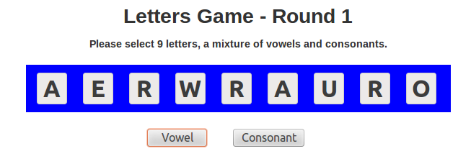
Letters
Best Words: AURORAE - ARREAR - ROARER - AURORA

Slide 4
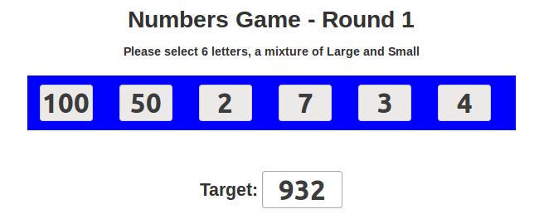
Numbers
Solution:
100 - 7 = 93
93 * 2 = 186
50 - 3 = 47
186 + 47 = 233
233 * 4 = 932

Slide 5
System Design
The project document has a comprehensive system design with a detailed textual description of the system and the UML diagrams.
The main development focus is on the numbers and letters solvers and offering this as an API service for other applications to use.
The Rails application will be used to demonstrate the operation of the developed solution.

Slide 6
Technologies Used
Ruby
Rails Framework
Heroku (Cloud Platform)
Dynos
isolated, virtualized Unix containers, that provide the environment required to run an application.

Slide 7
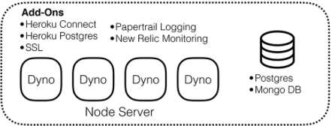
System Architecture
Rails MVC Web App
Heroku Cloud Platform

Slide 8
Research
The main issue with creating these solvers is the amount of permutations for each of the solution types. A brute force of the 9 letters will create approx. 771,000 unique combinations. The solvers created for this project will investigate all possible avenues to find the fastest solution to the problem.

Slide 9
Project Complexity
An efficient backtracking algorithm makes possible a very fast program to play the SCRABBLE Brand Crossword Game. The efficiency is achieved by creating data structures before the backtracking search begins that serve both to focus the search and to make each step of the search fast.
Source: The worlds fastest scrabble program – Apple and Jacobson 1998

Slide 10
Project Complexity
Data Structures
Algorithms
Performance Measurements:
Benchmarking
Profiling
A variety of algorithmic techniques and heuristics are used to make the search fast. A key element of the algorithm is the representation of the lexicon. These will be researched and investigated to find the optimal solver solution for both the numbers and letters game. Source: The worlds fastest scrabble program – Apple and Jacobson 1998

Slide 11
Demo
The demonstration will be presented now….
The prototype solution used the dictionary words in a ternary search method, checking each character in the word to see if it is in the 9 letters. If it is the letter is removed from the 9 and the next letter is checked. This process is repeated until the word passes or fails. This is repeated for each word in the dictionary. This solves in approx. 1.2 seconds. A gem was created for this using Echoe.

Slide 12

Demo

Slide 13
Testing
Combination of:
White Box
Black Box
Grey Box
Unit tests and TDD
Benchmarking / Profiling
Usability Study

Slide 14
Future Work (now to submission)
Starting the development phase of the project
Start the numbers solver
Researching / exploring different algorithms and techniques to optimise the solvers
Continually work on the project report
Create an API for the numbers and letters to allow others to create their own games

Slide 15

Questions

