Slide 1

Advanced Databases Data Cleaning: OpenRefine
Dr. Pierpaolo Dondio,

Slide 2
Some Info
Open Source project, previously GoogleRefine
A tool to clean data
It allows to
Filter data
Transform / manipulate data
Cluster data
Aggregate data
Reconcile data

Slide 3
Learning Objectives
What is OpenRefine? What can I do with it?
Installing OpenRefine
Exploring data
Analyzing and fixing data
Perform advanced operations:
Splitting, clustering, transforming, adding derived columns
Installing extensions
Linking datasets & named-entity extraction

Slide 4
What is OpenRefine?
Interactive Data Transformation (IDT) tool
A tool for visualizing and manipulating data
Not a good for creating new data
Extremely powerful for exploring, cleaning, and linking data
Open Source, free, and community supported
Formerly known as GoogleRefine
Currently version 3.3 (beta), 3.2 (stable)

Slide 5
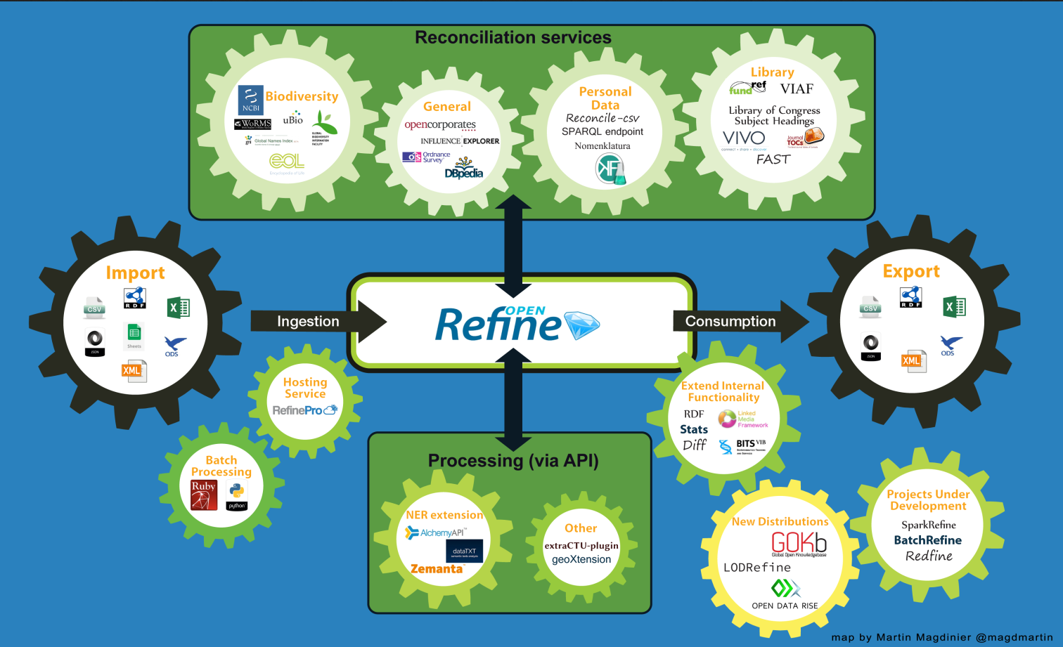
OpenRefine

Slide 6
Why OpenRefine?
Clean up data that is:
In a simple tabular format
Is inconsistently formatted
Has inconsistent terminology
Get an overview of a data set
Resolve inconsistencies
Split data up into more granular parts
Match local data up to other data sets
Enhance a data set with data from other sources

Slide 7
Installing OpenRefine
http://www.openrefine.org
Direct link to the downloads
https://github.com/OpenRefine/OpenRefine/wiki/Installation-Instructions
Windows
Download the ZIP archive.
Unzip & extract the contents of the archive to a folder of your choice.
To launch OpenRefine, double-click on openrefine.exe.
Mac
Download the DMG file.
Open the disk image & drag the OpenRefine icon into the Applications folder.
Double-click on the icon to start OpenRefine.

Slide 8
Installing OpenRefine
OpenRefine runs locally on your computer. It does not require an internet connection, unless you want to reconcile your data with external sources.
If you close you browser, you can get back OpenRefine by pointing it here: http://127.0.0.1:3333/ or http://localhost:3333
Your data is not stored online or shared with anyone.

Slide 9
OpenRefine Demo an introductory demo here: https://uidaholib.github.io/clean-your-data/)

Slide 10
Clustering Techniques
Key Collision Methods
Key Collision methods are based on the idea of creating an alternative representation of a value (a "key") that contains only the most valuable or meaningful part of the string and 'bucket's (or 'bin' as it's described inside OpenRefine's code) together different strings based on the fact that their key is the same (hence the name "key collision").
Fingerprint methods to generate “keys”
Fingerprint
N-grams Fingerprint
Phonetic fingerprint

Slide 11
Fingerprint
remove leading and trailing whitespace
change all characters to their lowercase representation
remove all punctuation and control characters
normalize extended western characters to their ASCII representation (for example "gödel" → "godel")
split the string into whitespace-separated tokens
sort the tokens and remove duplicates
join the tokens back together
“Tom, Cruise” vs. “Cruise tom” => same fingerprint (cruise tom)

Slide 12
N-grams Fingerprint
The n-gram fingerprint method is similar to the fingerprint method but instead of using whitespace separated tokens, it uses n-grams, where the n (or the size in chars of the token) can be specified by the user.
Example, the 2-gram fingerprint of "Paris" is "arispari" and the 1-gram fingerprint is "aiprs".
Why is this useful? In practice it can find clusters that the previous method didn't find even with strings that have small differences, with a very small performance price.
For example "Krzysztof", "Kryzysztof" and "Krzystof" have different lengths and different regular fingerprints, but share the same 1-gram fingerprint because they use the same letters.

Slide 13
Phonetic Fingerprint
A third keying method uses a phonetic fingerprinting (specifically, Metaphone3 method for English), which is a way to transform tokens into the way they are pronounced.
This is useful to spot errors that are due to people misunderstanding or not knowing the spelling of a word after only hearing it.
The idea being that similar sounding words will end up sharing the same key and thus being binned in the same cluster.
For example, "Reuben Gevorkiantz" and "Ruben Gevorkyants" share the same phonetic fingerprint for English pronounciation but they have different fingerprints.

Slide 14
Nearest Neighbor Methods (KNN)
While key collisions methods are very fast, they tend to be either too strict or too lax with no way to fine tune how much difference between strings we are willing to tolerate.
The Nearest Neighbor methods (also known as kNN), on the other hand, provide a parameter (the radius, or k) which represents a distance threshold: any pair of strings that is closer than a certain value will be binned together.
Unfortunately, given n strings, there are n(n-1)/2 pairs of strings (and relative distances) that need to be compared and this turns out to be too slow even for small datasets (a dataset with 3000 rows require 4.5 million distance calculations!)
Need a distance between strings
Leveinstein Distance
PPM

Slide 15
Levenshtein Distance
The Levenshtein distance (also known as "edit distance") is probably the simplest and most intuitive distance function between strings and is often still very effective due to its general applicability.
It measures the minimal number of 'edit operations' that are required to change one string into the other.
For example, "Paris" and "paris" have an edit distance of 1 as changing P into p is the only operation required. "New York" and "newyork" has edit distance 3: 2 substitutions and 1 removal. "Al Pacino" and "Albert Pacino" have an edit distance of 4 because it requires 4 insertions.
In practice, this distance is useful to spot typos, spelling mistakes

Slide 16
PPM
This distance is an implementation of a seminal paper about the use of the Kolmogorov complexity to estimate 'similarity' between strings and has been widely applied to the comparison of strings originating from DNA sequencing.
The idea is that because text compressors work by estimating the information content of a string, if two strings A and B are identical, compressing A or compressing A+B (concatenating the strings) should yield very little difference (ideally, a single extra bit to indicate the presence of the redundant information).
On the other hand, if A and B are very different, compressing A and compressing A+B should yield dramatic differences in length.
d(A,B) = comp(A+B) + comp(B+A) / (comp(A+A) + comp(B+B));

