Slide 1
Managing your FYP Supervisor
Damian Gordon

Slide 2
Contents
Understanding your supervisor
Manipulating your supervisor
Great Expectations
Common pitfalls
Dealing with conflict
Going forward

Slide 3
Understanding your Supervisor
Their goals
Their skills
Their hates
Their weaknesses

Slide 4
Their goals
Supervision is not a “soft number”
A lecturer gets as much credit on their timetable for doing a two-hour undergraduate first year lab (where they can just come in with little or no preparation required) as supervising four final year students (which requires a great deal of preparation, continuous reading, and thinking about the topic).
So what is motivating them?

Slide 5
Their goals
Giving back to the system
Help improve the quality of output for the BSc
Helping improve the reputation of the BSc
Interested in the topic
Related to their research interests

Slide 6
Their skills
They vaguely know about the topic you are doing
The offer a different set of skills
Their job isn’t to do the research for you, but rather to guide you on your journey.
They help you in different ways at different times

Slide 7
Their skills
At the beginning of your research
Knowing what has already been done
Anticipating problems that will be too easy or too hard

Slide 8
Their skills
In the middle
Watching out for the “big picture”
Nudging you in the right directions
Identifying common pitfalls
Keeping an eye on the clock

Slide 9
Their skills
At the end
Telling you when to stop
Knowing what a thesis looks like
Anticipating problems in your final demo

Slide 10
Their hates
Students who quit in the middle
Wasted effort all around

Slide 11
Their weaknesses
They can’t read your mind
They can’t remember everything you’ve told them
So you need to talk good notes
And remind them frequently
They may miss meetings

Slide 12
Manipulating your Supervisor
Keep your supervisor informed about
Scientific obstacles
Personal obstacles

Slide 13
Manipulating your Supervisor
Always be positive
You’ve supervisor will want to help if you do
You’ll feel better

Slide 14
Manipulating your Supervisor
Work hard
They will be willing to work hard for you
You’re more likely to get good results
A project is hard work

Slide 15
Manipulating your Supervisor
Write a lot
Notes to your supervisor
Notes to yourself (keep a blog)
Draft chapters
The more stuff they have to read, the less time they will have to think of stuff for you to do.

Slide 16

Great Expectations
Your expectations
Their expectations

Slide 17
Great Expectations
YOUR EXPECTATIONS
Intellectual support
Quality assurance
Tell you when to (not) stop
Emotional support
Encouragement
Constructive environment

Slide 18
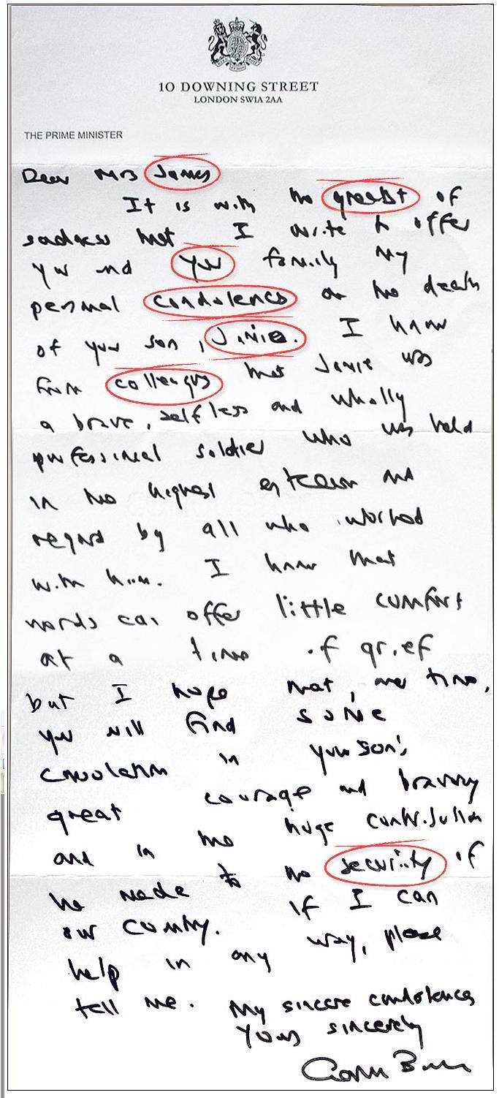
Great Expectations
THEIR EXPECTATIONS
You finish
Your drafts are well put together and spell-checked

Slide 19
Common pitfalls
Solving the world
Manna from heaven
sitting around waiting for inspiration
Misunderstood Genius
Love of Jargon
If I can do it, it's trivial
Love of complexity
Lost in abstraction
Analysis paralysis
http://homepages.inf.ed.ac.uk/bundy/how-tos/resbible.html

Slide 20
Psychological hurdles
Self-confidence
Thin skin
Cold start
Theory envy
Fear of exposure

Slide 21
Behind Schedule ?
Report the implications of delays
Discuss changes in plans
Direct resources
Avoid persecution
Respond early
Be flexible
Involve your supervisor(s) and others
Notes:
If you discover or anticipate a delay it is essential to take action
Report the implications of delays - other projects or work may be depending on the outcome of your project so give people time to react
Discuss changes in plans - involve others so they can make suggestions
Direct resources – you can see what tasks need to be completed
Avoid persecution - if someone else is telling you about problems, be constructive - or next time they may not tell you until it is too late
Respond early - so there is time to get back on track or re-think
Be flexible - use your project plans to find alternatives
Involve the client and stakeholders - they may have ideas or be prepared to be flexible too

Slide 22
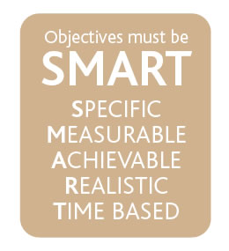
SMART Objectives
Specific
Measurable
Agreed
Realistic
Time Bound
Notes:
SMART Objectives – very common in industry and are used extensively for appraisals and form a simple test of whether the objective is truly a good objective.

Slide 23
Specific
Make the objective specific
Break large tasks down into smaller tasks
[X] Write up project
[√] Write second chapter of project
[√] Write section 1 of Results chapter of project
Breaking large tasks into smaller ones makes it easier to assess progress
Notes:
Specific – this ties back to the project management module where work breakdown structures where used to split large tasks into much smaller tasks. The aim of doing this allows the objective to be specific. The classic final year PhD student objective is write my PhD. The question of where to start is a difficult one and therefore splitting the task up can make the objective more specific and also achievable within a sensible time frame can help with motivation. Think of other examples of specific objectives. On the previous slide the aim make myself more employable is not at all specific – what is meant by employable !

Slide 24
Measurable
How do you know when you have completed the work
[X] Find lots of software in the my field of research
[√] Find 3 software tools in the next month that is relevant
Make sure they are evidenced based – you should have a deliverable attached to the objective
Notes:
Measurable – You need to know when you have finished the objective / completed the task. There is two elements therefore to writing measurable objectives. They should not include words like more – when do you know when you have made more contacts. Is it one or is it a million. The second element relates to actually having something which you can provide as evidence. Therefore deliverables attached to the objective is good (e.g. Short reports) as these can help you prove that you have achieved the objective (this will be important when you start work!).

Slide 25
Agreed
Get the agreement of the stakeholders in the project
Especially your supervisor!
[X] I think I will finish my project by the end of May
[X] My supervisor thinks I will finish my project by the end of January
[√] We agreed that my objective will be to finish my project by the end of April
Notes:
Agreed – In the project management sessions we talked about stakeholders and involving them in the project. Setting your objectives and agreeing them with your supervisor is important. This might take some negotiation but it worth doing this as everybody will be committed to the plan.
Note that if you ever set objectives for someone else make sure you discuss them with them as setting unachievable objectives for someone can prove a source of conflict.

Slide 26
Realistic
Will you achieve the objective?
Unrealistic objectives can be very de-motivating
Challenging objectives which are realistic can be motivating
[X] Publish 10 papers from my project
[√] Publish a paper from my project
Notes:
Realistic Objectives – It is important that the objectives you set are realistic. All too often people will set very unrealistic objectives and the end result is that the project is not delivered on time, resentment develops within the project stakeholders etc. Furthermore if you are being assessed against the objectives which are set, if they are unrealistic you may not achieve any of them! It is however important to set your self challenging objectives which you could achieve if you apply yourself – these are often referred to as stretch targets and are used to motivate staff.

Slide 27
Time Bound
Set timescales on your objectives
Deadlines and Milestones
Review progress against these deadlines
[X] Finish writing my experiment design chapter
[√] Finish the first draft of my experiment design chapter by the 1st of December
Notes:
Time Bound – It is important that there is an element of time linked to the objective. Again if the objective is open ended when do you when you have achieved the objective. Therefore set yourself deadlines and review yourself against them – don’t let the deadlines slip as the progress of the project overall could be in jeopardy. These can also be a useful time management tool as often people will work on something when little value is being added (80% of the value is provided by 20% of the effort) and a dealine can be used to force you to move on to the next objective.

Slide 28
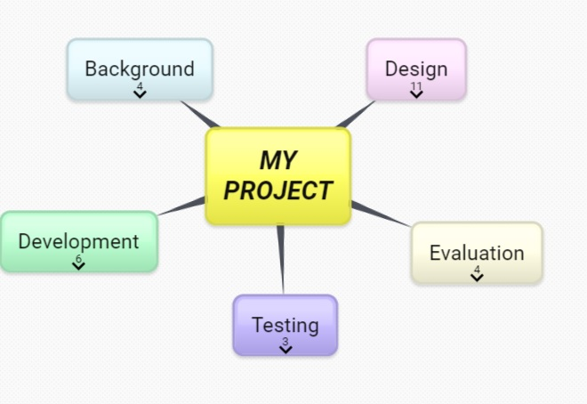
Mindmap

Slide 29
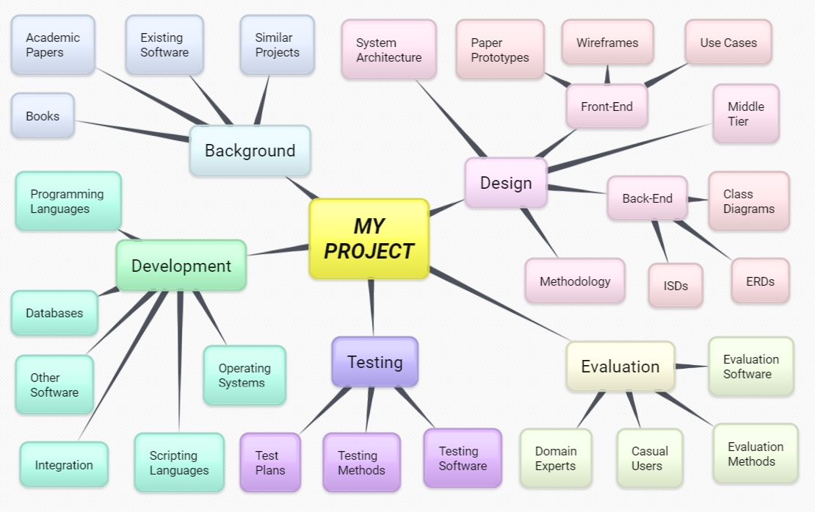
Mindmap

Slide 30
Dealing with conflict
Conflict is common
Supervision is like a marriage
Compromise is key
Let your supervisor “win” sometimes
Communication is key
Keep in touch with your supervisor
Meet
E-mail
Telephone
whatever

Slide 31
Going Forward
As long as there wasn’t too much conflict, your supervisor will make an excellent referee for your CV
But unlike a marriage your supervisor wants you to leave and stand on your own two feet
Your supervisor doesn’t know everything, so talk to many others (but do NOT, repeat DO NOT try to play people off against each other, “Well John said...”)
Help others

Slide 32
Remember
“No back-up ….
…no sympathy”

