Slide 1
Technical Architectures
Damian Gordon

Slide 2
Contents
1-Tier Architecture (Stand-Alone Application)
2-Tier Architecture (Client/Server)
3-Tier Architecture
N-Tier Architecture
N-Tier Architecture (with Server Load Balancing)
http://cis.cuyamaca.net/draney/214/web_server/client.htm

Slide 3
1-Tier Architecture (Stand-Alone Architecture)

Slide 4
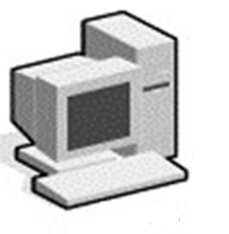
Stand-Alone
Stand-Alone describes an architecture where all of the elements of a system reside on one system.

Slide 5
2-Tier Architecture (Client/Server)

Slide 6
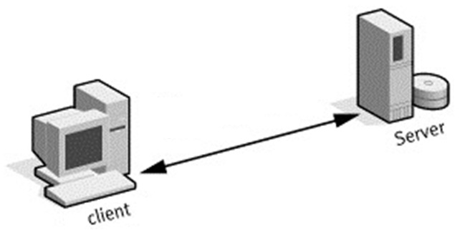

Slide 7
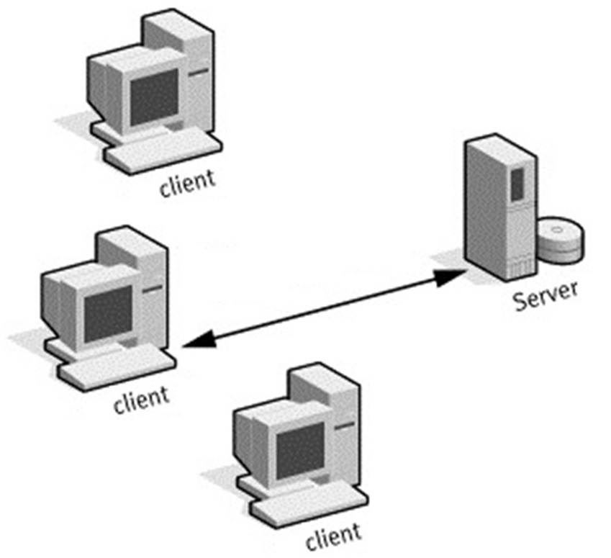

Slide 8
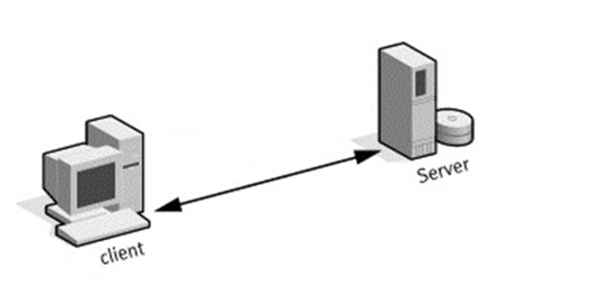
Client/Server
Client/Server describes the way in which software components interact to form a system that can be designed for multiple users.
This technology is a computing architecture that forms a composite system allowing distributed computation, analysis, and presentation between PCs and one or more larger computers on a network.
Each function of an application resides on the computer most capable of managing that particular function

Slide 9
Client/Server
There is no requirement that the client and server must reside on the same machine.
In practice, it is quite common to place a server at one site in a local area network (LAN) and the clients at the other sites.
The client, a PC or workstation, is the requesting machine and the server, a LAN file server, mini or mainframe, is the supplying machine.
Clients may be running on heterogeneous operating systems and networks to make queries to the server(s).

Slide 10
Client/Server
Networks provide connectivity between client/server and the protocols that they use to communicate.
The Internet provides connectivity between systems that function as clients, servers, or both.
Many services used on the Internet are based on client/server computing model.

Slide 11
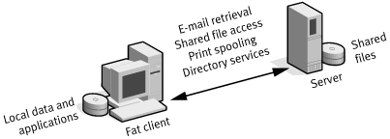

Slide 12
Client/Server
Client/server applications started with a simple, 2-tiered model consisting of a client and an application server.
The most common implementation is a 'fat' client - 'thin' server architecture, placing application logic in the client.
The database simply reports the results of queries implemented via dynamic SQL using a call level interface (CLI) such as Microsoft's Open Database Connectivity (ODBC).

Slide 13
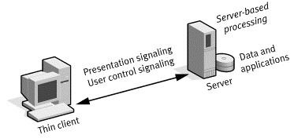

Slide 14


Slide 15
Client/Server
An alternate approach is to use thin client - fat server waylays that invokes procedures stored at the database server.
The term thin client generally refers to user devices whose functionality is minimized, either to reduce the cost of ownership per desktop or to provide more user flexibility and mobility.
In either case, presentation is handled exclusively by the client, processing is split between client and server, and data is stored on and accessed through the server.

Slide 16
Client/Server
Remote database transport protocols such as SQL-Net are used to carry the transaction.
The network 'footprint' is very large per query so that the effective bandwidth of the network, and thus the corresponding number of users who can effectively use the network, is reduced.
Furthermore, network transaction size and query transaction speed is slowed by this heavy interaction.
These architectures are not intended for mission critical applications.

Slide 17
Client/Server
Advantages of 2-Tier System
Good application development speed
Most tools for 2-tier are very robust
Two-tier architectures work well in relatively homogeneous environments with fairly static business rules

Slide 18
3-Tier Architecture

Slide 19
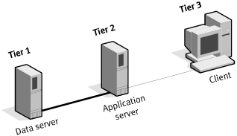

Slide 20
3-Tier Architecture
Inserting a middle tier in between a client and server achieves a 3-tier configuration.
The components of three-tiered architecture are divided into three layers:
a presentation layer,
functionality layer, and
data layer,
which must be logically separate.

Slide 21
3-Tier Architecture
The 3-tier architecture attempts to overcome some of the limitations of 2-tier schemes by separating presentation, processing, and data into separate distinct entities.
The middle-tier servers are typically coded in a highly portable, non-proprietary language such as C or Java.
Middle-tier functionality servers may be multithreaded and can be accessed by multiple clients, even those from separate applications.

Slide 22
3-Tier Architecture
The client interacts with the middle tier via a standard protocol such as API (Application Programming Interface), or RPC (Remote Procedure Call).
The middle-tier interacts with the server via standard database protocols.
The middle-tier contains most of the application logic, translating client calls into database queries and other actions, and translating data from the database into client data in return.

Slide 23
3-Tier Architecture
If the middle tier is located on the same host as the database, it can be tightly bound to the database via an embedded 3GL interface.
This yields a very highly controlled and high performance interaction, thus avoiding the costly processing and network overhead of SQL-Net, ODBC, or other CLIs (command line interfaces).
Furthermore, the middle tier can be distributed to a third host to gain processing power capability.

Slide 24
3-Tier Architecture
Advantages of 3-Tier Architecture
RPC calls provide greater overall system flexibility than SQL calls in 2-tier architectures
3-tier presentation client is not required to understand SQL. This allows firms to access legacy data, and simplifies the introduction of new data base technologies
Provides for more flexible resource allocation
Modularly designed middle-tier code modules can be reused by several applications
3-tier systems such as Open Software Foundation's Distributed Computing Environment (OSF/DCE) offers additional features to support distributed applications development

Slide 25
N-Tier Architecture

Slide 26
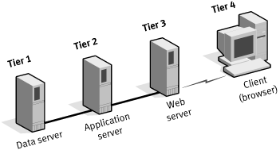

Slide 27
3-Tier Architecture
The 3-tier architecture can be extended to N-tiers when the middle tier provides connections to various types of services, integrating and coupling them to the client, and to each other.
Partitioning the application logic among various hosts can also create an N-tiered system.
Encapsulation of distributed functionality in such a manner provides significant advantages such as reusability, and thus reliability.

Slide 28
3-Tier Architecture
As applications become Web-oriented, Web server front ends can be used to offload the networking required to service user requests, providing more scalability and introducing points of functional optimization.
In this architecture, the client sends HTTP requests for content and presents the responses provided by the application system.
On receiving requests, the Web server either returns the content directly or passes it on to a specific application server.
The application server might then run CGI scripts for dynamic content, parse database requests, or assemble formatted responses to client queries, accessing dates or files as needed from a back-end database server or a file server.

Slide 29
N-Tier Architecture with Server Load Balancing

Slide 30
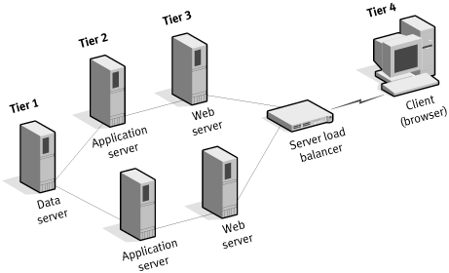

Slide 31
3-Tier Architecture
By segregating each function, system bottlenecks can be more easily identified and cleared by scaling the particular layer that is causing the bottleneck.
For example, if the Web server layer is the bottleneck, multiple Web servers can be deployed, with an appropriate server load-balancing solution to ensure effective load balancing across the servers.

Slide 32
3-Tier Architecture
The N-tiered approach has several benefits:
Different aspects of the application can be developed and rolled out independently
Servers can be optimized separately for database and application server functions
Servers can be sized appropriately for the requirements of each tier of the architecture
More overall server horsepower can be deployed

