Slide 1

Wikipedia Web Application for the Visually Impaired
DT211C/4
Computer Science
Infrastructure
Alex Hurduc
Supervisors: Dr. Michael Collins,
Prof. Stefan Zander

Slide 2
Project Overview
This project is about improving accessibility for visually impaired users to be able to traverse Wikipedia with ease using a screen reader.

Slide 3
Introduction
Current statistics show that 5% of the Irish population has some sort of visual impairment according to the National Council for the Blind Ireland (NCBI) register.

Slide 4
Background
World Wide Web Consortium (W3C)
Web Content Accessibility Guidelines (WCAG) 2.0
IT Accessibility Laws and Policies Section508

Slide 5
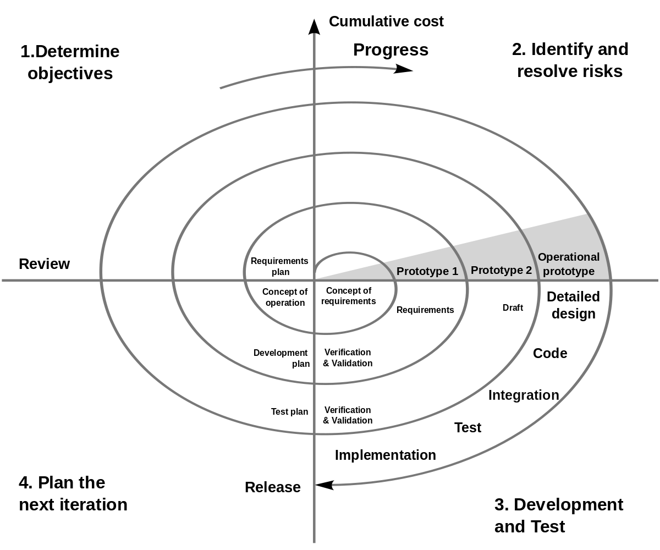
Methodology
Spiral Methodology used:

Slide 6
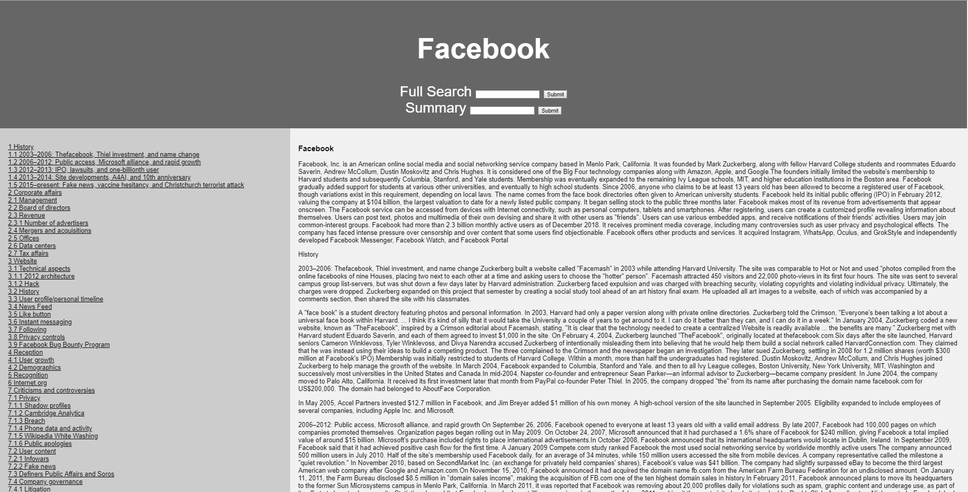
Design - Frontend
Full Search:

Slide 7
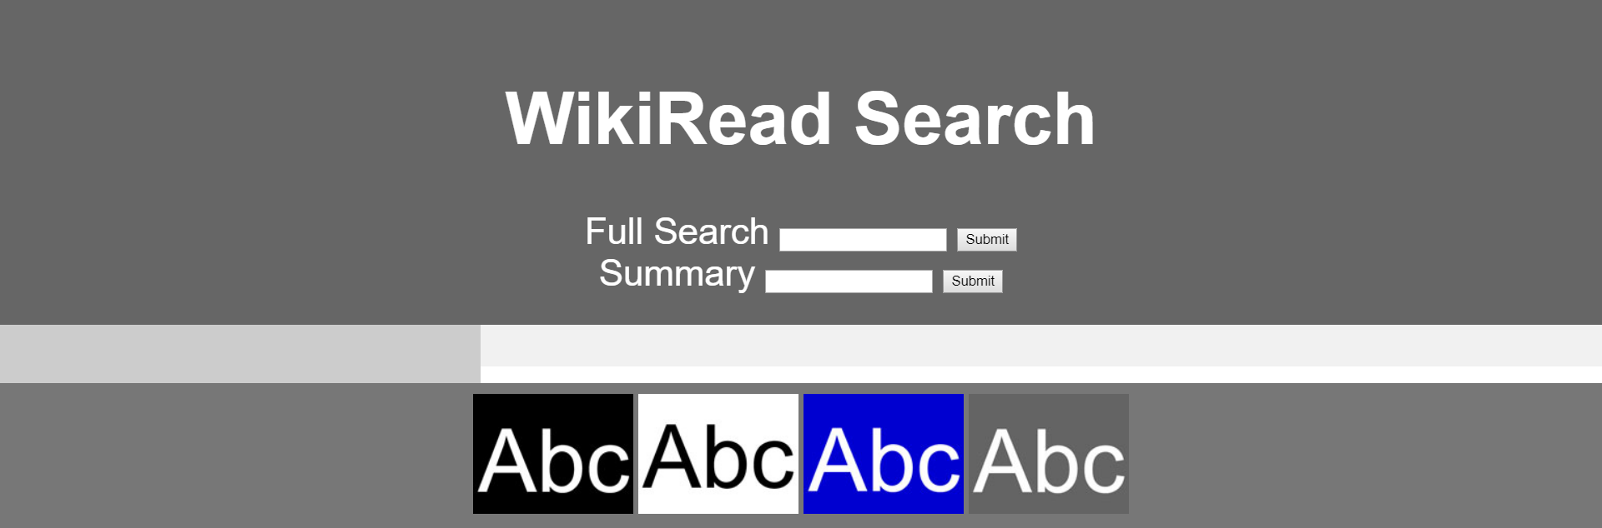
Design - Frontend
Theme Switching:

Slide 8
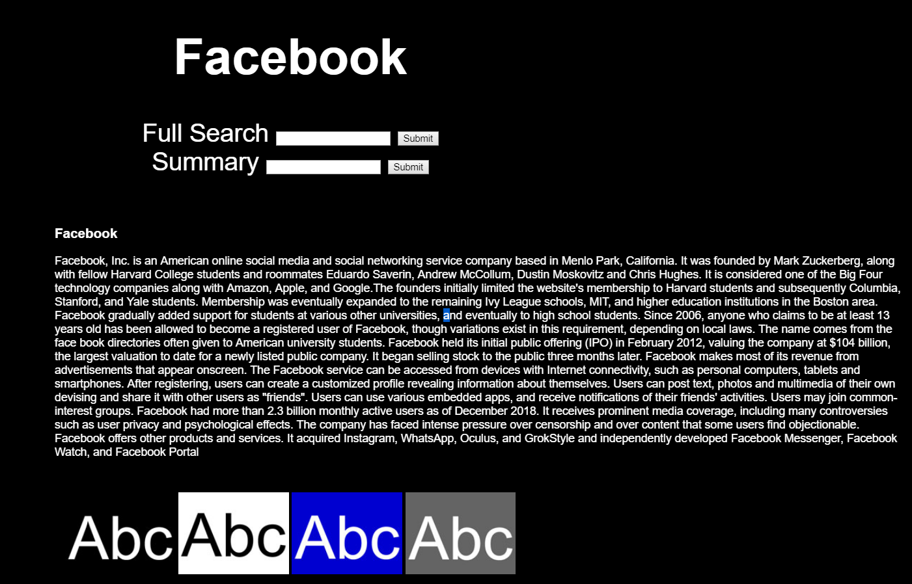
Design - Frontend
Summary Search:

Slide 9
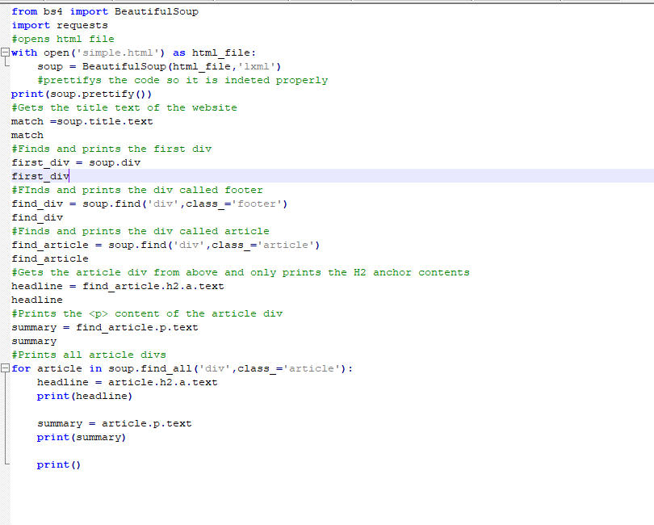
Design Back-End
Web Scraping full HTML

Slide 10
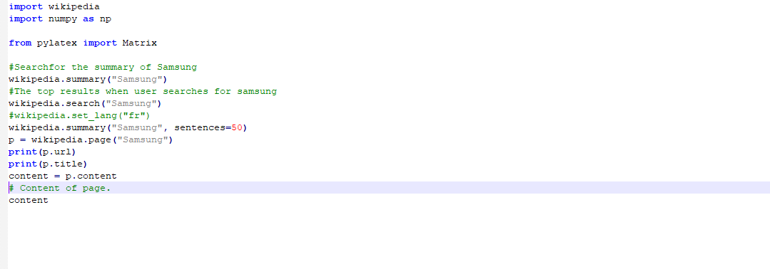
Design Back-End
Using PyWiki

Slide 11
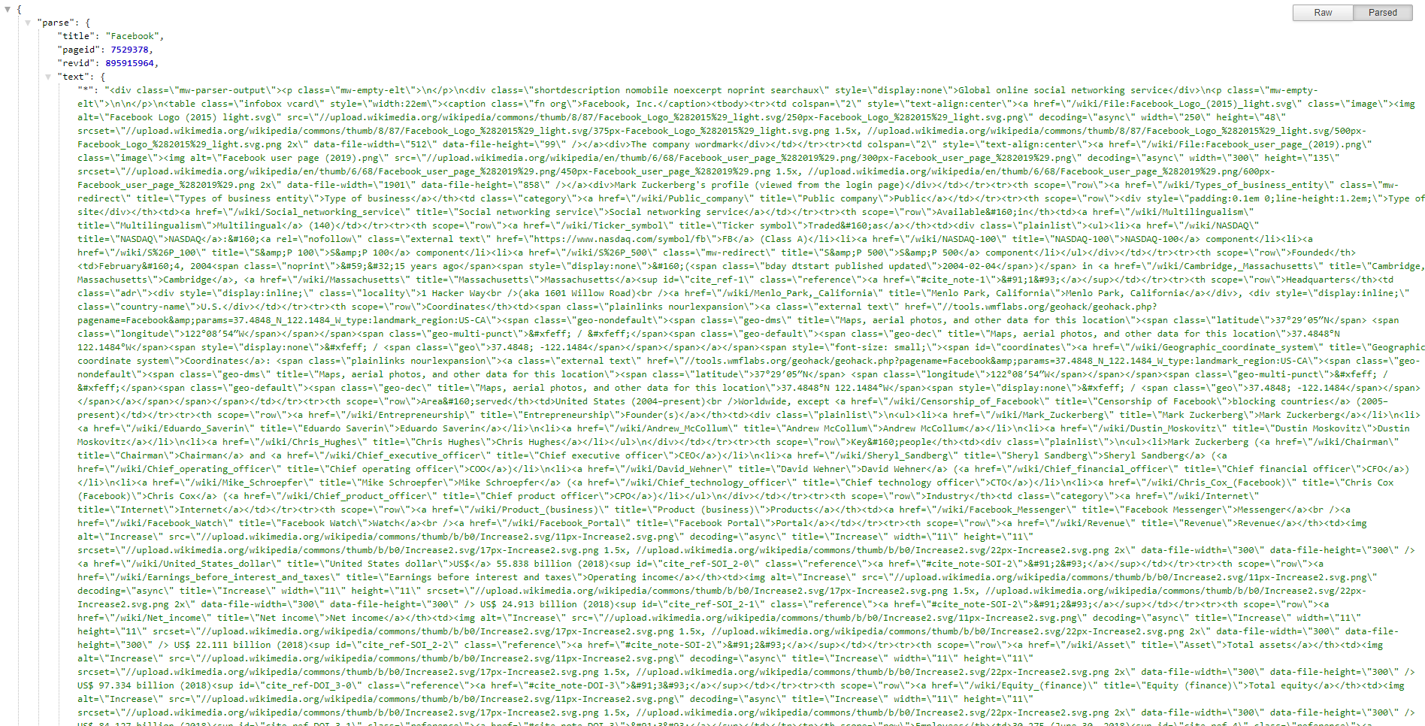
Design Back-End
Using Full Wikipedia.org API

Slide 12
Development
Technologies
  Operating System(s): Linux , Windows
  Programming Language(s): Python
  Scripting Languages: JavaScript, Flask, HTML ,CSS
  Web Servers: Nginx , uWSGI
  Tool(s): VirtualEnv, JAWS, NVDA

Slide 13
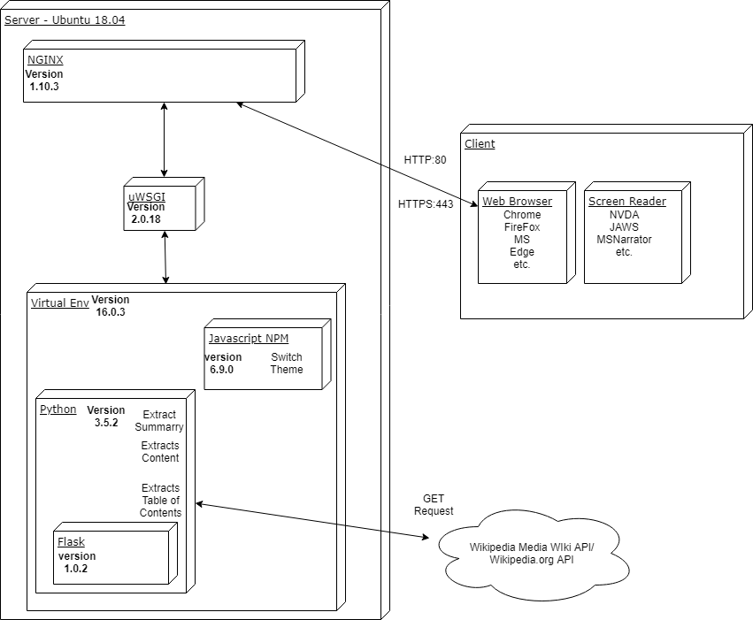
Development

Slide 14
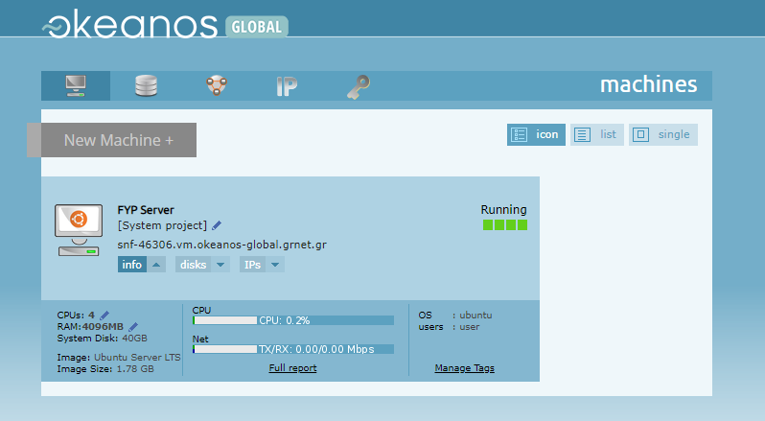
Development

Slide 15
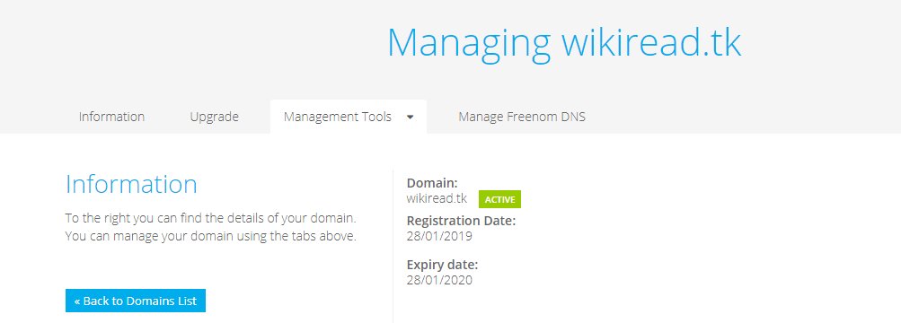
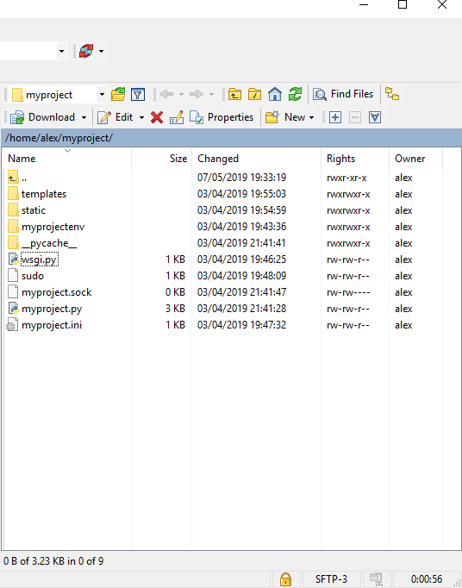
Development

Slide 16
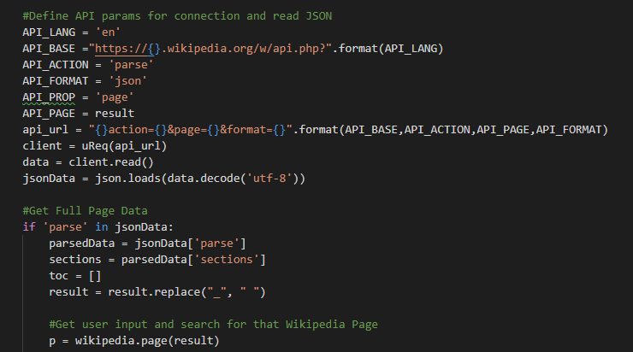
Development
API Parser

Slide 17
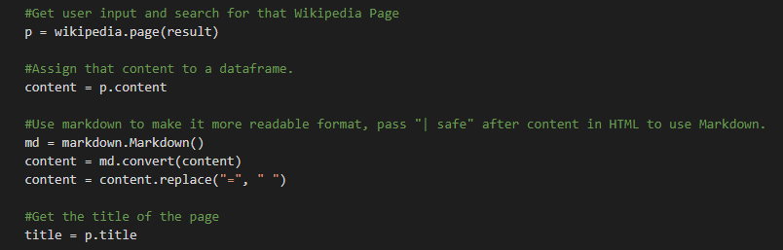
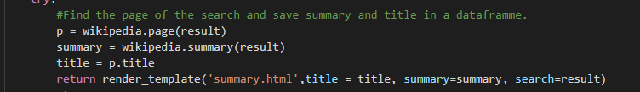
Development
Full Page
Summary Page

Slide 18
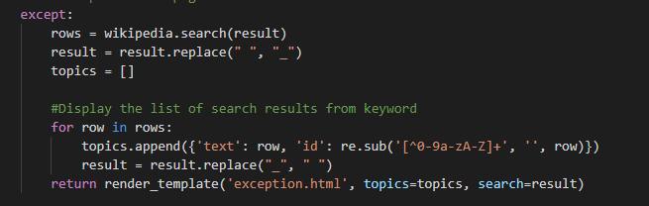
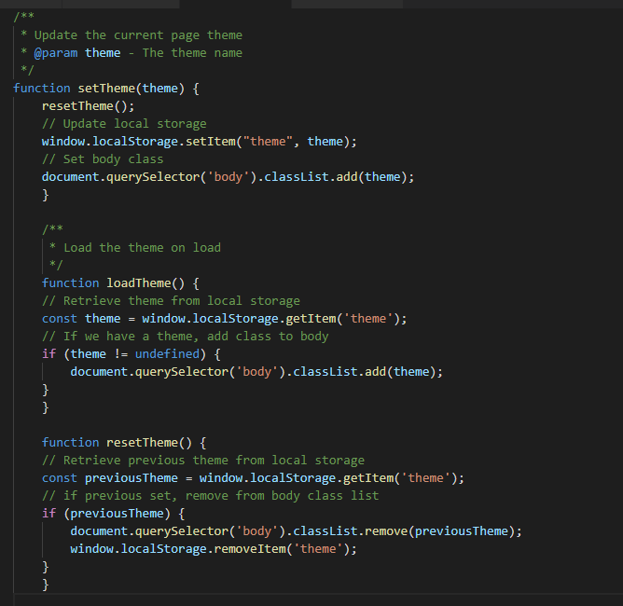
Development
Exception Page
Theme Switcher

Slide 19
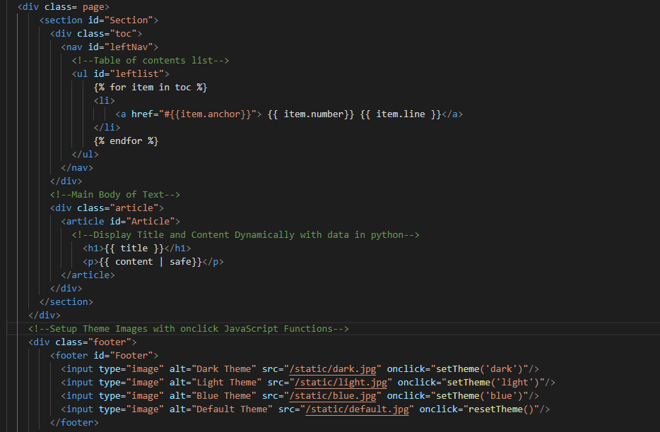
Development
HTML Page

Slide 20
Testing
Expert Testing
Application Guidelines Testing
Code Testing

Slide 21
Expert Testing
The Expert sits on the board of the Irish National Disability Authority and has over twenty years experience in the field, especially in developing tools for people with visual impairment.

Slide 22
Application Guideline Testing
Keystroke level model (KLM) Card, Moran and Newell (1980)
A11Y Compliance Platform
ACHECKER
AXE Chrome Plugin
Bookmarklets for Accessibility Testing
HTML_CODESNIFFER

Slide 23
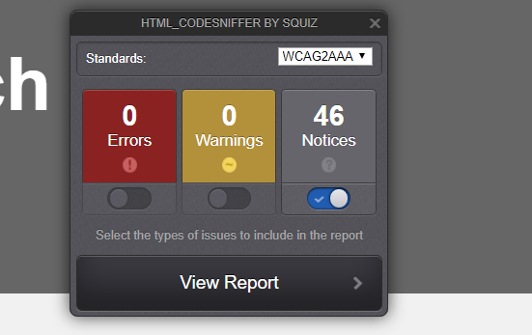
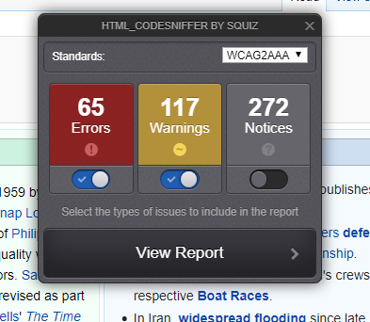
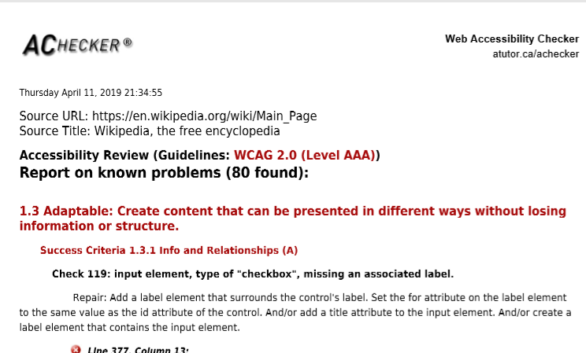
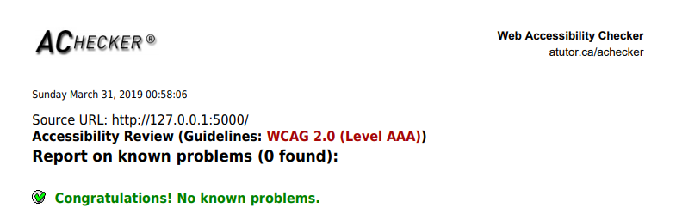
Application Guideline Testing

Slide 24
Code Testing
Bandit - tool designed to find common security issues in Python code. Bandit processes each file, builds an AST from it, and runs appropriate plugins against the AST nodes.
Pytest for Unit Testing as it was inspired by Junit and has similar functionality and structure.

Slide 25
Conclusions
Conforms to accessibility guidelines.
Improved screen reader compatibility.
Main ideas and findings fit with that of other researchers.
Overall the project scope set out at the start of the project was solved.

Slide 26
Future Work
Wikipedia Edit Page.
Future Testing with Visually Impaired.
Add Table Functionality

Slide 27
DEMO

Slide 28
Thank You and
Questions

