Slide 1
Object Oriented Testing (Introduction)
Damian Gordon

Slide 2
Object Oriented Testing
Testing is very important to make sure your code works.
As programs grow bigger and bigger it becomes very important to test the code, and to understand how changes in one part of the code can impact other parts of the code.
As the code grows it also becomes more and more difficult to manually test each possible path of execution.

Slide 3
Object Oriented Testing
To handle this, we can write automated tests.
These are programs that automatically run certain input through other parts of programs.
We can run these in seconds and cover a significant numbers of paths of execution (and makes retesting easier when anything in the program is changed).

Slide 4
Object Oriented Testing
The four main reasons to develop tests are:
To ensure the code is working the way the developer intends
To ensure the code continues to work after changes are made
To ensure the developer(s) have understood the requirements
To ensure the code has a maintainable interface

Slide 5
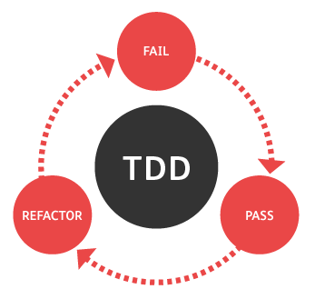
Test-Driven Development

Slide 6
Object Oriented Testing
“write tests first” – the mantra of Test-Driven Development
The key concept is that a developer shouldn’t write any code until they have written tests for that code first
Test-Driven Development is fun, it’s all about solving puzzles.

Slide 7
Object Oriented Testing
Test-Driven Development has two goals:
To ensure that tests are actually written, and written well. Too often developers leave the design of tests until after the development process, and then don’t bother because the code seems to work.
To help the developers envisage exactly what the code will do, and what processes and modules it will interact with, thus testing becomes part of the design process.

Slide 8

etc.

