Slide 1
Final Year Project:
Introduction

Slide 2
Contents
Who’s Who
Timelines
Deliverables
  Proposal
  Interim Report/Demo
  Project Fair/Dissertation/Final Demo
First Steps

Slide 3
Who’s Who

Slide 4
Who’s Who
The Student
The Supervisor
The Second Reader
The Project Co-ordinator
The Project Monitors

Slide 5
The Student
... The ultimate responsibility for the completion of the project lies with the student and the project should be the work of the student…
...Students are expected to behave with maturity in respect to their supervisors and project. This means that students should be courteous to their supervisors, accept direction, complete work as required and be punctual for meetings...
..If a student has any queries or problems with their project that cannot be resolved by the supervisor, they can communicate this to the project co-ordinator...

Slide 6
The Supervisor
... The role of the supervisor is to direct, advise and assess the student through each stage of the project…
...It is important to remember that the supervisor is not there to do the work for the student but to guide and assess the work as it is being completed. The supervisor may also give technical advice to the student as required…
... . If a supervisor is worried about the performance of a student, this should be communicated to the project co-ordinator so that corrective action can be taken...

Slide 7
The Second Reader
...The role of the second reader is that of an impartial judge. The basis on which the second reader assesses projects are the deliverables, namely the progress report, the demonstration and the project dissertation…

Slide 8
Project Co-ordinator
...The role of the project co-ordinator is to oversee the management and administration associated with the projects. Any queries or problems experienced by either staff or students should be communicated to the project Co-ordinator...
...Another responsibility of the project Co-ordinator, along with the project monitors, is to ensure fairness in marking across all the projects...

Slide 9
Project Monitor
...The responsibility of the project monitor(s), along with the project Co-ordinator, is to ensure fairness in marking across all projects...

Slide 10
Timelines

Slide 11
Timelines
Final
Demo
Project
Proposal
Interim Report
and Demo
Dissertation
submission
October
December
September
April

Slide 12
Timelines
Final
Demo
Write-up
Project
Proposal
Interim Report
and Demo
Dissertation
submission
Research and
background reading
Software
Design
Software
Development
Testing and
Evaluation
October
December
September
April

Slide 13
Main Deliverables

Slide 14
Main Deliverables
Project Proposal
Interim Report
Interim Demo
Project Fair (optional)
Software Demo
Easter Presentation
Dissertation Document

Slide 15
First Steps

Slide 16
First Steps
Decide on a project topic…

Slide 17
First Steps
What subjects have I liked so far?
What assignments were interesting?
What lecturers seemed cool?
What does my work experience or life experience suggest?
What have the students does last year?

Slide 18
Some Projects from last year
Alzheimer's app and website
App development using AI
Blockchain for ticket purchase
Blockchain solution for the pharmaceutical industry
Capturing and verifying digital footage
Computer networking with multipath transport protocol
Computer Vision to Detect Handheld Weapons in Video
Crypto Alert Trading Application

Slide 19
Some Projects from last year
Depression and anxiety app and website
Development of a classroom management system
Dynamic and Proactive Auto Scaling of Microservices
Dynamic encryption techniques using Neural Nets
Image Recognition of Dogs
Maps for Property Price Prediction
Recommender System for Property Prices

Slide 20
Some Projects from last year
Security Authentication digitally
Sentiment Analysis Based on Twitter
Smart Tool to help build APIs
Tool for novice weightlifters
Universally Designed Mobile Application
Using VR in architecture

Slide 21
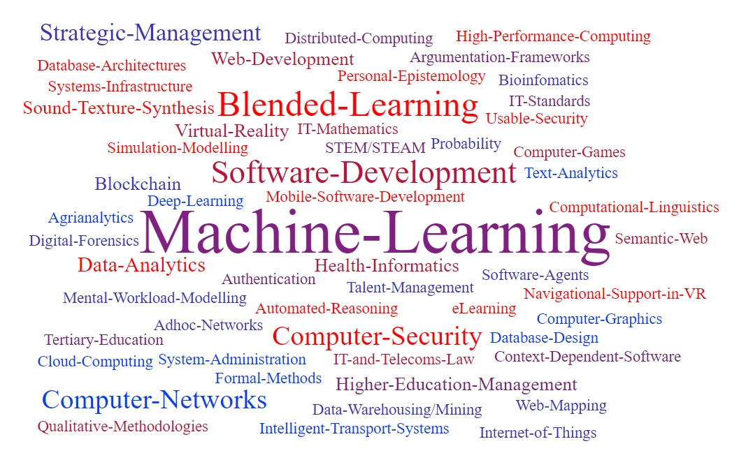
Lecturer Interests

Slide 22
Project Ideas
Please following this twitter account now:
@Ethics4EU
It will be tweeting about some interesting computer science dilemmas.

Slide 23
Project Ideas
How do I know if my idea is good?

Slide 24
Project Ideas
How do I know if my idea is good?
Email Damian.Gordon@dit.ie
Subject: “FYP8: Project Ideas”

Slide 25
Project Ideas
Course website (for the moment):
http://damiantgordon.com/Courses/ProjectsL8/

Slide 26
The Project Proposal

Slide 27
Project Proposal
Project Title:
Summary:
Background (and References):
Proposal Approach:
Deliverables:
Technical Requirements:
2 FYP Reviews:

Slide 28
Summary (Abstract)
What is the area of study?
What is the problem being tackled?
What does the literature say?
How did you tackle the problem?
How did you implement the solution?
What results have you gotten?

Slide 29
Summary (Abstract)
ABOUT 200 WORDS

Slide 30
Summary (Abstract)
“This research investigates the area of knowledge capture in the domain of knowledge management.”
“By introducing a new technology into my work place the staff will be able to record their ideas.”
“Existing research indicates that there may be benefits to capturing the organisational knowledge.”
“In this work a Wiki server was be introduced into the workplace, and logins provided to staff.”
“The Wiki has a range of templates to support the range of approaches to ideas generation.”
“Results suggest that the use of this Wiki has aided in capturing key organisational knowledge.”

Slide 31
Summary (Abstract) - Merge
This research investigates the area of knowledge capture in the domain of knowledge management. By introducing a new technology into my work place the staff will be able to record their ideas. Existing research indicates that there may be benefits to capturing the organizational knowledge. In this work a Wiki server was be introduced into the workplace, and logins provided to staff. The Wiki has a range of templates to support the range of approaches to ideas generation. Results suggest that the use of this Wiki has aided in capturing key organisational knowledge.

Slide 32
Background (and References)
What have you read about this topic?
Give one sentence explaining why you are doing the project.
Read 4-6 papers about the topic you are doing your project on, and write a one or two sentence summary about each of them.
Add a list of references in Harvard style.

Slide 33
Proposal Approach
What are you going to do?
Write about 200 words explaining the functionality of the system.
Write 100 words about each of the following:
  Design and research
  Implementation
  Testing / Maintenance

Slide 34
Deliverables
What are you going to give us?
A Dissertation
An Interim Report
A working system that will …
What else?
  An Instruction Manual (optional)
  Videos of the system working (optional)
  Etc.

Slide 35
Technical Requirements
What do you need?
Laptop (?)
Python (?)
AWS (?)
Lego Mindstorms Kit (?)

Slide 36
Project Proposal
Sample and Template here:
http://damiantgordon.com/Courses/ProjectsL8/

Slide 37
Project Proposal
DUE DATE: 3RD OCTOBER 2019, NOON.
SUBMISSION WILL BE TO BRIGHTSPACE.

Slide 38
Thanks

