Slide 1
Maintaining your Motivation
Damian Gordon

Slide 3
Run It Out
By Edmund Vance Cooke
When you once have hit the ball, Run it out. Though your chance be great or small, Run it out. Many a fumble comes you know, Many a baseman muffs a throw, But you’re lost unless you go! Run it out.
Come the best, or come the worst, Run it out. You are gone? All right, but first, Run it out. Would-have-done or might-have been Never have a chance to win; Lively now and dig right in! Run it out.
In the game, or out, the rule “Run it out” Is the motto of your school; Run It out. Here is one who thinks it wise Just to play for exercise, But he’ll score more, if he tries; Run it out!
You may fall of course, but still Run it out. If you don’t you know you will. Run it out. How alike are the beginning Of the losing or the winning— Just an eyelash to an inning! Run it out.
Courage now and keep your heart! Nothing comes without a start, Run it out. Other Shakespeare’s might be printing, Other Titians might be tinting, If some constant coach kept hinting, “RUN IT OUT!”

Slide 4
1
Don’t rely on willpower alone, it doesn’t work by itself

Slide 5
2
Take small steps, make minor changes, don’t try to make big leaps

Slide 6
3
Change the environment (the context) that will get you out of old habits.

Slide 7
3
Change the environment (the context) that will get you out of old habits.
Half the amount of time you spend on facebook
Stop reading your personal e-mail 24/7
Don’t get stuck watching TV too much
Start worrying about writer’s block

Slide 8
4
Create new behaviours, focus on action, don’t dwell on the past it just wastes time

Slide 9
5
Forget about your lack of motivation, just make the new behaviour easier to do.

Slide 10
6
Use triggers to get you going.

Slide 11
6
Use triggers to get you going.
Listening to upbeat music
Reading something fun
An energizing work out
Reviewing jobs ads
Watching a fun video

Slide 12
7
Focus on your emotions, not your intellect, feelings lead to motivation

Slide 13
8
Focus on concrete behaviours, not abstract goals.

Slide 14
8
Focus on concrete behaviours, not abstract goals.
I’ll get my project full implemented
I’ll spend 2 hours a day on my project

Slide 15
9
You don’t need to change your behaviour forever, just for a short period of time.

Slide 16
Behaviour change is easy, don’t think it’s hard.
10

Slide 17
SMART Objectives
Objectives must be
SMART
SPECIFIC
MEASURABLE
AGREED
REALISTIC
TIME BASED
Notes:
SMART Objectives – very common in industry and are used extensively for appraisals and form a simple test of whether the objective is truly a good objective.

Slide 18
SPECIFIC
Make the objective specific
Break large tasks down into smaller tasks
[X] Write FYP thesis
[√] Write Results chapter of FYP thesis
[√] Write section 1 of Results chapter of FYP thesis
Breaking large tasks into smaller ones makes it easier to assess progress
Notes:
Specific – this ties back to the project management module where work breakdown structures where used to split large tasks into much smaller tasks. The aim of doing this allows the objective to be specific. The classic final year PhD student objective is write my PhD. The question of where to start is a difficult one and therefore splitting the task up can make the objective more specific and also achievable within a sensible time frame can help with motivation. Think of other examples of specific objectives. On the previous slide the aim make myself more employable is not at all specific – what is meant by employable !

Slide 19
MEASURABLE
How do you know when you have completed the work
[X] Make more contacts in the my field of research
[√] Make 3 contacts using e-mail
[X] Publish a number of papers from my thesis
[√] Write a paper after my project is over
Make sure they are evidenced based – you should have a deliverable attached to the objective
Notes:
Measurable – You need to know when you have finished the objective / completed the task. There is two elements therefore to writing measurable objectives. They should not include words like more – when do you know when you have made more contacts. Is it one or is it a million. The second element relates to actually having something which you can provide as evidence. Therefore deliverables attached to the objective is good (e.g. Short reports) as these can help you prove that you have achieved the objective (this will be important when you start work!).

Slide 20
AGREED
Get the agreement of the stakeholders in the project
Especially your supervisor!
[X] I think I will finish this set of experiments by the end of March
[X] My supervisor thinks I will finish these experiments by the end of January
[√] We agreed that my objective will be to finish the experiments by the end of February
Notes:
Agreed – In the project management sessions we talked about stakeholders and involving them in the project. Setting your objectives and agreeing them with your supervisor is important. This might take some negotiation but it worth doing this as everybody will be committed to the plan.
Note that if you ever set objectives for someone else make sure you discuss them with them as setting unachievable objectives for someone can prove a source of conflict.

Slide 21
REALISTIC
Will you achieve the objective?
Unrealistic objectives can be very de-motivating
Challenging objectives which are realistic can be motivating
[X] Publish 10 papers from my FYP
[√] Publish a paper from my FYP
Notes:
Realistic Objectives – It is important that the objectives you set are realistic. All too often people will set very unrealistic objectives and the end result is that the project is not delivered on time, resentment develops within the project stakeholders etc. Furthermore if you are being assessed against the objectives which are set, if they are unrealistic you may not achieve any of them! It is however important to set your self challenging objectives which you could achieve if you apply yourself – these are often referred to as stretch targets and are used to motivate staff.

Slide 22
TIME BASED
Set timescales on your objectives
Deadlines and Milestones
Review progress against these deadlines
[X] Finish writing my literature review
[√] Finish the first draft of my literature review by the 1st of December
Notes:
Time Bound – It is important that there is an element of time linked to the objective. Again if the objective is open ended when do you when you have achieved the objective. Therefore set yourself deadlines and review yourself against them – don’t let the deadlines slip as the progress of the project overall could be in jeopardy. These can also be a useful time management tool as often people will work on something when little value is being added (80% of the value is provided by 20% of the effort) and a dealine can be used to force you to move on to the next objective.

Slide 23
TIME SCALES
Set objectives at multiple timescales
This week I will read 4 papers on modelling
This month I will prepare a short report on modelling
In the next 2 months I will review the three principle modelling techniques and write the literature review of these techniques for my thesis
Notes:
Time scales - It is useful to set objectives at multiple levels – one week, one month, 6 months – 1 year. This will let you focus on the big picture as well as on the short-term tasks. A useful technique which can be used to improve your time management is to set weekly SMART objectives to help organise your time. The objectives at a number of timescales can be linked back to the WBS discussed in the project management session – the bottom level tasks may be weekly objectives whilst the higher level tasks are longer term.

Slide 24
Time Management
1 The Present 2 86,400 3 Tick When I Should Tock? 4 Am I Working My “A’s” Off? 5 Conquer Procrastination 6 Pacing 7 Take the Offensive With a Planner 8 Be Realistic in your Expectations
9 Is The Jar Full?
10 Be the Bunny

Slide 25
1. The Present

Slide 26
1. The Present
Yesterday is History
Tomorrow’s a Mystery
But Today is a Gift
That’s Why They Call it
The Present
Notes:
3

Slide 27
Time is a Non Renewable Resource
Once it is gone, it is gone.
You will never see this moment again.

Slide 28
A Fordham University Study of first year students found the following:
On weekdays students spent TWICE as much time on leisure activities as on studying.
On weekends students spent SIX TIMES as much time on leisure activities as on studying.
Notes:
5

Slide 29
What’s your “LQ” Leisure Quotient?
Sometimes we just don’t realize how much time we spent in non productive ways.
Here are some examples of leisure:
Visiting between classes
Listening to CD’s
Watching tv
Daydreaming
What others can you think of?

Slide 30
Finding your LQ
For the next week, keep a close record each day of how much time you spend on leisure activities.
Divide this number by 960* minutes to get your “LQ”.
*960 minutes equals 16 waking hours per day.
Leisure activities are important to help you recharge, but too much can be detrimental.

Slide 31
2. 86,400

Slide 32
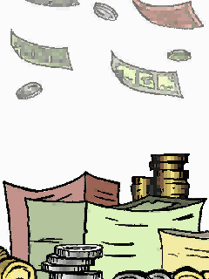
2. Eighty Six Thousand Four Hundred
Picture this:
Each day your bank deposits €86,400 in your bank account.
There’s just one catch.
You have to spend it all in one day.
You can’t carry over any money to the next day.

Slide 33
What would you do?
DUH?
You’d spend it all, Right?

Slide 34
24 hours per day
X
60 minutes per hour
X
60 seconds per minute
=
86,400 Seconds

Slide 35
Every Second Counts
Spend every second in an efficient and productive way
If you fail to use the day’s deposits, the loss is yours.

Slide 36
To Realize the Value of:
ONE YEAR, ask a student who failed a year’s exams.
ONE MONTH, ask a mother who gave birth to a premature baby.
ONE WEEK, ask the editor of a weekly newspaper.
ONE DAY, ask a daily wage laborer with kids to feed.
ONE HOUR, ask the lovers who are waiting to meet.
ONE MINUTE, ask a person who missed the train.
ONE SECOND, ask a person who just avoided an accident.
ONE MILLISECOND, ask the person who won a silver medal in the Olympics.

Slide 37
3. Tick When I Should Tock?

Slide 38
3. Am I trying to Tick when my Body Wants to Tock?
Circadian Rhythms
Circadian rhythms are internal biological clocks that regulate many functions and activities, including sleep, temperature, metabolism, alertness, blood pressure, heart rate and hormone levels and immunities.
About every 24 hours our bodies cycle through metabolic and chemical changes.
These Circadian Rhythms are reset by sunlight each morning.
Whether you are a “Morning Person” or a “Night Owl” is determined by these cycles.
Notes:
7

Slide 39
Maximize your Efficiency Work With Your Body Cycles-not Against Them
If we learn to listen to our bodies, we can work with these natural rhythms instead of fighting them.
We can make more efficient use of our time by scheduling certain activities at certain times of the day.

Slide 40
Cognitive Tasks 8am - 12 noon*
Cognitive, or mental, tasks such as reading, calculating, and problem solving are performed most efficiently in the morning.
*If you are a Night Owl, shift these times about 3-4 hours later in the day.

Slide 41
Short term memory 6 am - 10 am
Short term memory tasks such as last minute reviewing for tests are best performed early in the morning.
*If you are a Night Owl, shift these times about 3-4 hours later in the day.

Slide 42
Long term memory 1 pm - 4pm*
Longer term Memory tasks such as memorizing speeches and information for application are best performed in the afternoon.
*If you are a Night Owl, shift these times about 3-4 hours later in the day.
Notes:
8

Slide 43
Manual Dexterity 2 pm to 6 pm*
You are most efficient at tasks involving the use of your hands such as keyboarding and carpentry in the afternoon and early evening.
*If you are a Night Owl, shift these times about 3-4 hours later in the day.

Slide 44
Physical Workouts 4 pm to 9 pm *
Because of Circadian Rhythms it is best to engage in physical activity in the evening when your large muscle coordination is at its peak.
Studies show you will perceive the workout to be easier in the evening.
Exercising about 5 hours before bedtime improves the quality of sleep.
*If you are a Night Owl, shift these times about 3-4 hours later in the day.

Slide 45
Student Lag, aka Jet Lag
Are you creating the equivalent of jet lag by keeping an inconsistent sleep schedule?
Answer the following questions to find out.

Slide 46
Do you Suffer from Student Jet Lag?
Do you get up at about the the same time each morning?
Yes___No____
Do you wake up without an alarm most mornings?
Yes___No____
Do you almost always get 7-9 hours of sleep per night?
Yes___No____

Slide 47
Student Jet Lag
If you answered No to any of the questions, you are compromising your body’s efficiency.

Slide 48
Learn more about Circadian Rhythms
Secrets of Our Body Clocks Revealed
Perry, Dawson. Macmillan Publishing, 1988

Slide 49
4. Am I Working My “A’s” Off?

Slide 50
4. Am I Working My “A’s” Off?
Economist Vilfredo Pareto identified the 80/20 Rule.
In any list of tasks, 80% of the importance lies in 20% of the list.
Notes:
9

Slide 51
How would prioritize this list of daily tasks? Write the underlined word of the tasks which would be on your “A” List “B” List “C” List
Buy laundry detergent.
Write a eight page essay for systems analysis.
Prepare for a programming test.
Dust the videos on the bookcase.
Review for midterm test that counts for 50% of grade.
Schedule an appointment with a lecturer.
Complete a blog entry.
Email a high school friend on another college.
Shop for a new pair of athletic shoes.
Notes:
10

Slide 52
Are you working your “A’s” Off? or Do You Have C-Fever?
“A” LIST
1 Midterm test that counts for 50% of grade.
2 Write a eight page essay for system analysis.
“B” LIST
3 Prepare for a test in programming.
4 Schedule an appointment with a lecturer.
5 Complete a journal entry.
“C” LIST
6 Buy laundry detergent.
7 Dust the videos on the bookcase.
8 Email a high school friend on another campus.
9 Shop for a new pair of athletic shoes.
Notes:
11

Slide 53
“C” Fever
Have you ever noticed?
That the videos must be alphabetized before you can settle in to review for a test.
That rumpled pile of clothes left in the corner since Thursday night just has to get folded and put away before you can start that English essay.
If so, you may be suffering from “C” Fever

Slide 54
5. Conquer Procrastination

Slide 55
5. Conquer Procrastination
Why is “C” fever as common as the cold?
The “A” tasks may :
Produce minimal endorphins
Be too lengthy
Be too difficult
Be too threatening because of the possibility of failure
Be too threatening because of the possibility of success
Notes:
12

Slide 56
It’s All about Endorphins - The Feel Good Hormone
Develop a Conditioned Response to the Tasks you Procrastinate
Set a goal to complete a task/project
After completing the task, reward yourself with something that is pleasurable for you
The body releases endorphins- the feel good hormone
Over time with repetition, you will come to associate feeling good with completing a task/project
You won’t procrastinate as much

Slide 57
Divide and Conquer Procrastination
A father gave his son a bundle of sticks and asked him to break it. After the boy struggled, the father took the bundle, untied it and broke one stick at a time.
We procrastinate because the “A” tasks seem too lengthy or too difficult
Divide a lengthy task into smaller, shorter parts that seem easier to complete
Divide a forty page chapter into 10 page sections
Reward yourself after completing each section.

Slide 58
Fear of Success and Failure
We procrastinate because we fear FAILURE.
It is easier to accept that we failed because we didn’t even attempt a project than to fail at doing the project.
We procrastinate because we fear SUCCESS.
If I get all “A’s” this semester, everyone will expect the same next semester.
If I do an outstanding job on this project, my boss will just pile on more work.

Slide 59
If you are going to Procrastinate, at least take the blame!
Student to Teacher…
“I don’t have my paper today because the lab assistant couldn’t get the printer to work.”
“I’m late to class because I couldn’t find a parking space.”
“I’d like to study on a regular basis, but it isn’t always possible with my hectic sleeping schedule!”
Notes:
6

Slide 60
6. Pacing

Slide 61
6. Pacing
Athletes know the phenomenon of running with someone ahead of them to increase their times.
The same effect can be achieved with studying and completing schoolwork.
Notes:
13

Slide 62
Because work expands or contracts to fit the time allotted, make pacing work for you by doing the following:
Estimate the time needed to complete a task.
Subtract 15% from that estimate.
Set a timer to help you reach the goal of completing the task in reduced time.

Slide 63
7. Take the Offensive With a Planner

Slide 64
7. Take the Offensive with a PLANNER
A planner helps you:
See the big picture
Plan ahead to avoid “11th Hour” efforts
Be time efficient
Notes:
14

Slide 65
Using a Planner Effectively
Select a planner that you will be likely to carry with you.
At the beginning of each semester, record test dates, project due dates etc from all of your syllabi for your classes.
Use pencil because schedules change
Keep your planner handy

Slide 66
8. Be Realistic in your Expectations

Slide 67
8. Be Realistic
Examine your schedule.
Be realistic about what you can accomplish.
Don’t try to juggle too many things.
Don’t set yourself up for failure.

Slide 68
The Two to One Rule of Thumb
For every hour you are in class, you should study at least two hours
=

Slide 69
SCHOOL IS A FULL TIME JOB
Full time student spends 15 hours in class per week
Full time student spends a minimum of 30 hours per week studying
15 plus 30 equals 45 hours per week
Work an absolute MAXIMUM of 20 hours per week
SCHOOL IS A FULL TIME JOB!

Slide 70
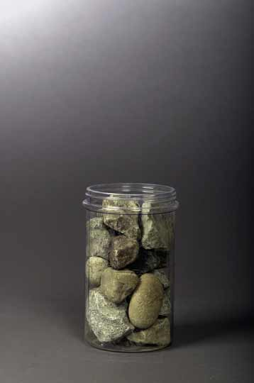
9. Is The Jar Full?
Stephen Covey in his book, First Things First, shares the following story experienced by one of his associates: I attended a seminar once where the instructor was lecturing on time. At one point, he said, "Okay, time for a quiz." He reached under the table and pulled out a wide-mouthed gallon jar. He set it on the table next to a platter with some fist-sized rocks on it. "How many of these rocks do you think we can get in the jar?" he asked.

Slide 71
After we made our guess, he said, "Okay. Let's find out." He set one rock in the jar . . . then another . . . then another. I don't remember how many he got in, but he got the jar full. Then he asked, "Is this jar full?" Everyone looked at the rocks and said, "Yes."

Slide 72
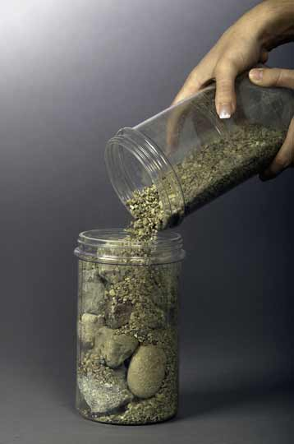
Then he said, "Ahhh" He reached under the table and pulled out a bucket of gravel. Then he dumped some gravel in and shook the jar and the gravel went in all the little spaces left by the big rocks. Then he grinned and said once more, "Is the jar full?"

Slide 73
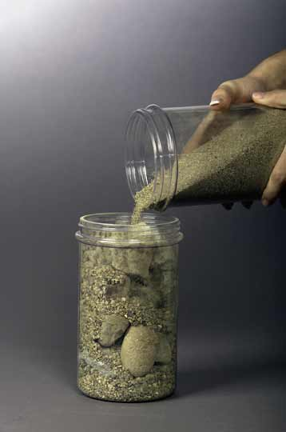
By this time the class was on to him. "Probably not," we said. "Good!" he replied. He reached under the table and brought out a bucket of sand. He started dumping the sand in and it went into all of the little spaces left by the rocks and the gravel. Once more he looked and said, "Is this jar full?" "No!" we roared.

Slide 74
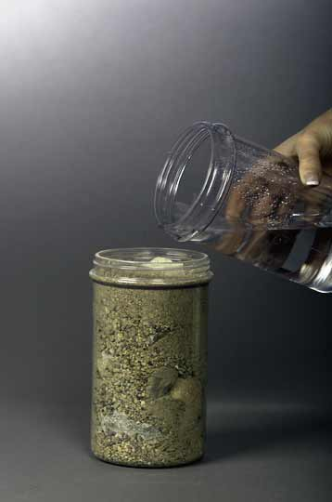
He said, "Good!" and he grabbed a pitcher of water and began to pour it in. He got something like a quart of water in that jar. Then he said, " Well, what's the point?" Somebody said, "Well, there are gaps, and if you work really hard you can always fit some more things into your life."

Slide 75
"No," he said, "that's not really the point.
The point is this:
Put the
Big Rocks
in First

Slide 76
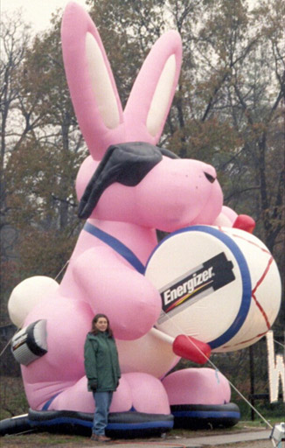
10.
Be The Bunny
Just Keep
Going
And going
And going
And going
And going…

Slide 77
1 The Present 2 86,400 3 Tick When I Should Tock? 4 Am I Working My “A’s” Off? 5 Conquer Procrastination 6 Pacing 7 Take the Offensive With a Planner 8 Be Realistic in your Expectations 9 Is The Jar Full? 10 Be The Bunny
Here are the 9 Main Points you have written to remind you how to
Manage Your Time
Notes:
15

Slide 78
Don’t Forget
An important part of making these strategies work is the daily reminder.
Take the time to place each of these eight Post-its in conspicuous places such as your alarm clock, refrigerator, television, and bathroom mirror to serve as a constant reminder.

