Slide 1
Software Testing
Damian Gordon

Slide 2

Question
Why do pilots bother doing pre-flight checks when the chances are that the plane is working fine?

Slide 3
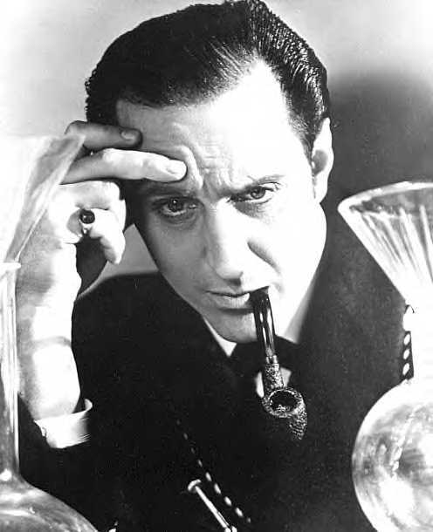
Software Testing
Software testing is an investigate process to measure the quality of software.
Test techniques include, but are not limited to, the process of executing a program or application with the intent of finding software bugs.

Slide 4
Software Testing
How is a software system built?
Customer contacts an I.T. Company and requests that a software system be created
The customer works with an analyst to define a design of the software system
The design is given to developers to build the software system
The developed system is given to software testers to check if it is OK
The system is handed over to the customers

Slide 5
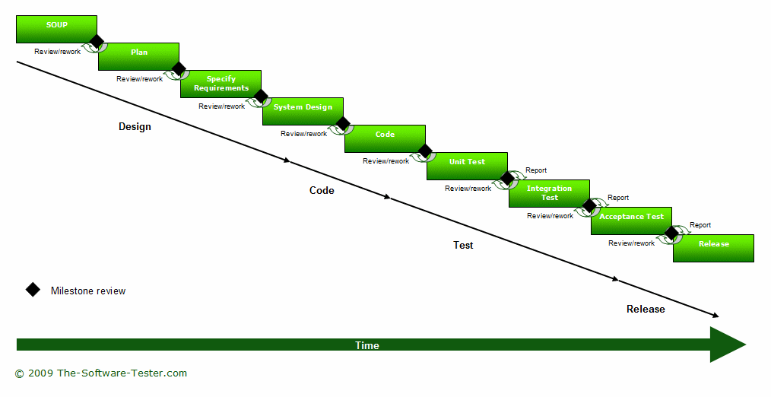
Software Testing

Slide 6
A bit of history...

Slide 7
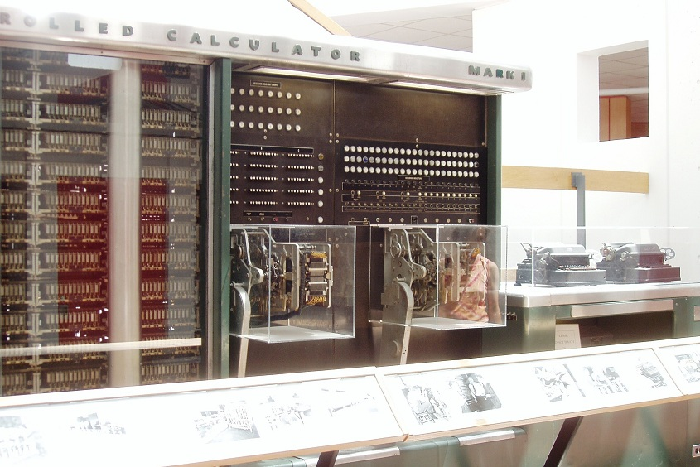
Harvard Mark I
1944AD
The IBM Automatic Sequence Controlled Calculator (ASCC), called the Mark I by Harvard University was an electro-mechanical computer.
It was devised by Howard H. Aiken, built at IBM and shipped to Harvard in February 1944.
It began computations for the U.S. Navy Bureau of Ships in May and was officially presented to the university on August 7, 1944.
It was very reliable, much more so than early electronic computers.

Slide 8
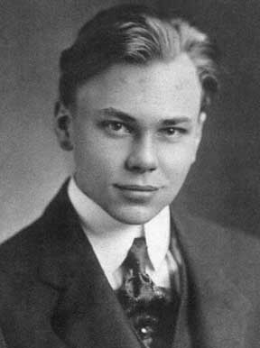
Howard H. Aiken
Howard Hathaway Aiken
Born March 8, 1900
Died March 14, 1973
Born in Hoboken, New Jersey
He envisioned an electro-mechanical computing device that could do much of the tedious work for him.
With help from Grace Hopper and funding from IBM, the machine was completed in 1944.

Slide 9
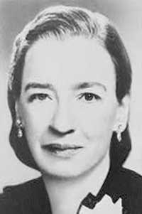
Grace Hopper
Rear Admiral Grace Murray Hopper
Born December 9, 1906
Died January 1, 1992
Born in New York City, New York
Computer pioneer who developed the first compiler for a computer programming language

Slide 10
The First Bug
1945AD
Grace Hopper served at the Bureau of Ships Computation Project at Harvard University working on the computer programming staff.
A moth was found trapped between points at Relay #70, Panel F, of the IBM Harvard Mark II Aiken Relay Calculator while it was being tested at Harvard University, 9 September 1945.
The operators affixed the moth to the computer log, with the entry: "First actual case of bug being found".
Grace Hopper said that they "debugged" the machine, thus introducing the term "debugging a computer program".

Slide 11
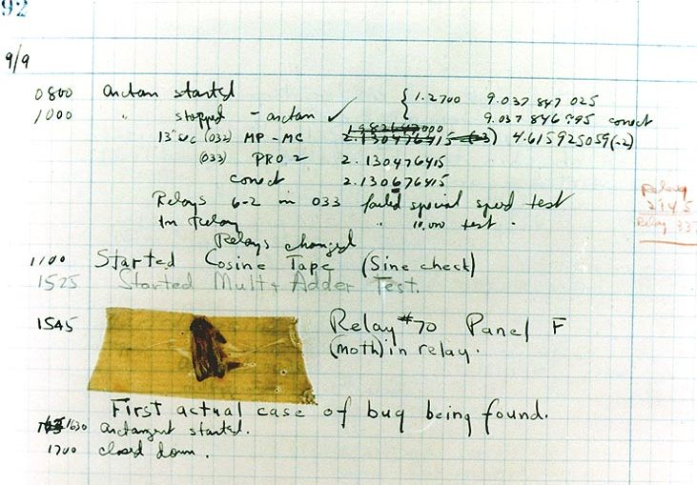

Slide 12
Bugs a.k.a. …
Defect
Fault
Problem
Error
Incident
Anomaly
Variance
Failure
Inconsistency
Product Anomaly
Product Incidence

Slide 13
Eras of Testing
Gelperin, D.; Hetzel, B. (1988). "The Growth of Software Testing". CACM 31 (6).
Years | Era | Description
1945-1956 | Debugging orientated | In this era, there was no clear difference between testing and debugging.
1957-1978 | Demonstration orientated | In this era, debugging and testing are distinguished now - in this period it was shown, that software satisfies the requirements.
1979-1982 | Destruction orientated | In this era, the goal was to find errors.
1983-1987 | Evaluation orientated | In this era, the intention here is that during the software lifecycle a product evaluation is provided and measuring quality.
1988- | Prevention orientated | In the current era, tests are used to demonstrate that software satisfies its specification, to detect faults and to prevent faults.

Slide 14
Software Testing Methods

Slide 15
Box Approach

Slide 16
Box Approach
Black
Box
White
Box
Grey
Box

Slide 17
Black Box Testing
Black box testing treats the software as a "black box"—without any knowledge of internal implementation.
Black box testing methods include:
equivalence partitioning,
boundary value analysis,
all-pairs testing,
fuzz testing,
model-based testing,
exploratory testing and
specification-based testing.
Black
Box

Slide 18
White Box Testing
White box testing is when the tester has access to the internal data structures and algorithms including the code that implement these.
White box testing methods include:
API testing (application programming interface) - testing of the application using public and private APIs
Code coverage - creating tests to satisfy some criteria of code coverage (e.g., the test designer can create tests to cause all statements in the program to be executed at least once)
Fault injection methods - improving the coverage of a test by introducing faults to test code paths
Mutation testing methods
Static testing - White box testing includes all static testing
White
Box

Slide 19
Grey Box Testing
Grey Box Testing involves having knowledge of internal data structures and algorithms for purposes of designing the test cases, but testing at the user, or black-box level.
The tester is not required to have a full access to the software's source code.
Grey box testing may also include reverse engineering to determine, for instance, boundary values or error messages.
Grey
Box

Slide 20
An Exercise

Slide 21
Here's the algorithm – follow exactly!!
Draw a diagonal line
Draw another diagonal line connected to the top of the first one
Draw a straight line from the point where the diagonal lines meet
Draw a horizontal line over the straight line
At the bottom of the straight line, draw a curvy line
Draw a diagonal line from the bottom of the first diagonal to the straight line
Draw a diagonal line from the bottom of the second diagonal to the straight line
Notes:
Only need to use this slide if they don't have the hand-out.

Slide 22
How did the pictures turn out?
Compare your picture with others' pictures…
Were they different?
Why?
What was difficult about following the instructions
What was missing from the instructions?
Notes:
Bring out detail, correctness, ambiguity

Slide 23
It was meant to be a kite!!
Draw a diagonal line
Draw another diagonal line connected to the top of the first one
Draw a straight line from the point where the diagonal lines meet
Draw a horizontal line over the straight line
At the bottom of the straight line, draw a curvy line
Draw a diagonal line from the bottom of the first diagonal to the straight line
Draw a diagonal line from the bottom of the second diagonal to the straight line
Notes:
In a jokey fashion, show how the instructions "obviously" give us a kite!! (step through the animation of the kite picture).

Slide 24
It was meant to be a kite!!
Now write a set of instructions that work!
Ensure only one way to interpret each step
unambiguous
… and enough detail in each step
Notes:
Then get them to try writing out a better/correct version.
Once they have done this, get one of them to call out their list of instructions – and with a pen/chalk in hand, follow their instructions on the board at the front. Be as awkward as possible, illuminating any possible remaining ambiguity!!! You can encourage other pupils to shout out corrections if required – and they probably will!!
Be sure that a set of correct instructions is discussed by the end.

Slide 25
Putting all this together…
This time:
write an Algorithm
test it yourself
get someone else to try it out…
Can you be sure your algorithm will work ok?

Slide 26
(a) Write & test your algorithm
The task/problem:
make a shape out of paper – one sheet of A4
Write the algorithm
Write a set of instructions that explains how to make a paper shape from 1 sheet of A4 paper
Test it
Try out your algorithm – does it work?
Note: follow your instructions as closely as possible
Adjust the instructions if necessary
Notes:
*** Need three sheets of scrap paper per person (1 for their shape, 1 to write instructions for making it, and 1 for making their partner's shape).
Leave it vague as to exactly what the shape is. The automatic thing is a plane – but try not to say this and see if folk will come up with other shapes.
If the pupils are stuck, then prompt them – e.g. fan, fortune teller, water bomb, plane.
Do this as three very separate steps: Make the thing first, then write the instructions, then test.

Slide 27
Types of Testing

Slide 28
Unit Testing
Lowest level functions and procedures in isolation
Each logic path in the component specifications

Slide 29
Module Testing
Tests the interaction of all the related components of a module
Tests the module as a stand-alone entity

Slide 30
Subsystem Testing
Tests the interfaces between the modules
Scenarios are employed to test module interaction

Slide 31
Integration Testing
Tests interactions between sub-systems and components
System performance
Stress
Volume

Slide 32
Acceptance Testing
Tests the whole system with live data
Establishes the ‘validity’ of the system

Slide 33
Testing Tools

Slide 34
Testing Tools
Program testing and fault detection can be aided significantly by testing tools and debuggers. Testing/debug tools include features such as:
Program monitors, permitting full or partial monitoring of program code (more on the next slide).
Formatted dump or symbolic debugging, tools allowing inspection of program variables on error or at chosen points.
Automated functional GUI testing tools are used to repeat system-level tests through the GUI.
Benchmarks, allowing run-time performance comparisons to be made.
Performance analysis (or profiling tools) that can help to highlight hot spots and resource usage.

Slide 35
Testing Tools
Program monitors, permitting full or partial monitoring of program code including:
Instruction set simulator, permitting complete instruction level monitoring and trace facilities
Program animation, permitting step-by-step execution and conditional breakpoint at source level or in machine code
Code coverage reports

