Slide 1
Final Year Project
Proposal

Slide 2
Note
The template, and a sample are available here:
http://damiantgordon.com/Courses/ProjectsL8/

Slide 3
Contents
Project Title
Summary
Background (and References)
Proposal Approach
Deliverables
Technical Requirements
Project Plan

Slide 4
Project Title
This is your research topic – it tell us what the project is about
Use terminology relevant to the research discipline
Make it as long or as short as you like

Slide 5
Summary
200 words max.
Summarises your project
Answers the following questions
  What area of computer science is this project in?
  What problem are you tackling?
  What does you background reading tell you about this?
  How are you going to implement a solution?
  How will you evaluate it?

Slide 6
Background (and References)
Finding out what is happening in the area of research is a vital step along your journey, to find and understand how others in your field have tackled similar problems and the results they obtained, shortcomings they observed and methodologies they employed are the goals of the this process.

Slide 7
Background (and References)
At least 4 references, but there is no upper maximum.
For each reference give us three sentences:
  An overview of the reference
  What results or conclusions they got
  How it ties in with your project
Include a diagram for one or two of them.

Slide 8
Good Sources ?
Journal Papers
Conference Papers
Textbooks
Other Books
Company Whitepapers
Company Websites
Blogs
Wikis
Credibility

Slide 9
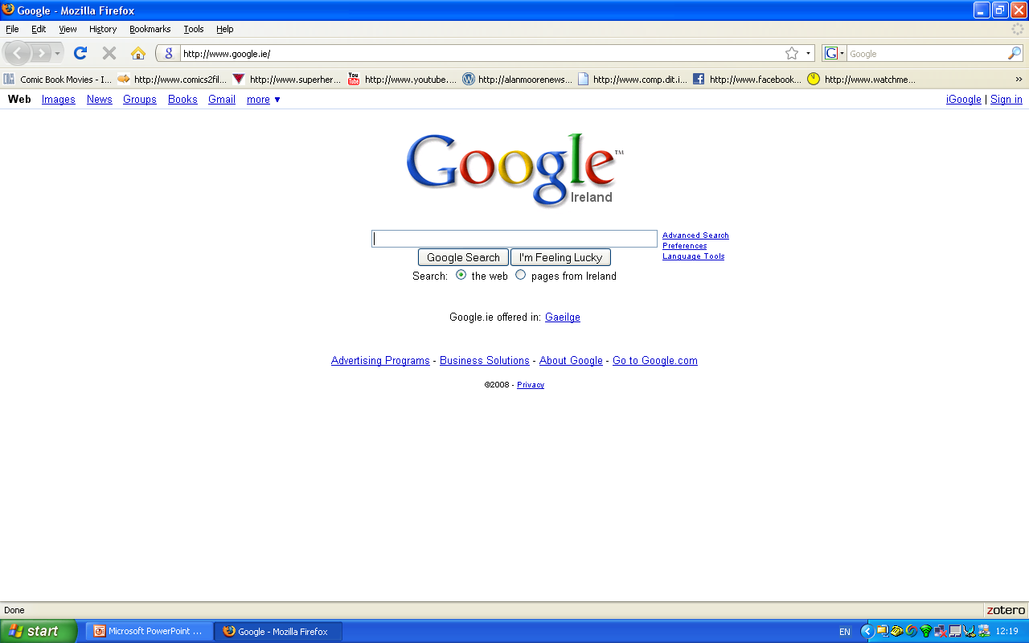

Slide 10
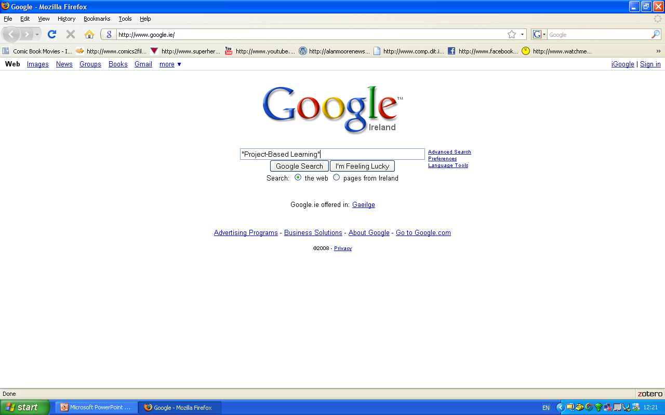

Slide 11
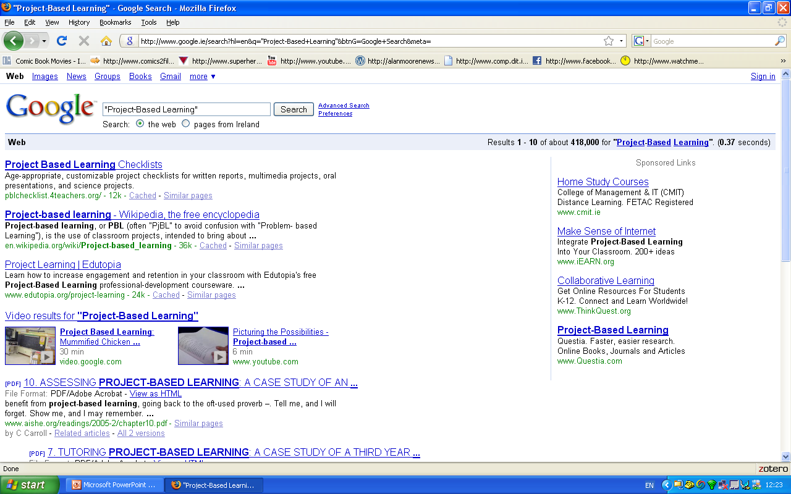

Slide 13
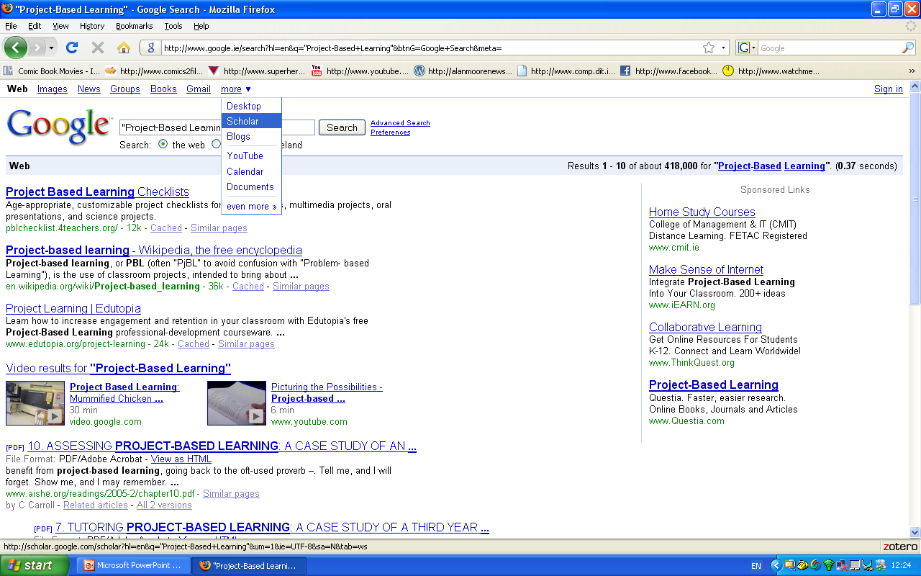

Slide 14
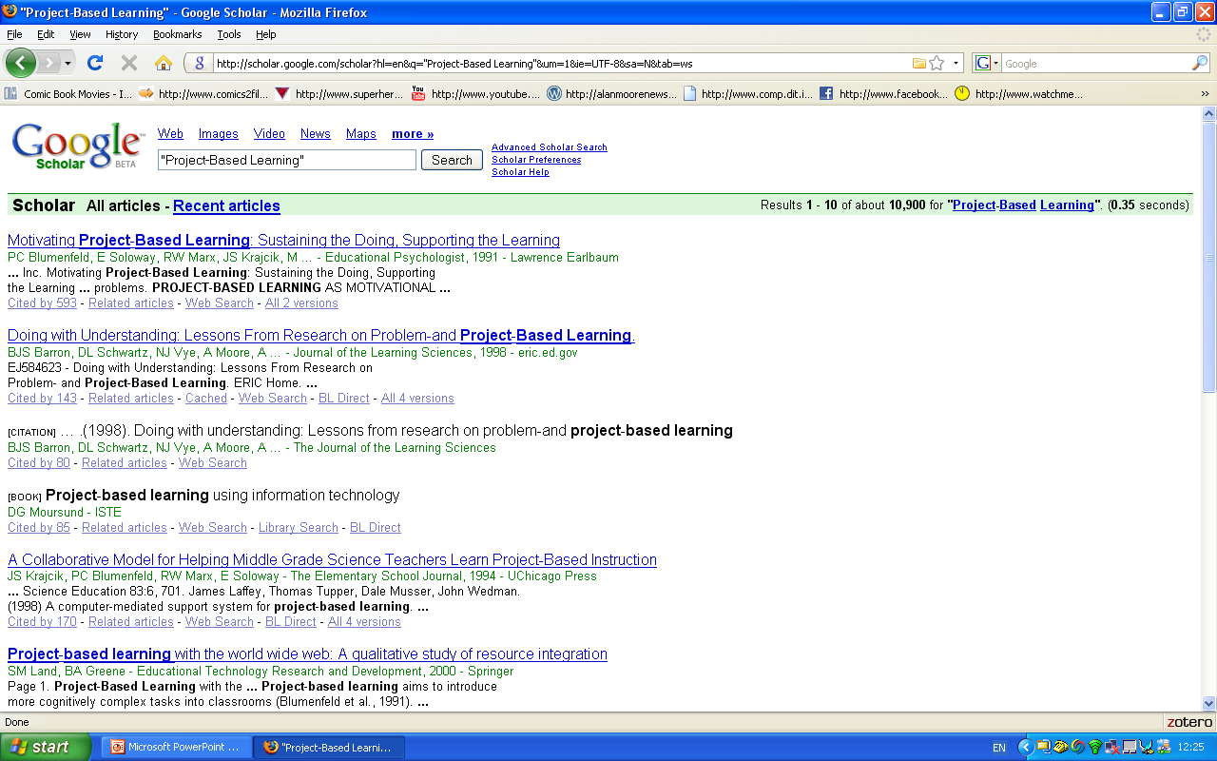

Slide 15
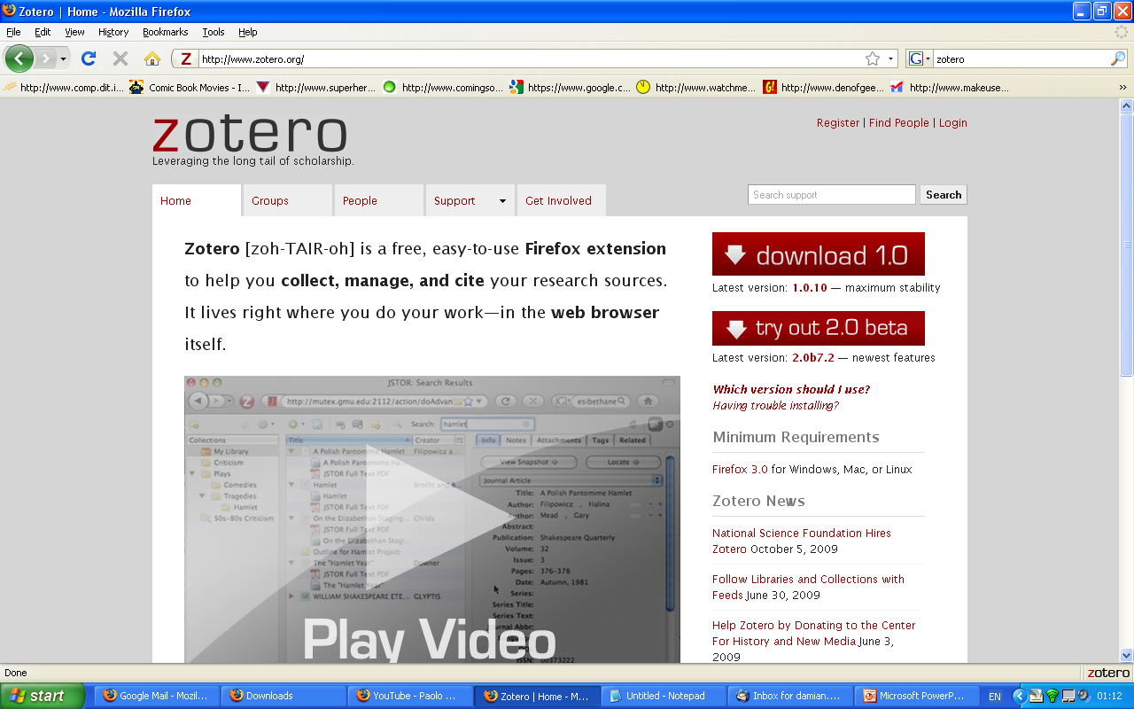

Slide 16
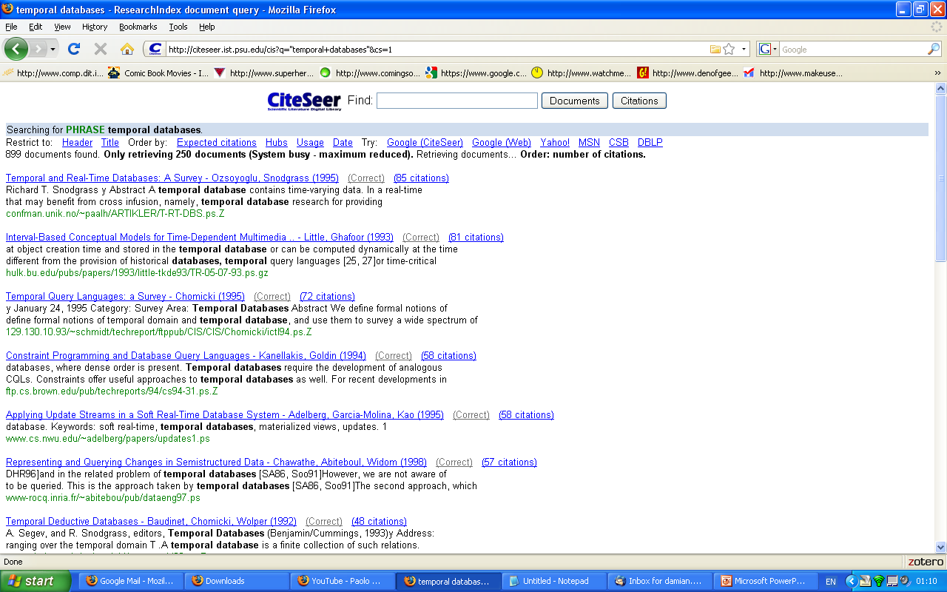

Slide 17
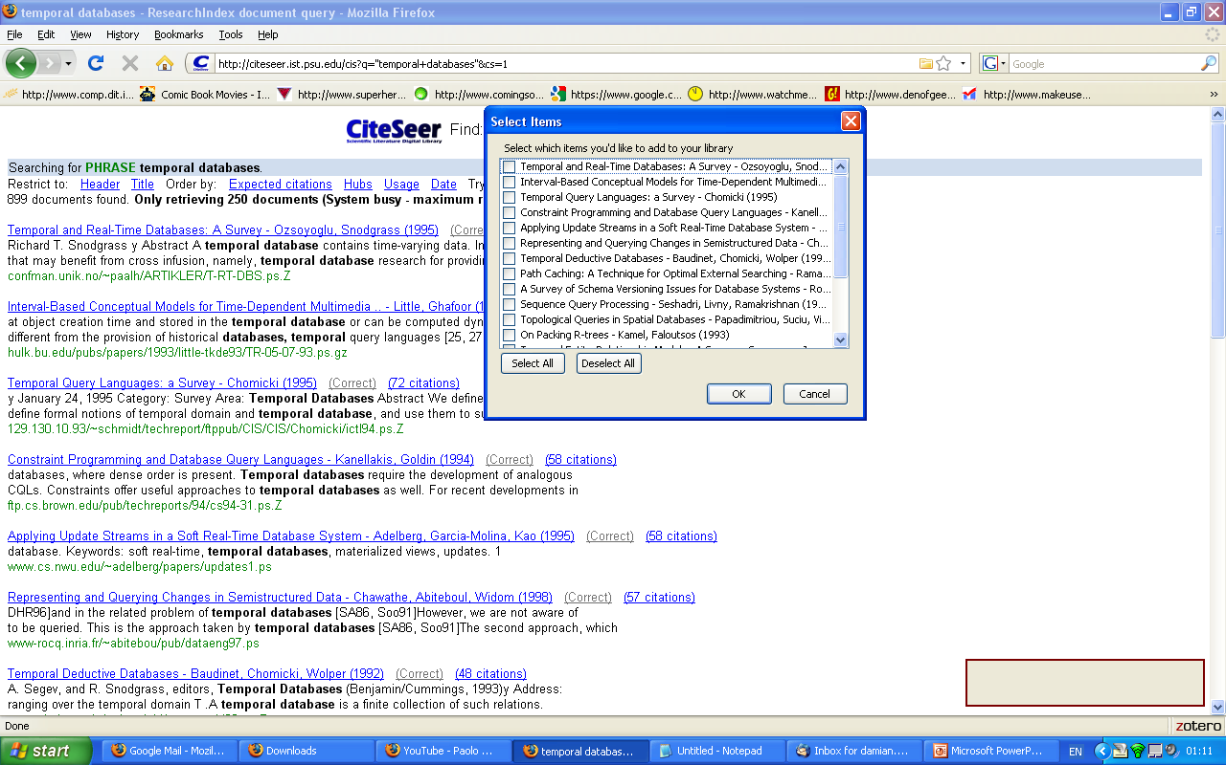

Slide 18
Proposal Approach
What software will be used?
  Programming languages
  Operating Systems
  Middleware
  etc
What Hardware will be used?
What methodology will be employed?
What do you imagine the architecture of the system will be (client-server/3-tier/n-tier)?
What will you do?
How will you test and evaluate it?

Slide 19
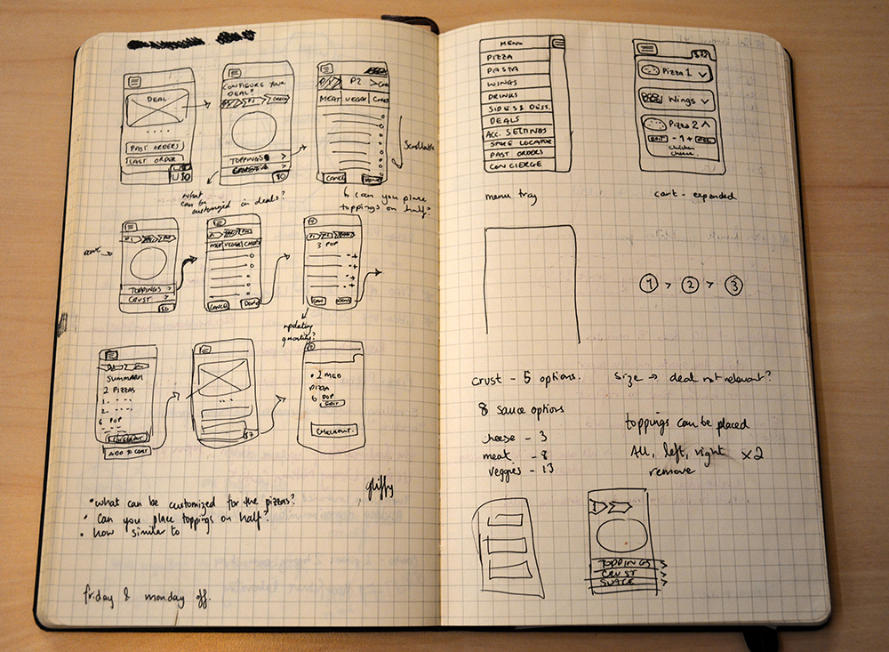

Slide 20
Proposal Approach
Create plenty of paper prototypes.
Can you describe what a user has to do
(1) The first time they log in
(2) As they regularly use the system
(3) If the system makes a mistake how
can the user fix it.

Slide 21
More on Evaluation
Think about things like;
  Quality of the research and it’s outcomes
  Design of the system
  Design being implemented in code
  Code Structure and Robustness
  Standards Compliant
  how open in nature the design and code
  Extensibility
  inter-operability
  How easy the system is to Administrate
  System Stability
  Quality of testing and testing reports

Slide 22
Deliverables
Project dissertation
User manual?
Software and Configuration Files
Demo
Priority Features:
  Putting together the physical network
  Installing Operating systems on servers
  Getting LDAP set up and authenticating users and synchronising with Active Directory
  Installing Remote Desktop software on the servers and configuring them to accept connections
Secondary Features:
  Unified Home Directories/Drives
  Session Choosing at Logon
  SunRay Integration

Slide 23
Technical Requirements
What software do you need?
Is there a free or open source alternative?
Do you need any specialist software?

Slide 24
2 FYPs
Dissertations are available from the library website:
http://library.dit.ie/search/X?SEARCH=(dt211c)&SORT=D
http://library.dit.ie/search/X?SEARCH=(dt228)&SORT=D
About 200 words each.

