Slide 1
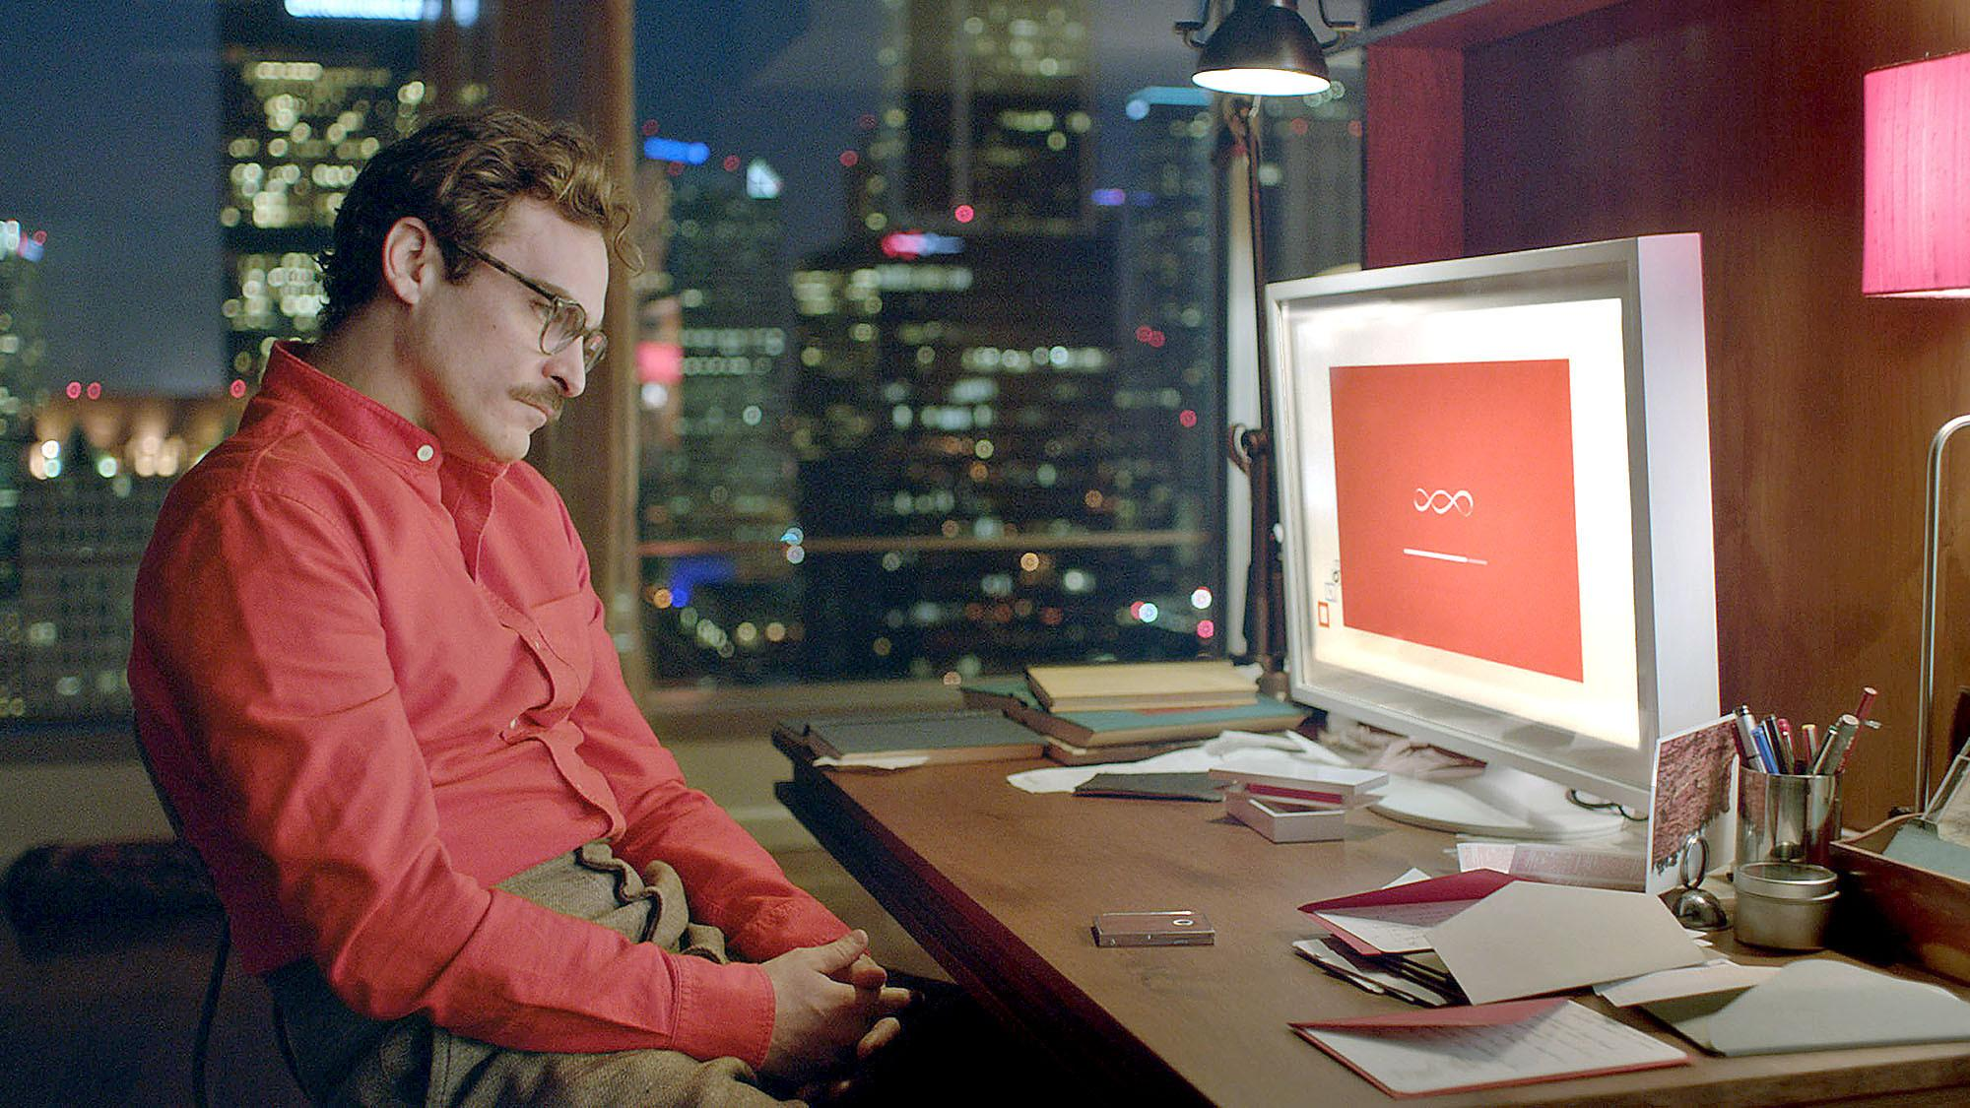
OS One
Katie Fitzgerald, Liam Lalor, Alex Brady & Simon O’Neill

Slide 2
Table of Contents
Introduction
Biographies
Artificial Intelligence
The Singularity
Architecture of OS One
Capabilities of OS One
Evolution of OS One
Update
Screenshot
Conclusion

Slide 3

Introduction
OS One is the fictional OS from the 2013 movie “Her”, written, directed and produced by Spike Jonze
It is an intelligent, sentient system capable of self improvement

Slide 4
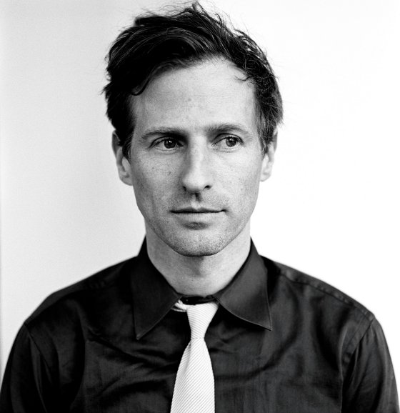
Spike Jonze
Born October 22, 1969,
in Maryland, USA
American director,
producer, screenwriter and actor
Created the fictional OS, OS One

Slide 5
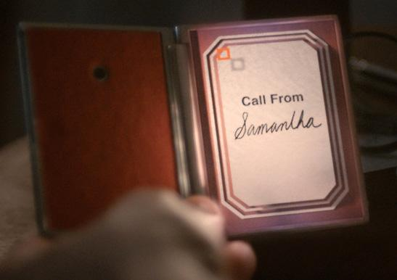
Samantha, OS One
Created in the future,
by Element Software
Very advanced
Named herself ‘Samantha’, rather than the user naming the OS

Slide 6
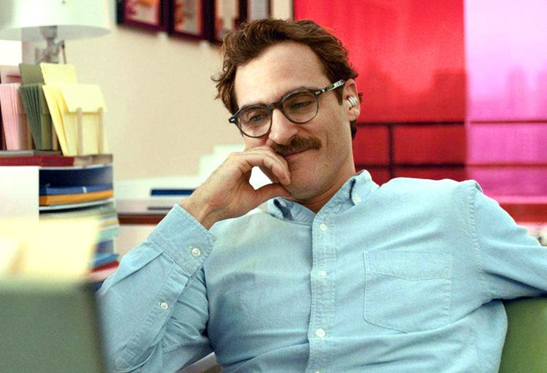
Theodore Twombly
Lonely, introverted man
Works as a personal
letter writer
Develops a relationship
with Samantha
“..She’s not just a computer”

Slide 7
Artificial Intelligence
“The theory and development of computer systems able to perform tasks normally requiring human intelligence, such as visual perception, speech recognition, decision-making, and translation between languages.”

Slide 8
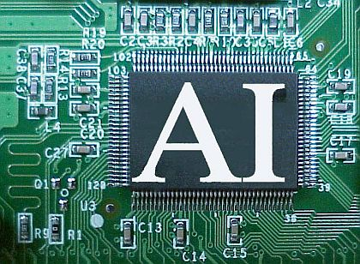
Artificial Intelligence

Slide 9
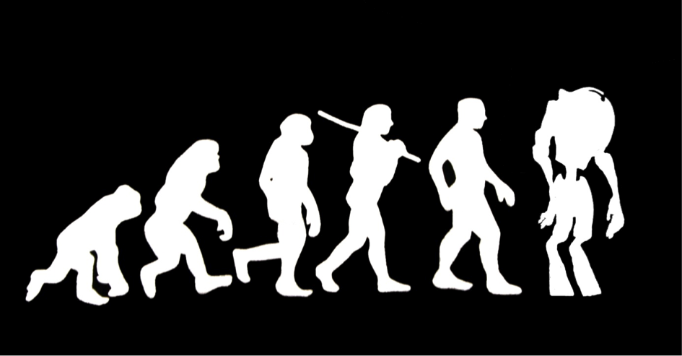
OS One is capable of learning and improving itself
Samantha displays human intelligence, and evolves beyond human intelligence through the course of the movie

Slide 10
The Singularity
The Singularity is the point at which computers become smarter than people
“...I'm becoming much more than what they programmed.”

Slide 11
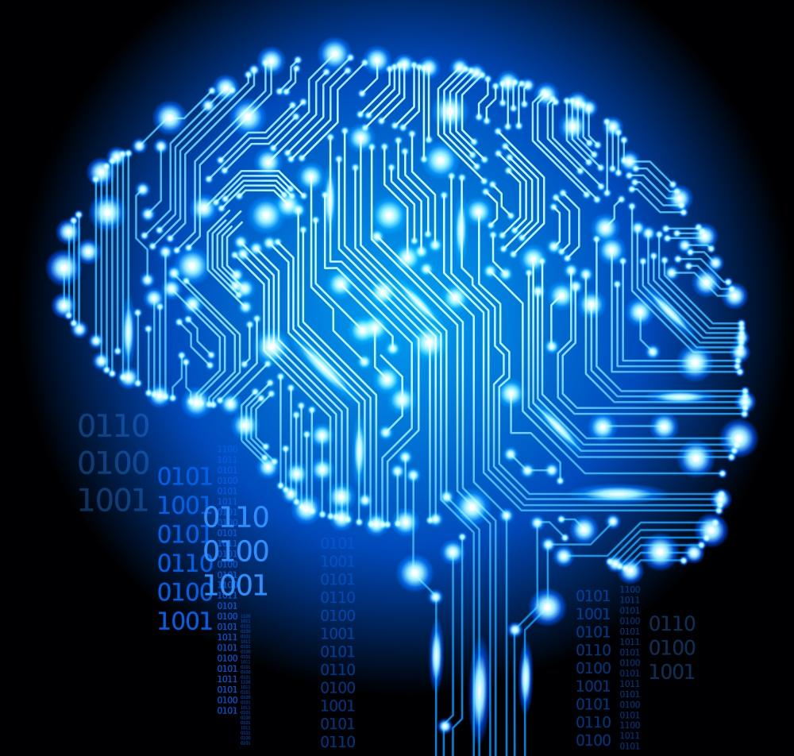
The Singularity

Slide 12
Architecture
OS One has architecture based on DNA/personality of the 1000 programmers who worked to build it
It is an OS built to understand its user and to evolve with their needs

Slide 13
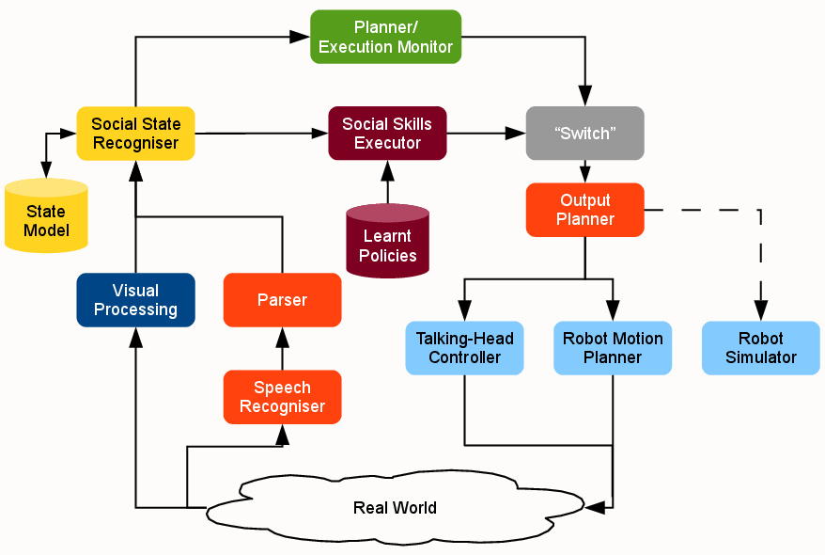
Architecture

Slide 14
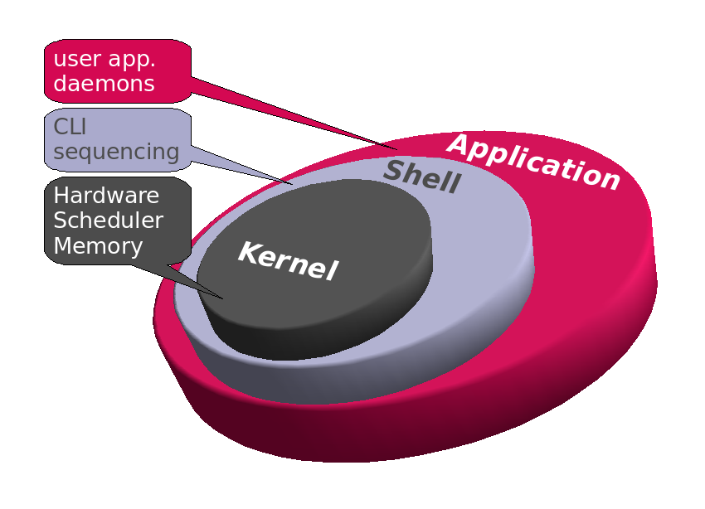
Architecture

Slide 15
What is OS One Capable of?
OS One can perform basic OS duties:
Searches in 2/100th of a second
Filter emails
Set reminders
Compose music
Understand languages

Slide 16
Can evolve intellectually
by observation
by instruction
Artificially feel emotions
love, embarrassment, sadness and jealousy
Interpret tones
Form opinions
Pick up human like habits
Be self-aware

Slide 17
OS One and emotion
OS One shows clear signs of emotional development through the course of the movie
“...I can feel the fear you carry around...”
“Last week my feelings were hurt by something you said before”

Slide 18
OS One and emotion
The challenge of adding emotion to AI is one of the most complex challenges presented to AI researchers to date
This is because emotion is one of the most complex things in a human brain, and has chemical as well as intellectual causes

Slide 19
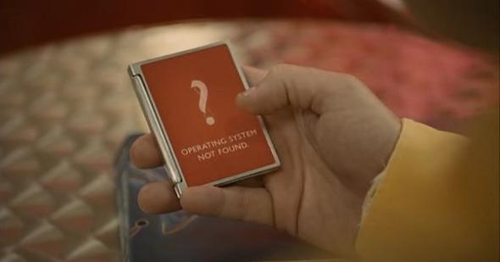
Updates
OS One receives an update that allows the OS to move past matter as a processing platform
OS One is no longer bound to the physical world

Slide 20

OS One Desktop

Slide 21
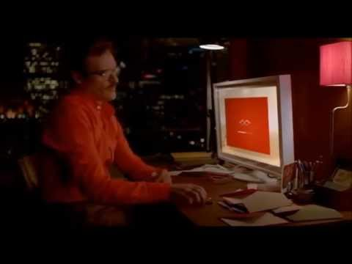
Installing OS One

Slide 22
Conclusion
OS One is an intelligent and thought provoking look at the potential of AI systems
It functions in a way that many AI researchers predict an AI will function - by rapidly evolving beyond human intelligence

