Slide 1
Introduction to Operating Systems (Summary)
Damian Gordon

Slide 2

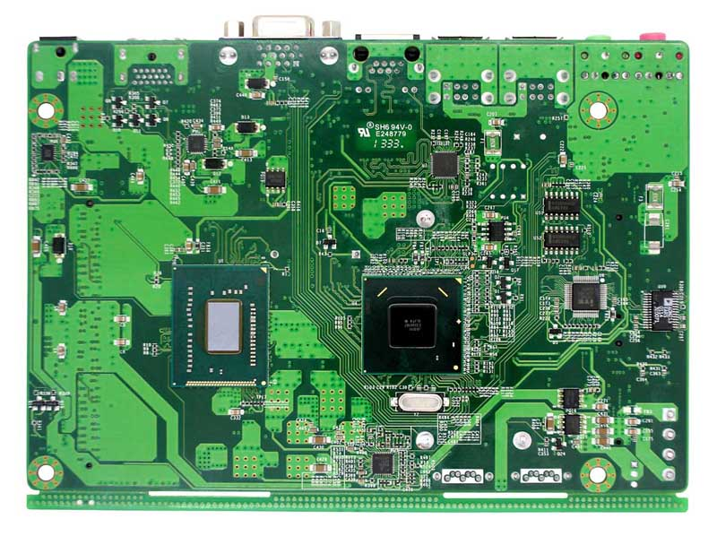
Software
Applications
OPERATING SYSTEM
Computer
Hardware

Slide 3
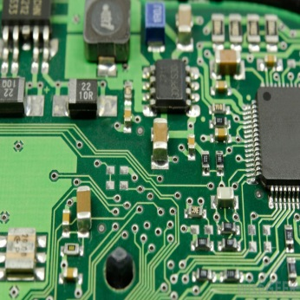
Typical OS Architecture
User
Applications
Shell
Kernel
Hardware

Slide 4







LAMP
User
Interface
Python
Php
Perl
Web Server
Apache
Database
MySQL
Operating System
Linux

Slide 5



XAMPP
User
Interface
Python
Php
Perl
Web Server
Apache
Database
MariaDB
Operating System
X
Cross-
Platform

Slide 6
Operating
System
Memory
Manager
File
Manager
Process
Manager
Device
Manager
Network
Manager

Slide 7

The Little-Man Computer (Summary)
Damian Gordon

Slide 8
The Little-Man Computer
Fetch the next instruction from memory at the address in the program counter
Decode the instruction using the control unit
Increment the Program Counter
The control unit commands the rest of the computer to execute the instruction
Go to step 1

Slide 9
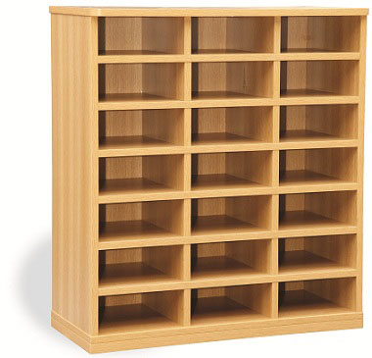

0
1
2
3
4
5
6
7
8
STORE
10
11
9
LOAD
13
14
12
In-tray
-
Out-tray
16
15
19
18
Pigeon Holes
In-tray
Program
Counter
Calculator
Out-tray

Slide 10
The Little-Man Computer
TYPE OF INSTRUCTION | INSTRUCTION | CODE
Arithmetic | ADD | 1xx
Arithmetic | SUBTRACT | 2xx
Data Movement | STORE | 3xx
Data Movement | LOAD | 5xx
Branching | BRA | 6xx
Branching | BRZ | 7xx
Branching | BRP | 8xx
Input/Output | INPUT | 901
Input/Output | OUTPUT | 902
Machine Control | STOP | 000

Slide 11
The Little-Man Computer
INBOX --> ACCUMULATOR
INPUT the first number, enter into calculator
ACCUMULATOR --> MEMORY[10]
STORE the calculator's current value in memory location [10]
INBOX --> ACCUMULATOR INPUT the second number, enter into calculator
ACCUMULATOR --> MEMORY[11]
STORE the calculator's current value in memory location [11]
00
01
02
03
ACCUMULATOR = ACCUMULATOR - MEMORY[10]
SUBTRACT the second number from the first value
IS ACCUMULATOR POSITIVE? GOTO MEMORY[08]
BRANCH to memory location [08] if accumulator is positive
MEMORY[10] --> ACCUMULATOR
LOAD the first value back into the calculator
ACCUMULATOR = ACCUMULATOR - MEMORY[11]
SUBTRACT the second number from the first value
04
05
06
07
ACCUMULATOR --> OUTBOX
OUTPUT the calculator's result to the OUT-TRAY
Take a break
[Used for data]
[Used for data]
08
09
10
11

Slide 12
The Little-Man Computer
INP
STA 10
INP
STA 11
00
01
02
03
SUB 10
BRP 08
LDA 10
SUB 11
04
05
06
07
OUT
HLT
DAT
DAT
08
09
10
11

Slide 13
The Little-Man Computer
901
310
901
311
00
01
02
03
210
808
510
211
04
05
06
07
902
000
DAT
DAT
08
09
10
11

Slide 14
Data Structures (Summary)
Damian Gordon

Slide 15
Data Structures
Queue (FIFO)
Stack (LIFO)
Heap

Slide 16
Processor Management (Summary)
Damian Gordon

Slide 17
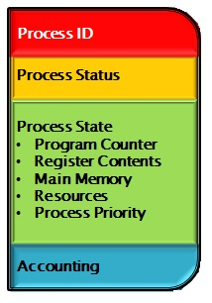
Processor Management
User 1
Process
1
Running
Executable 1
User 2
Process
2
Running
Executable 1

Slide 18
Processor Management
The Processor Manager is made up of two sub-managers:
Job Scheduler
Process Scheduler

Slide 19
Job Scheduler
A group of processes is called a “job”
The Job Scheduler takes the group of processes (“jobs”)
The Job Scheduler takes this group of process (“jobs”) and re-orders them on the basis of balancing Batch and Interactive processes

Slide 20
Job Scheduler
I/O Heavy
CPU Heavy

Slide 21
Job Scheduler
CPU Heavy
CPU Heavy
CPU Heavy
I/O Heavy
I/O Heavy

Slide 22
Process Scheduler
The operating system runs each process one at a time using the process scheduler
The process scheduler allows each process to run on the CPU for a given period of time (“RUNNING”), and then swaps that process out, and swaps another one into the CPU, and the initial process is set to “READY”
If the process is waiting for I/O for too long, the process is set to “WAITING”

Slide 23
Processor Management
Other statuses that a process can have are:
Job Scheduler
HOLD
FINISHED
Process Scheduler
RUNNING
READY
WAITING

Slide 24
Processor Management
JOB SCHEDULER
HOLD
FINISHED
Admitted
Scheduler
Dispatch
Exit
PROCESS SCHEDULER
READY
RUNNING
Interrupt
I/O or
Event completion
I/O or
Event wait
WAITING

Slide 25
Process Scheduling Policies (Summary)
Damian Gordon

Slide 26
Process Scheduling Policies
Maximum Throughput
Minimize Response Time
Minimize Turnaround Time
Minimize Waiting Time
Maximise CPU Efficiency
Ensure Fairness For All Jobs

Slide 27
Process Scheduling Algorithms
First Come, First Served (FCFS)
Shortest Job Next (SJN)
Priority Scheduling
Shortest Remaining Time (SRT)
Round Robin
Multi-Level Queues

Slide 28
Seven Types of Deadlock
Deadlock on file requests
Deadlock in databases
Deadlock in dedicated device allocation
Deadlock in multiple device allocation
Deadlock in spooling
Deadlock in a network
Deadlock in disk sharing

Slide 29
File Management (Summary)
Damian Gordon

Slide 30
Hard Disk
Track
Block
v
v
v
Sector

Slide 31
File Management
Some definitions:
A FIELD is a collection of bytes that can be identified by a user, and has a type and size.
A RECORD is a collection of related FIELDS.
A FILE is a collection of records.
A DIRECTORY (or FOLDER) is a special type of file that which has lists of files and their attributes.

Slide 32
Physical Storage Allocation
There are three main ways a file is physically stored in memory:
Contiguous Storage
Non-contiguous Storage
Indexed Storage

Slide 33
Contiguous Storage
a | b | c | d | e | f | g | h
Does it fit here?
YES

Slide 34
Non-contiguous Storage
a | b | c | d
e | f | g | h
extent

Slide 35
Indexed Storage
File 1
File 2
e | f | g | h
 |  |  |  |  |  |  |  |  |  |  |  |  |  |  | v | w | x | y | z
a | b | c | d
INDEX BLOCK:
File | Address | Size | Next
File 1 | 1 | 4 | 9
File 1 | 9 | 4 | -
File 2 | 15 | 5 | -

Slide 36
Access Control Matrix
 | User 1 | User 2 | User 3 | User 4 | User 5
File 1 | RWED | --E- | --E- | RWED | R---
File 2 | ---- | R-E- | R-E- | R--- | RWE-
File 3 | R-E- | RW-- | R-E- | R-E- | R--D
File 4 | R--- | RWE- | R--- | RWED | --E-

Slide 37
Network Management (Summary)
Damian Gordon

Slide 38
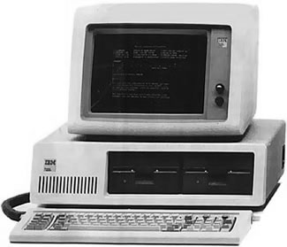
Computer Networks
When we hook up computers together using data communication facilities, we call this a computer network.

Slide 39
Computer Networks
A Site is a specific location in a network containing two or more computer systems.
A Host is a is a specific computer system in a site that provides services.
A Node is the name assigned to the host to identify it to other computers.

Slide 40
Network Topologies
Star
Ring
Bus
Tree

Slide 41
Hybrid Network Topologies
Star + Bus
Ring + Bus
Star + Ring

Slide 42
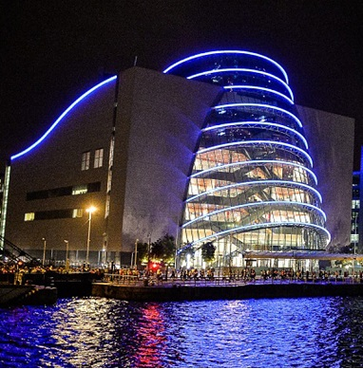


Network Types
LAN
MAN
WAN

Slide 43
Memory Management (Summary)
Damian Gordon

Slide 44
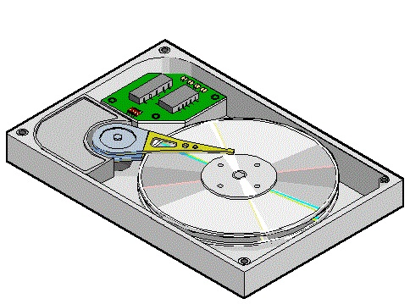
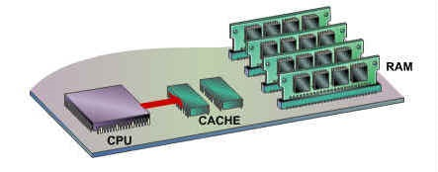
Memory Management
Approximate number of clock cycles to access
the various elements of the memory hierarchy.
HARD DISK
(SECONDARY
MEMORY)
CACHE 1
(MAIN
MEMORY)
2
10¹
10³
10⁷

Slide 45
Single-User System
If I create a program:
to be processed, it has
to be writen entirely into
Main Memory, in
contiguous space
MAIN
MEMORY
PROGRAM 1
200K
available

Slide 46
Fixed Partitions
PARTITION 1
100K
PARTITION 2
25K
250K
PARTITION 3
25K
PARTITION 4
50K
PARTITION 5
50K

Slide 47
Fixed Partitions
Let’s add some jobs in:
PARTITION 1
PROGRAM 1
100K
INTERNAL FRAGMENTATION
PROGRAM 2
PARTITION 2
25K
250K
EMPTY PARTITION
PARTITION 3
25K
PROGRAM 3
PARTITION 4
50K
INTERNAL FRAGMENTATION
PARTITION 5
EMPTY PARTITION
50K

Slide 48
Dynamic Partitions
Let’s add some jobs in:
PROGRAM 1
PROGRAM 2
PROGRAM 5
250K
EXTERNAL FRAGMENTATION
PROGRAM 4

Slide 49
Partitions
If the Memory Manager wants a FIRST-FIT ALGORITHM then it stores a table in order of memory locations.
If the Memory Manager wants a BEST-FIT ALGORITHM then it stores a table in order of size of memory locations.
Starts | Size | Status
315 | 40 | FREE
250 | 50 | FREE
Starts | Size | Status
200 | 50 | BUSY
250 | 50 | FREE
300 | 15 | BUSY
315 | 40 | FREE
355 | 25 | BUSY
Starts | Size | Status
300 | 15 | BUSY
355 | 25 | BUSY
315 | 40 | BUSY

Slide 50
Deallocating space
1. There are jobs either side of the freed space:
200-250
PROGRAM 5
PROGRAM 5
200-250
250-300
PROGRAM 3
PROGRAM 3
250-300
300-315
PROGRAM 6
300-315
315-340
PROGRAM 4
PROGRAM 4
315-340
340-355
340-355
355-380
PROGRAM 8
PROGRAM 8
355-380

Slide 51
Deallocating space
2. There are is a job on one side, and it’s free on the other side of the freed space:
200-250
PROGRAM 5
PROGRAM 5
200-250
250-300
PROGRAM 3
PROGRAM 3
250-300
300-315
PROGRAM 6
300-355
315-355
355-380
PROGRAM 8
PROGRAM 8
355-380

Slide 52
Deallocating space
3. There are no jobs on either side of the freed space:
200-250
PROGRAM 5
PROGRAM 5
200-250
250-300
250-355
300-315
PROGRAM 6
315-355
355-380
PROGRAM 8
PROGRAM 8
355-380

Slide 53
Memory Management: Virtual Memory (Summary)
Damian Gordon

Slide 54
Virtual Memory
HARD DISK
(SECONDARY
MEMORY)
CACHE 1
(MAIN
MEMORY)
Computer programs are stored here
Then they are moved to here
2
Until they need to be executed

Slide 55
Virtual Memory
In modern operating systems, before a job is loaded into main memory, it is divided into chunks, called PAGES.
Job 3
Page 1
Page 2
Page 3
Page 4
Page 5
Page 6
Page 7

Slide 56
Virtual Memory
Each PAGE is loaded into memory locations called PAGE FRAMES.
MAIN
MEMORY
Page Frame 1
Page Frame 2
Page Frame 3
Page Frame 4
Page Frame 5
200K
available
Page Frame 6
Page Frame 7
Page Frame 8
Page Frame 9
Page Frame 10

Slide 57
Virtual Memory
Consider a program that 350 bytes, and the page size is 100 bytes.
Main
Memory
Operating
System
Job 1:
350 bytes
Page 0
A little bit of internal fragmentation
Page 1
Page 2
Page 2
Page 3
Page 0
Page 1
Page 3

Slide 58
Computer Security (Summary)
Damian Gordon

Slide 59
Operating
System
Memory
Manager
File
Manager
Process
Manager
Device
Manager
Network
Manager
Security
Manager

Slide 60
Operating System Security
The operating system uses a number of different ways to protect the system:
Your credentials (e.g. username and password)
Your authorisation (e.g. drwxr-x-r--)
Your location (e.g. inside/outside the LAN)
Your behaviour (e.g. deleting lots of files)
The firewall

Slide 61
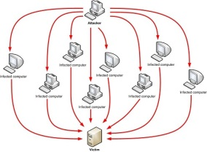
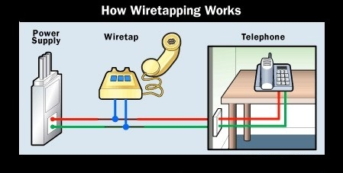
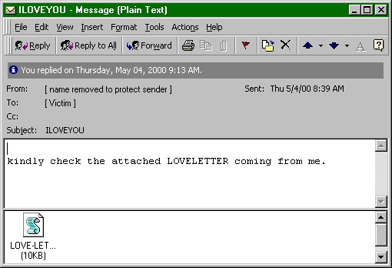
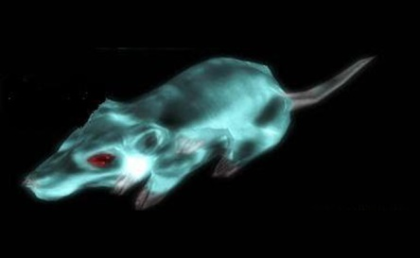
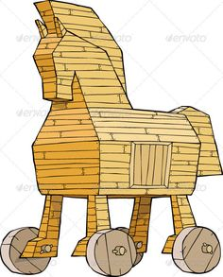
Operating Systems Attacks
Intentional Attacks
Denial-of-Service (DoS) Attack
Wiretapping
Viruses
Worms
Trojans
Unintentional Attacks
Parallel writes
Unintentional Denial-of-Service (DoS)

Slide 62


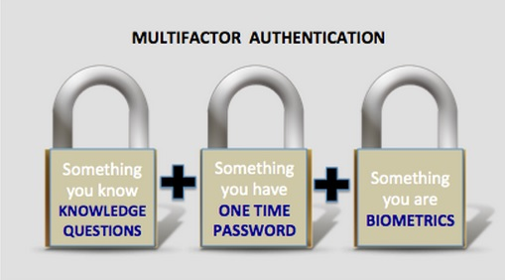
System Protection
System protection is multifaceted, four protection methods include:
Antivirus Software
Firewalls
Patch Management
Authentication
CAPTCHAs
reCAPTCHAs
Smart Cards
Biometrics

Slide 63
Device Management (Summary)
Damian Gordon

Slide 64
Device Management
The main functions of the device manager are:
Monitor the status of all devices, including storage drives, printers and other peripherals
Enforce pre-set policies on which process gets which device for how long
Deal with the allocation of devices to processes
Deal with the de-allocation of devices to processes, both at a temporary basis (e.g. when the process is interrupted) and on a permanent basis (e.g. when the process is completed).

Slide 65
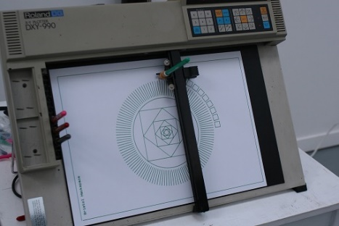
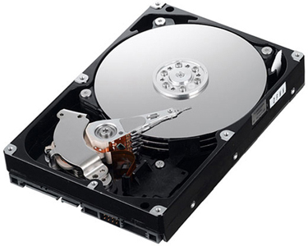
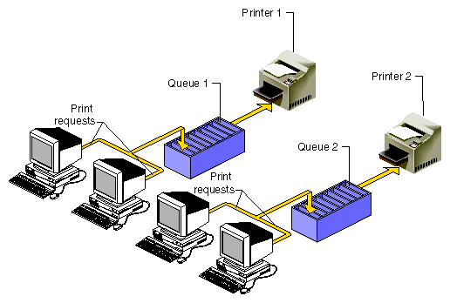
Device Management
There are three main types of devices:
Dedicated Devices
Shared Devices
Virtual Devices

Slide 66

Device Management
Two types of disks:
Magnetic Disks – have magnetised “beads” that are either N-S (1) or S-N (0). The disk head reader reads magnetic fields. Has multiple tracks, and have different sector sizes.
Optical Disks – have indented areas called pits (0) and non-indented areas called lands (1). Has a single track, and has equal sector sizes.

Slide 67
Device Management
Magnetic Disks Optical Disks

Slide 68
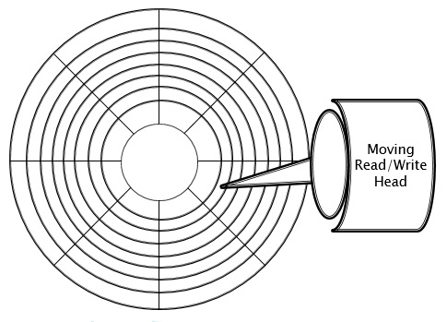
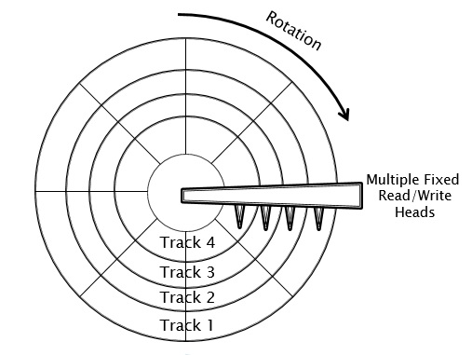
Device Management
We’ll look at two magnetic disk configurations:
Mobile-Head Magnetic Disk Storage
Fixed-Head Magnetic Disk Storage

Slide 69
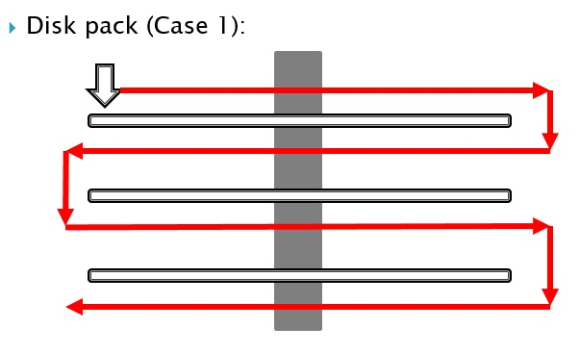
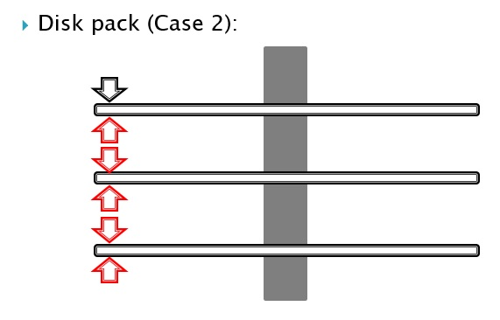
Device Management
Writing to disk:
One surface at a time (Case 1)
One track at a time (Case 2)

Slide 70
Device Management
Optical Disk Storage:
Three important performance measures are:
Data Transfer Rate - amount of data that can be read from the disk.
Average Access Time - how long (on average) it takes to move the disk head to a specific place on the disk.
Cache Size – measures re-read ability.

Slide 71
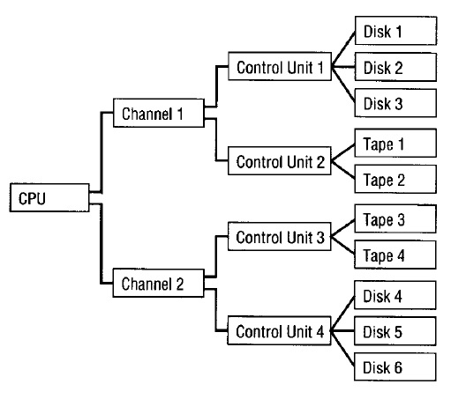
Device Management

Slide 72
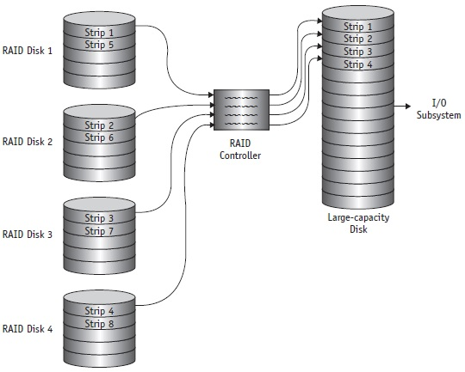
Device Management

Slide 73

Linux (Summary)
Damian Gordon

Slide 74
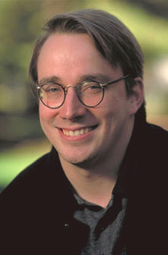
Linus Benedict Torvalds
Born: December 28, 1969 (age 45)
Born in Helsinki, Finland
Chief developer on the Linux kernel
Created the revision control system Git
2014 IEEE Computer Society Computer Pioneer Award

Slide 75
Design Goals of Linux
The three design goals of Linux are:
Modularity
Simplicity
Portability

Slide 76
Linux: Processor Management
Linux does JOB SCHEDULING and PROCESS SCHEDULING as we have discussed before.
Linux also has fork() and exec()
fork() gives the user to create a copy of an executing program.
exec() overwrites an existing program, but doesn’t change the process id (pid).
Notes:
https://en.wikipedia.org/wiki/Linux_kernel

Slide 77
Linux: Processor Management
Name | Priority Level | Process Type | Scheduling Policy
SCHED_FIFO | Highest Priority | For non-pre-emptable real-time processes. | First In, First Out (FIFO)
SCHED_RR | Medium Priority | For pre-emptable real-time processes. | Round Robin and priority
SCHED_OTHER | Lowest Priority | For normal processes. | Priority only
Notes:
https://en.wikipedia.org/wiki/Linux_kernel

Slide 78
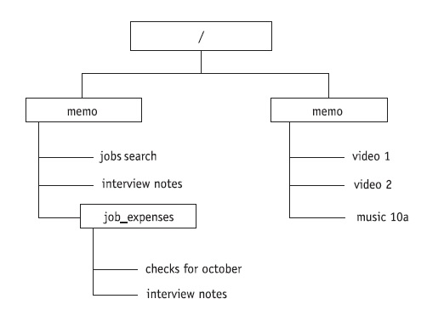
Linux: File Management
A typical Linux file structure is:
Notes:
https://en.wikipedia.org/wiki/Linux_kernel

Slide 79
Linux: Memory Management
Linux allocated 1GB for the kernel, and 3GB for executing processes.
The 3GB address space is divided into:
Process code
Process data
Shared library data used by processes
Stack used by process
Notes:
https://en.wikipedia.org/wiki/Linux_kernel

Slide 80
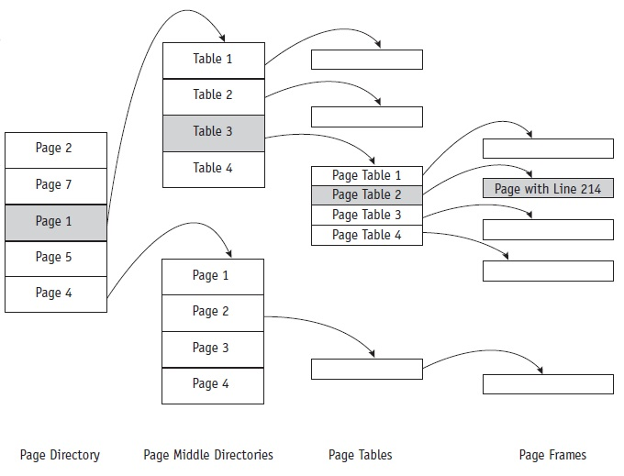
Linux: Memory Management
Each virtual address in memory is stored as four elements: Main Directory, Middle Directory, Page Table Directory, Page Frame
Notes:
https://en.wikipedia.org/wiki/Linux_kernel

Slide 81
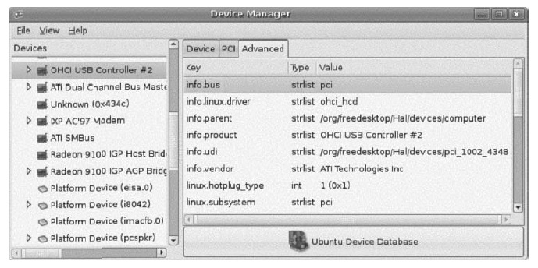
Linux: Device Management
Linux is device independent, which improves its portability from one system to another.
Device drivers supervise the transmission of data between main memory and the peripheral unit.
Notes:
https://en.wikipedia.org/wiki/Linux_kernel

Slide 82
Linux: Device Management
A device driver (or driver) is a computer program that operates or controls a particular type of device that is attached to a computer.
A driver provides a software interface to hardware devices, enabling operating systems and other computer programs to access hardware functions without needing to know precise details of the hardware being used.
Notes:
https://en.wikipedia.org/wiki/Linux_kernel

Slide 83
Thanks!

