Slide 1
Memory Management: Virtual Memory
Damian Gordon

Slide 2
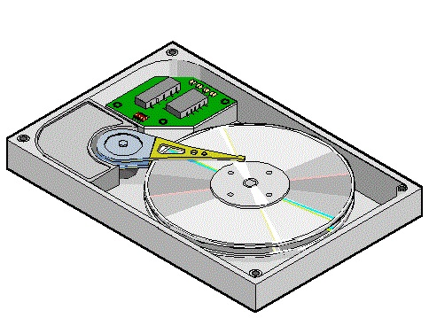
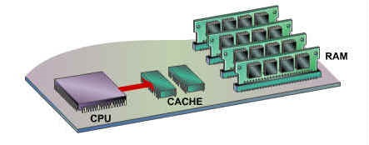
Virtual Memory
HARD DISK
(SECONDARY
MEMORY)
CACHE 1
(MAIN
MEMORY)
2

Slide 3
Virtual Memory
HARD DISK
(SECONDARY
MEMORY)
CACHE 1
(MAIN
MEMORY)
2

Slide 4
Virtual Memory
HARD DISK
(SECONDARY
MEMORY)
CACHE 1
(MAIN
MEMORY)
Computer programs are stored here
2

Slide 5
Virtual Memory
HARD DISK
(SECONDARY
MEMORY)
CACHE 1
(MAIN
MEMORY)
Computer programs are stored here
Until they need to be executed
2

Slide 6
Virtual Memory
HARD DISK
(SECONDARY
MEMORY)
CACHE 1
(MAIN
MEMORY)
Computer programs are stored here
Until they need to be executed
2
Then they are moved to here

Slide 7
Virtual Memory
In modern operating systems, before a job is loaded into main memory, it is divided into chunks, called PAGES.

Slide 8
Virtual Memory
In modern operating systems, before a job is loaded into main memory, it is divided into chunks, called PAGES.
Job 3

Slide 9
Virtual Memory
In modern operating systems, before a job is loaded into main memory, it is divided into chunks, called PAGES.
Job 3
Page 1
Page 2
Page 3
Page 4
Page 5
Page 6
Page 7

Slide 10
Virtual Memory
Each PAGE is loaded into memory locations called PAGE FRAMES.

Slide 11
Virtual Memory
Each PAGE is loaded into memory locations called PAGE FRAMES.
MAIN
MEMORY
200K
available

Slide 12
Virtual Memory
Each PAGE is loaded into memory locations called PAGE FRAMES.
MAIN
MEMORY
Page Frame 1
Page Frame 2
Page Frame 3
Page Frame 4
Page Frame 5
200K
available
Page Frame 6
Page Frame 7
Page Frame 8
Page Frame 9
Page Frame 10

Slide 13
Virtual Memory
If the PAGES are the exact same size as the PAGE FRAMES (and the same size as the disk sectors), this scheme works very well.
MAIN
MEMORY
Page Frame 1
Page Frame 2
Page Frame 3
Page Frame 4
Page Frame 5
200K
available
Page Frame 6
Page Frame 7
Page Frame 8
Page Frame 9
Page Frame 10

Slide 14
Virtual Memory
The Memory Manager prepares a program for execution by doing the following:
Determine the number of pages in the program
Locate enough empty page frames in main memory
Load all the program’s pages into them
The empty page frame does not have to be contagious.

Slide 15
Virtual Memory
Consider a program that 350 bytes, and the page size is 100 bytes.

Slide 16
Virtual Memory
Consider a program that 350 bytes, and the page size is 100 bytes.
Job 1:
350 bytes

Slide 17
Virtual Memory
Consider a program that 350 bytes, and the page size is 100 bytes.
Job 1:
350 bytes
Page 0

Slide 18
Virtual Memory
Consider a program that 350 bytes, and the page size is 100 bytes.
Job 1:
350 bytes
Page 0
Page 1

Slide 19
Virtual Memory
Consider a program that 350 bytes, and the page size is 100 bytes.
Job 1:
350 bytes
Page 0
Page 1
Page 2

Slide 20
Virtual Memory
Consider a program that 350 bytes, and the page size is 100 bytes.
Job 1:
350 bytes
Page 0
Page 1
Page 2
Page 3

Slide 21
Virtual Memory
Consider a program that 350 bytes, and the page size is 100 bytes.
Main
Memory
Job 1:
350 bytes
Page 0
Page 1
Page 2
Page 3

Slide 22
Virtual Memory
Consider a program that 350 bytes, and the page size is 100 bytes.
Main
Memory
Operating
System
Job 1:
350 bytes
Page 0
Page 1
Page 2
Page 3

Slide 23
Virtual Memory
Consider a program that 350 bytes, and the page size is 100 bytes.
Main
Memory
Operating
System
Job 1:
350 bytes
Page 0
Page 1
Page 2
Page 2
Page 3
Page 0
Page 1
Page 3

Slide 24
Virtual Memory
Consider a program that 350 bytes, and the page size is 100 bytes.
Main
Memory
Operating
System
Job 1:
350 bytes
Page 0
A little bit of internal fragmentation
Page 1
Page 2
Page 2
Page 3
Page 0
Page 1
Page 3

Slide 25
Demand Paging
A useful extension to the notion of PAGING is DEMAND PAGING.
Demand Paging introduces the notion that you don’t have to load the whole program into memory, just part of it.
Because not all of the program needs to be in memory at the same time.

Slide 26
Demand Paging
This means that lots of programs can be run at the same time, and there is an illusion of a significantly larger amount of memory than with regular paging.

Slide 27
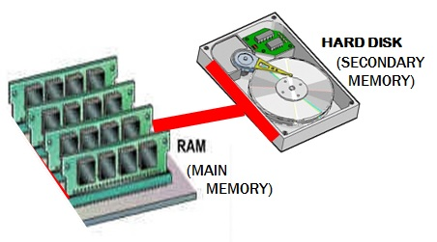
Demand Paging
To make this work, pages have to be moved very quickly from Secondary Storage to Main Memory and back again (this is called “swapping”).

Slide 28
Virtual Memory
This leads to the concept of VIRTUAL MEMORY
The size of main memory appears much larger than the actual size, since many programs can appear to be fully loaded into main memory at the same time, when in actual fact, only part of many programs are loaded into main memory.

