Slide 1
Computer Security
Damian Gordon

Slide 2
Operating
System
Memory
Manager
File
Manager
Process
Manager
Device
Manager
Network
Manager

Slide 3
Operating
System
Memory
Manager
File
Manager
Process
Manager
Device
Manager
Network
Manager
Security
Manager

Slide 4
Operating System Security
The operating system uses a number of different ways to protect the system:
Your credentials (e.g. username and password)
Your authorisation (e.g. drwxr-x-r--)
Your location (e.g. inside/outside the LAN)
Your behaviour (e.g. deleting lots of files)
The firewall

Slide 5
Intentional Attacks

Slide 6
Intentional Attacks
Denial-of-Service (DoS) Attack
Wiretapping
Viruses
Worms
Trojans

Slide 7
Denial-of-Service (DoS) Attack

Slide 8
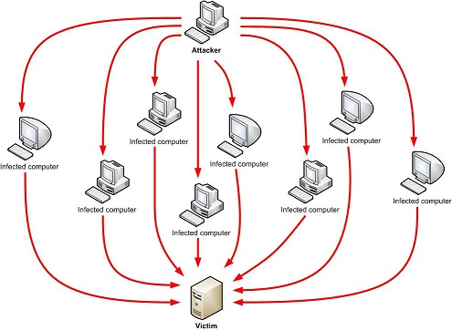
Denial-of-Service (DoS) Attack
Makes the “victim” computer unavailable to its users. Typically used on computers that act as Web Servers.

Slide 9
Denial-of-Service (DoS) Attack
Works by making the “victim” computer perform a task over and over again, thus preventing it from doing other jobs.
For example, if the computer is supposed to take orders from customers, and the first step is for the “victim” computer to identify itself to the customer computer, a DoS attack might keep making the “victim” computer identify itself and therefore unable to do other work.

Slide 10
Denial-of-Service (DoS) Attack
A Distributed Denial-of-Service (DDoS) is where the attack source is more than one, often thousands of, unique IP addresses.
It is like to a group of people crowding the entry door to a shop, and not letting legitimate customers enter into the shop or business, disrupting normal operations.

Slide 11
Denial-of-Service (DoS) Attack
How does it work?
There are a variety of approaches that can work, we’ll look at a HTTP POST DoS attack.

Slide 12
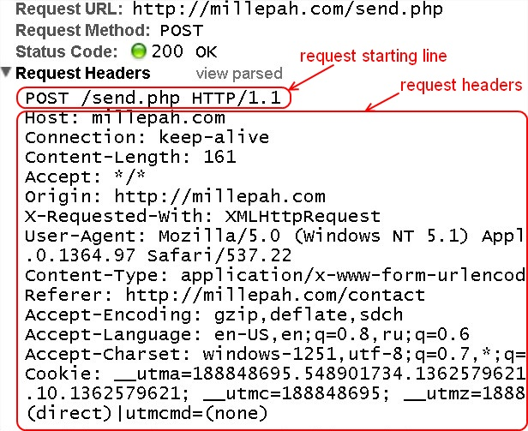

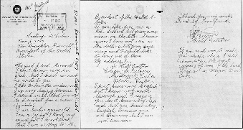
Denial-of-Service (DoS) Attack
HTTP
POST
Attack
How does it work?
There are a variety of approaches that can work, we’ll look at a HTTP POST DoS attack.
<HTTP Message>
HEAD
BODY

Slide 13
Denial-of-Service (DoS) Attack
HTTP
POST
Attack
A legitimate HTTP POST header, which includes a 'Content-Length' field to specify the size of the message body to follow. However, the attacker then proceeds to send the actual message body at an extremely slow rate (e.g. 1 byte/110 seconds).

Slide 14
Denial-of-Service (DoS) Attack
HTTP
POST
Attack
Due to the entire message being complete, the target server will attempt to obey the 'Content-Length' field in the header, and wait for the entire body of the message to be transmitted, which can take a very long time.

Slide 15
Denial-of-Service (DoS) Attack
HTTP
POST
Attack
The attacker establishes hundreds or even thousands of such connections, until all resources for incoming connections on the server (the victim) are used up, hence making any further (including legitimate) connections impossible until all data has been sent.

Slide 16
DoS Attack Case Study
Bollywood versus Anonymous

Slide 17

DoS Attack Case Study
Bollywood versus Anonymous
Bollywood is the nickname for the Hindi language film industry, based in Mumbai, the capital of Maharashtra in India. Bollywood is also one of the largest centres of film production in the world, and is more formally referred to as Hindi cinema.

Slide 18
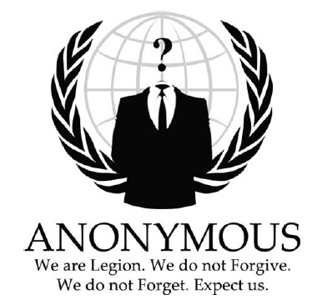
DoS Attack Case Study
Bollywood versus Anonymous
Anonymous are a loosely associated international network of activist and hacktivist groups. The group became known for a series of well-publicized publicity stunts and Denial-of-Service (DoS) attacks on government, religious, and corporate websites.

Slide 19
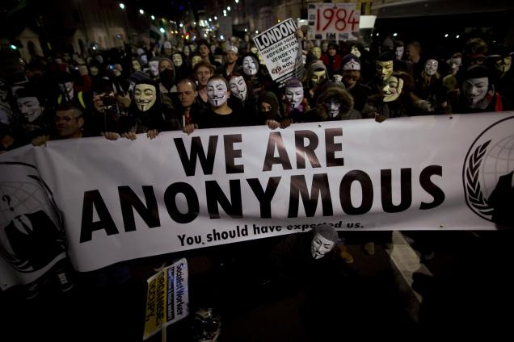
DoS Attack Case Study
Bollywood versus Anonymous
Anonymous are a loosely associated international network of activist and hacktivist groups. The group became known for a series of well-publicized publicity stunts and Denial-of-Service (DoS) attacks on government, religious, and corporate websites.

Slide 20
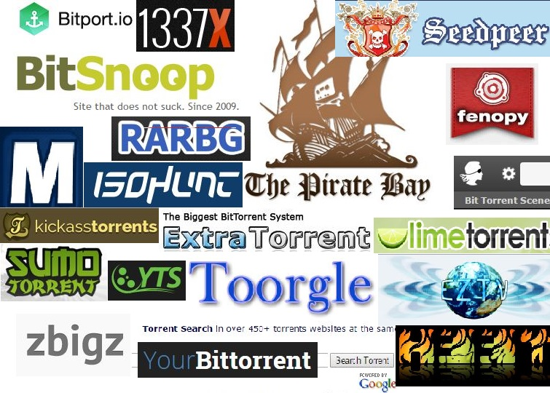
DoS Attack Case Study
Bollywood versus Anonymous
Bollywood was unhappy with the torrent sites:

Slide 21

DoS Attack Case Study
Bollywood versus Anonymous
In 2010, several Bollywood companies hired Aiplex Software to launch DDoS attacks on websites that did not respond to takedown notices.

Slide 22
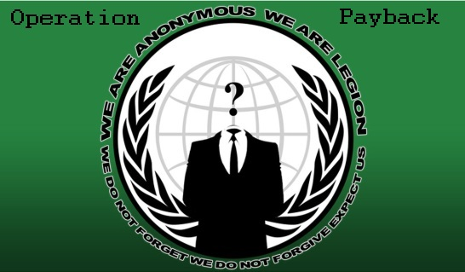
DoS Attack Case Study
Bollywood versus Anonymous
Piracy activists then created Operation Payback in September 2010 in retaliation

Slide 23
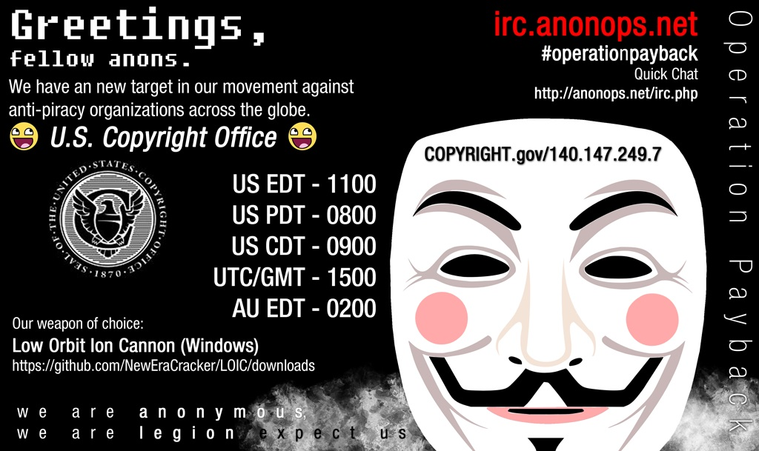

Slide 24
DoS Attack Case Study
Bollywood versus Anonymous
The original plan was to attack Aiplex Software directly, but upon finding some hours before the planned DDoS that another individual had taken down the firm's website on their own, Operation Payback moved to launching attacks against the websites of copyright stringent organisations Motion Picture Association of America (MPAA) and International Federation of the Phonographic Industry, giving the two websites a combined total downtime of 30 hours.

Slide 25
DoS Attack Case Study
Bollywood versus Anonymous
In the following two days, Operation Payback attacked a multitude of sites affiliated with the MPAA, the Recording Industry Association of America (RIAA), and British Phonographic Industry. Law firms such as ACS:Law, Davenport Lyons and Dunlap, Grubb & Weaver (of the US Copyright Group) were also attacked.

Slide 26
Wiretapping

Slide 27
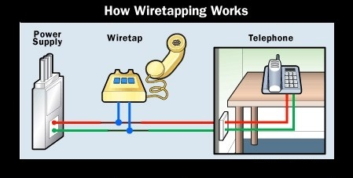
Wiretapping
Wiretapping has been around since the 1890s, it’s simply a matter of gaining access to the transmission media and using a device to intercept the signals.

Slide 28
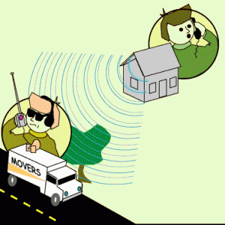
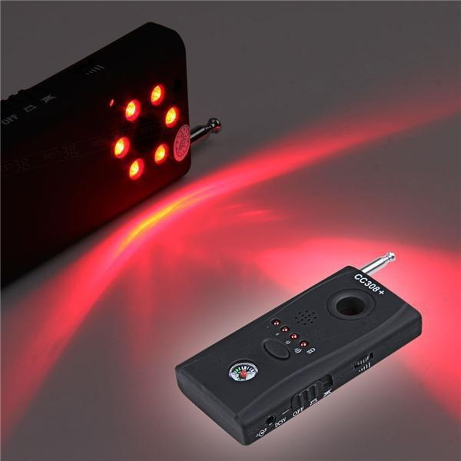
Wiretapping
Wireless wiretapping works in the exact same way, except that there is no need to have physical contact with the transmission media.
This is why we should encrypt wireless transmissions.

Slide 29
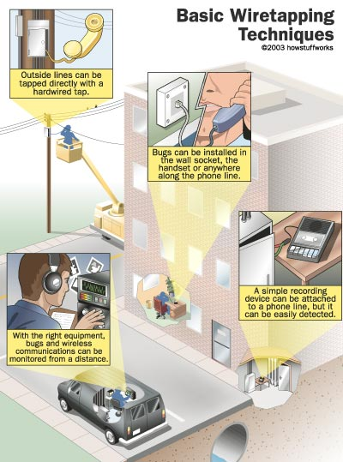
Wiretapping

Slide 30
Wiretapping
There are two forms of wiretapping:
Passive Wiretapping is where you are recording the data transmitted, but not interfering with it.
Active Wiretapping is where you are recording the data and also modifying it before it is sent onto the receiver.

Slide 31
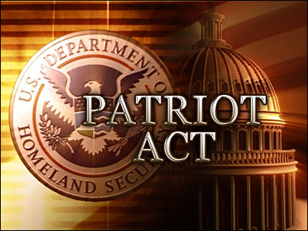
Wiretapping Case Study
USA Patriot Act
The USA PATRIOT Act
Title II: Enhanced Surveillance Procedures

Slide 32
Wiretapping Case Study
USA Patriot Act
The USA PATRIOT Act
Title II: Enhanced Surveillance Procedures
Section 209 made it easier for authorities to gain access to voicemail as they no longer must apply for a wiretap order, and instead just apply for a normal search warrant.
The FBI can secretly conduct a physical search or wiretap on U.S. citizens to obtain evidence of crime without proving probable cause, as the Fourth Amendment explicitly requires.

Slide 33
Wiretapping Case Study
What it doesn’t cover
USA Patriot Act
The USA PATRIOT Act
On February 9, 2016, the FBI asked Apple Inc. to create a new version of the phone's iOS operating system that could be installed and run in the phone's random access memory to disable certain security features that Apple refers to as "GovtOS“, the FBI had recovered an Apple iPhone 5C owned by the San Bernardino County, California government, that had been issued to its employee, Syed Rizwan Farook, one of the shooters involved in the December 2015 San Bernardino attack. The attack killed 14 people and seriously injured 22.

Slide 34
Wiretapping Case Study
What it doesn’t cover
USA Patriot Act
The USA PATRIOT Act
Apple declined due to its policy to never undermine the security features of its products. The FBI responded by successfully applying to a United States magistrate judge, Sherri Pym, to issue a court order, mandating Apple to create and provide the requested software. The order was not a subpoena, but rather was issued under the All Writs Act of 1789.

Slide 35
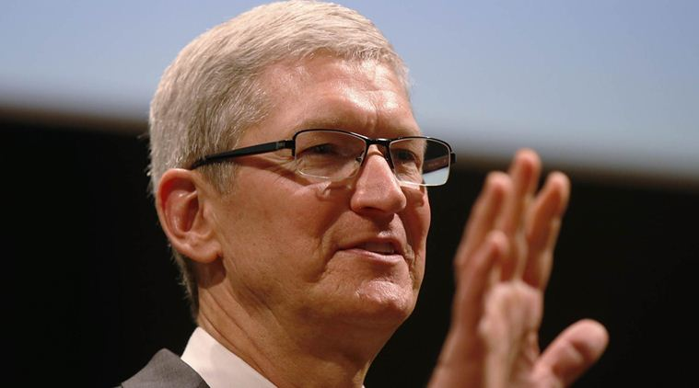
Wiretapping Case Study
What it doesn’t cover
USA Patriot Act
The USA PATRIOT Act
On February 16, 2016, Apple chief executive officer Tim Cook released an online statement to Apple customers, explaining the company's motives for opposing the court order. He also stated that while they respect the FBI, the request they made threatens data security by establishing a precedent that the U.S. government could use to force any technology company to create software that could undermine the security of its products.

Slide 36
Wiretapping Case Study
What it doesn’t cover
USA Patriot Act
The USA PATRIOT Act
On March 28, 2016, the FBI said it had unlocked the iPhone with the third party's help, and an anonymous official said that the hack's applications were limited; the Department of Justice vacated the case.

Slide 37
Wiretapping Case Study
What it doesn’t cover
USA Patriot Act
For more detail:
In September 2015, Apple released a white paper detailing the security measures in its iOS 9 operating system.
The iPhone 5C model can be protected by a four-digit PIN code. After more than ten incorrect attempts to unlock the phone with the wrong PIN, the contents of the phone will erase the AES encryption key that protects its stored data.
https://www.apple.com/business/docs/iOS_Security_Guide.pdf

Slide 38
Viruses

Slide 39
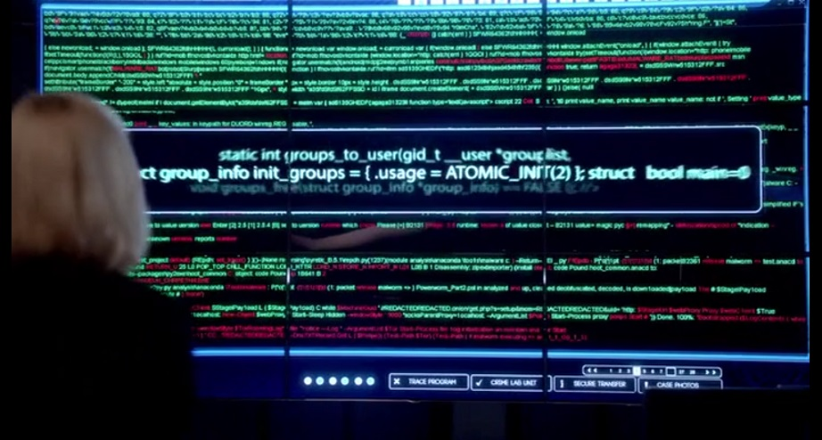
Viruses
A Computer Virus is a program that alters the way a computer works without permission of the user. It is typically self-executing and self-replicating.

Slide 40
Viruses
A Virus is typically written for a specific operating system, so a virus that works on Windows usually won’t work on Linux.
Virus writers exploit vulnerabilities in a specific operating systems.

Slide 41
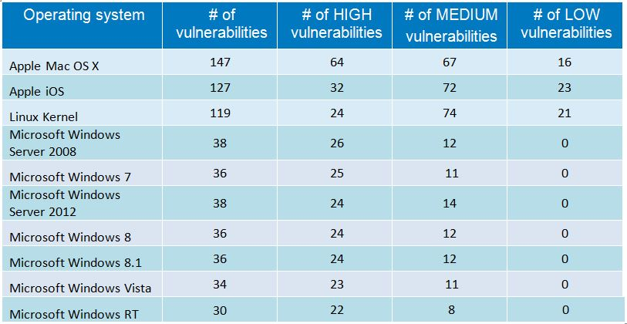
Viruses
Most vulnerable operating systems and applications in 2014

Slide 42
Types of Viruses
Boot Sector Virus
File Infector Virus
Macro Virus
Multipartite Virus
Polymorphic Virus

Slide 43
Types of Viruses
Boot Sector Virus: Infects the boot sector. There are two types of boot sector viruses:
Master Boot Record (MBR): A MBR can contain code that locates and invokes its volume record.
Volume Boot Record (VBR): A VBR can contain code that loads and invokes the operating system.

Slide 44
Types of Viruses
File Infector Virus: Perhaps the most common type of virus, the file infector takes root in a host file. This type of virus may end up deleting the file that was originally infected, or it may rewrite it or replace it with something else.
Usually infects .COM and .EXE files.

Slide 45
Types of Viruses
Macro Virus: This is a virus that can be hidden in data files, like Word documents and Spreadsheets.
Disable macros on files that you don’t trust.

Slide 46
Types of Viruses
Multipartite Virus: A virus of this type may spread in multiple ways, and it may take different actions on an infected computer depending on variables, such as the operating system installed or the existence of certain files.
Can infect boot sector and files.

Slide 47
Types of Viruses
Polymorphic Virus: A polymorphic Virus can mutate over time or after every contaminated file and changes the code that is used to deliver the payload.

Slide 48
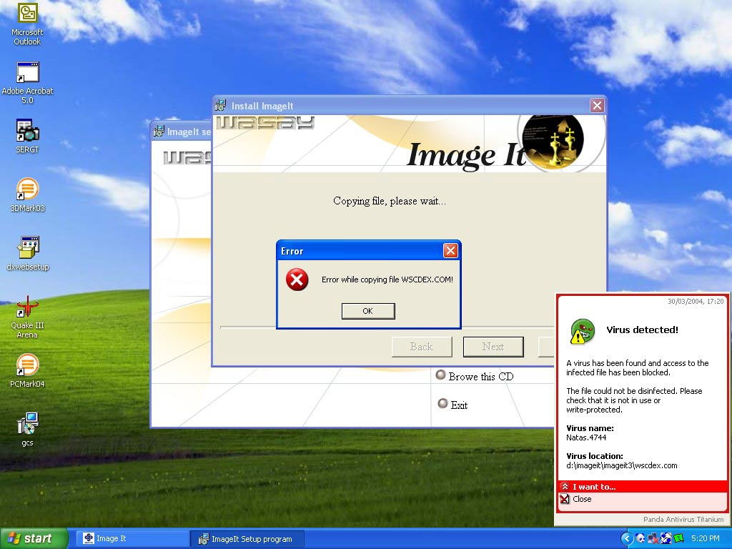
Virus Case Study
Natas Virus
The Natas Virus

Slide 49
Virus Case Study
Natas Virus
The Natas Virus
Natas is a memory-resident stealth virus which is highly polymorphic, that affects master boot records, boot sectors of diskettes, files .COM and also .exe programs.

Slide 50
Virus Case Study
Natas Virus
The Natas Virus
Natas (Satan spelled backwards) is a computer virus written by James Gentile, a then 18-year-old hacker from San Diego, California who went by the alias of "Little Loc" and later "Priest".
The virus was made for a Mexican politician who wanted to win the Mexican elections by affecting all the Mexican Federal Electoral Institute (IFE) computers with a floppy disk.

Slide 51
Virus Case Study
Natas Virus
The Natas Virus
The virus first appeared in Mexico City in May 1992, spread by a consultant using infected floppy disks. The virus became widespread in Mexico and the southwest United States.
The virus also made its way to the other side of the USA, infecting computers at the United States Secret Service knocking their network offline for approximately three days.

Slide 52
Virus Case Study
Natas Virus
The Natas Virus
When a file infected with Natas is executed, it becomes memory resident, taking up 5,664 bytes in memory and infects the master boot record and COMMAND.COM. The virus infects files when they are executed, opened or copied, appending its 4,746 bytes to .COM, .EXE and .OVL files.

Slide 53
Worms

Slide 54
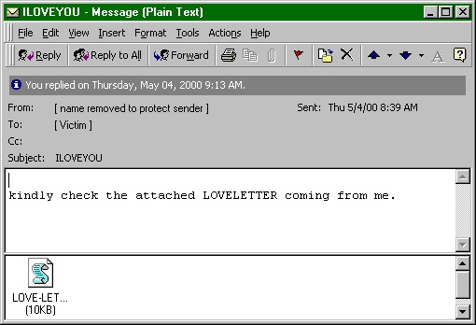
Worms
A computer worm is program that replicates itself in order to spread to other computers (often using a computer network). Unlike a computer virus, it does not need to attach itself to an existing program

Slide 55
Worms
Worms usually slow down processor time, and take up memory space, they also typically take up network bandwidth.
Some worms that have been created are designed only to spread, and do not attempt to change the systems they pass through. However, as the Morris worm and Mydoom showed, even these worms can cause major disruption by increasing network traffic.

Slide 56
Helpful Worms
Since the start of computer networks there have been attempts to create useful worms, for example, the Nachi family of worms tried to download and install patches from Microsoft's website to fix vulnerabilities in the host system—by exploiting those same vulnerabilities.

Slide 57
Helpful Worms
In practice, although this may have made these systems more secure, it generated considerable network traffic, rebooted the machine in the course of patching it, and did its work without the consent of the computer's owner.
Several worms, like XSS worms, have been written to research how worms spread. For example, the effects of changes in social activity or user behaviour.

Slide 58
Worm Case Study
“I love you” worm
The ILOVEYOU Worm

Slide 59
Worm Case Study
“I love you” worm
The ILOVEYOU Worm
ILOVEYOU, sometimes referred to as Love Letter, was a computer worm that attacked tens of millions of Windows personal computers on and after May 4th, 2000.
it started spreading as an email message with the subject line "ILOVEYOU" and the attachment "LOVE-LETTER-FOR-YOU.txt.vbs“

Slide 60
Worm Case Study
“I love you” worm
The ILOVEYOU Worm
The worm did damage on the local machine, overwriting random types of files (including Office files, image files, and audio files; however after overwriting MP3 files the virus would hide the file), and sent a copy of itself to all addresses in the Windows Address Book used by Microsoft Outlook.

Slide 61
Worm Case Study
“I love you” worm
The ILOVEYOU Worm
The worm originated in the Philippines, thereafter across the world, moving first to Hong Kong, then to Europe, and finally the United States, as employees began their workday that Friday morning. The outbreak was later estimated to have caused US $5.5-8.7 billion in damages worldwide, and estimated to cost the US $15 billion to remove the worm.

Slide 62
Trojans

Slide 63
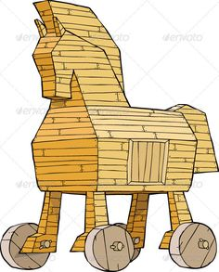
Trojans
A Trojan is a malicious program that misrepresents itself to appear useful, routine, or interesting in order to persuade a victim to install it.

Slide 64
Trojans
Trojans are generally spread by some form of social engineering, for example where a user is duped into executing an e-mail attachment disguised to be unsuspicious, (e.g., a routine form to be filled in), or by downloading.
Unlike computer viruses and worms, Trojans generally do not attempt to inject themselves into other files or otherwise propagate themselves.

Slide 65
Trojans
Types of things Trojans do:
Destructive Behaviour
Use of Resources, or Identity
Money, Theft, or Ransom
Data Theft
Spying, Surveillance, or Stalking

Slide 66
Trojans
Destructive Behaviour
Crashing the computer or device.
Modification or deletion of files.
Data corruption.
Formatting disks, destroying all contents.
Spread malware across the network.
Spy on user activities and access sensitive information.

Slide 67
Trojans
Use of Resources, or Identity
Use of the machine as part of a botnet (e.g. to perform automated spamming)
Using computer resources for mining cryptocurrencies
Using the infected computer as proxy for illegal activities and/or attacks on other computers.
Infecting other connected devices on the network.

Slide 68
Trojans
Money, Theft, or Ransom
Electronic money theft
Installing ransomware such as CryptoLocker

Slide 69
Trojans
Data Theft
Data theft, including for industrial espionage
User passwords or payment card information
User personally identifiable information
Trade secrets

Slide 70
Trojans
Spying, Surveillance, or Stalking
Keystroke logging
Watching the user's screen
Viewing the user's webcam
Controlling the computer system remotely

Slide 71
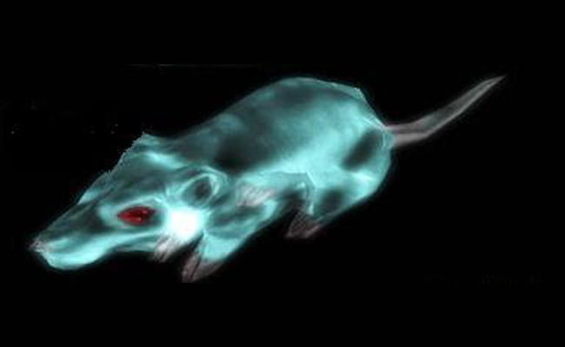
Trojan Case Study
Gh0st RAT
Trojan
The Gh0st RAT Trojan

Slide 72
Trojan Case Study
Gh0st RAT
Trojan
The Gh0st RAT Trojan
Gh0st RAT is a Trojan horse for the Windows platform that was used to hack into some of the most sensitive computer networks on Earth. It is a cyber spying computer program. The "Rat" part of the name refers to the software's ability to operate as a "Remote Administration Tool".

Slide 73
Trojan Case Study
Gh0st RAT
Trojan
The Gh0st RAT Trojan
It can:
Take full control of the remote screen.
Provide real time as well as offline keystroke logging.
Provide live feed of webcam, and microphone.
Download remote binaries on the infected remote host.
Take control of remote shutdown and reboot of host.
Disable infected computer remote keyboard input.
Enter into shell of remote infected host with full control.
Provide a list of all the active processes.

Slide 74
Trojan Case Study
Gh0st RAT
Trojan
The Gh0st RAT Trojan
Gh0st Rat was originally made by the C.Rufus Security Team in 2005. Just as with other well-featured “off-the-shelf” trojans like Poison Ivy, Hupigon and DarkComet it has been used by all sorts of people – from script kiddies to resourceful targeted attack actors.

Slide 75
Trojan Case Study
Gh0st RAT
Trojan
The Gh0st RAT Trojan
In less than two years (2007-2009) Gh0st Rat infiltrated at least 1,295 computers in 103 countries, including many belonging to embassies, foreign ministries and other government offices, as well as the Dalai Lama’s Tibetan exile centres in India, Brussels, London and New York.

Slide 76
Unintentional Attacks

Slide 77
Unintentional Attacks
An unintentional attack is any breach of security that was not as a result of a planned intrusion.
For example, if two processes are updating the same record and it results in an incomplete modification of the record, that is an unintentional attack.

Slide 78
Unintentional Attacks
The Year 2000 problem (aka the Millennium bug, or the Y2K bug) was caused by programmers who reduced the four-digit year to two digits.
This made the year 2000 indistinguishable from 1900.

Slide 79
Unintentional Attacks
Unintentional Denial-of-Service
When Michael Jackson died in 2009, websites such as Google and Twitter slowed down or even crashed. Many sites' servers thought the requests were from a virus or spyware trying to cause a denial-of-service attack, warning users that their queries looked like "automated requests from a computer virus or spyware application".

Slide 80
System Protection

Slide 81
System Protection
System protection is multifaceted, four protection methods include:
Antivirus Software
Firewalls
Patch Management
Authentication

Slide 82
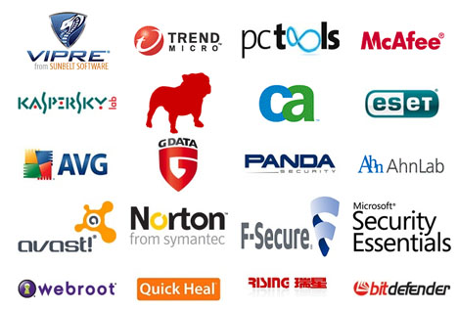
Antivirus Software
Antivirus Software is used to protect systems from attack by malicious software.

Slide 83
Antivirus Software
The software can be preventative, diagnostic, or a combination of both.
As new viruses are identified security vendors and government agencies provide information and updates about them.

Slide 84
Antivirus Software
Antivirus software is usually capable of repairing files infected by a virus, but it generally cannot repair the damage done by worms, Trojans, and blended approaches.
This is since viruses usually add code to an existing file, whereas worms, Trojans, and blended approaches usually fully replace files.

Slide 85
Antivirus Software
Examples of Antivirus software include:
Bitdefender Antivirus Plus
Kaspersky Anti-Virus
Webroot SecureAnywhere AntiVirus
Emsisoft Anti-Malware
F-Secure Anti-Virus 2015
Malwarebytes Anti-Exploit
McAfee AntiVirus Plus
Panda Antivirus Pro
Trend Micro Antivirus+ Security
VoodooSoft VoodooShield

Slide 86
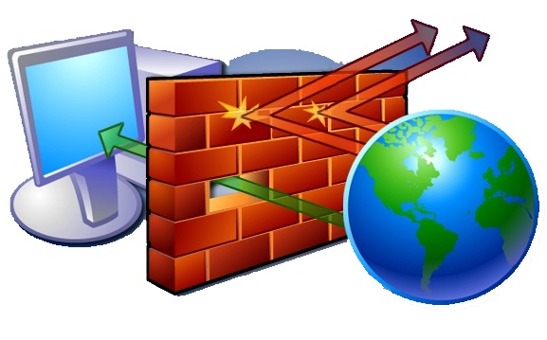
Firewalls
A firewall is a network security system that monitors and controls the incoming and outgoing network traffic based on predetermined security rules.

Slide 87
Firewalls
Network firewalls can be software programs running on general purpose hardware, or hardware-based firewall computer appliances, that filter traffic between two or more networks.
Firewall appliances may also offer other functionality to the internal network they protect such as acting as a DHCP or VPN server for that network.

Slide 88
Firewalls
Network firewalls can be software programs running on general purpose hardware, or hardware-based firewall computer appliances, that filter traffic between two or more networks.
Firewall appliances may also offer other functionality to the internal network they protect such as acting as a DHCP or VPN server for that network.

Slide 89
Firewalls
Firewalls typically:
Log activities that access the internet
Maintain access control based on the senders’ and receivers’ IP addresses
Maintain access control based on the services being requested
Hide the internal network from unauthorized users
Verify that virus protection is installed and running
Perform authentication based on the source of a request from the Internet

Slide 90
Firewalls
Firewalls use a combination of packet filtering and proxy servers.
Packet Filtering means that the firewall reviews all of the header information of each packet coming into the computer and going out to make sure there is noting suspicious present.
Proxy Servers sit in between the local computer and network, and intercept all requests to the local computer from the network, and verify them before passing them onto the local computer.

Slide 91
Firewalls
Examples of Firewalls include:
Bullguard
ZoneAlarm
McAfee
Norton
AVG Anti-virus
Bitdefender
Avira
Kaspersky Lab

Slide 92
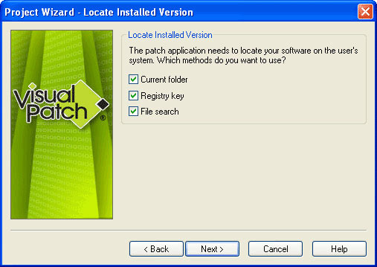
Patch Management
A patch is a piece of software that can be applied to an operating system (or any other software) to correct an issue with that software.

Slide 93
Patch Management
Most operating systems will have several patches after their initial release and usually update the version of the program when successfully installed.
Software patches can be found through the software developer's website, or are automatically downloaded after each system restart.

Slide 94
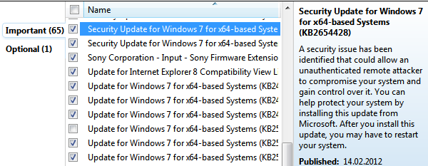
Patch Management
A security patch is a change applied to an operating system to correct a discovered vulnerability.
This corrective action will prevent successful exploitation and remove or mitigate a threat’s capability to exploit a specific vulnerability in that operating system.

Slide 95
Patch Management
Security patches are the primary method of fixing security vulnerabilities in operating systems.
Currently Microsoft releases its security patches once a month, and other operating systems and software projects have security teams dedicated to releasing the most reliable software patches as soon after a vulnerability announcement as possible.

Slide 96
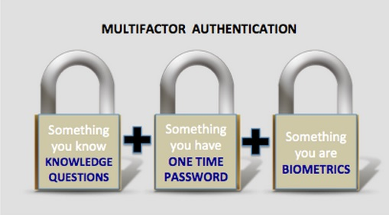
Authentication
Authentication is verification that an individual trying to access the system is authorised to do so.

Slide 97
Authentication
Let’s consider passwords, they should be:
Easy to remember
Hard to guess
Changed often
Never written down
Never part of an automated login
Passwords are stored on the system in an encrypted format, so when you type in your password, it is encrypted using the same algorithm, and the two encryptions are compared to verify.

Slide 98
Authentication
Top 25 US Passwords in 2016
1. 123456 (Unchanged)
2. password (Unchanged)
3. 12345678 (Up 1)
4. qwerty (Up 1)
5. 12345 (Down 2)
6. 123456789 (Unchanged)
7. football (Up 3)
8. 1234 (Down 1)

Slide 99
Authentication
Top 25 US Passwords in 2016
9. 1234567 (Up 2)
10. baseball (Down 2)
11. welcome (New)
12. 1234567890 (New)
13. abc123 (Up 1)
14. 111111 (Up 1)
15. 1qaz2wsx (New)
16. dragon (Down 7)

Slide 100
Authentication
Top 25 US Passwords in 2016
17. master (Up 2)
18. monkey (Down 6)
19. letmein (Down 6)
20. login (New)
21. princess (New)
22. qwertyuiop (New)
23. solo (New)
24. passw0rd (New)
25. starwars (New)

Slide 101
Authentication
The longer the password, the better.
A password of eight (8) letters, just using lowercase letters has 26⁸ (208,827,064,576) possible combinations.
A password of ten (10) letters, just using lowercase letters has 26¹⁰ (141,167,100,000,000) possible combinations.
A password of eight (8) letters, using all letters and numbers has 95⁸ (6,634,204,300,000,000) possible combinations.
A password of ten (10) letters, using all letters and numbers has 95¹⁰ (59,873,694,000,000,000,000) possible combinations.

Slide 102
Authentication
Where are the passwords stored?
On Windows:
c:\windows\system32\config\SAM
On Linux
/etc/shadow
On Unix and (some) Apple
/etc/passwd

Slide 103
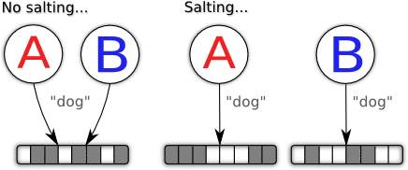
Authentication
Salting
Some operating systems (not Windows) make the passwords even harder to guess by adding in a few extra random bits into the encrypted password. So even if two people have the same password, they will be stored differently.

Slide 104
Authentication
Alternatives to passwords:
CAPTCHAs
reCAPTCHAs
Smart Cards
Biometrics

Slide 105

Authentication
CAPTCHAs
CAPTCHA ("Completely Automated Public Turing test to tell Computers and Humans Apart") is a type of challenge-response test.
The term was coined in 2003 by Luis von Ahn, Manuel Blum, Nicholas J. Hopper, and John Langford.
This form of CAPTCHA requires that the user type the letters of a distorted image, sometimes with the addition of an obscured sequence of letters or digits that appears on the screen

Slide 106

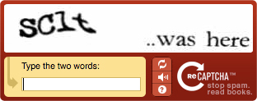
Authentication
reCAPTCHAs
The reCAPTCHA service supplies subscribing websites with images of words that are hard to read for optical character recognition (OCR) software.
The text is obscured with horizontal lines and warped.

Slide 107
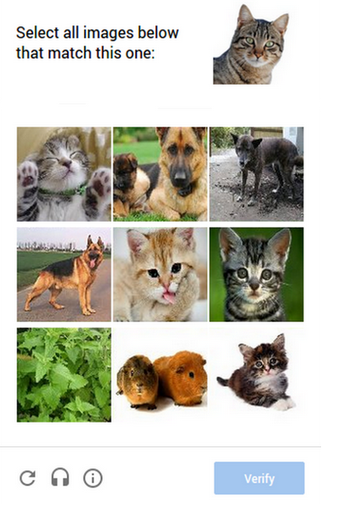
Authentication
Image reCAPTCHAs
In 2014, reCAPTCHA implemented another system in which users are asked to select one or more images from a selection of nine images.

Slide 108
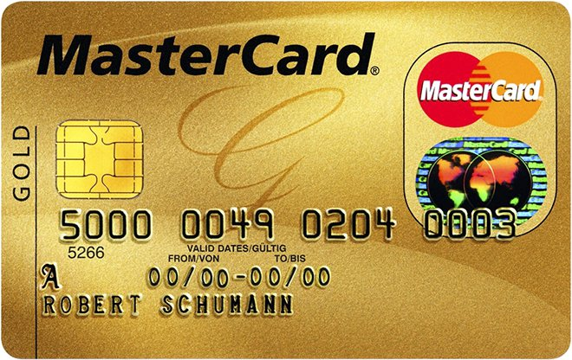
Authentication
Smart Cards
A smart card, chip card, or integrated circuit card (ICC) is any pocket-sized card that has embedded integrated circuits.
Smart cards can be either contact or contactless smart card. Smart cards can provide personal identification, authentication, data storage, and application processing.
Smart cards may provide strong security authentication for single sign-on (SSO) within large organizations.

Slide 109
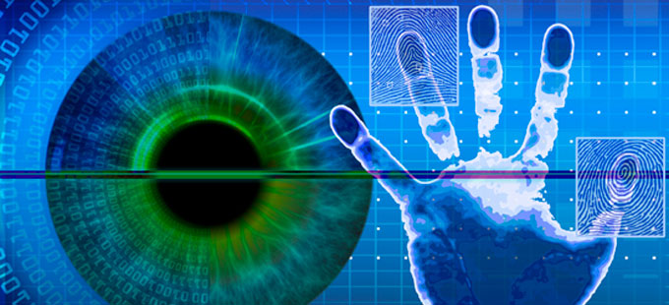
Authentication
Biometrics
Biometrics authentication (or realistic authentication) is used as a form of identification and access control.
Examples include, but are not limited to fingerprint, palm veins, face recognition, DNA, palm print, hand geometry, iris recognition, retina and odour/scent.
Behavioral characteristics are related to the pattern of behavior of a person, including but not limited to typing rhythm, gait, and voice.

Slide 110
Computer Security (Summary)
Damian Gordon

Slide 111
Operating
System
Memory
Manager
File
Manager
Process
Manager
Device
Manager
Network
Manager
Security
Manager

Slide 112
Operating System Security
The operating system uses a number of different ways to protect the system:
Your credentials (e.g. username and password)
Your authorisation (e.g. drwxr-x-r--)
Your location (e.g. inside/outside the LAN)
Your behaviour (e.g. deleting lots of files)
The firewall

Slide 113
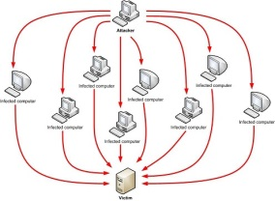

Operating Systems Attacks
Intentional Attacks
Denial-of-Service (DoS) Attack
Wiretapping
Viruses
Worms
Trojans
Unintentional Attacks
Parallel writes
Unintentional Denial-of-Service (DoS)

Slide 114

System Protection
System protection is multifaceted, four protection methods include:
Antivirus Software
Firewalls
Patch Management
Authentication
CAPTCHAs
reCAPTCHAs
Smart Cards
Biometrics

