Slide 1
Data Structures
Damian Gordon

Slide 2
Data Structures
What is a queue?

Slide 3

Data Structures
What is a queue?

Slide 4
Data Structures
What is a queue?
5
31
47
81
71
10

Slide 5
Data Structures
What is a queue?
5
31
47
81
71
10

Slide 6
Data Structures
What is a queue?
It’s a structure that conforms to the principle of First In, First Out (FIFO).
The first item to join the queue is the first item to be served.

Slide 7
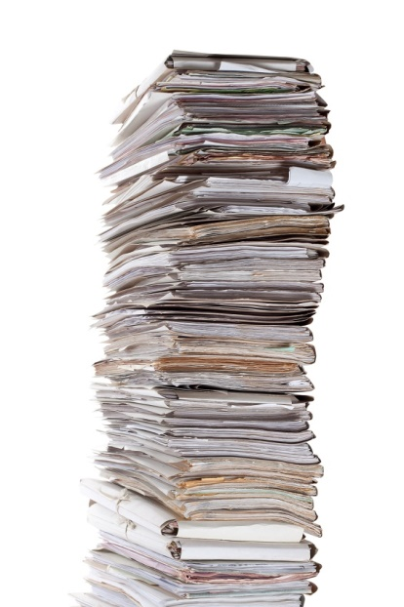
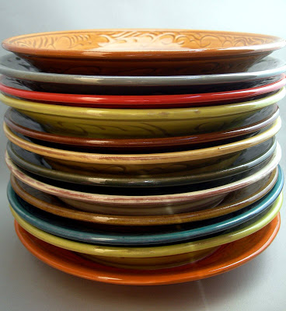
Data Structures
What is a stack?

Slide 8
Data Structures
What is a stack?
5
31
47
81
71
10

Slide 9
Data Structures
What is a stack?
5
31
47
81
71
10

Slide 10
Data Structures
What is a stack?
It’s a structure that conforms to the principle of Last In, First Out (LIFO).
The last item to join the stack is the first item to be served.

Slide 11
Data Structures
What is a heap?

Slide 12
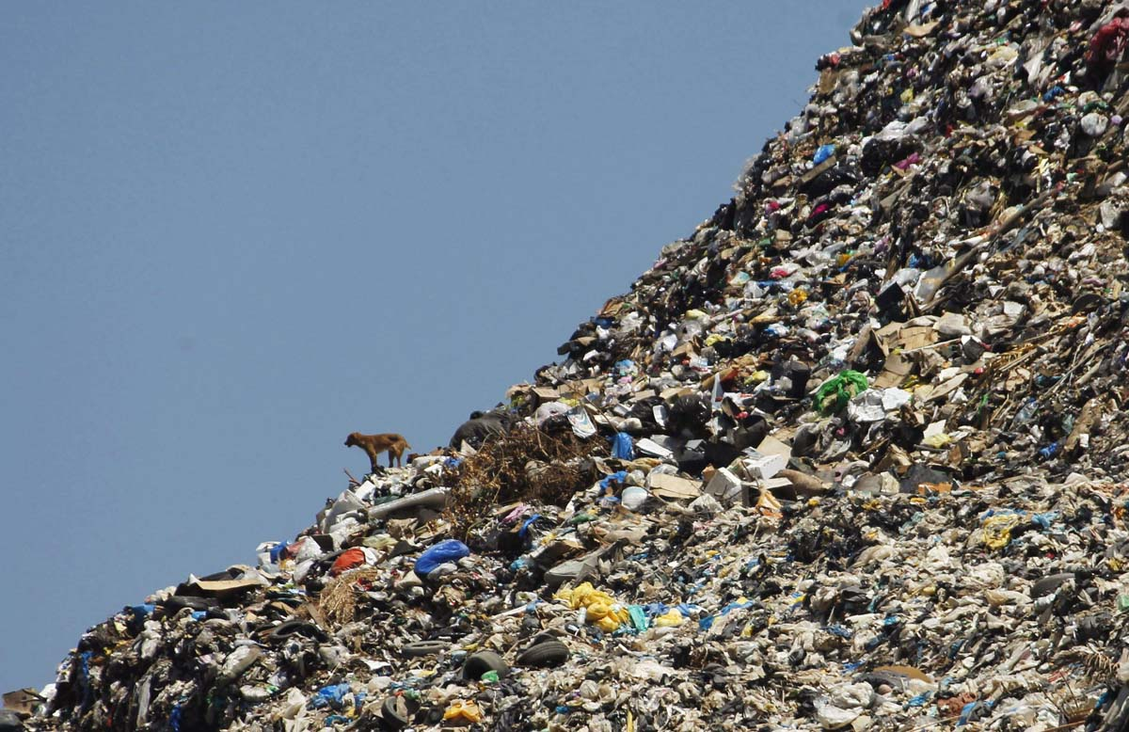
Data Structures
What is a heap?

Slide 13
Data Structures
What is a heap?
81
47
71
31
5
10
1

Slide 14
Data Structures
What is a heap?
81
47
71
31
5
10
1

Slide 15
Data Structures
What is a heap?
A heap is a tree-like structure generally each node has two children nodes, where the lower values are stored near the bottom of the tree and higher values towards the top of the tree.

Slide 16
Data Structures
What is a heap?
MORE FORMALLY:
The heap property:
If A is a parent node of B then the key of node A is ordered with respect to the key of node B with the same ordering applying across the heap

Slide 17
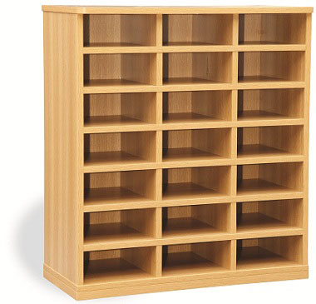
Data Structures
What is a queue?
0
1
2
3
4
5
6
7
8
10
11
9
13
14
12
16
17
15
19
20
18

Slide 18
Data Structures
What is a queue?
0
1
2
3
4
5
6
7
8
10
11
9
13
14
12
16
17
15
19
20
18

Slide 19
Data Structures
What is a stack?
0
1
2
3
4
5
6
7
8
10
11
9
13
14
12
16
17
15
19
20
18

Slide 20
Data Structures
What is a stack?
0
1
2
3
4
5
6
7
8
10
11
9
13
14
12
16
17
15
19
20
18

Slide 21
Data Structures
What is a heap?
0
1
2
3
4
5
6
7
8
10
11
9
13
14
12
16
17
15
19
20
18

Slide 22
Data Structures
What is a heap?
0
1
2
Based on value not location
3
4
5
6
7
8
10
11
9
13
14
12
16
17
15
19
20
18

