Slide 1
Processor Scheduling
Damian Gordon

Slide 2
Process Scheduling Policies

Slide 3
Process Scheduling Policies
What are good policies to schedule processes?

Slide 4
Process Scheduling Policies
What are good policies to schedule processes?
Maximum Throughput
Minimize Response Time
Minimize Turnaround Time
Minimize Waiting Time
Maximise CPU Efficiency
Ensure Fairness For All Jobs

Slide 5
Process Scheduling Policies
MAXIMUM THROUGHPUT
Get as many jobs done as quickly as possible.
There are several ways to achieve this, e.g. run only short jobs, run jobs without interruptions.

Slide 6
Process Scheduling Policies
MINIMIZE RESPONSE TIME
Ensure that interactive requests are dealt with as quickly as possible.
This could be achieved by scheduling just with a lot of I/O jobs first, and leave the computational jobs for later.

Slide 7
Process Scheduling Policies
MINIMIZE TURNAROUND TIME
Ensure that jobs are completed as quickly as possible.
This could be achieved by scheduling just with a lot of computation jobs first, and leave the I/O jobs for later, so there is no user delays.

Slide 8
Process Scheduling Policies
MINIMIZE WAITING TIME
Move jobs out of the READY status as soon as possible.
This could be achieved by reduce the number of users allowed on the system, so that the CPU would be available whenever a job enters the READY status.

Slide 9
Process Scheduling Policies
MAXIMISE CPU EFFICIENCY
Keep the CPU busy 100% of the time.
This could be achieved by scheduling just with a lot of computation jobs, and never run the I/O jobs.

Slide 10
Process Scheduling Policies
ENSURE FAIRNESS FOR ALL JOBS
Give everyone an equal amount of CPU time and I/O time.
This could be achieved by giving all jobs equal priority, regardless of it’s characteristics.

Slide 11
Process Scheduling Algorithms

Slide 12
Process Scheduling Algorithms
Here are six commonly used process scheduling algorithms

Slide 13
Process Scheduling Algorithms
Here are six commonly used process scheduling algorithms
First Come, First Served (FCFS)
Shortest Job Next (SJN)
Priority Scheduling
Shortest Remaining Time (SRT)
Round Robin
Multi-Level Queues

Slide 14
Process Scheduling Algorithms
First Come, First Served (FCFS)
A very simple algorithm that uses a FIFO structure.
Implemented as a non-pre-emptive scheduling algorithm.
Works well for Batch Processes, where users don’t expect any interaction.

Slide 15
Process Scheduling Algorithms
Shortest Job Next (SJN)
Also called Shortest Job First (SJF).
A very simple algorithm that schedules processes based on CPU cycle time.
Implemented as a non-pre-emptive scheduling algorithm.
Works well for Batch Processes, where it is easy to estimate CPU time.

Slide 16
Process Scheduling Algorithms
Priority Scheduling
An algorithm that schedules processes based on priority.
Implemented as a non-pre-emptive scheduling algorithm.
One of the most common algorithms used in systems that are mainly Batch Processes.
If two jobs come in of equal priority are READY, if works on a FIRST COME, FIRST SERVED basis.

Slide 17
Process Scheduling Algorithms
Shortest Remaining Time (SRT)
A pre-emptive scheduling version of the Shortest Job Next (SJN) algorithm.
An algorithm that schedules processes based on the one which is nearest to completion.
It can only be implemented on systems that are only Batch Processes, since you have to know the CPU time required to complete each job.

Slide 18
Process Scheduling Algorithms
Round Robin
A pre-emptive scheduling algorithm that is used extensively in interactive systems
All active processes are given a pre-determined slice of time (“time quantum”).
Choosing the time quantum is the key decision, for interactive systems the quantum must be small, whereas for batch systems it can be longer.

Slide 19
Process Scheduling Algorithms
Multi-Level Queues
This isn’t really a separate scheduling algorithm, it can be used with others.
Jobs are grouped together based on common characteristics.
For example, CPU-bound jobs based in one queue, and the I/O-bound jobs in another queue, and the process scheduler can select jobs from each queue based on balancing the load.

Slide 20
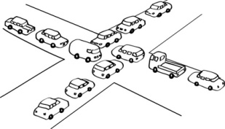
Deadlock

Slide 21
Deadlock
Deadlock can be said to occur when a process is allocated some non-sharable resources (such as files, printers or scanners), but is forced to wait for other non-sharable resources.

Slide 22
Deadlock
PROGRAM ProcA:
BEGIN
Do Stuff;
Open (File1);
Do more stuff;
Open (File2);
Do stuff;
END.

Slide 23
Deadlock
PROGRAM ProcA:
BEGIN
Do Stuff;
Open (File1);
Do more stuff;
Open (File2);
Do stuff;
END.

Slide 24
Deadlock
PROGRAM ProcA:
BEGIN
Do Stuff;
Open (File1);
Do more stuff;
Open (File2);
Do stuff;
END.

Slide 25
Deadlock
PROGRAM ProcA:
BEGIN
Do Stuff;
Open (File1);
Do more stuff;
Open (File2);
Do stuff;
END.
Is it free?

Slide 26
Deadlock
PROGRAM ProcA:
BEGIN
Do Stuff;
Open (File1);
Do more stuff;
Open (File2);
Do stuff;
END.
Is it free?
YES

Slide 27
Deadlock
PROGRAM ProcA:
BEGIN
Do Stuff;
Open (File1);
Do more stuff;
Open (File2);
Do stuff;
END.
Is it free?
Continue

Slide 28
Deadlock
PROGRAM ProcA:
BEGIN
Do Stuff;
Open (File1);
Do more stuff;
Open (File2);
Do stuff;
END.

Slide 29
Deadlock
PROGRAM ProcA:
BEGIN
Do Stuff;
Open (File1);
Do more stuff;
Open (File2);
Do stuff;
END.
Is it free?

Slide 30
Deadlock
PROGRAM ProcA:
BEGIN
Do Stuff;
Open (File1);
Do more stuff;
Open (File2);
Do stuff;
END.
Is it free?
NO

Slide 31
Deadlock
PROGRAM ProcA:
BEGIN
Do Stuff;
Open (File1);
Do more stuff;
Open (File2);
Do stuff;
END.
Is it free?
WAIT

Slide 32
Deadlock
PROGRAM ProcA:
BEGIN
Do Stuff;
Open (File1);
Do more stuff;
Open (File2);
Do stuff;
END.
Is it free?
WAIT

Slide 33
Deadlock
PROGRAM ProcA:
BEGIN
Do Stuff;
Open (File1);
Do more stuff;
Open (File2);
Do stuff;
END.

Slide 34
Deadlock
PROGRAM ProcA:
BEGIN
Do Stuff;
Open (File1);
Do more stuff;
Open (File2);
Do stuff;
END.
PROGRAM ProcB:
BEGIN
Do Stuff;
Open (File2);
Do more stuff;
Open (File1);
Do stuff;
END.

Slide 35
Deadlock
PROGRAM ProcA:
BEGIN
Do Stuff;
Open (File1);
Do more stuff;
Open (File2);
Do stuff;
END.
PROGRAM ProcB:
BEGIN
Do Stuff;
Open (File2);
Do more stuff;
Open (File1);
Do stuff;
END.

Slide 36

Deadlock
PROGRAM ProcA:
BEGIN
Do Stuff;
Open (File1);
Do more stuff;
Open (File2);
Do stuff;
END.
PROGRAM ProcB:
BEGIN
Do Stuff;
Open (File2);
Do more stuff;
Open (File1);
Do stuff;
END.

Slide 37
Deadlock
PROGRAM ProcA:
BEGIN
Do Stuff;
Open (File1);
Do more stuff;
Open (File2);
Do stuff;
END.
PROGRAM ProcB:
BEGIN
Do Stuff;
Open (File2);
Do more stuff;
Open (File1);
Do stuff;
END.

Slide 38
Deadlock
PROGRAM ProcA:
BEGIN
Do Stuff;
Open (File1);
Do more stuff;
Open (File2);
Do stuff;
END.
PROGRAM ProcB:
BEGIN
Do Stuff;
Open (File2);
Do more stuff;
Open (File1);
Do stuff;
END.

Slide 39
Deadlock
PROGRAM ProcA:
BEGIN
Do Stuff;
Open (File1);
Do more stuff;
Open (File2);
Do stuff;
END.
PROGRAM ProcB:
BEGIN
Do Stuff;
Open (File2);
Do more stuff;
Open (File1);
Do stuff;
END.

Slide 40
Deadlock
Process A

Slide 41
Deadlock
File 1
Process A
File 2

Slide 42
Deadlock
File 1
Process A
File 2

Slide 43

Deadlock
File 1
Process A
File 2

Slide 44
Deadlock
File 1
Process A
File 2

Slide 45
Deadlock
File 1
Process A
File 2

Slide 46
Deadlock
Process B

Slide 47
Deadlock
File 1
Process B
File 2

Slide 48
Deadlock
File 1
Process B
File 2

Slide 49
Deadlock
File 1
Process B
File 2

Slide 50
Deadlock
File 1
Process B
File 2

Slide 51
Deadlock
File 1
Process B
File 2

Slide 52
Deadlock
File 1
Process A
Process B
File 2

Slide 53
Seven Types of Deadlock
Deadlock on file requests
Deadlock in databases
Deadlock in dedicated device allocation
Deadlock in multiple device allocation
Deadlock in spooling
Deadlock in a network
Deadlock in disk sharing

Slide 54
Deadlock on File Requests
We just saw it:

Slide 55
Deadlock on File Requests
We just saw it:
File 1
Process A
Process B
File 2

Slide 56
Deadlock on File Requests
Only occurs because a process is allowed to lock a resource for the duration of its execution.

Slide 57
Deadlock in Databases
Similar
Record 1
Transaction
A
Transaction
B
Record 2

Slide 58
Deadlock in Databases
Begin transaction TA:
read balance1 [ 100 ]
balance1 = balance1 - 100
if balance < 0
print “insufficient funds”
abort T1
end
write balance1 [ 0 ]
read balance2 [ 100 ]

Slide 59
Deadlock in Databases
Begin transaction TA:
read balance1 [ 100 ]
balance1 = balance1 - 100
if balance < 0
print “insufficient funds”
abort T1
end
write balance1 [ 0 ]
read balance2 [ 100 ]
Begin transaction TB:
read balance2 [ 100 ]
balance2 = balance2 - 100
if balance < 0
print “insufficient funds”
abort T2
end
write balance2 [ 0 ]
read balance1 [ 100 ]

Slide 60
Deadlock in Databases
Begin transaction TA:
read balance1 [ 100 ]
balance1 = balance1 - 100
if balance < 0
print “insufficient funds”
abort T1
end
write balance1 [ 0 ]
read balance2 [ 100 ]
Begin transaction TB:
read balance2 [ 100 ]
balance2 = balance2 - 100
if balance < 0
print “insufficient funds”
abort T2
end
write balance2 [ 0 ]
read balance1 [ 100 ]

Slide 61
Deadlock in Databases
Begin transaction TA:
read balance1 [ 100 ]
balance1 = balance1 - 100
if balance < 0
print “insufficient funds”
abort T1
end
write balance1 [ 0 ]
read balance2 [ 100 ]
Begin transaction TB:
read balance2 [ 100 ]
balance2 = balance2 - 100
if balance < 0
print “insufficient funds”
abort T2
end
write balance2 [ 0 ]
read balance1 [ 100 ]

Slide 62
Deadlock in Dedicated Device Allocation
For example DVD Read/Write drives

Slide 63
Deadlock in Dedicated Device Allocation
DVD-R
1
Process
A
Process
B
DVD-R
2

Slide 64
Deadlock in Multiple Device Allocation
More than over device, e.g. DVD-R, printer, scanner.

Slide 65
Deadlock in Multiple Device Allocation
DVD-R
1
Process
A
Process
B
Scanner 1

Slide 66
Deadlock in Multiple Device Allocation
DVD-R
1
Process
A
Process
B
Printer
1
Process
C
Scanner 1

Slide 67
Deadlock in Spooling
What is Spooling?

Slide 68
Deadlock in Spooling
What is Spooling?
SPOOL is an acronym for Simultaneous Peripheral Operations On-Line.

Slide 69
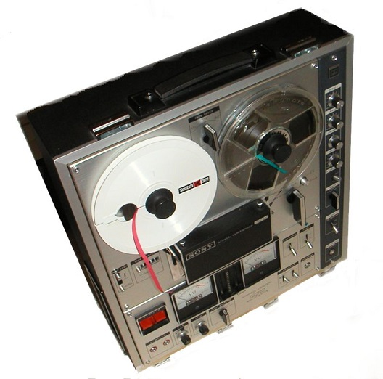
Deadlock in Spooling
What is Spooling?
SPOOL is an acronym for Simultaneous Peripheral Operations On-Line.

Slide 70
Deadlock in Spooling
What is Spooling?
SPOOL is an acronym for Simultaneous Peripheral Operations On-Line.
A simple example of a spooling application is print spooling, which places a print job a queue for extended or later processing.

Slide 71
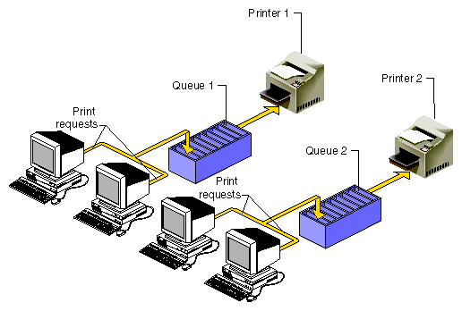
Deadlock in Spooling
What is Spooling?
Spool 1
Spool 2

Slide 72
Deadlock in Spooling
If all 108 of you guys had a 10-page assignment you had to hand up by 11am and you all printed your files at the same time at 10:55am, the spool might first accept page 1 from everyone, then page 2, and so on.,, but if it gets to page 9 and then the spooler is full, things get stuck. The printer might not want to print any jobs unless it has a full 10 pages from any one job, so we are deadlocked.

Slide 73
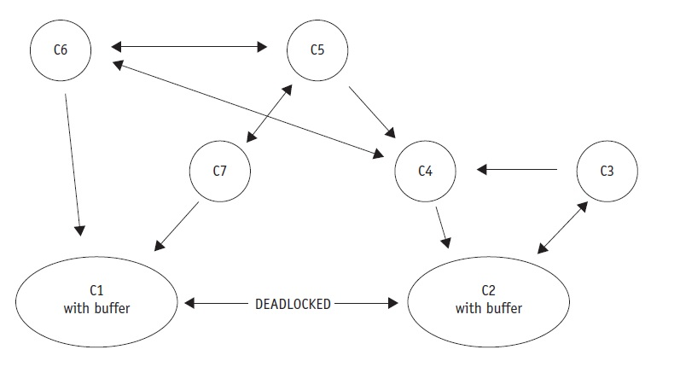
Deadlock in a Network

Slide 74
Deadlock in a Network
For example, a medium-sized word-processing centre has seven computers on a network, each on different nodes. C1 receives messages from nodes C2, C6, and C7 and sends messages to only one: C2. C2 receives messages from nodes C1, C3, and C4 and sends messages to only C1 and C3. The direction of the arrows in the diagram indicates the flow of messages.

Slide 75
Deadlock in a Network
Messages received by C1 from C6 and C7 and destined for C2 are buffered in an output queue. Messages received by C2 from C3 and C4 and destined for C1 are buffered in an output queue. As the traffic increases, the length of each output queue increases until all of the available buffer space is filled. At this point C1 can’t accept any more messages (from C2 or any other computer) because there’s no more buffer space available to store them.

Slide 76
Deadlock in a Network
For the same reason, C2 can’t accept any messages from C1 or any other computer, not even a request to send. The communication path between C1 and C2 becomes deadlocked; and because C1 can’t send messages to any other computer except C2 and can only receive messages from C6 and C7, those routes also become deadlocked. C1 can’t send word to C2 about the problem and so the deadlock can’t be resolved without outside intervention.

Slide 77
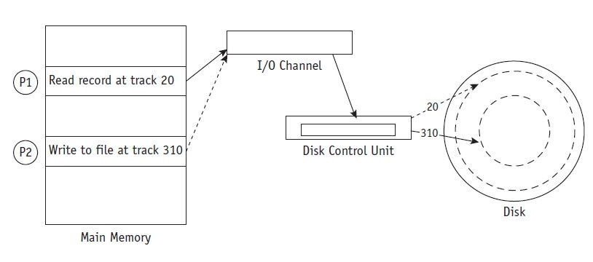
Deadlock in Disk Sharing

Slide 78
Deadlock in Disk Sharing
For example, at an insurance company the system performs many daily transactions. One day the following series of events ties up the system:

Slide 79
Deadlock in Disk Sharing
1. Customer Service (P1) wishes to show a payment so it issues a command to read the balance, which is stored on track 20 of a disk.

Slide 80
Deadlock in Disk Sharing
2. While the control unit is moving the arm to track 20, P1 is put on hold and the I/O channel is free to process the next I/O request.

Slide 81
Deadlock in Disk Sharing
3. While the arm is moving into position, Accounts Payable (P2) gains control of the I/O channel and issues a command to write someone else’s payment to a record stored on track 310. If the command is not “locked out,” P2 will be put on hold while the control unit moves the arm to track 310.

Slide 82
Deadlock in Disk Sharing
4. Because P2 is “on hold” while the arm is moving, the channel can be captured again by P1, which reconfirms its command to “read from track 20.”

Slide 83
Deadlock in Disk Sharing
5. Because the last command from P2 had forced the arm mechanism to track 310, the disk control unit begins to reposition the arm to track 20 to satisfy P1. The I/O channel would be released because P1 is once again put on hold, so it could be captured by P2, which issues a WRITE command only to discover that the arm mechanism needs to be repositioned.

Slide 84
Deadlock in Disk Sharing
This is LIVELOCK.

Slide 85
Modelling Deadlock

Slide 86
File 1
File 2
File 3
Process A
Process B
Process c

Slide 87

File 1
File 2
File 3
Process A
Process B
Process c

Slide 88
File 1
File 2
File 3
Process A
Process B
Process c

Slide 89
File 1
File 2
File 3
Process A
Process B
Process c

Slide 90
Starvation: The Dining Philosopher’s Problem

Slide 91
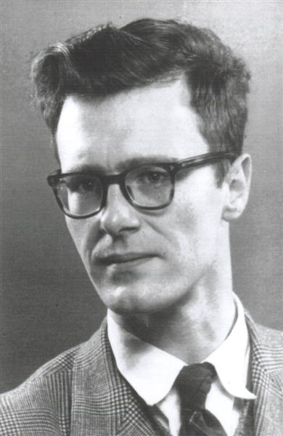
Edsger W. Dijkstra
Born May 11, 1930
Died August 6, 2002
Born in Rotterdam, Netherlands
A Dutch computer scientist, who received the 1972 Turing Award for fundamental contributions to developing programming languages.

Slide 92
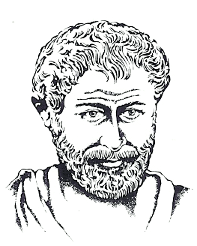
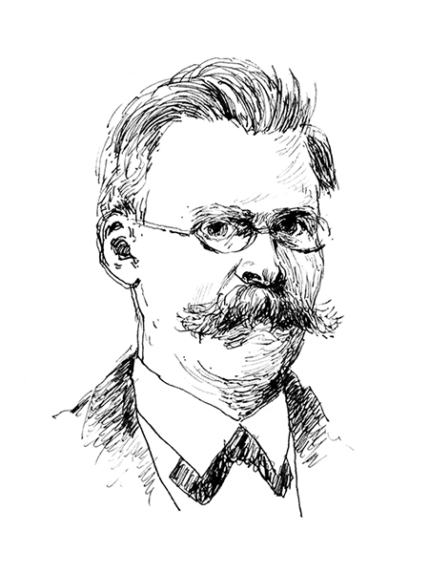

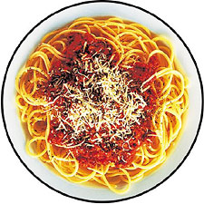

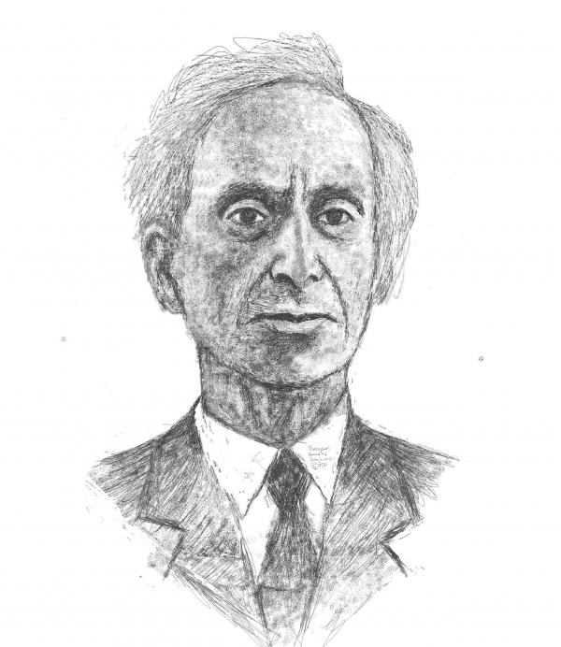


Slide 99
Semaphores

Slide 100
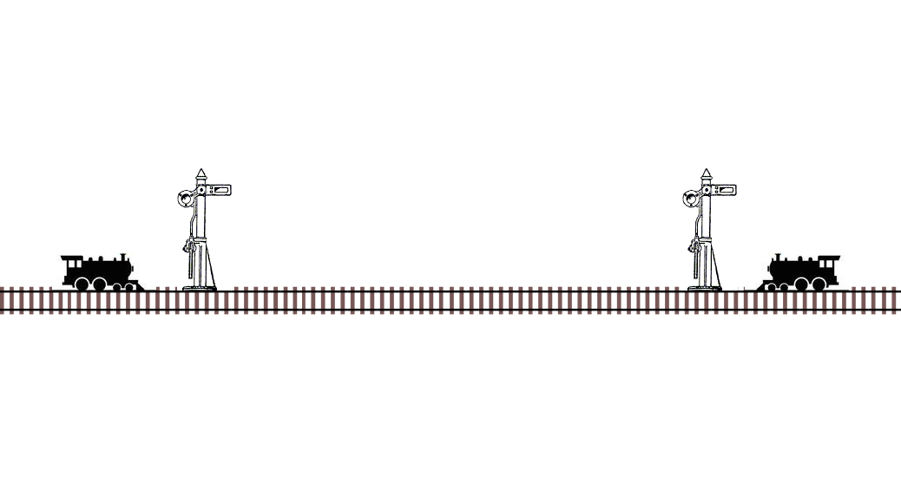

Slide 107


