Slide 1
File Management
Damian Gordon

Slide 2
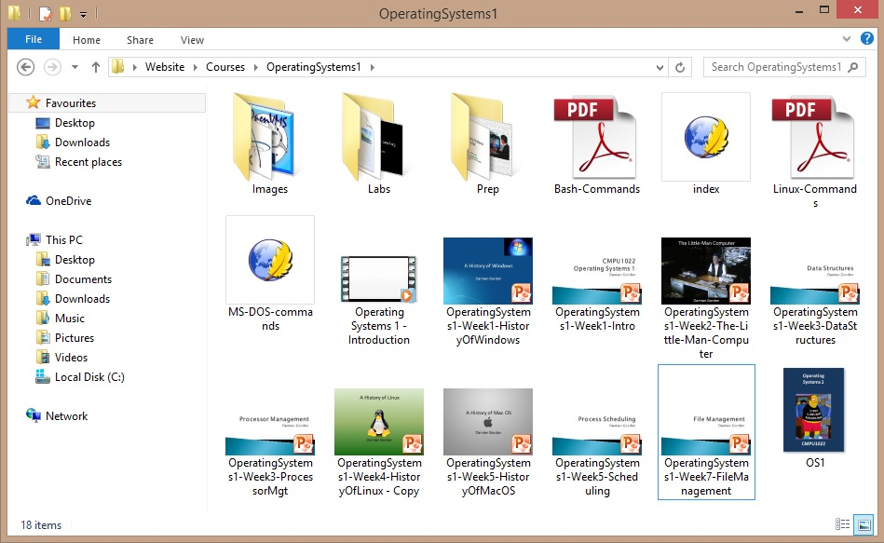
File Management

Slide 3

Damian’s
Believe It or Not!
BELIEVE IT OR NOT…
From the computer’s point of view, there is no such thing as a file.
It is only because the operating system is creating the illusion of a file that they exist
From the computer’s point of view, there is only blocks of memory, either allocated or unallocated.

Slide 4
File Management
The File Manager (or File Management System) is the manager in the Operating System that creates the illusion that there are files and folders being stored in computer memory.
Operating System
Files and Folders
Hardware
Memory Locations

Slide 5
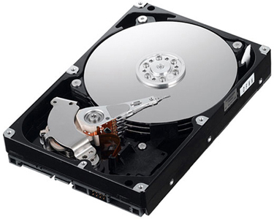
Hard Disk

Slide 6
Hard Disk
v
v
v

Slide 7
Hard Disk
Track
v
v
v

Slide 8
Hard Disk
Track
v
v
v
Sector

Slide 9
Hard Disk
Track
Block
v
v
v
Sector

Slide 10
v
v
v

Slide 13
Unallocated Memory
(Available Memory)

Slide 15
Allocated Memory
(Used Memory)

Slide 16
File Management
The File Manager
Keeps track of where files are stored
Determines how the files are stored
Follows operating system file allocation policies
Uses available storage space efficiently for files
Creates a record/log of all file usage
Allocates a file to a user if is free, and if they are permitted access to it.
De-allocates file when user finished with it.

Slide 17
File Management
The file manager ALLOCATES a file by reading it from the hard disk and loading it into memory while updating its record of who is using what file.
The file manager DEALLOCATES a file by updating the file tables and rewriting the file (if changed) to the hard disk. Any processes waiting to access the file will be notified.

Slide 18
File Management
Some definitions:
A FIELD is a collection of bytes that can be identified by a user, and has a type and size.
A RECORD is a collection of related FIELDS.
A FILE is a collection of records.
A DIRECTORY (or FOLDER) is a special type of file that which has lists of files and their attributes.

Slide 19
File Management
Typical things you can do with a file are:
CREATE
OPEN
DELETE
RENAME
COPY
etc.

Slide 20
File Management
The name of a file is usually in two parts:

Slide 21
File Management
The name of a file is usually in two parts:
MakeABackup.bat

Slide 22
File Management
The name of a file is usually in two parts:
MakeABackup.bat
Filename

Slide 23
File Management
The name of a file is usually in two parts:
MakeABackup.bat
Filename
extension

Slide 24
File Management
.avi | Microsoft Video for Windows movie
.dbf | dbase II, III, IV data file
.doc(x) | Microsoft Word for Windows
.gif | Graphics Interchange Format
.htm | Hypertext Markup Language (common web page file)
.html | Hypertext Markup Language (common web page file)
.jpg | JPEG graphic file
.mpg | MPEG Video file
.mid | MIDI music file
.mov | QuickTime movie

Slide 25
File Management
.pdf | Adobe Portable Document Format file
.ppt(x) | PowerPoint file
.psd | Photoshop file
.qxd | QuarkXPress file
.rm | Real Audio/Video streaming file
.rtf | Rich Text Format
.tif | TIFF graphic file
.txt | ASCII text file
.wav | Sound file
.xls(x) | Excel spreadsheet

Slide 26
File Management
The full filename includes path information:
C:\WINDOWS\system32\MakeABackup.bat
Filename
extension

Slide 27
File Management
The full filename includes path information:
C:\WINDOWS\system32\MakeABackup.bat
path
Filename
extension

Slide 28
File Management
The full filename includes path information:
C:\WINDOWS\system32\MakeABackup.bat
path
Filename
extension
Absolute filename

Slide 29
File Management
If I am in the following folder:
C:\WINDOWS\system32\BackupFolder\
Then the address of the file is:
..\MakeABackup.bat

Slide 30
File Management
If I am in the following folder:
C:\WINDOWS\system32\BackupFolder\
Then the address of the file is:
..\MakeABackup.bat
Relative filename

Slide 31
Physical Storage Allocation
The Operating System store files as records in memory, where many records make up a single file.
There are three main ways a file is physically stored in memory:
Contiguous Storage
Non-contiguous Storage
Indexed Storage

Slide 32
v
v
v

Slide 33
Contiguous Storage
Contiguous Storage means that records of a file are stored one after another.
It is a very simple policy to implement, and once you have found the start of the file, it’s very easy to find the rest of it.

Slide 34
Contiguous Storage

Slide 35
Contiguous Storage
New file:
a | b | c | d | e | f | g | h

Slide 36
Contiguous Storage
a | b | c | d | e | f | g | h
Does it fit here?

Slide 37
Contiguous Storage
a | b | c | d | e | f | g | h
Does it fit here?
NO

Slide 38
Contiguous Storage
a | b | c | d | e | f | g | h

Slide 39
Contiguous Storage
a | b | c | d | e | f | g | h

Slide 40
Contiguous Storage
a | b | c | d | e | f | g | h
Does it fit here?

Slide 41
Contiguous Storage
a | b | c | d | e | f | g | h
Does it fit here?
NO

Slide 42
Contiguous Storage
a | b | c | d | e | f | g | h

Slide 43
Contiguous Storage
a | b | c | d | e | f | g | h
Does it fit here?

Slide 44
Contiguous Storage
a | b | c | d | e | f | g | h
Does it fit here?
YES

Slide 45
Contiguous Storage
a | b | c | d | e | f | g | h
Does it fit here?
YES

Slide 46
Contiguous Storage
a | b | c | d | e | f | g | h
Does it fit here?
YES

Slide 47
Contiguous Storage
The problem with is that if you have expand the file, you either need to have free space allocated at the end, or copy the whole file to a different location on the disk that has enough space.

Slide 48
Non-contiguous Storage
Non-contiguous Storage means that records of a file are stored where ever there is free space.
The file manager will try to put as much of it together as possible, but there will be other part spread out over the disk.
These extra bits are sometimes called extents and these are linked together with pointers.
This means there is no easy way to determine the exact location of a record in a file.

Slide 49
Non-contiguous Storage
New file:
a | b | c | d | e | f | g | h

Slide 50
Non-contiguous Storage
a | b | c | d | e | f | g | h
Does it fit here?

Slide 51
Non-contiguous Storage
a | b | c | d | e | f | g | h
Does it fit here?
Who cares, this is
where it is going

Slide 52
Non-contiguous Storage
a | b | c | d | e | f | g | h

Slide 53
Non-contiguous Storage
a | b | c | d | e | f | g | h

Slide 54
Non-contiguous Storage
a | b | c | d
e | f | g | h

Slide 55
Non-contiguous Storage
a | b | c | d
e | f | g | h
extent

Slide 56
Non-contiguous Storage
a | b | c | d
e | f | g | h
extent

Slide 57
Non-contiguous Storage
a | b | c | d
e | f | g | h
extent

Slide 58
Indexed Storage
Indexed Storage means that as well as the records in the file, an index block is created, with pointers to each individual file.

Slide 59
Indexed Storage
e | f | g | h
 |  |  |  |  |  |  |  |  |  |  |  |  |  |  | v | w | x | y | z
a | b | c | d

Slide 60
Indexed Storage
e | f | g | h
 |  |  |  |  |  |  |  |  |  |  |  |  |  |  | v | w | x | y | z
a | b | c | d
File 1:
abcdefgh
File 2:
vwxyz

Slide 61
Indexed Storage
File 1
e | f | g | h
 |  |  |  |  |  |  |  |  |  |  |  |  |  |  | v | w | x | y | z
a | b | c | d
File 1:
abcdefgh
File 2:
vwxyz

Slide 62
Indexed Storage
File 1
File 2
e | f | g | h
 |  |  |  |  |  |  |  |  |  |  |  |  |  |  | v | w | x | y | z
a | b | c | d
File 1:
abcdefgh
File 2:
vwxyz

Slide 63
Indexed Storage
File 1
File 2
e | f | g | h
 |  |  |  |  |  |  |  |  |  |  |  |  |  |  | v | w | x | y | z
a | b | c | d
File 1:
abcdefgh
Without an INDEX BLOCK, how do I find file 2?
File 2:
vwxyz

Slide 64
Indexed Storage
File 1
File 2
e | f | g | h
 |  |  |  |  |  |  |  |  |  |  |  |  |  |  | v | w | x | y | z
a | b | c | d
File 1:
abcdefgh
Without an INDEX BLOCK, how do I find file 2?
File 2:
vwxyz
We do a sequential search.

Slide 65
Indexed Storage
File 1
File 2
e | f | g | h
 |  |  |  |  |  |  |  |  |  |  |  |  |  |  | v | w | x | y | z
a | b | c | d
Is this file 2?

Slide 66
Indexed Storage
File 1
File 2
e | f | g | h
 |  |  |  |  |  |  |  |  |  |  |  |  |  |  | v | w | x | y | z
a | b | c | d
NO
Is this file 2?

Slide 67
Indexed Storage
File 1
File 2
e | f | g | h
 |  |  |  |  |  |  |  |  |  |  |  |  |  |  | v | w | x | y | z
a | b | c | d
Is this file 2?

Slide 68
Indexed Storage
File 1
File 2
e | f | g | h
 |  |  |  |  |  |  |  |  |  |  |  |  |  |  | v | w | x | y | z
a | b | c | d
NO
Is this file 2?

Slide 69
Indexed Storage
File 1
File 2
e | f | g | h
 |  |  |  |  |  |  |  |  |  |  |  |  |  |  | v | w | x | y | z
a | b | c | d
Is this file 2?

Slide 70
Indexed Storage
File 1
File 2
e | f | g | h
 |  |  |  |  |  |  |  |  |  |  |  |  |  |  | v | w | x | y | z
a | b | c | d
NO
Is this file 2?

Slide 71
Indexed Storage
File 1
File 2
e | f | g | h
 |  |  |  |  |  |  |  |  |  |  |  |  |  |  | v | w | x | y | z
a | b | c | d
Is this file 2?

Slide 72
Indexed Storage
File 1
File 2
e | f | g | h
 |  |  |  |  |  |  |  |  |  |  |  |  |  |  | v | w | x | y | z
a | b | c | d
NO
Is this file 2?

Slide 73
Indexed Storage
File 1
File 2
e | f | g | h
 |  |  |  |  |  |  |  |  |  |  |  |  |  |  | v | w | x | y | z
a | b | c | d
Is this file 2?

Slide 74
Indexed Storage
File 1
File 2
e | f | g | h
 |  |  |  |  |  |  |  |  |  |  |  |  |  |  | v | w | x | y | z
a | b | c | d
NO
Is this file 2?

Slide 75
Indexed Storage
File 1
File 2
e | f | g | h
 |  |  |  |  |  |  |  |  |  |  |  |  |  |  | v | w | x | y | z
a | b | c | d
Is this file 2?

Slide 76
Indexed Storage
File 1
File 2
e | f | g | h
 |  |  |  |  |  |  |  |  |  |  |  |  |  |  | v | w | x | y | z
a | b | c | d
NO
Is this file 2?

Slide 77
Indexed Storage
File 1
File 2
e | f | g | h
 |  |  |  |  |  |  |  |  |  |  |  |  |  |  | v | w | x | y | z
a | b | c | d
Is this file 2?

Slide 78
Indexed Storage
File 1
File 2
e | f | g | h
 |  |  |  |  |  |  |  |  |  |  |  |  |  |  | v | w | x | y | z
a | b | c | d
NO
Is this file 2?

Slide 79
Indexed Storage
File 1
File 2
e | f | g | h
 |  |  |  |  |  |  |  |  |  |  |  |  |  |  | v | w | x | y | z
a | b | c | d
Is this file 2?

Slide 80
Indexed Storage
File 1
File 2
e | f | g | h
 |  |  |  |  |  |  |  |  |  |  |  |  |  |  | v | w | x | y | z
a | b | c | d
NO
Is this file 2?

Slide 81
Indexed Storage
File 1
File 2
e | f | g | h
 |  |  |  |  |  |  |  |  |  |  |  |  |  |  | v | w | x | y | z
a | b | c | d
Is this file 2?

Slide 82
Indexed Storage
File 1
File 2
e | f | g | h
 |  |  |  |  |  |  |  |  |  |  |  |  |  |  | v | w | x | y | z
a | b | c | d
NO
Is this file 2?

Slide 83
Indexed Storage
File 1
File 2
e | f | g | h
 |  |  |  |  |  |  |  |  |  |  |  |  |  |  | v | w | x | y | z
a | b | c | d
Is this file 2?

Slide 84
Indexed Storage
File 1
File 2
e | f | g | h
 |  |  |  |  |  |  |  |  |  |  |  |  |  |  | v | w | x | y | z
a | b | c | d
NO
Is this file 2?

Slide 85
Indexed Storage
File 1
File 2
e | f | g | h
 |  |  |  |  |  |  |  |  |  |  |  |  |  |  | v | w | x | y | z
a | b | c | d
Is this file 2?

Slide 86
Indexed Storage
File 1
File 2
e | f | g | h
 |  |  |  |  |  |  |  |  |  |  |  |  |  |  | v | w | x | y | z
a | b | c | d
NO
Is this file 2?

Slide 87
Indexed Storage
File 1
File 2
e | f | g | h
 |  |  |  |  |  |  |  |  |  |  |  |  |  |  | v | w | x | y | z
a | b | c | d
Is this file 2?

Slide 88
Indexed Storage
File 1
File 2
e | f | g | h
 |  |  |  |  |  |  |  |  |  |  |  |  |  |  | v | w | x | y | z
a | b | c | d
NO
Is this file 2?

Slide 89
Indexed Storage
File 1
File 2
e | f | g | h
 |  |  |  |  |  |  |  |  |  |  |  |  |  |  | v | w | x | y | z
a | b | c | d
Is this file 2?

Slide 90
Indexed Storage
File 1
File 2
e | f | g | h
 |  |  |  |  |  |  |  |  |  |  |  |  |  |  | v | w | x | y | z
a | b | c | d
NO
Is this file 2?

Slide 91
Indexed Storage
File 1
File 2
e | f | g | h
 |  |  |  |  |  |  |  |  |  |  |  |  |  |  | v | w | x | y | z
a | b | c | d
Is this file 2?

Slide 92
Indexed Storage
File 1
File 2
e | f | g | h
 |  |  |  |  |  |  |  |  |  |  |  |  |  |  | v | w | x | y | z
a | b | c | d
NO
Is this file 2?

Slide 93
Indexed Storage
File 1
File 2
e | f | g | h
 |  |  |  |  |  |  |  |  |  |  |  |  |  |  | v | w | x | y | z
a | b | c | d
Is this file 2?

Slide 94
Indexed Storage
File 1
File 2
e | f | g | h
 |  |  |  |  |  |  |  |  |  |  |  |  |  |  | v | w | x | y | z
a | b | c | d
NO
Is this file 2?

Slide 95
Indexed Storage
File 1
File 2
e | f | g | h
 |  |  |  |  |  |  |  |  |  |  |  |  |  |  | v | w | x | y | z
a | b | c | d
Is this file 2?

Slide 96
Indexed Storage
File 1
File 2
e | f | g | h
 |  |  |  |  |  |  |  |  |  |  |  |  |  |  | v | w | x | y | z
a | b | c | d
YES
Is this file 2?

Slide 97
Indexed Storage
File 1
File 2
e | f | g | h
 |  |  |  |  |  |  |  |  |  |  |  |  |  |  | v | w | x | y | z
a | b | c | d
File 1:
abcdefgh
File 2:
vwxyz

Slide 98
Indexed Storage
File 1
File 2
e | f | g | h
 |  |  |  |  |  |  |  |  |  |  |  |  |  |  | v | w | x | y | z
a | b | c | d
So how does it work with an INDEX BLOCK?
File 1:
abcdefgh
File 2:
vwxyz

Slide 99
Indexed Storage
File 1
File 2
e | f | g | h
 |  |  |  |  |  |  |  |  |  |  |  |  |  |  | v | w | x | y | z
a | b | c | d
INDEX BLOCK:
File 1:
abcdefgh
File | Address | Size | Next
File 1 | 1 | 4 | 9
File 1 | 9 | 4 | -
File 2 | 15 | 5 | -
File 2:
vwxyz

Slide 100
Indexed Storage
File 1
File 2
e | f | g | h
 |  |  |  |  |  |  |  |  |  |  |  |  |  |  | v | w | x | y | z
a | b | c | d
INDEX BLOCK:
File | Address | Size | Next
File 1 | 1 | 4 | 9
File 1 | 9 | 4 | -
File 2 | 15 | 5 | -

Slide 101
Indexed Storage
File 1
File 2
e | f | g | h
 |  |  |  |  |  |  |  |  |  |  |  |  |  |  | v | w | x | y | z
a | b | c | d
INDEX BLOCK:
File | Address | Size | Next
File 1 | 1 | 4 | 9
File 1 | 9 | 4 | -
File 2 | 15 | 5 | -

Slide 102
Indexed Storage
File 1
File 2
e | f | g | h
 |  |  |  |  |  |  |  |  |  |  |  |  |  |  | v | w | x | y | z
a | b | c | d
INDEX BLOCK:
File | Address | Size | Next
File 1 | 1 | 4 | 9
File 1 | 9 | 4 | -
File 2 | 15 | 5 | -

Slide 103
Indexed Storage
File 1
File 2
e | f | g | h
 |  |  |  |  |  |  |  |  |  |  |  |  |  |  | v | w | x | y | z
a | b | c | d
INDEX BLOCK:
File | Address | Size | Next
File 1 | 1 | 4 | 9
File 1 | 9 | 4 | -
File 2 | 15 | 5 | -

Slide 104
Indexed Storage
This support both sequential and direct access to records, and for larger files there can be multiple indexes.

Slide 105
Access Control Matrix
The Access Control Matrix shows the access that each user has for each file on the system. The possible accesses are:
R: Read
W: Write
E: Execute
D:Delete

Slide 106
Access Control Matrix
 | User 1 | User 2 | User 3 | User 4 | User 5
File 1 | RWED | --E- | --E- | RWED | R---
File 2 | ---- | R-E- | R-E- | R--- | RWE-
File 3 | R-E- | RW-- | R-E- | R-E- | R--D
File 4 | R--- | RWE- | R--- | RWED | --E-

Slide 107
Access Control Matrix
 | Mary | Anne | Tom | Bob | Lyn
Word. exe | RWED | --E- | --E- | RWED | R-E-
Lect1. ppt | ---- | R-E- | R-E- | R--- | RWE-
Scan. Exe | R-E- | RW-- | R-E- | R-E- | R-ED
Chrome.exe | R-E- | RWE- | R-E- | RWED | --E-

Slide 108
Access Control Matrix
In DOS the Access Controls are:
R: Read
W: Write
C: Change
F: Full Control

Slide 109
Access Control Matrix
In DOS access to a file can assigned to one of two groups:
User
User Group

Slide 110
Access Control Matrix
In DOS if we want to grant permissions to file, e.g. MakeABackup.bat, we do:
cacls

Slide 111
Access Control Matrix
In DOS if we want to grant permissions to file, e.g. MakeABackup.bat, we do:
cacls filename arguments

Slide 112
Access Control Matrix
In DOS if we want to grant permissions to file, e.g. MakeABackup.bat, we do:
cacls filename [/T] [/M] [/L] [/S[:SDDL]] [/E] [/C] [/G user:?] [/R user [...]] [/P user:? [...]] [/D user [...]]

Slide 113
Access Control Matrix
In DOS cacls works as follows:
Argument | Description
filename | Display access control lists (ACLs) of file
/T | Changes ACLs of specified files in the current directory and all subdirectories.
/M | Changes ACLs of volumes mounted to a directory.
/L | Work on the Symbolic Link itself versus the target.
/S | Displays the SDDL string for the DACL.
/S:SDDL | Replaces the ACLs with those specified in the SDDL string (not valid with /E, /G, /R, /P, or /D).

Slide 114
Access Control Matrix
In DOS cacls works as follows:
Argument | Description
/E | Edit ACL instead of replacing it.
/C | Continue on access denied errors.
/G user:? | Grant specified user access rights. ? can be: R, W, C, or F
/R user | Revoke specified user's access rights (only valid with /E).
/P user:? | Replace specified user's access rights. ? can be: R, W, C, or F
/D user | Deny specified user access.

Slide 115
Access Control Matrix
Add Read-Only permission to a single file CACLS MakeABackup.bat /E /G "Power Users":R
Add Full Control permission to a second group of users CACLS MakeABackup.bat /E /G "FinanceUsers":F
Now revoke the Read permissions from the first group CACLS MakeABackup.bat /E /R "Power Users"

Slide 116
Access Control Matrix
Now give the first group Full Control CACLS MakeABackup.bat /E /G "Power Users":F
Give Finance group Full Control of folder and all sub-folders CACLS c:\docs\work /E /T /C /G "FinanceUsers":F

Slide 117
Access Control Matrix
In Linux/Unix the Access Controls are:
R: Read
W: Write
X: Execute

Slide 118
Access Control Matrix
In Linux/Unix access to a file can assigned to one of three groups:
User
User Group
World

Slide 119
Access Control Matrix
In Linux/Unix access to a file can assigned to one of three groups:
User -you
User Group – everyone in your group
World – everyone with a login to the system

Slide 120
Access Control Matrix
In Linux/Unix access to a file can assigned to one of three groups:
-rwxrwxrwx
User User Group World

Slide 121
Access Control Matrix
In Linux/Unix access to a file can assigned to one of three groups:
-rwxrwxrwx
-111111111

Slide 122
Access Control Matrix
In Linux/Unix access to a file can assigned to one of three groups:
-rwxr-xr-x
-111101101

Slide 123
Access Control Matrix
In Linux/Unix access to a file can assigned to one of three groups:
-rwx--x--x
-101001001

Slide 124
Access Control Matrix
In Linux/Unix access to a file can assigned to one of three groups:
-rwxrwxrwx
-111111111
- 7 7 7

Slide 125
Access Control Matrix
In Linux/Unix access to a file can assigned to one of three groups:
-rwxr-xr-x
-111101101
- 7 5 5

Slide 126
Access Control Matrix
In Linux/Unix access to a file can assigned to one of three groups:
-rwx--x--x
-111001001
- 7 1 1

Slide 127
Access Control Matrix
If we want to grant permissions to file, e.g. MakeABackup.bat, we do:
chmod 755 MakeABackup.sh
chmod 777 MakeABackup.sh
chmod 700 MakeABackup.sh

Slide 128
Access Control Matrix
In Linux/Unix, access to a file can assigned to one of three groups:
-rwxrwxrwx
User User Group World

Slide 129
Access Control Matrix
In Linux/Unix, access to a folder/directory can assigned to one of three groups:
drwxrwxrwx
User User Group World

Slide 130
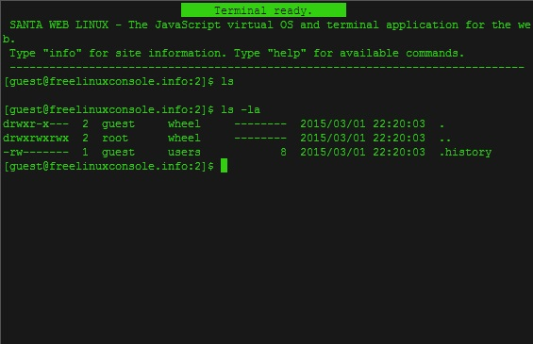
Access Control Matrix

