Slide 1
Network Managment
Damian Gordon

Slide 2
Computer Networks
When we hook up computers together using data communication facilities, we call this a computer network.

Slide 3
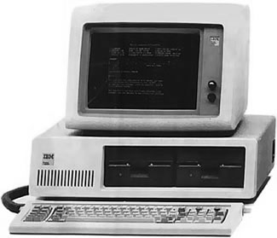
Computer Networks
When we hook up computers together using data communication facilities, we call this a computer network.

Slide 4
Computer Networks
When we hook up computers together using data communication facilities, we call this a computer network.

Slide 5
Computer Networks
When we hook up computers together using data communication facilities, we call this a computer network.

Slide 6
Computer Networks
When we hook up computers together using data communication facilities, we call this a computer network.

Slide 7
Computer Networks
By creating a network computers get to share resources, CPU, memory, etc.
There are two ways to configure operating systems to make them network enabled
Network Operating System (NOS)
Distributed Operating System (D/OS)

Slide 8
Computer Networks
A Network Operating System (NOS) is for a single-user operating system. Users are aware of other resources and computer on the network, and can access them by logging into the appropriate remote host.

Slide 9
Computer Networks
A Distributed Operating System (D/OS) is for a multi-user operating system. Users can access other resources and computer on the network in a unified way. Every resource is visible on every site.

Slide 10
Computer Networks
A Site is a specific location in a network containing two or more computer systems.
A Host is a is a specific computer system in a site that provides services.
A Node is the name assigned to the host to identify it to other computers.

Slide 11
Computer Networks
Site
Host
Node

Slide 12
Network Topologies

Slide 13
Network Topologies
We can hook up the network into a number of different shapes (or topologies).
The most common shapes are:
Star
Ring
Bus
Tree
Hybrid

Slide 14
Network Topologies
There are advantages and disadvantages to each shape (or topology).

Slide 15
Star Topology
A star topology is also called a hub topology, or a centralized topology.
A traditional approach to connecting devices where all transmitted data passed through a central controller.

Slide 16
Star Topology

Slide 17
Star Topology

Slide 18
Star Topology
Host
1
Host
2
Host
6
Central
Controller
Host
3
Host
5
Host
4

Slide 19
Star Topology
This topology make routing very easy since the central controller is connected to all other hosts, and knows the path to all hosts.

Slide 20
Star Topology
Sending a message from
Host 1 to Host 3
Host 1 to Host 4
Host
1
Host
2
Host
6
Central
Controller
Host
3
Host
5
Host
4

Slide 21
Star Topology
Sending a message from
Host 1 to Host 3
Host 1 to Host 4
Host
1
Host
2
Host
6
Central
Controller
Host
3
Host
5
Host
4

Slide 22
Star Topology
Sending a message from
Host 1 to Host 3
Host 1 to Host 4
Host
1
Host
2
Host
6
Central
Controller
Host
3
Host
5
Host
4

Slide 23
Star Topology
Sending a message from
Host 1 to Host 3
Host 1 to Host 4
Host
1
Host
2
Host
6
Central
Controller
Host
3
Host
5
Host
4

Slide 24
Star Topology
The real issue with this is that the central controller must be highly reliable and be able to handle all the network traffic, no matter how busy.

Slide 25
Ring Topology
A ring topology is one where all hosts are connected together in a closed loop.

Slide 26
Ring Topology

Slide 27
Ring Topology

Slide 28
Ring Topology
Host
1
Host
2
Host
6
Host
3
Host
5
Host
4

Slide 29
Ring Topology
Data is passed around in packets and typically is passed in one direction around the loop.
The packet knows its Source and Destination hosts.

Slide 30
Ring Topology
It will loop from the Source, around to the Destination host, which makes a copy of the packet, and the original packet continues the loop back to the Source.

Slide 31
Ring Topology
Sending a message from
Host 1 to Host 6
Host
1
Host
2
Host
6
Host
3
Host
5
Host
4

Slide 32
Ring Topology
Sending a message from
Host 1 to Host 6
Host
1
Host
2
Host
6
Host
3
Host
5
Host
4

Slide 33
Bus Topology
A bus topology is one where all the sites are connected to a single communications line (or bus) running the length of the network.

Slide 34
Bus Topology

Slide 35
Bus Topology

Slide 36
Bus Topology
Host
1
Host
2
End-point
Controller
End-point
Controller
Host
3
Host
4
Host
5

Slide 37
Bus Topology
Hosts can send data from one host to another via the bus, the message will usually be sent in both directions, and will keep travelling until they reach the End-Point Controllers.
So if I want to send from Host 1 to Host 3.

Slide 38
Bus Topology
Host
1
Host
2
End-point
Controller
End-point
Controller
Host
3
Host
4
Host
5

Slide 39
Bus Topology
Sending a message from
Host 1 to Host 3
Host
1
Host
2
End-point
Controller
End-point
Controller
Host
3
Host
4
Host
5

Slide 40
Bus Topology
Sending a message from
Host 1 to Host 3
Host
1
Host
2
End-point
Controller
End-point
Controller
Host
3
Host
4
Host
5

Slide 41
Bus Topology
Some bus topologies only allow the packets to travel in one direction until the reach the end-point controller, who can send it back in the opposite direction if the destination hasn’t received the packet yet.

Slide 42
Bus Topology
Host
1
Host
2
End-point
Controller
End-point
Controller
Host
3
Host
4
Host
5

Slide 43
Bus Topology
Sending a message from
Host 1 to Host 3
Host
1
Host
2
End-point
Controller
End-point
Controller
Host
3
Host
4
Host
5

Slide 44
Bus Topology
Sending a message from
Host 1 to Host 3
Host
1
Host
2
End-point
Controller
End-point
Controller
Host
3
Host
4
Host
5

Slide 45
Tree Topology
A tree topology is a combination of bus topologies. The cables branch out, and there are no closed loops.
The tree begins at a Head End Controllers and each branch terminates at an End Point Controller.

Slide 46
Tree Topology
A tree topology is a combination of bus topologies. The cables branch out, and there are no closed loops.
The tree begins at a Head End Controllers and each branch terminates at an End Point Controller.

Slide 47
Tree Topology
A packet from one node to another will be sent down all branches, and will be absorbed by the End Point Controllers of the branches that does not contain the Destination host.
Let’s do an example of going from Host 4 to Host 5.

Slide 48
Tree Topology

Slide 49
Tree Topology

Slide 50
Tree Topology
Host
1
Host
2
End point
Controller
Host
3
Host
4
Head end
Controller
End point
Controller
Host
5
Host
6
End point
Controller

Slide 51
Tree Topology
Host
1
Host
2
Sending a message from
Host 1 to Host 4
End point
Controller
Host
3
Host
4
Head end
Controller
End point
Controller
Host
5
Host
6
End point
Controller

Slide 52
Tree Topology
Host
1
Host
2
Sending a message from
Host 1 to Host 4
End point
Controller
Host
3
Host
4
Head end
Controller
End point
Controller
Host
5
Host
6
End point
Controller

Slide 53
Hybrid Topology
A hybrid topology is one which combines any two of the previous topologies.

Slide 54
Hybrid Topology
STAR + BUS

Slide 55
Hybrid Topology
H1
H2
H7
H8
H6
CC
H3
EPC
EPC
H5
H4
H9
H10

Slide 56
Hybrid Topology
H1
H2
H7
H8
H6
CC
EPC
H5
H4
H9
H10

Slide 57
Hybrid Topology
RING + BUS

Slide 58
Hybrid Topology
H1
H2
H7
H8
H6
H3
EPC
EPC
H5
H4
H9
H10

Slide 59
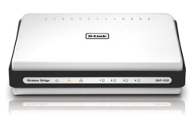
Hybrid Topology
H1
H2
H7
H8
H6
EPC
H5
H4
H9
H10

Slide 60
Hybrid Topology
H1
H2
H7
H8
H6
EPC
Switch
H5
H4
H9
H10

Slide 61
Hybrid Topology
STAR + RING

Slide 62
Hybrid Topology
H1
H2
H7
H8
H6
CC
H3
H12
H9
H5
H4
H11
H10

Slide 63
Hybrid Topology
H1
H2
H7
H8
H6
CC
H9
H5
H4
H11
H10

Slide 64
Hybrid Topology
H1
H2
H7
H8
H6
CC
H9
Switch
H5
H4
H11
H10

Slide 65
Network Types

Slide 66
Network Types
We can classify networks by the geographical distance they cover:
Local Area Network (LAN)
Metropolitan Area Network (MAN)
Wide Area Network (WAN)
Wireless Local Area Network (WLAN)

Slide 67
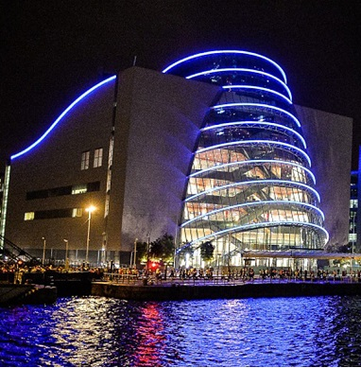
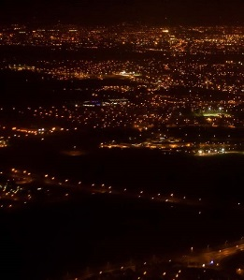
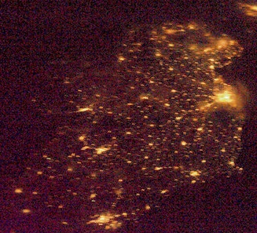
Network Types
LAN
MAN
WAN

Slide 68
Network Types
A Local Area Network (LAN) is a network within a single building or campus, e.g. an office, a college, or a warehouse. It is typically owned and used by a single organisation. Typically it’s a cluster of PCs or workstations. A LAN can be linked to larger networks via a bridge or gateway.

Slide 69
Network Types
A Metropolitan Area Network (MAN) is a network that covers a full street, a neighbourhood, or even a city, as long as it doesn’t exceed a circumference of 100 kilometres. The MAN is often owned and run as a public utility, and are typically configured as a Ring Topology.

Slide 70
Network Types
A Wide Area Network (WAN) is a network that a country, or connects countries. The WAN is often owned and run as a public utility, but telephone companies have WANs also. WANs can use anything for satellites to microwaves transmissions. The most common example of a WAN is the Internet, but there are other commercial WANs.

Slide 71
Network Types
A Wireless Local Area Network (WLAN) is a wireless LAN. It works exactly the same as a normal LAN, but the technology means that the network uses a wireless protocol such as IEEE 802.11a, IEEE 802.11b, IEEE 802.11g, or IEEE 802.11n. Additionally 802.16 (the mobile WiMAX standard) is available.

