Slide 1
Anything much happen in OSs in 2015?
Damian Gordon

Slide 2

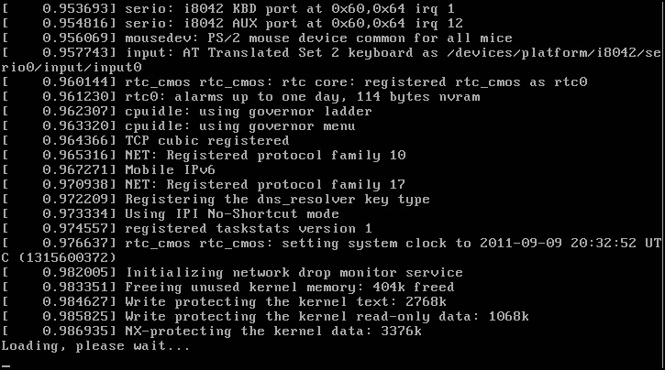
Linux V4.0
12th April
2015
A *fairly* small release, some VM clean-ups
The unification of the PROTNONE and NUMA handling for page tables.
Some people advocated the 4.0 version number, to eventually see 4.1.15 - because "that was the version of Linux SkyNet used for the T-800 Terminator".

Slide 3
Linux V4.0
Version | Original release date | Current Version | Support Model
4.0 | 12 April 2015 | 4.0.9 | Maintained from April 2015 to July 2015
4.1 | 22 June 2015 | 4.1.15 | Maintained from July 2015 to September 2017
4.2 | 30 August 2015 | 4.2.8 | Maintained from August 2015 to December 2015
4.3 | 1 November 2015 | 4.3.3 | Supported version
4.4 | 10 January 2016 | 4.4 | Maintained from January 2016 to February 2018

Slide 4

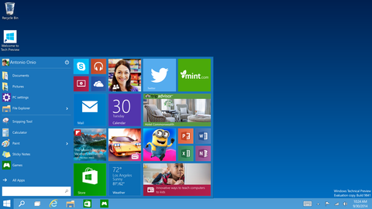
Windows 10
29th
July
2015
Threshold
Return of ‘Start’ button, a virtual desktop system, integration with Windows Phone
Device dependent interface
Incorporates Microsoft's intelligent personal assistant Cortana

Slide 5
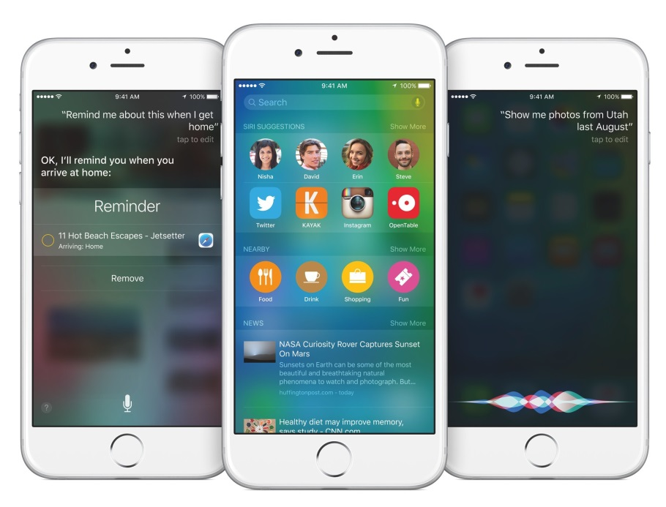
iOS 9
16th September
2015
Monarch
Focuses less on new features and more on under-the-hood optimizations, as well as battery improvements. iOS 9 also adds a number of features to the iPad to improve productivity. These include Slide Over, Split View, and Picture in Picture, for enhanced multitasking.
iOS 9 includes a new News app which displays news from sources such as The New York Times, CNN, Wired, and ESPN

Slide 6
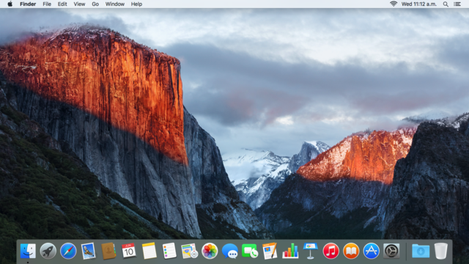
OS X v10.11
30th September
2015
El Capitan
Focuses mainly on performance, stability and security. Adds multi-touch gestures to applications like Mail and Messages
Has a new security feature called System Integrity Protection (SIP, aka "rootless") that protects system processes, files and folders from being tampered with.

Slide 7

Android V6
5th October
2015
Marshmallow
Marshmallow focuses on improving the overall user experience of the previous version, introducing a new permissions architecture, new APIs for contextual assistants and a new power management system.
A new "Assist" API allows information from a currently-opened app to be sent to a designated "assistant" application for analysis and processing.

Slide 8

Thank you.

