Slide 1
Anything much happen in OSs in 2016 ?
Damian Gordon

Slide 2

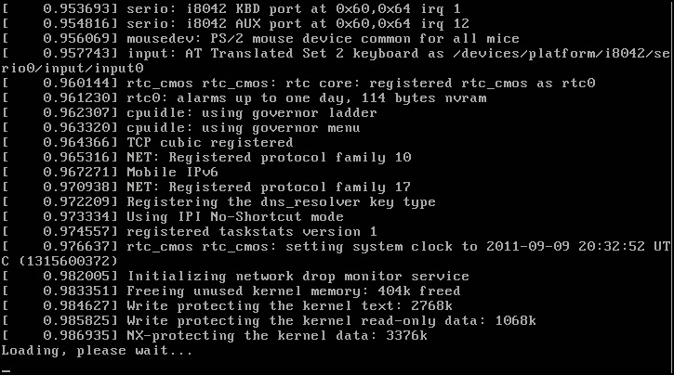
Linux V4.10
15 Jan, 2017
A *fairly* small release by Linus Torvalds, on device drivers, some architecture work, some file systems fixes and some network issues.
Some people advocated the 4.0 version number, to eventually see 4.1.15 - because "that was the version of Linux SkyNet used for the T-800 Terminator".

Slide 3
Linux V4.0
Version | Original release date | Current Version | Support Model
4.0 | 12 April 2015 | 4.0.9 | Maintained from April 2015 to July 2015
4.1 | 22 June 2015 | 4.1.38 | Maintained from July 2015 to September 2017
4.2 | 30 August 2015 | 4.2.8 | Maintained from August 2015 to December 2015
4.3 | 1 November 2015 | 4.3.6 | Maintained from November 2015 to February 2016
4.4 | 10 January 2016 | 4.4.44 | Maintained from January 2016 to February 2018
4.5 | 13 March 2016 | 4.5.7 | Maintained from March 2016 to June 2016
Notes:
https://en.wikipedia.org/wiki/Linux_kernel

Slide 4
Linux V4.0
Version | Original release date | Current Version | Support Model
4.6 | 15 May 2016 | 4.6.7 | Maintained from May 2016 to August 2016
4.7 | 24 July 2016 | 4.7.10 | Maintained from July 2016 to October 2016
4.8 | 25 September 2016 | 4.8.17 | Maintained from September 2016 to January 2017
4.9 | 11 December 2016 | 4.9.5 | Latest mainline release
4.10 | 15 January 2017 | 4.10-rc4 | Latest unstable release
Notes:
https://en.wikipedia.org/wiki/Linux_kernel

Slide 5

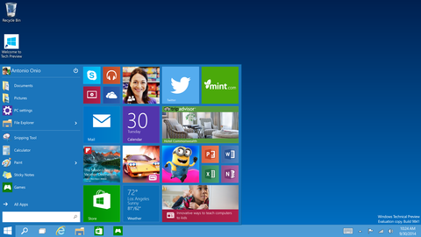
Windows 10
29 July,
2015
Threshold
Return of ‘Start’ button, a virtual desktop system, integration with Windows Phone
Device dependent interface
Incorporates Microsoft's intelligent personal assistant Cortana

Slide 6
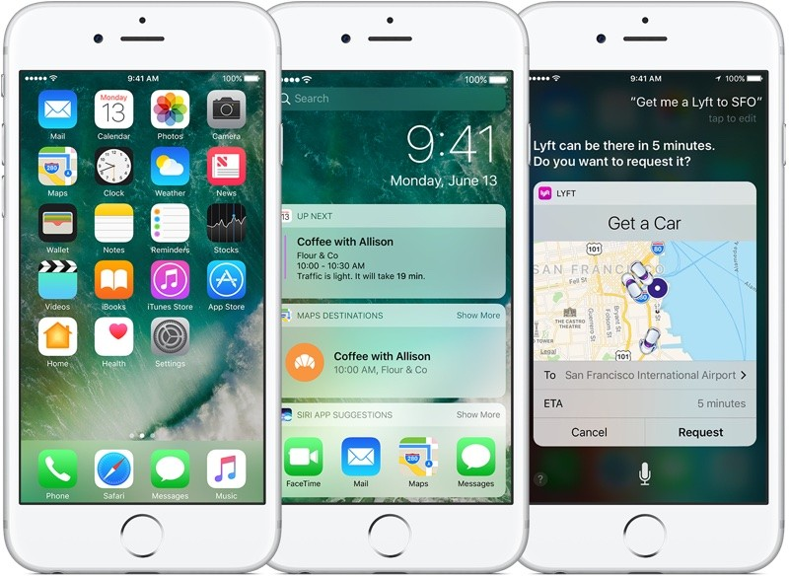
iOS 10
September 13, 2016
Whitetale
Significant updates to iMessage, Siri, Photos, 3D Touch, and the lock screen.
As part of the overall Continuity features, a new Universal Clipboard feature allows users of Mac PCs running macOS Sierra and iOS devices running iOS 10 to copy material to and from different devices through iCloud.
iOS 10 features new sound effects for locking the device and for keyboard clicks.

Slide 7
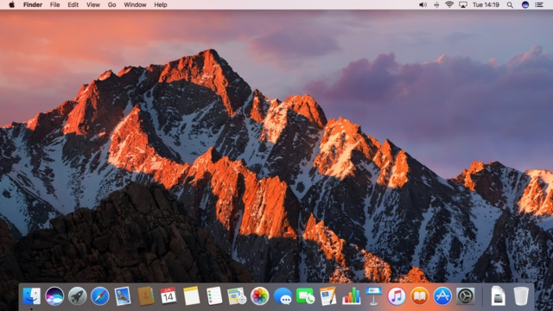
OS X v10.12
June 13, 2016
Sierra
Its major new features concern Continuity, iCloud, and windowing, as well as support for Apple Pay and Siri.
In the 10.12.2 update the "time remaining" estimate has been removed after complaints of the battery life of 2016 MacBook Pros.

Slide 8

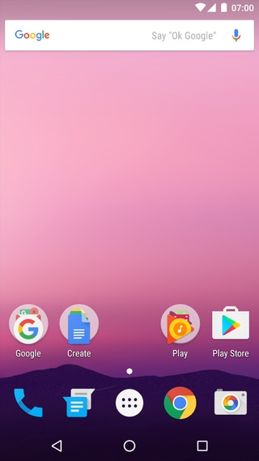
Android V7
August 22, 2016
Nougat
Nougat changes include the ability to display multiple apps on-screen at once in, support for inline replies to notifications, as well as an OpenJDK-based Java environment and support for the Vulkan graphics rendering API.
Introduces a split-screen display mode for phones, in which two apps can be snapped to occupy halves of the screen.
Notes:
https://en.wikipedia.org/wiki/Android_version_history

Slide 9
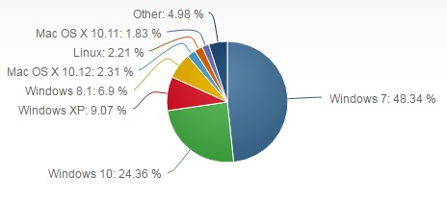
Desktop OS Market Share

Slide 10

Thank you.

