Slide 1
Introduction to Operating Systems
Damian Gordon

Slide 2
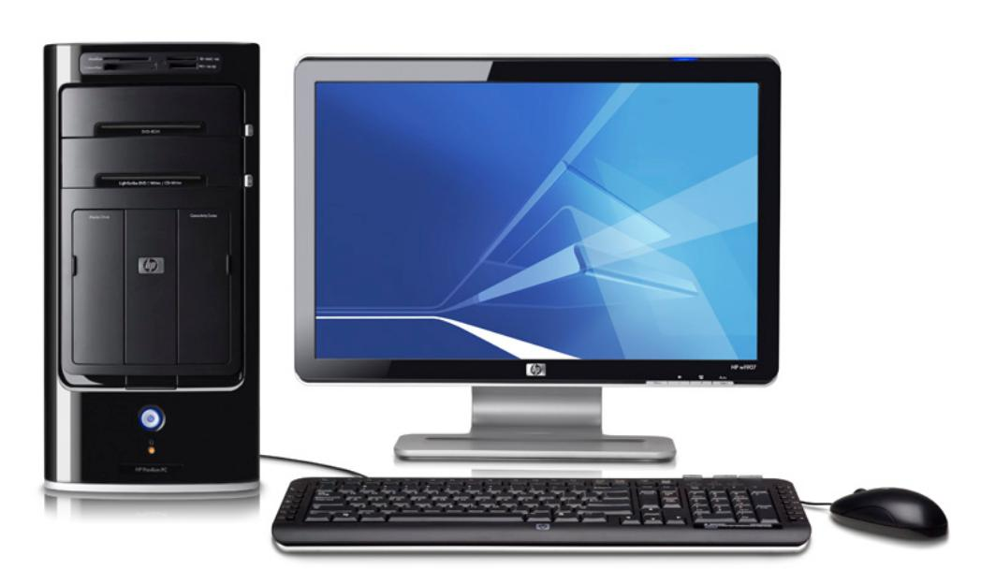

Slide 3
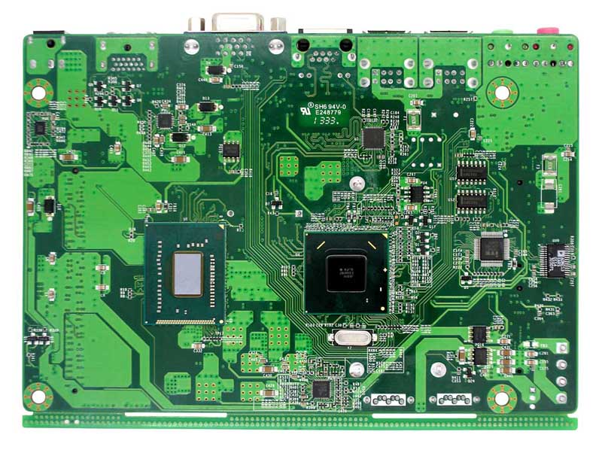
Computer
Hardware

Slide 4
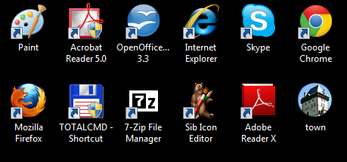
Software
Applications
Computer
Hardware

Slide 5
Software
Applications
OPERATING SYSTEM
Computer
Hardware

Slide 6
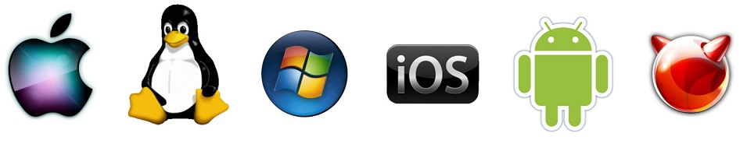
Software
Applications
OPERATING SYSTEM
UNIX
Computer
Hardware

Slide 7
Two Types of Interfaces
CLI (Command-Line Interface)
GUI (Graphical User Interface)

Slide 8
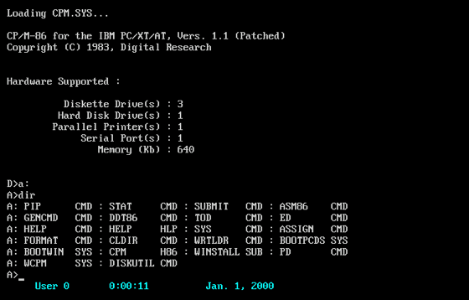
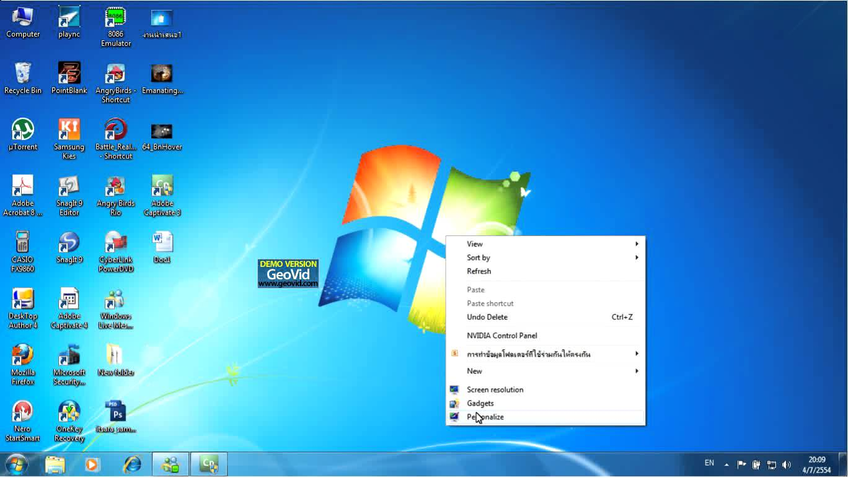
Two Types of Interfaces
CLI (Command-Line Interface)
GUI (Graphical User Interface)

Slide 9
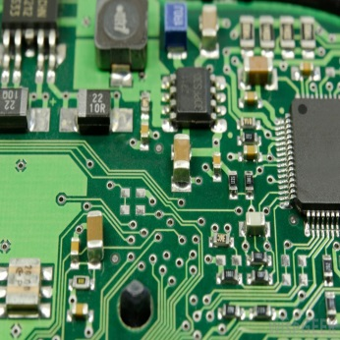
Typical OS Architecture
Hardware

Slide 10
Typical OS Architecture
Kernel

Slide 11
Typical OS Architecture
Shell

Slide 12
Typical OS Architecture
User
Applications

Slide 13
Terminology
Hardware is the physical elements of a computer system. It is the physical parts of a computer, such as the monitor, mouse, keyboard, computer data storage, hard disk drive (HDD), graphic cards, sound cards, memory, motherboard, and so on.
The Kernel is a computer program that manages input/output requests from software, and translates them into data processing instructions for the central processing unit and other electronic components of a computer.
The Shell is an interface for access to an operating system's services. In general, operating system shells use either a command-line interface (CLI) or graphical user interface (GUI).
User Applications are computers program designed to perform a group of coordinated functions, tasks, or activities for the benefit of the user.

Slide 14
Introduction to common Operating Systems

Slide 15
UNIX
Whose logo is this?

Slide 16
Unix
UNIX
Developed by Ken Thompson and Dennis Ritchie
Unix was launched in 1969
It is a CLI (Command-Line Interface)
Written in the C programming language
Led to a variety of academic and commercial variants, e.g. University of California, Berkeley (BSD), Microsoft (Xenix), IBM (AIX) and Sun Microsystems (Solaris)

Slide 17
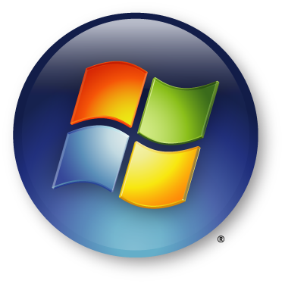
Whose logo is this?

Slide 18
Windows
Developed by Microsoft - Bill Gates & Paul Allen
Windows was launched in 1985
Built on DOS (Disk Operating System), which is a CLI (Command-Line Interface)
Has two modes User Mode (the user cannot directly access the hardware) and Kernel Mode (the user can access the hardware)
Runs on Computers, Tablets (Surface), and integration with Xbox

Slide 19
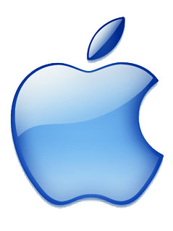
Whose logo is this?

Slide 20
Apple MacOS (later OS X)
Developed by Apple - Steve Wozniak & Steve Jobs
MacOS was launched in 1984
MacOS is a native GUI (Graphical User Interface)
MacOS evolved into OS X, which combined technologies from MacOS, Unix, and NeXT
Runs on Computers and other devices.

Slide 21

Whose logo is this?

Slide 22
Linux
Developed by Linus Benedict Torvalds
Linux was launched in 1992
Linux is a CLI (Command-Line Interface)
Torvalds made the code of Linux freely available to everyone on the internet, and therefore lots of people created their own versions of Linux, e.g. Debian, RedHat, SUSE, SlackWare, Gentoo, Ubuntu

Slide 23

Whose logo is this?

Slide 24
Android
Developed by Andy Rubin, Rich Miner, Nick Sears, and Chris White
Android was launched in 2003
Based on the Linux kernel
Android is a GUI designed primarily for touchscreen mobile devices such as smartphones and tablets

Slide 25
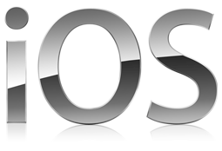
Whose logo is this?

Slide 26
iOS
Developed by Steve Jobs and Scott Forstall
iOS was launched in 2007
Based on the MacOS
iOS is a GUI designed primarily for touchscreen mobile devices such as iPhones, iPods, iPads, and AppleTV.

Slide 27
A few more notes on Linux

Slide 28
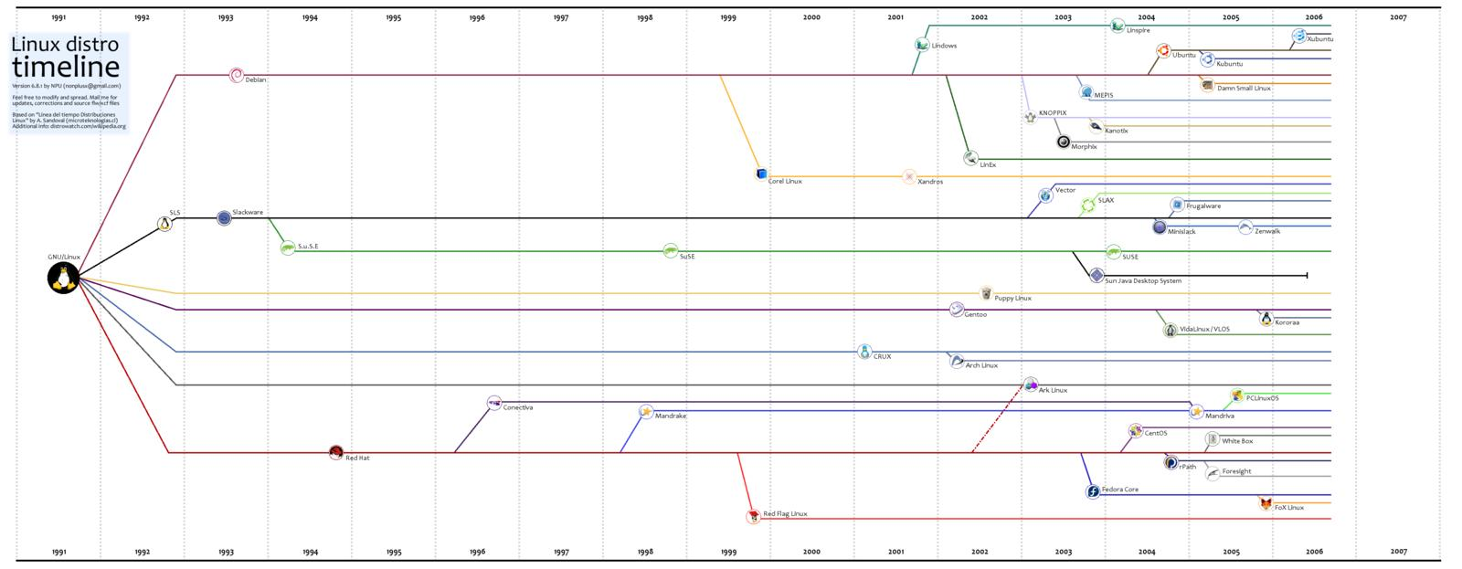
Linux

Slide 29
Linux
A Linux distribution (often called a distro for short) is an operating system made from a software collection, which is based upon the Linux kernel and, often, a package management system.
Almost six hundred Linux distributions exist, with close to five hundred out of those in active development, constantly being revised and improved.
There are commercially backed distributions, such as Fedora (Red Hat), openSUSE (SUSE) and Ubuntu (Canonical Ltd.), and entirely community-driven distributions, such as Debian, Slackware, Gentoo and Arch Linux.

Slide 30





LAMP
Php
Linux
Apache
MySQL
Perl

Slide 31
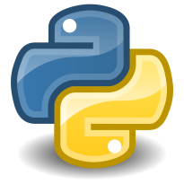
LAMP
Python
Php
Linux
Apache
MySQL
Perl

Slide 32



LAMP
User
Interface
Python
Php
Perl
Web Server
Apache
Database
MySQL
Operating System
Linux

Slide 33
LAMP
LAMP is an model of web service solution stacks, named as an acronym of the names of its original four open-source components: the Linux operating system, the Apache HTTP Server, the MySQL relational database management system (RDBMS), and the PHP programming language.
The LAMP components are largely interchangeable and not limited to the original selection. As a solution stack, LAMP is suitable for building dynamic web sites and web applications.

Slide 34

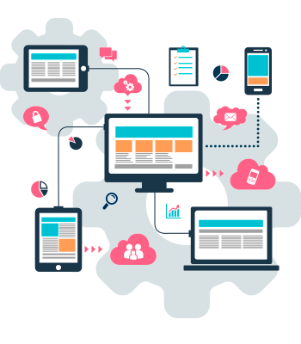

XAMPP
Python
Php
X
Cross-
Platform
Apache
MariaDB
Perl

Slide 35
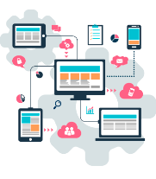
XAMPP
User
Interface
Python
Php
Perl
Web Server
Apache
Database
MariaDB
Operating System
X
Cross-
Platform

Slide 36
OTHER VARIANTS
WAMP (Microsoft Windows)
MAMP (OS X)
SAMP (Solaris)
FAMP (FreeBSD)
iAMP (iSeries)
WIMP (IIS in place of Apache)
LEMP (Nginx in place of Apache)
LAPP (PostgreSQL in place of MySQL)

Slide 37
Main features of an Operating System

Slide 38
Operating
System
Memory
Manager
File
Manager
Process
Manager
Device
Manager
Network
Manager

Slide 39
Process Manager
Process
Manager
The OS must allocate resources to processes, enable processes to share and exchange information, protect the resources of each process from other processes and enable synchronisation among processes. To meet these requirements, the OS must maintain a data structure for each process, which describes the state and resource ownership of that process, and which enables the OS to exert control over each process.

Slide 40
Memory Manager
Memory
Manager
The memory management function keeps track of the status of each memory location, either allocated or free. It determines how memory is allocated among competing processes, deciding which gets memory, when they receive it, and how much they are allowed. When memory is allocated it determines which memory locations will be assigned. It tracks when memory is freed or unallocated and updates the status.

Slide 41
File Manager
File
Manager
A file manager or file browser is a computer program that provides a user interface to manage files and folders. The most common operations performed on files or groups of files include creating, opening (e.g. viewing, playing, editing or printing), renaming, moving or copying, deleting and searching for files, as well as modifying file attributes, properties and file permissions. Folders and files may be displayed in a hierarchical tree based on their directory structure.

Slide 42
Device Manager
Device
Manager
The device manager is responsible for detecting and managing devices, performing power management, and exposing devices to userspace. Device drivers allow user applications to communicate with a system's devices. They provide a high-level abstraction of the hardware to user applications while handling the low-level device-specific I/O and interrupts.

Slide 43
Network Manager
Network
Manager
The network manager manages the relationship between the operating system and the network(s) that it is connected to. This means that the user can be unaware of issues like connectivity, and network speed.

Slide 44

Thank you.

