Slide 1



Cloud Computing
Grid Computing
Cloud Computing

Slide 2
Lecture Contents
Grid Computing Definitions
Criteria for a Grid & Benefits
Grid Concept
Grid Applications
Grid Topologies
Middleware
Hourglass Model
Aspects of the Problem
Globus Toolkit
Grid Computing & Cloud Computing
Why use them?

Slide 3
Grid Computing
Pooling compute resources
For scientific computing and simulation
from multiple administrative domains
Virtual Supercomputer, Virtual Organizations
SPMD - Same Program Multiple Data
coarse grained parallel applications
Examples
SETI@HOME
Berkeley Open Infrastructure for Network Computing (BOINC)
Globus toolkit (GTK)
Standardization efforts at Open Grid Forum (OGF)

Slide 4
Grid Computing definitions
Grid computing is a form of distributed computing whereby a "super and virtual computer" is composed of a cluster of networked, loosely coupled computers, acting in concert to perform very large tasks.
Facilitates flexible, secure, coordinated large scale resource sharing among dynamic collections of individuals, institutions, and resource
Enable communities (“virtual organizations”) to share geographically distributed resources as they pursue common goals

Slide 5
Criteria for a Grid:
Coordinates resources that are not subject to centralized control.
Uses standard, open, general-purpose protocols and interfaces.
Delivers nontrivial qualities of service.

Slide 6
Benefits
Exploit Underutilized resources
Resource load Balancing
Virtualize resources across an enterprise
Data Grids, Compute Grids
Enable collaboration for virtual organizations

Slide 7
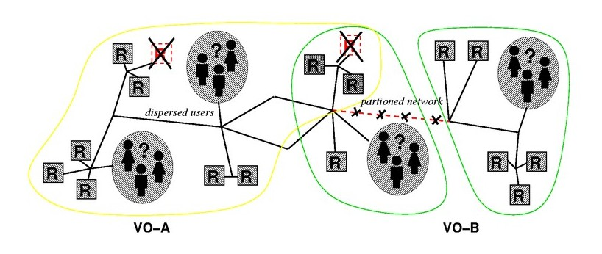
The Grid
“Resource sharing & coordinated problem solving in dynamic, multi-institutional virtual organizations”

Slide 8
Grid Concept (Take 1)
Analogy with the electrical power grid
“On-demand” access to ubiquitous distributed computing
Transparent access to multi-petabyte distributed data bases
Easy to plug resources into
Complexity of the infrastructure is hidden
“When the network is as fast as the computer's internal links, the machine disintegrates across the net into a set of special purpose appliances” (George Gilder)

Slide 9
Grid Vision (Take 2)
e-Science and information utilities Science increasingly done through distributed global collaborations between people, enabled by the Internet
Using very large data collections, terascale computing resources, and high performance visualisation
Derived from instruments and facilities controlled and shared via the infrastructure
Scaling x1000 in processing power, data, bandwidth

Slide 10
Elements of the Problem
Resource sharing
Computers, storage, sensors, networks, …
Heterogeneity of device, mechanism, policy
Sharing conditional: negotiation, payment, …
Coordinated problem solving
Integration of distributed resources
Compound quality of service requirements
Dynamic, multi-institutional virtual orgs
Dynamic overlays on classic org structures
Map to underlying control mechanisms

Slide 11
Grid Applications
Data and computationally intensive applications:
This technology has been applied to computationally-intensive scientific, mathematical, and academic problems like drug discovery, economic forecasting, seismic analysis back office data processing in support of e-commerce
A chemist may utilize hundreds of processors to screen thousands of compounds per hour.
Teams of engineers worldwide pool resources to analyze terabytes of structural data.
Meteorologists seek to visualize and analyze petabytes of climate data with enormous computational demands.

Slide 12
Grid Topologies
Intragrid
Local grid within an organisation
Trust based on personal contracts
Extragrid
Resources of a consortium of organisations
connected through a (Virtual) Private Network
Trust based on Business to Business contracts
Intergrid
Global sharing of resources through the internet
Trust based on certification

Slide 13
Computational Grid
“A computational grid is a hardware and software infrastructure that provides dependable, consistent, pervasive, and inexpensive access to high-end computational capabilities.”
”The Grid: Blueprint for a New Computing Infrastructure”, Kesselman & Foster
Example : Science Grid (US Department of Energy)

Slide 14
Data Grid
A data grid is a grid computing system that deals with data — the controlled sharing and management of large amounts of distributed data.
Data Grid is the storage component of a grid environment. Scientific and engineering applications require access to large amounts of data, and often this data is widely distributed. A data grid provides seamless access to the local or remote data required to complete compute intensive calculations.
Example :
Biomedical informatics Research Network (BIRN),
the Southern California earthquake Center (SCEC).

Slide 15
A typical view of Grid environment
Grid Information Service system collects the details of the available Grid resources and passes the information to the resource broker.
A User sends computation or data intensive application to Global Grids in order to speed up the execution of the application.
A Resource Broker distribute the jobs in an application to the Grid resources based on user’s QoS requirements and details of available Grid resources for further executions.
Grid Resources (Cluster, PC, Supercomputer, database, instruments, etc.) in the Global Grid execute the user jobs.

Slide 16
Grid Middleware
Grids are typically managed by grid ware - a special type of middleware that enable sharing and manage grid components based on user requirements and resource attributes (e.g., capacity, performance)

Slide 17
Grid Middleware
Software that connects other software components or applications to provide the following functions:
Run applications on suitable available resources – Brokering, Scheduling
Provide uniform, high-level access to resources – Web Services, Service Oriented Architectures
Address inter-domain issues of security, policy, etc. – Federated Identities
Provide application-level status
monitoring and control

Slide 18
The Hourglass Model
Focus on architecture issues
Propose set of core services as basic infrastructure
Used to construct high-level, domain-specific solutions (diverse)
Design principles
Keep participation cost low
Enable local control
Support for adaptation
“IP hourglass” model
A p p l i c a t i o n s
Diverse global services
Core
services
Local OS

Slide 19
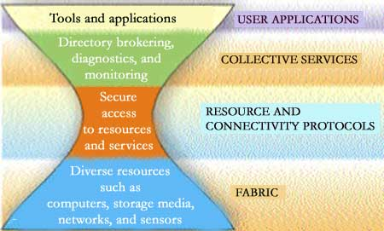

Slide 20
Aspects of the Problem
Need for interoperability when different groups want to share resources
Diverse components, policies, mechanisms
E.g., standard notions of identity, means of communication, resource descriptions
Need for shared infrastructure services to avoid repeated development, installation
E.g., one port/service/protocol for remote access to computing, not one per tool/appln
E.g., Certificate Authorities: expensive to run
A common need for protocols & services

Slide 21
Globus Toolkit™
A software toolkit addressing key technical problems in the development of Grid-enabled tools, services, and applications
Offer a modular set of orthogonal services
Enable incremental development of grid-enabled tools and applications
Implement standard Grid protocols and APIs
Available under liberal open source license
Large community of developers & users
Commercial support

Slide 22
General Approach
Define Grid protocols & APIs
Protocol-mediated access to remote resources
Integrate and extend existing standards
“On the Grid” = speak “Intergrid” protocols
Develop a reference implementation
Open source Globus Toolkit
Client and server SDKs, services, tools, etc.
Grid-enable wide variety of tools
Globus Toolkit, FTP, SSH, Condor, SRB, MPI, …
Learn through deployment and applications

Slide 23
Data Intensive Physical Sciences
High energy & nuclear physics
Including new experiments at CERN
Gravity wave searches
LIGO, GEO, VIRGO
Time-dependent 3-D systems (simulation, data)
Earth Observation, climate modeling
Geophysics, earthquake modeling
Fluids, aerodynamic design
Pollutant dispersal scenarios
Astronomy: Digital sky surveys

Slide 24
Data Intensive Biology and Medicine
Medical data
X-Ray, mammography data, etc. (many petabytes)
Digitizing patient records (ditto)
X-ray crystallography
Molecular genomics and related disciplines
Human Genome, other genome databases
Proteomics (protein structure, activities, …)
Protein interactions, drug delivery
Virtual Population Laboratory (proposed)
Simulate likely spread of disease outbreaks
Brain scans (3-D, time dependent)

Slide 25
Grid computing Cloud computing
Grids enable access to shared computing power and storage capacity from your desktop
Clouds enable access to leased computing power and storage capacity from your desktop

Slide 26
Who provides the service?
GRID:
Research institutes and universities federate their services around the world through projects such as EGI-InSPIRE and the European Grid Infrastructure
Cloud
Large individual companies e.g. Amazon and Microsoft and at a smaller scale, institutes and organisations deploying open source software such as Open Slate, Eucalyptus and Open Nebula.

Slide 27
Who uses the service?
GRID:
Research collaborations, called "Virtual Organisations", which bring togetherresearchers around the world working in the same field.
Cloud
Commercial businesses or researchers with generic IT needs

Slide 28
Who pays for the service?
GRID:
Governments - providers and users are usually publicly funded research organisations, for example through National Grid Initiatives.
Cloud
The cloud provider pays for the computing resources; the user pays to use them

Slide 29
Where are the computing resources?
GRID:
In computing centres distributed across different sites, countries and continents.
Cloud
The cloud providers private data centres which are often centralised in a few locations with excellent network connections and cheap electrical power.

Slide 30
Why use them?
GRID:
You don`t need to buy or maintain your own large computer centre
You can complete more work more quickly and tackle more difficult problems.
You can share data with your distributed team in a secure way..
Cloud
You don`t need to buy or maintain your own personal computer centre
You can quickly access extra resources during peak work periods

Slide 31
What are they useful for?
GRID:
Grids were designed to handle large sets of limited duration jobs that produce or use large quantities of data (e.g. the LHC and life sciences)
Cloud
Clouds best support long term services and longer running jobs (E.g. facebook.com)
Cloud IAAS can also be used to scale up for limited duration jobs however

Slide 32
Grid vs. Cloud
Grid never considered the interactive end user
jobs are being submitted through portals
results are being retrieved hours later in form of log files and collected program output.
Grid did not integrate administrative domains.
install certificates, enable ssh login, and setting up mutual trust relationships across all partners
Creating a huge, distributed virtual supercomputer,
which is managed in a batch-job-processing scheme.

Slide 33
Cloud Computing
Course notes, video lecture and podcast version available at
www.dit.ie/webcourses

