Slide 1

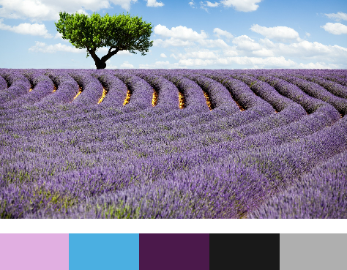
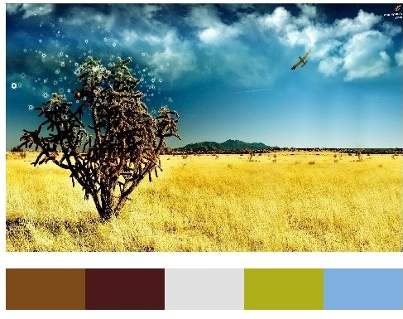
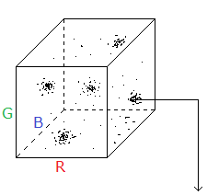
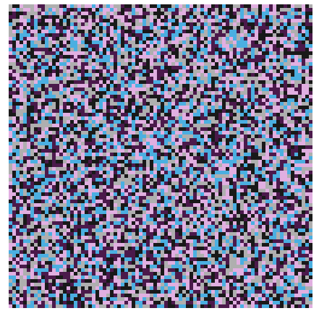
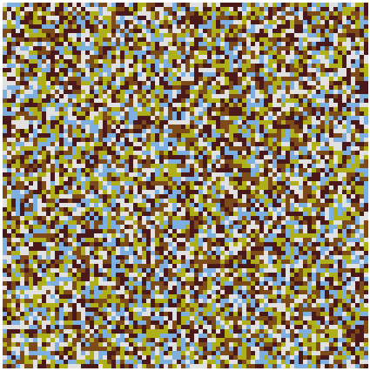


Team 40
Markov’s Easel
Operation
Catapult
Damien Thomas, Howard Henderson, William Chen, Matthew Bounds
How This Ties in to KEEN Values
Phase 1- Iterating over the image and RGB Analysis
By calling PixelArray() on the image, we returned a list of numbers. One of these numbers corresponds to one pixel, and that number was converted to a red, green and blue value using integer division and remainders.
8912918
% 256 --> 136 (R)
// 256 % 256 --> 0 (G)
Curiosity- when the project began, it started with a question: “What can we do in two weeks?” What we were able to do then didn’t matter. We had the curiosity to explore what Python was capable of, and the willingness to learn how these things could be accomplished. The end result was a project that was wholly inspired by that simple question.
// 256 // 256 % 256 --> 22 (B)
Phase 2- Simplifying RGB values and preparation for further analysis
Because RGB values can be between 0 and 255, there are over 16 million potential color combinations. While it is wholly possible to store this many values and use them in later processes, hardware and time limitations required us to simplify the entire palette to 125 different colors. Using a simple conditional statement, we set RGB values to 25 plus a multiple of 50, up to 225.
136 in range(100, 150) --> 125
8198425
0 in range(0, 50) --> 25
Connections- The project went through several design phases, from audio processing to simulating random events to teaching an AI to paint. Eventually, we settled on the palette as a main project, but were able to integrate both random image generation and audio generation into the final product. The connections we drew between visual and audio data, as well as random generation, exemplify this value.
22 in range(0, 50) --> 25
Phase 3- Quantifying simplified RGB values in the image and picking out peaks
We created a three-dimensional list, representative of a complex plane, to track the RGB value counts. By using integer division on the simplified RGB values, we were able to return an index which was incremented for every pixel that matched it. The end result was a series of ‘clusters’: similar RGB values that formed groups on the complex plane, usually with a dense central value that matched thousands of pixels.
Creating Value- Many programs and applications exist that have identical concepts to our palette creation, audio processing, etc. The combination of these ideas, however, leads to many possibilities. If a note was mapped to a color, we could ‘hear’ a picture, or ‘draw’ music based on tones. The artistic and musical applications of the program can be continually modified and expanded, and we believe this reflects the progress expected of the modern world.
Phase 4- Analyzing clusters to find ‘peaks’, mapping peaks back to simplified RGB values, and displaying colors
By checking if every number was greater than the number on either side of it, with the exception of the ends, we were able to return the centers of these clusters, then take the five largest centers by sorting the centers least to greatest and removing all but the last five. Each of these large numbers were searched for in the original three-dimensional array of counts, and their index was returned. The process from Phase 3 backward was essentially reversed. We multiplied each index of the peak by 50 and added 25 to get the simplified RGB value of that count. These colors could easily be displayed in a small bar under the image.
[...[...[0, 121, 3546, 786, 21]...]...]
[...3546...]
index[3][4][1]
11526475
3 * 50 + 25 = 175 (R)
4 * 50 + 25 = 225 (G)
1 * 50 + 25 = 75 (B)
Top- ‘paletteTest10.jpg’ output, with photo and respective palette.
Middle- ‘paletteTest20.jpg’ output, with photo and respective palette.
Bottom left- a random image generated with paletteTest10’s color palette.
Bottom right- a random image generated with paletteTest20’s color palette.
What does this mean?- As a group with very little programming experience collectively, the project was a lot to learn and apply in two weeks. We hope to continue these developments in the future on a larger scale. By applying the KEEN framework to our designs, we aim to continue building our experience and innovate for a technologically expanding world.
Phase 5 – Integrating a parallel project – a music generator using the same principle to produce randomized music and to serve as a complement to the color palette
By loading a blues scale in the note class and writing a rhythm function, the program basically can play any rhythm based on a fixed scale of notes. Because of the inherent nature of a blues scale, randomized notes are capable of making musical sense. By pre-loading the notes, the program becomes a platform that allows the user to compose any type of rhythm performed in jazz notes by a specialized randomizer.
Notes: C, Eb, F, F#, G, Bb, C
Operation Catapult 2015
Session 98
Sponsored by the Kern Family Foundation

