Slide 1

treaps
Japanese Maple Tree in Portland, Oregon Japanese Gardens
https://falcor88.deviantart.com/art/1390614-615874978450917-1162797191-N-413184974

Slide 2
All About Treaps
Combination of Binary Search Tree & a Heap
Purpose is to have a balanced tree like a heap (fast insertions/deletions) but also be able to search quickly like a binary search tree.

Slide 3
All About Treaps
In addition to the key value stored in each node, you have a priority number
Key value – follows standard BST ordering (left is smaller and right is greater)
Priority – randomly assigned value that follows max-heap property

Slide 4
treaps operations - search
SEARCH is the same as a Binary Search Tree – searches through the nodes (looking at the value in the node) to see if it matches.
The thing (value) you are searching for is called a key

Slide 5
Tree Operations – insert & delete
The TREAP is self-balancing – it uses rotations to maintain max-heap property during insertion & deletion.

Slide 6
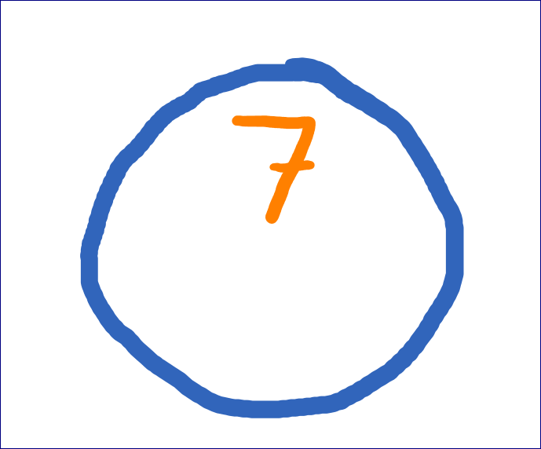
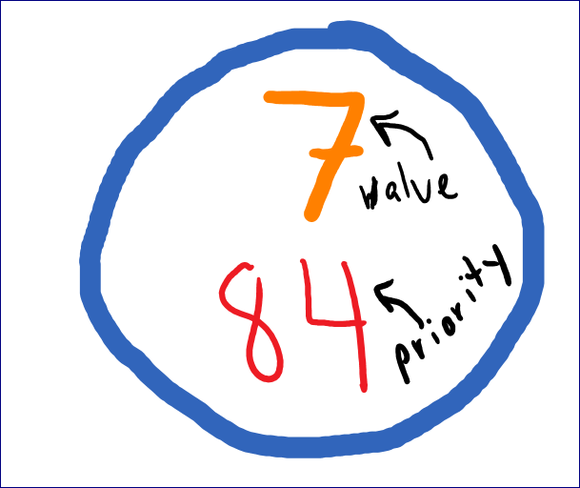
treaps operations - insert
insert step one
insert node as in a BST using the value to compare.
insert step two
assign a random priority number

Slide 7
treaps operations - insert
insert step three
Use the max-heap property to percolate node up to maintain heap (this is based on priority number – not the value!)

Slide 8
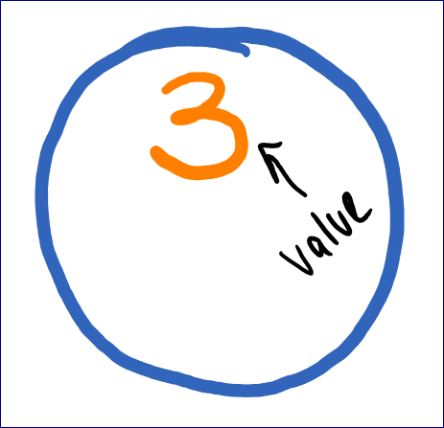
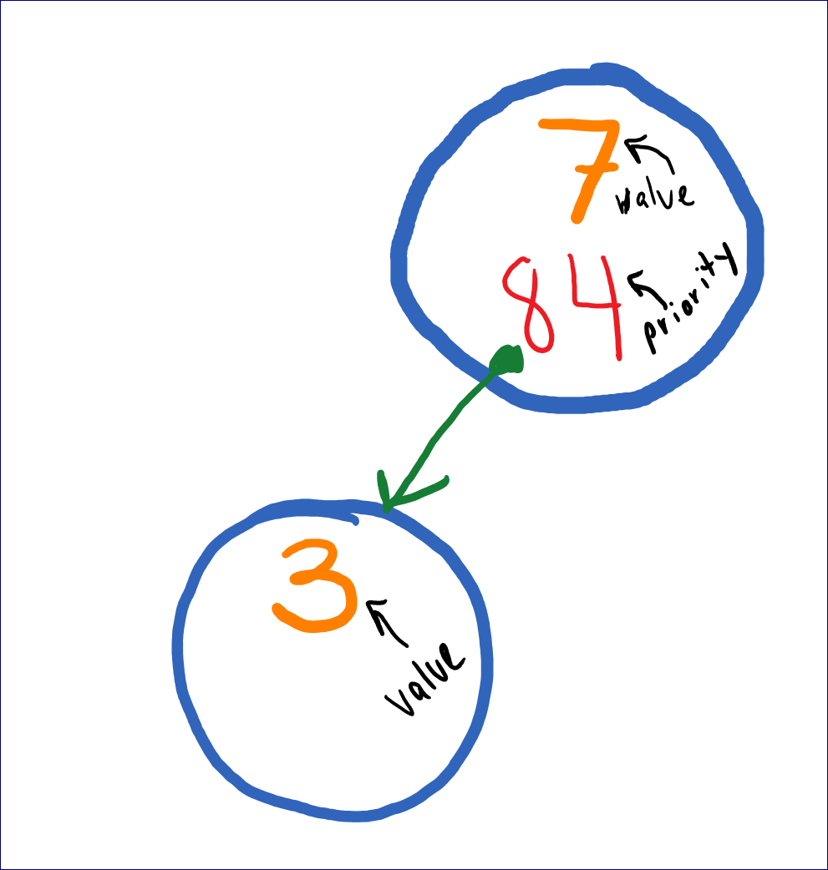
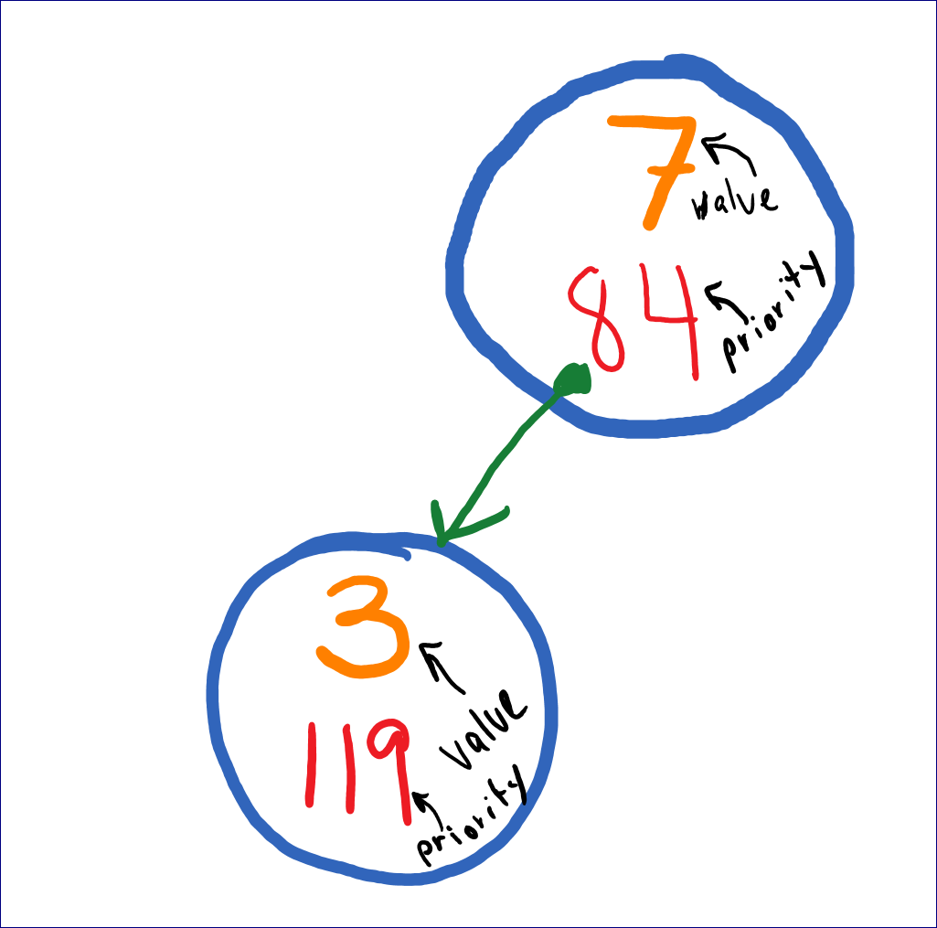
treaps operations – insert (AGAIN)
insert step one
insert node as in a BST using the value to compare.
insert step two
assign a random priority number

Slide 9
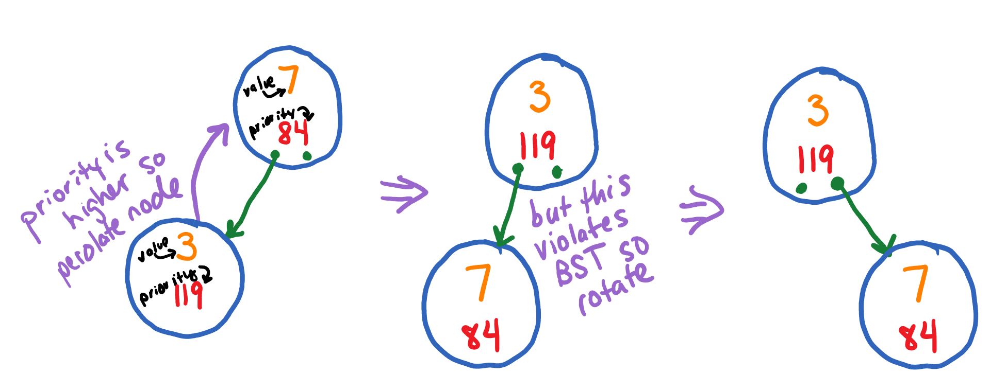
treaps operations - insert
Use the max-heap property to percolate node up to maintain heap (this is based on priority number – not the value!)
Also – rotate if necessary to maintain BST on the key value
insert step three

Slide 10
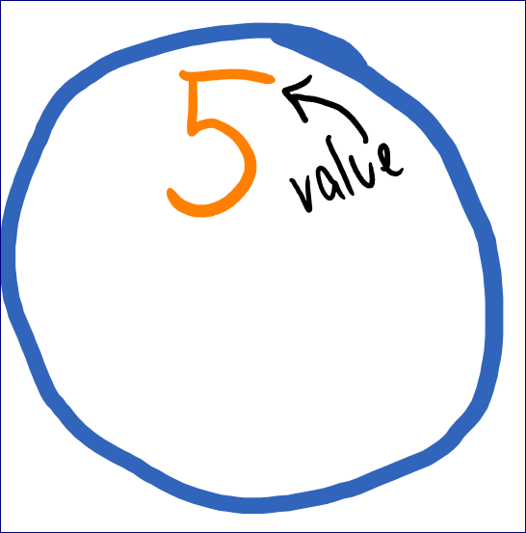
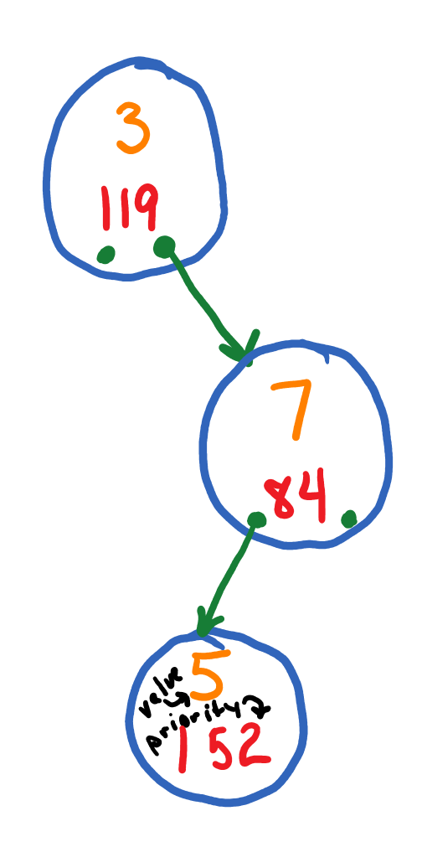
treaps operations – insert (AGAIN)
insert step one
insert node as in a BST using the value to compare.
insert step two
assign a random priority number

Slide 11
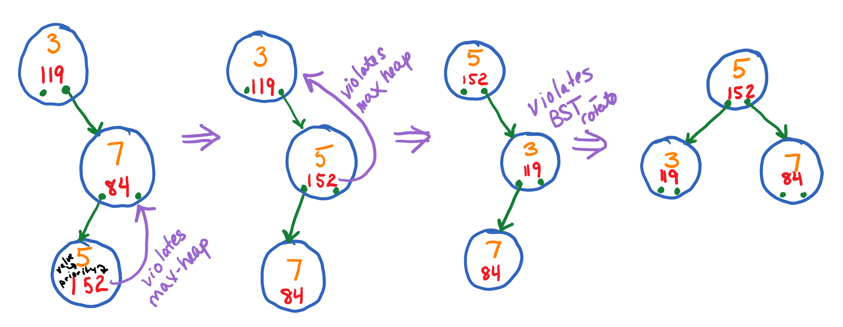
treaps operations - insert
insert step three
Use the max-heap property to percolate node up to maintain heap (this is based on priority number – not the value!) Then make rotations to maintain BST on value if necessary.

Slide 12
treaps operations - insert
delete step one
Set the node you want to delete to have a new priority such that the node should be a leaf (negative infinity or minimum for a max-heap). Note: you can use numeric_limits C++ class for this.
delete step two
Percolate down (bubble down) using rotations until the node is a leaf

Slide 13
treaps operations - insert
delete step three
delete the leaf node.

Slide 14
Treaps example code
Below are two pages that show some C++ code for Treap
https://www.geeksforgeeks.org/treap-a-randomized-binary-search-tree/
https://www.geeksforgeeks.org/treap-set-2-implementation-of-search-insert-and-delete/

Slide 15
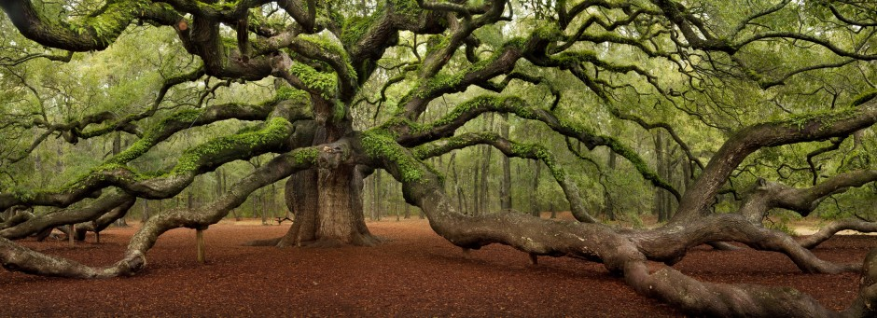
Angel oak tree, South Carolina (just outside of Charleston)
https://matadornetwork.com/trips/21-beautiful-trees-forests/

