Slide 1
Information theory Project Audio CD
Arthur.Duysens@UGent.be
Kaixin.Chang@ugent.be

Slide 2
Practical
Groups of 3-4 people (already made) deadline: 23:59 on the 3rd of May
Upload report and code to Ufora zip-file: groupXX.zip with a folder groupXX
Oral defense on 18th and 19th May
Score: 20% of total (at least 8/20 needed to pass the course!)
Survey on week 3, 6 and 9
Questions: Arthur.Duysens@ugent.be
Kaixin.Chang@ugent.be

Slide 3
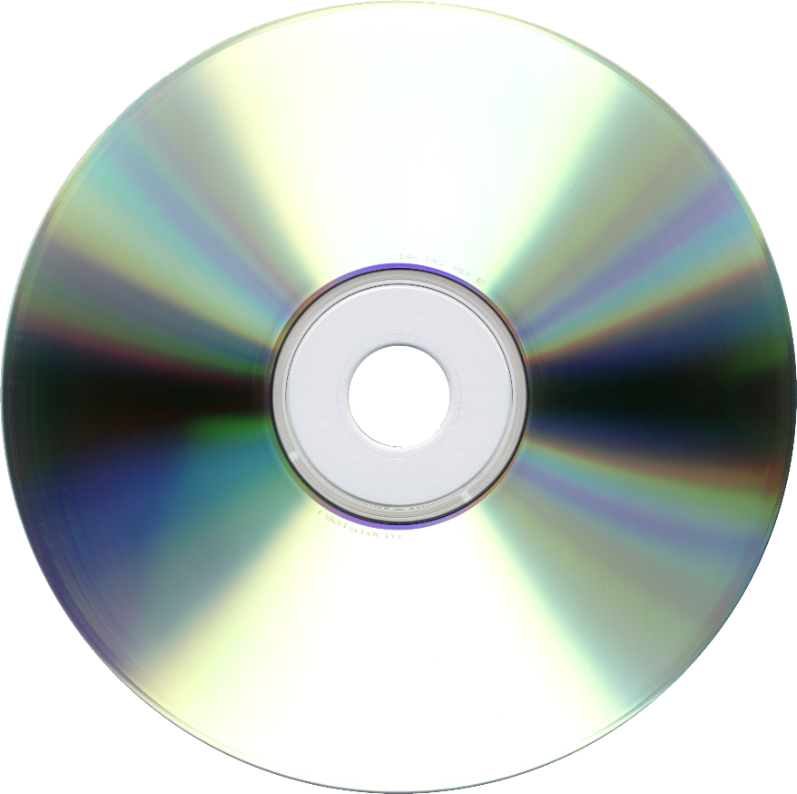
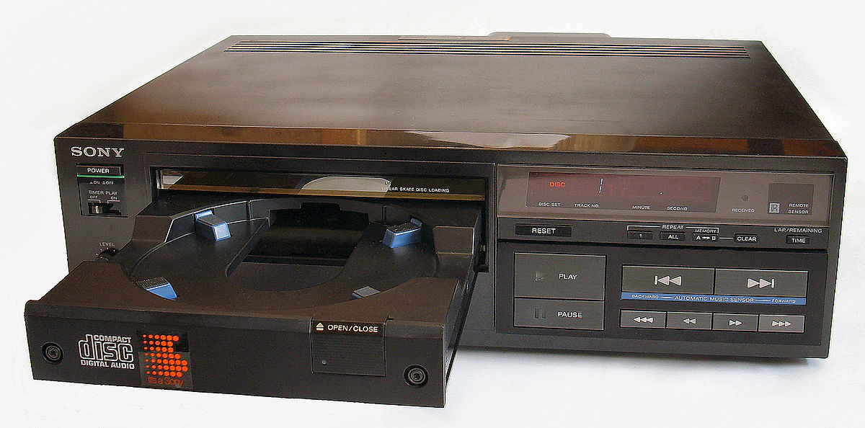
Compact Disc Digital Audio
Introduced by Sony and Philips in 1980
First commercially released CD player (1982)

Slide 4
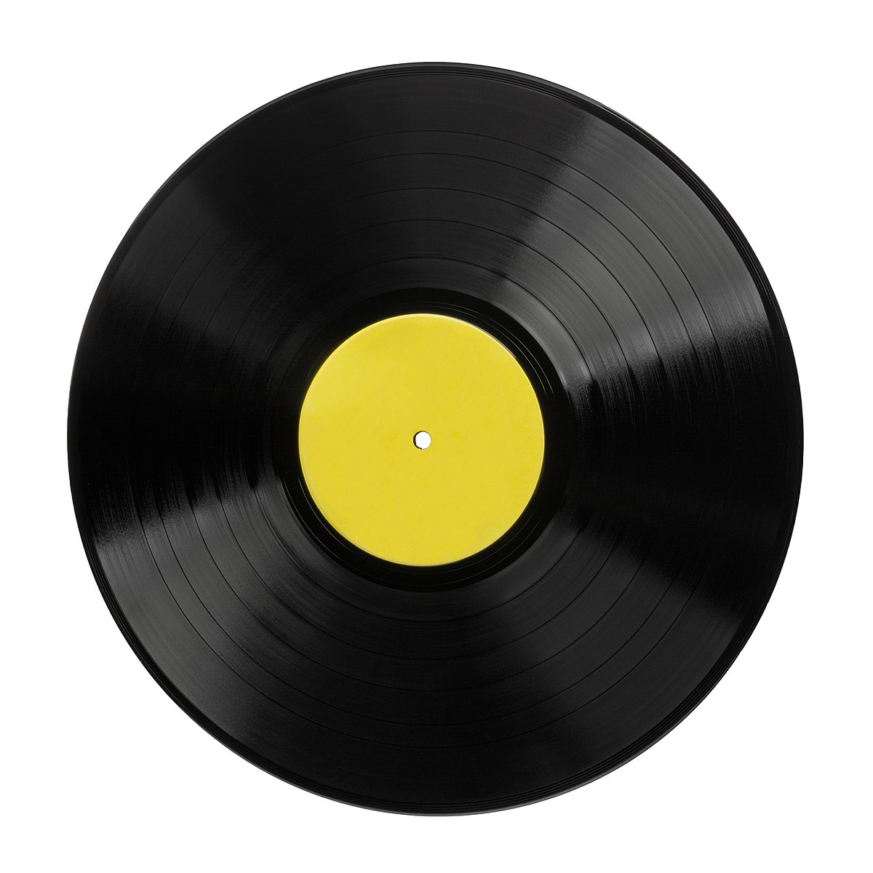
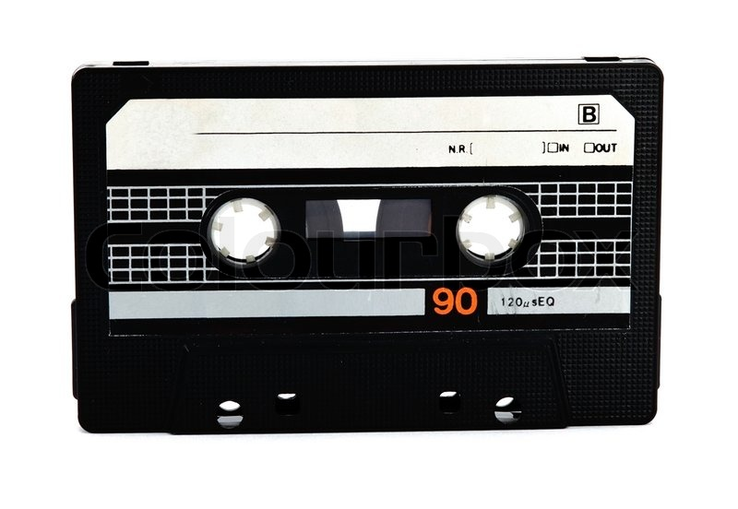
Comparison with Analog audio
Analog audio: scratches and noise in readout impair the sound
Digital audio: error correction allows perfect recovery of the original digital audio

Slide 5
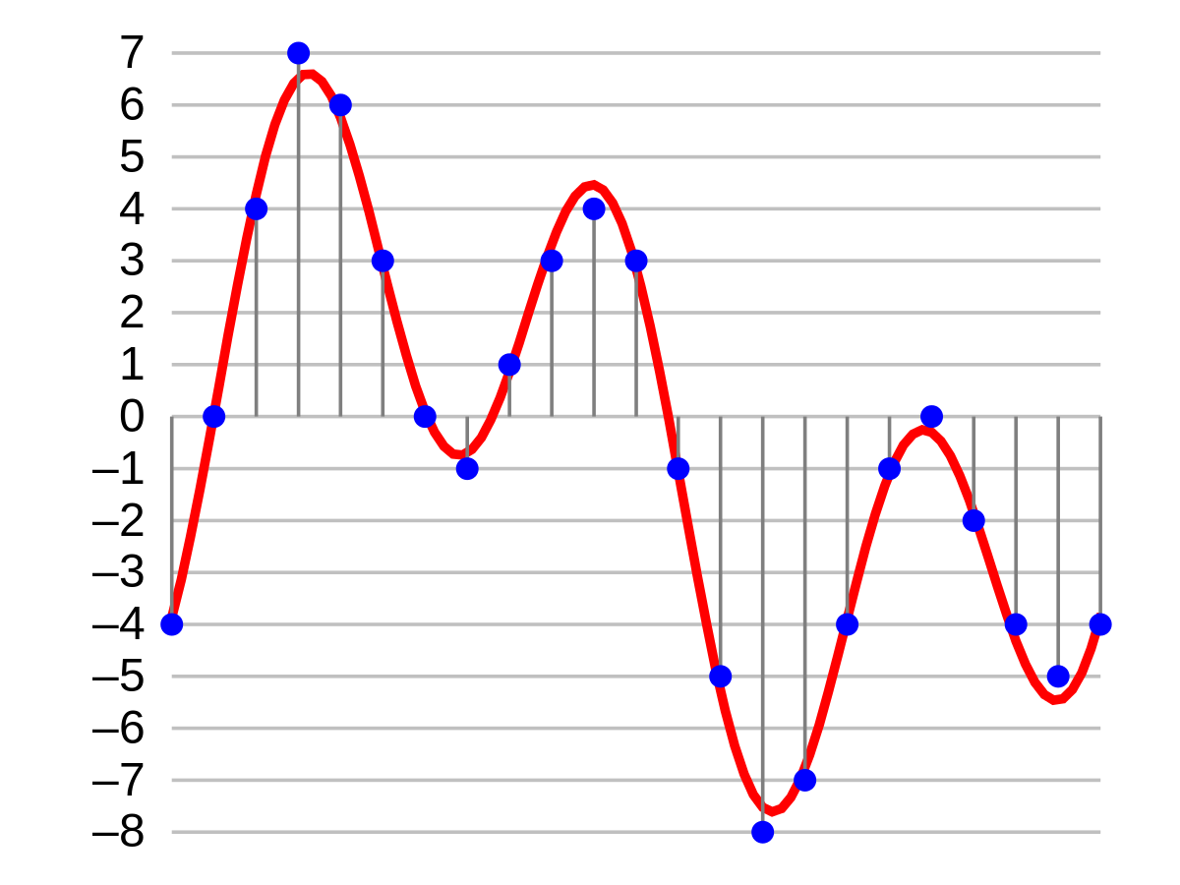
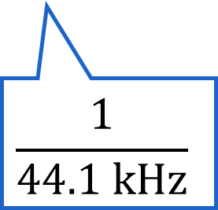
Digital audio
16 bit linear PCM, F_{s} = 44.1 kHz
$$\frac{1}{44.1 \text{kHz}}$$
Example: 4 bit linear PCM

Slide 6
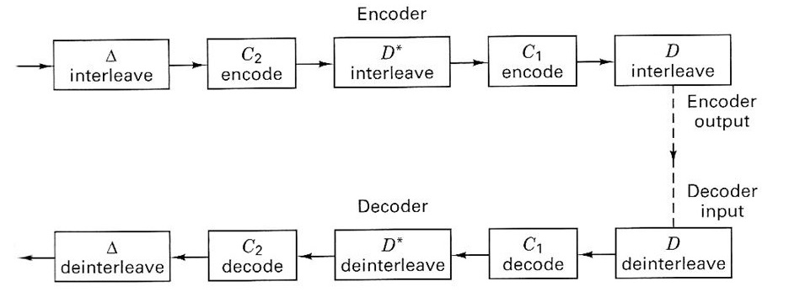
Cross-Interleaved RS coding
Coding to protect from scratches, fingerprints, etc.
Two Reed-Solomon codes separated by an interleaver → result failed decoding C₁ spread over multiple codewords C₂

Slide 7
Project Information
Assignment available on Ufora
The project is implemented in Python
Python: install galois and reedsolo package
A number of files will be available on Ufora, you have to complete the given functions.
Input and output arguments of the functions cannot be altered.

