Slide 1



GH-HeMAB
View in Power BI
Last data refresh:
12/17/2025 9:55:32 AM UTC
Downloaded at:
12/17/2025 9:57:37 AM UTC

Slide 2
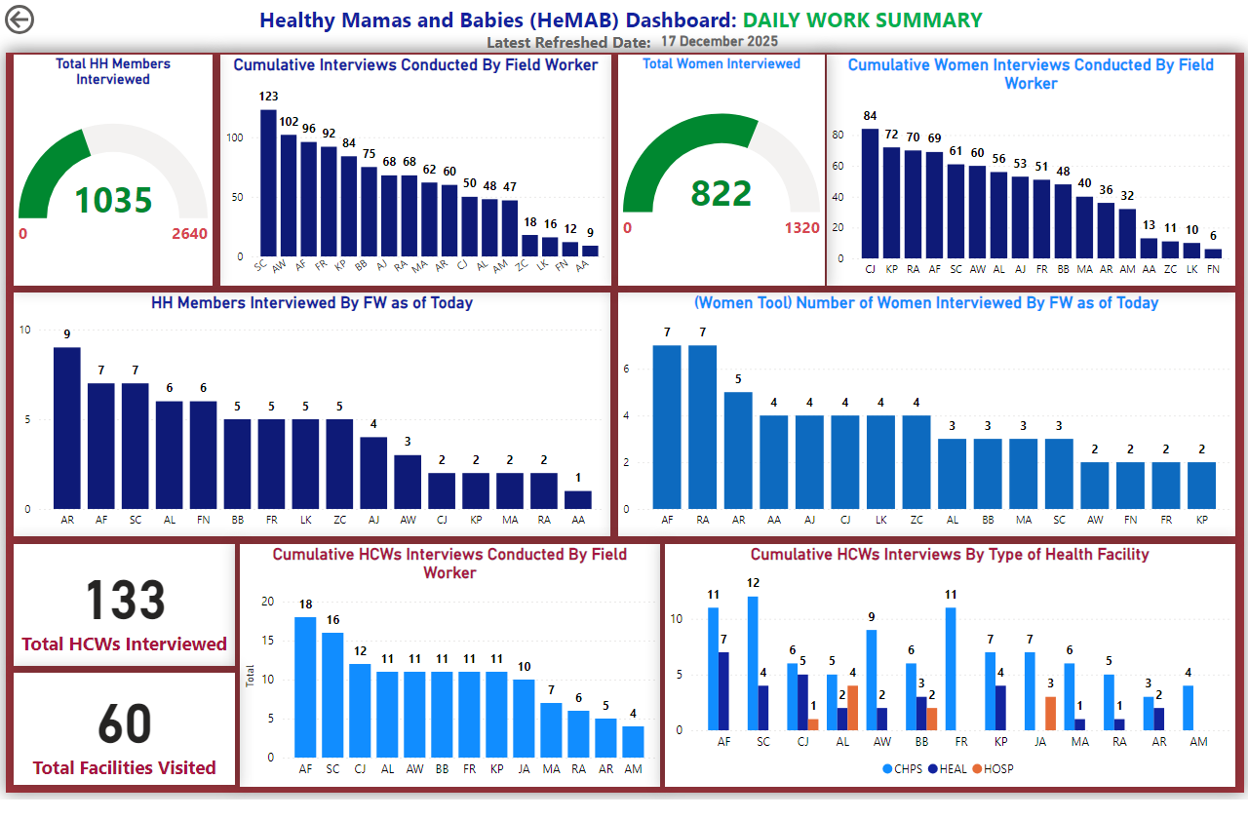
Daily Work Summary
Notes:
HH Members Interviewed By FW as of Today
No alt text provided
actionButton
No alt text provided
card
No alt text provided
textbox
No alt text provided
textbox
No alt text provided
(Women Tool) Number of Women Interviewed By FW as of Today
No alt text provided
shape
No alt text provided
gauge
No alt text provided
Cumulative Interviews Conducted By Field Worker
No alt text provided
gauge
No alt text provided
Cumulative Women Interviews Conducted By Field Worker
No alt text provided
card
No alt text provided
Cumulative HCWs Interviews Conducted By Field Worker
No alt text provided
card
No alt text provided
Cumulative HCWs Interviews By Type of Health Facility
No alt text provided

Slide 3
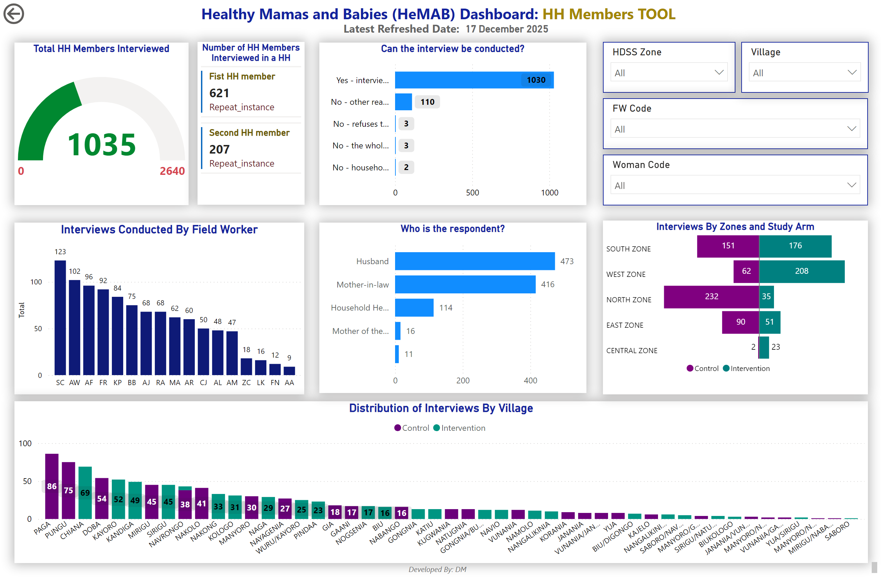
HHmembers-Summary
Notes:
Interviews Conducted By Field Worker
No alt text provided
slicer
No alt text provided
Distribution of Interviews By Village
No alt text provided
actionButton
No alt text provided
card
No alt text provided
textbox
No alt text provided
textbox
No alt text provided
gauge
No alt text provided
Who is the respondent?
No alt text provided
Can the interview be conducted?
No alt text provided
Interviews By Zones and Study Arm
No alt text provided
slicer
No alt text provided
slicer
No alt text provided
slicer
No alt text provided
Number of HH Members Interviewed in a HH
No alt text provided
textbox
No alt text provided

Slide 4
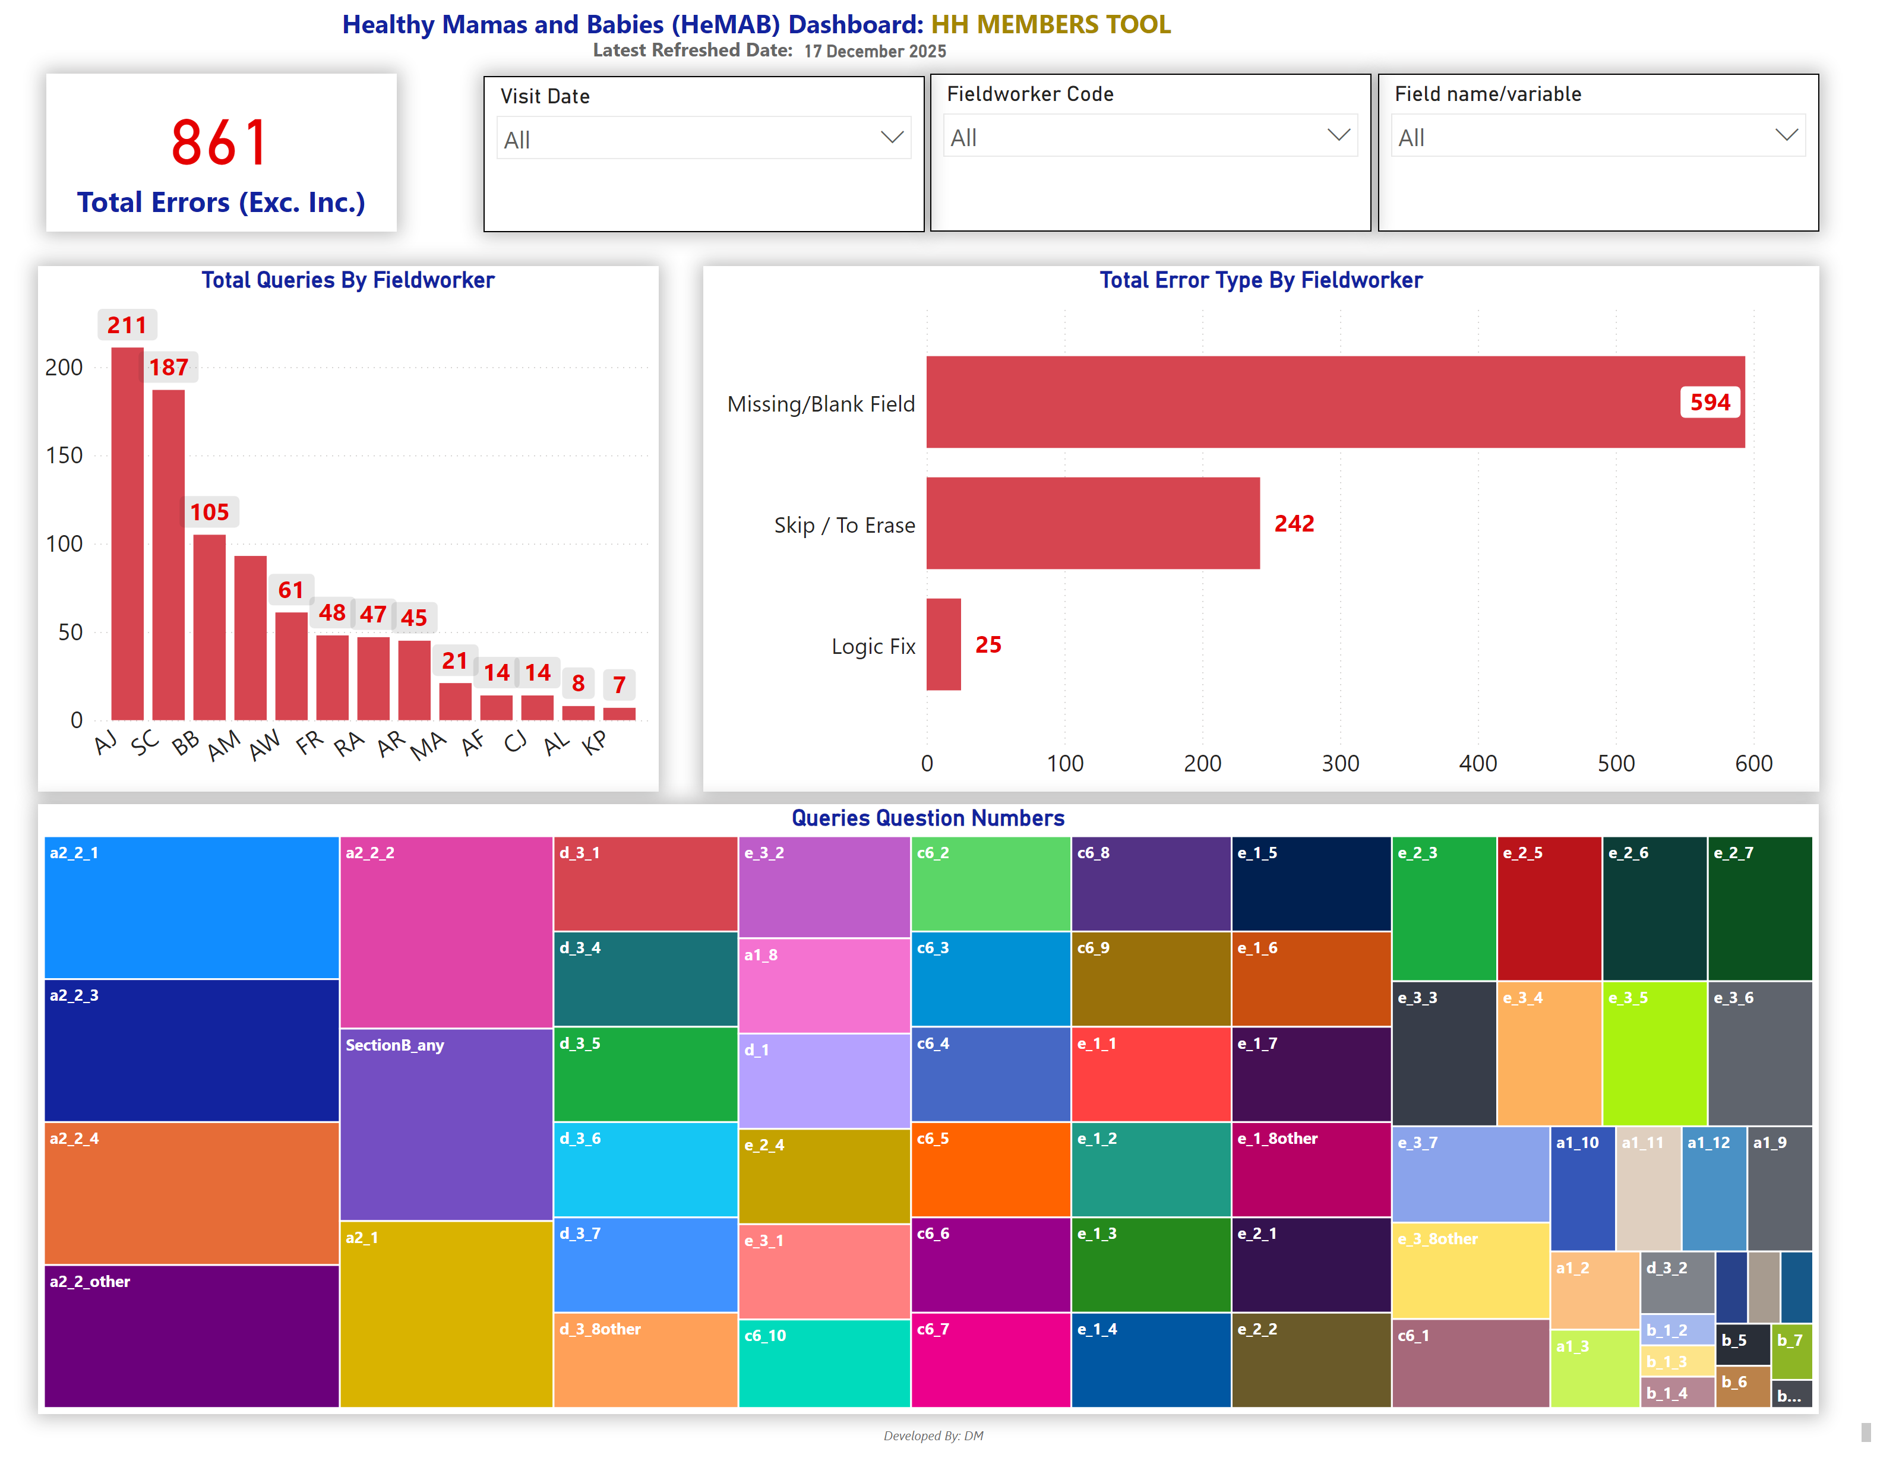
HHmembers-Queries
Notes:
slicer
No alt text provided
card
No alt text provided
Total Queries By Fieldworker
No alt text provided
Total Error Type By Fieldworker
No alt text provided
slicer
No alt text provided
slicer
No alt text provided
Queries Question Numbers
No alt text provided
card
No alt text provided
textbox
No alt text provided
textbox
No alt text provided
textbox
No alt text provided

Slide 5
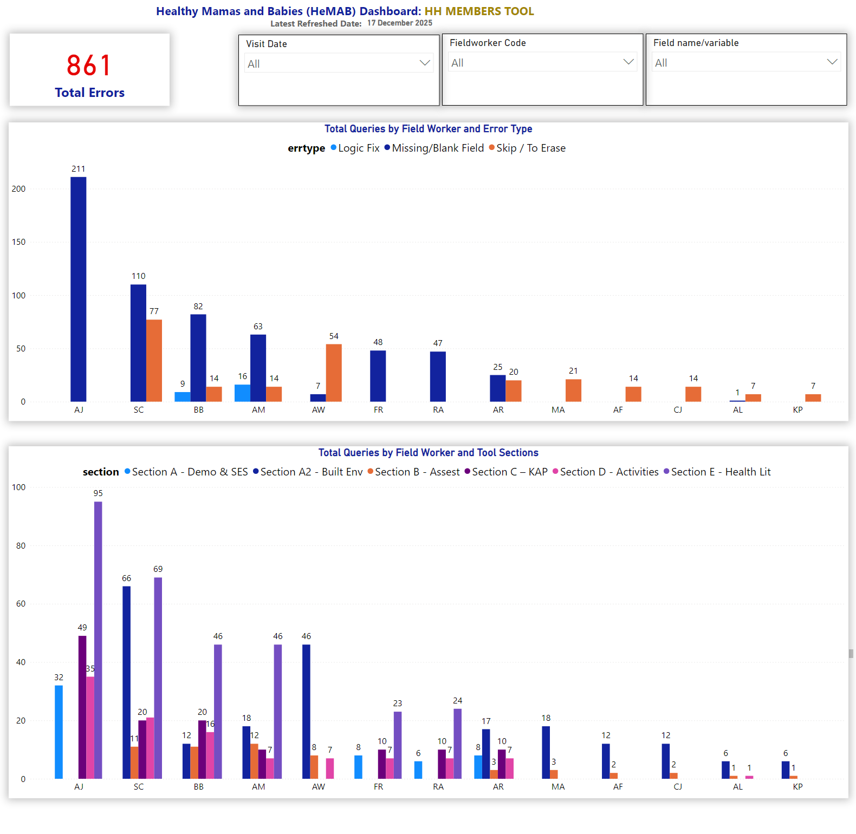
HHmembers-Queries 2
Notes:
slicer
No alt text provided
card
No alt text provided
slicer
No alt text provided
slicer
No alt text provided
card
No alt text provided
textbox
No alt text provided
textbox
No alt text provided
textbox
No alt text provided
Total Queries by Field Worker and Error Type
No alt text provided
Total Queries by Field Worker and Tool Sections
No alt text provided

Slide 6
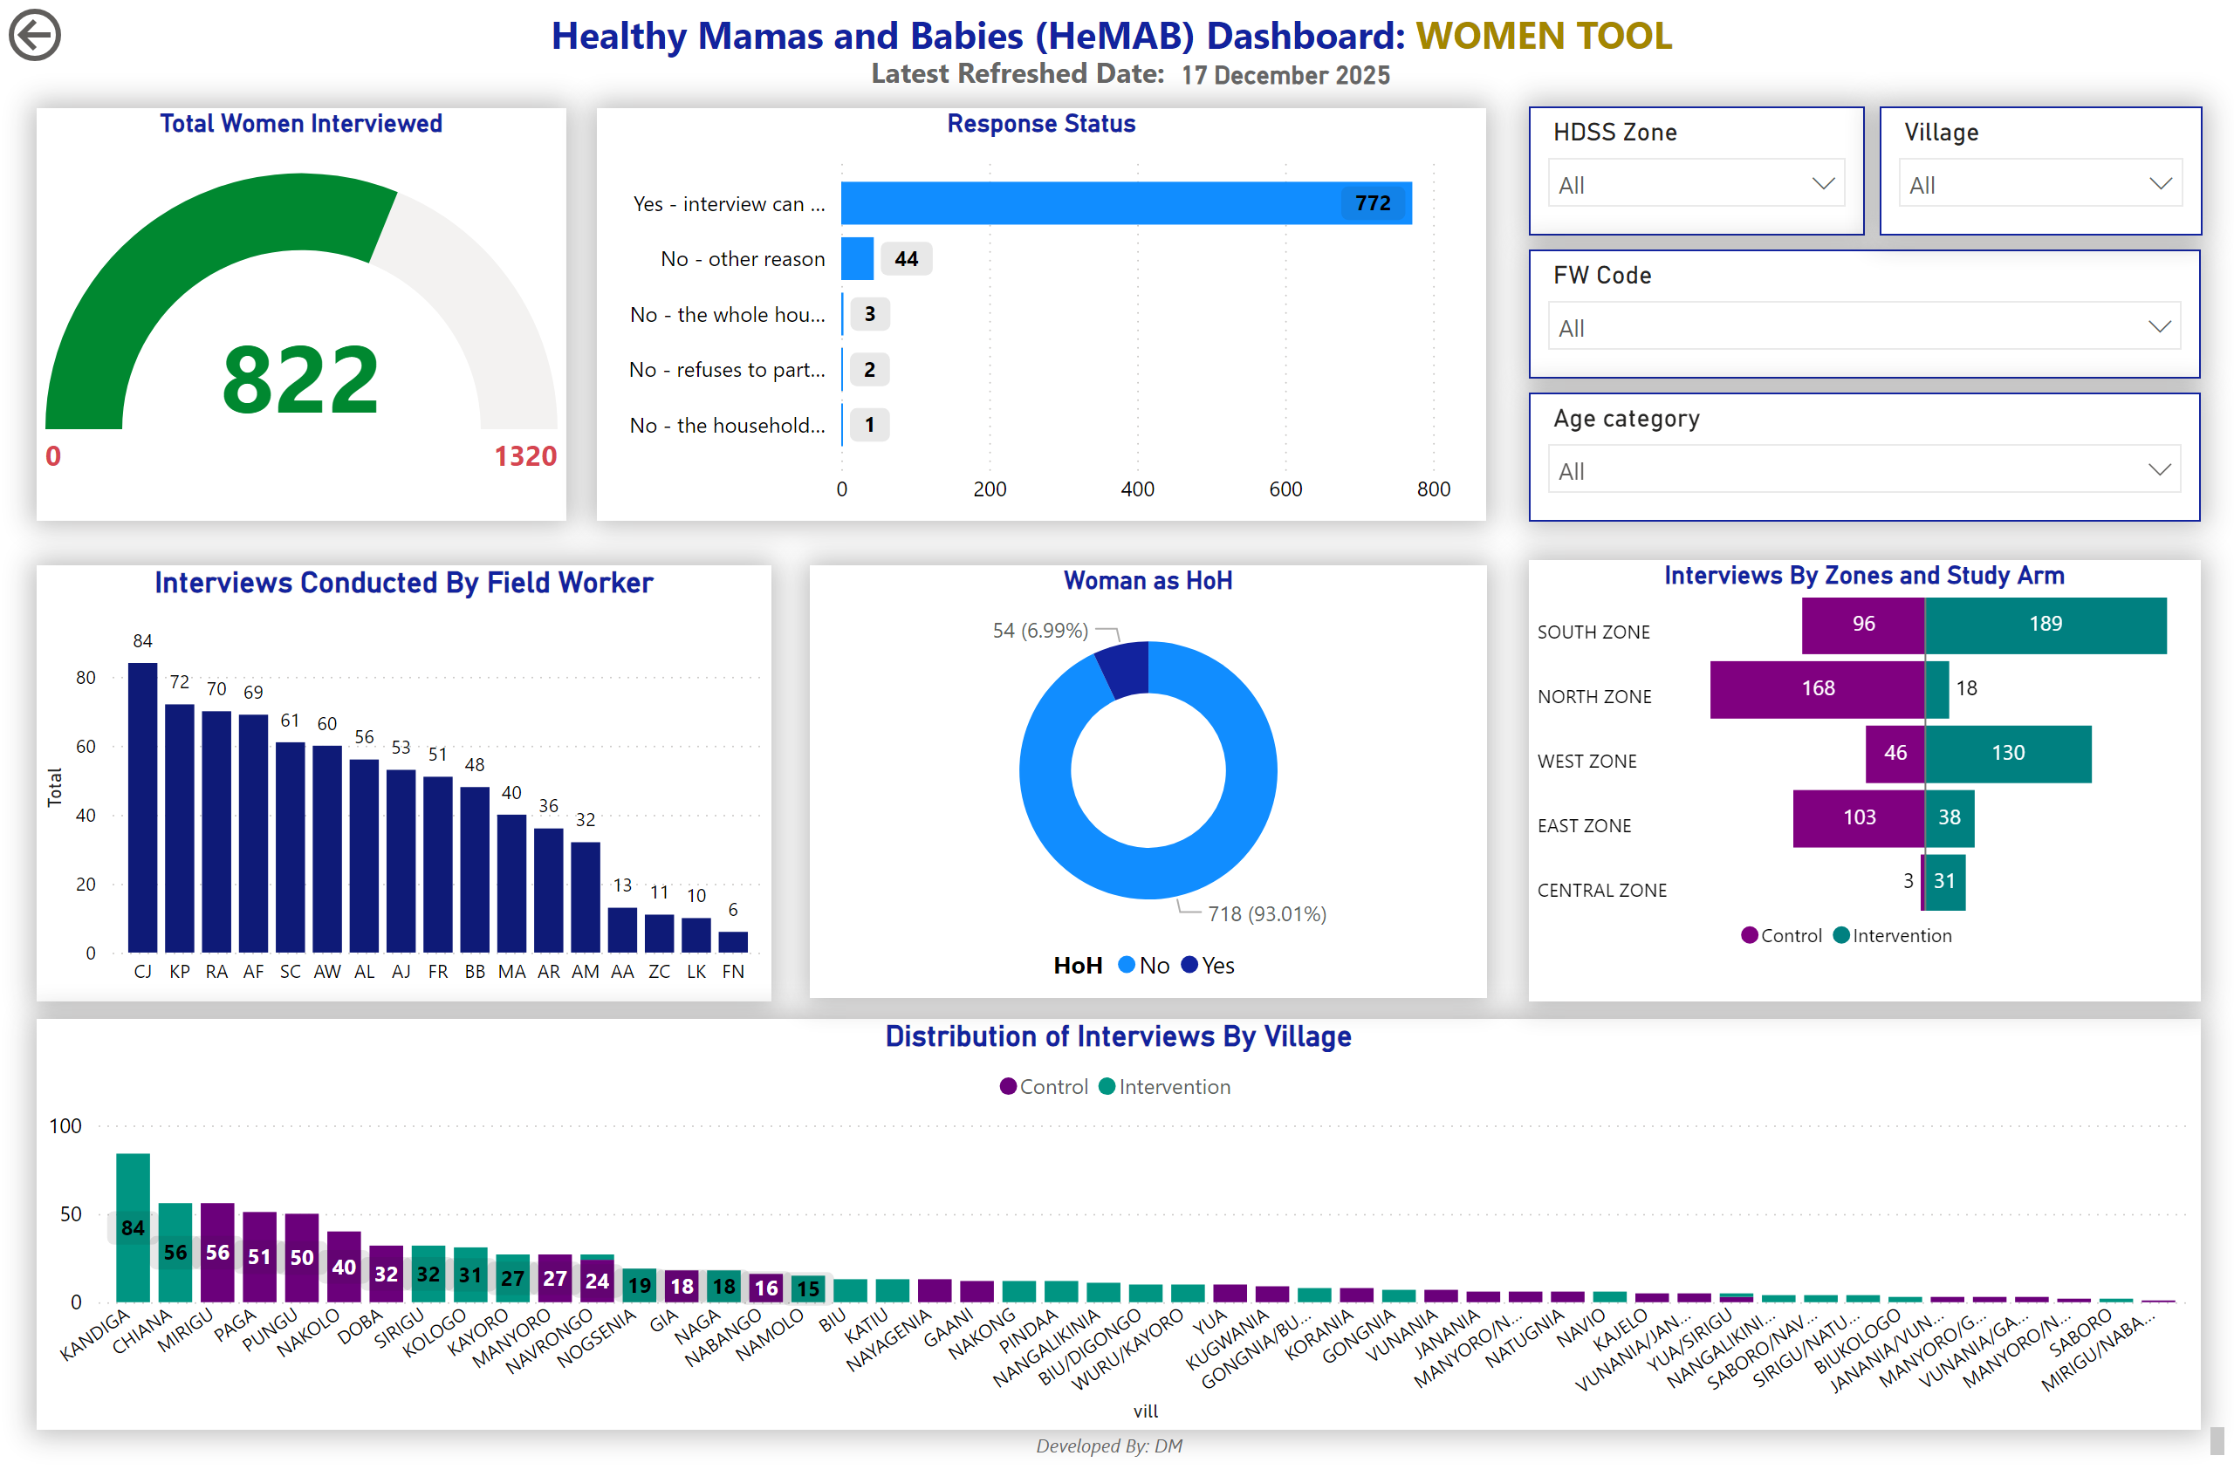
Women-Summary
Notes:
Interviews Conducted By Field Worker
No alt text provided
slicer
No alt text provided
Distribution of Interviews By Village
No alt text provided
actionButton
No alt text provided
card
No alt text provided
textbox
No alt text provided
textbox
No alt text provided
gauge
No alt text provided
Woman as HoH
No alt text provided
Response Status
No alt text provided
Interviews By Zones and Study Arm
No alt text provided
slicer
No alt text provided
slicer
No alt text provided
slicer
No alt text provided
textbox
No alt text provided

Slide 7
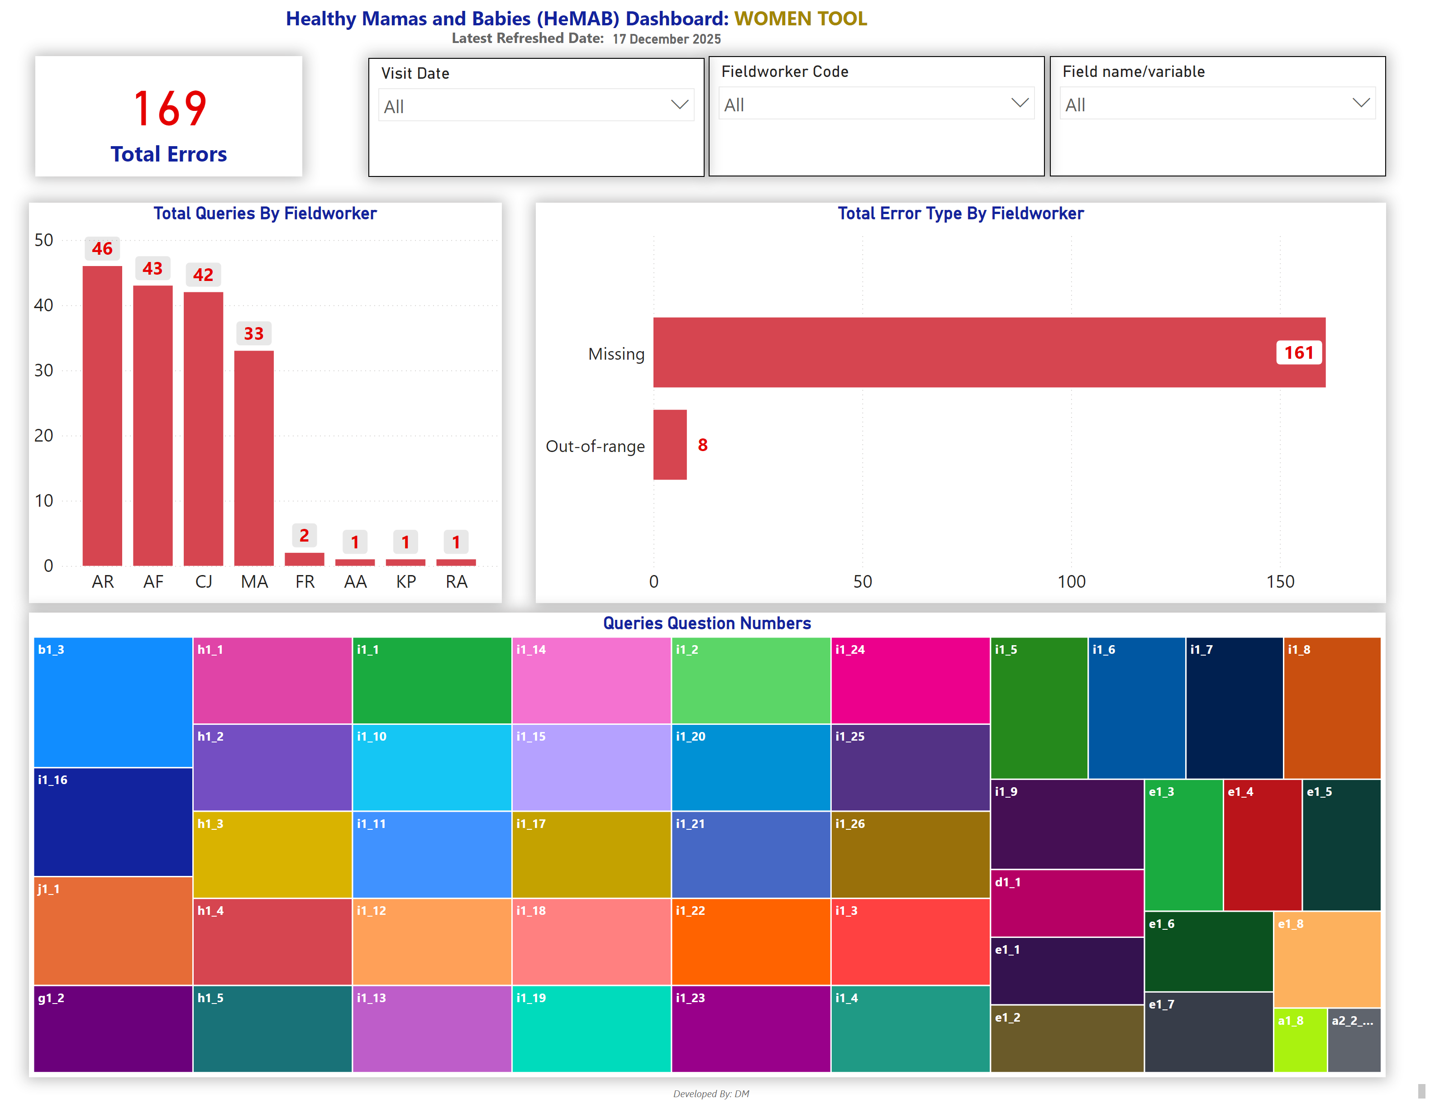
Women-Queries
Notes:
slicer
No alt text provided
card
No alt text provided
Total Queries By Fieldworker
No alt text provided
Total Error Type By Fieldworker
No alt text provided
slicer
No alt text provided
slicer
No alt text provided
Queries Question Numbers
No alt text provided
card
No alt text provided
textbox
No alt text provided
textbox
No alt text provided
textbox
No alt text provided

Slide 8
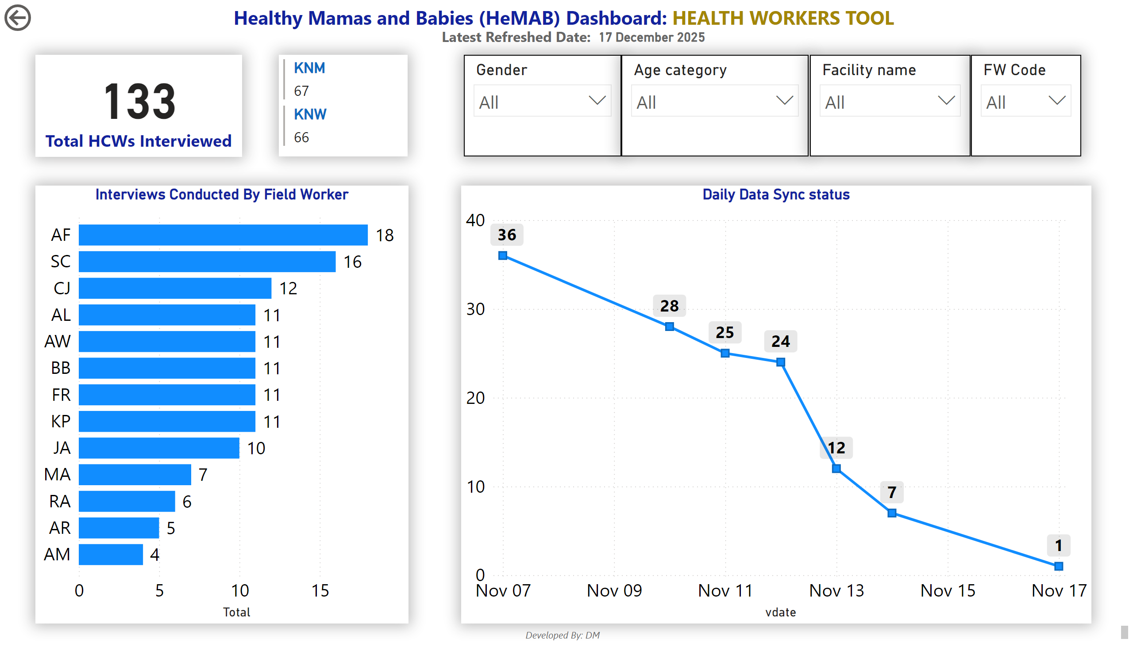
HW-Summary
Notes:
card
No alt text provided
multiRowCard
No alt text provided
Interviews Conducted By Field Worker
No alt text provided
slicer
No alt text provided
slicer
No alt text provided
slicer
No alt text provided
Daily Data Sync status
No alt text provided
actionButton
No alt text provided
slicer
No alt text provided
card
No alt text provided
textbox
No alt text provided
textbox
No alt text provided
textbox
No alt text provided

Slide 9
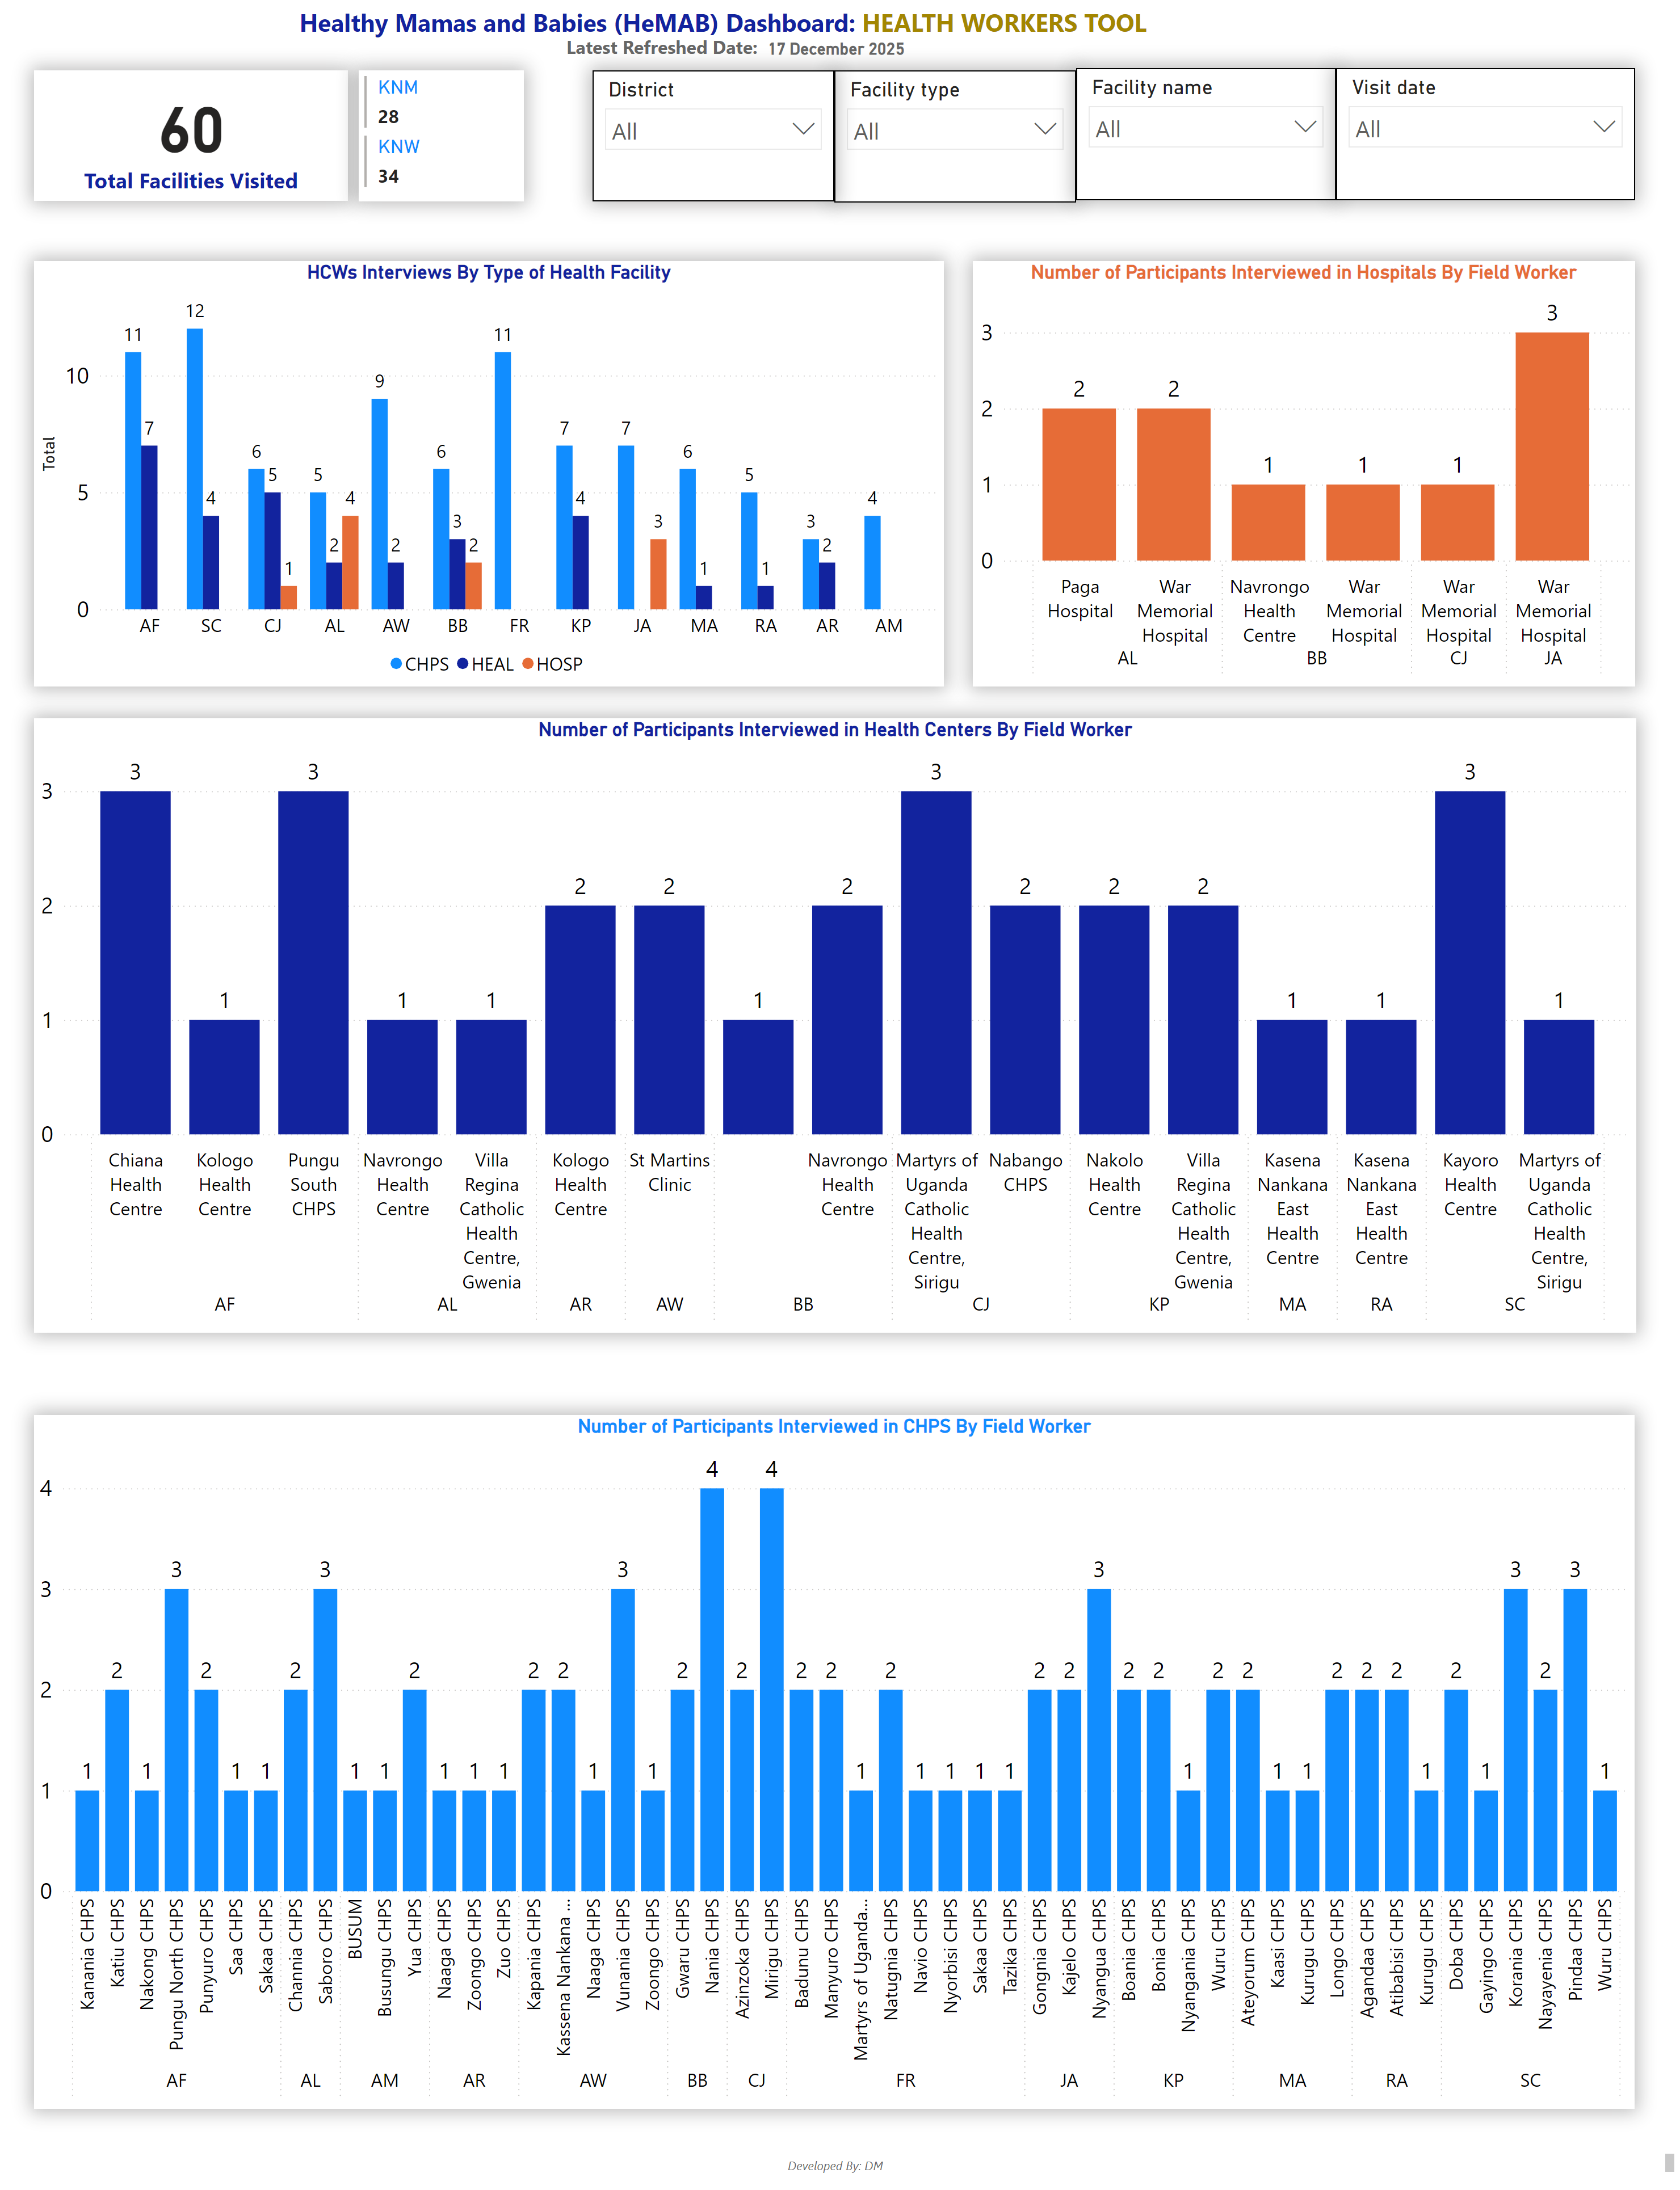
HW-Summary 2
Notes:
card
No alt text provided
multiRowCard
No alt text provided
Number of Participants Interviewed in Hospitals By Field Worker
No alt text provided
slicer
No alt text provided
slicer
No alt text provided
slicer
No alt text provided
slicer
No alt text provided
Number of Participants Interviewed in Health Centers By Field Worker
No alt text provided
Number of Participants Interviewed in CHPS By Field Worker
No alt text provided
HCWs Interviews By Type of Health Facility
No alt text provided
card
No alt text provided
textbox
No alt text provided
textbox
No alt text provided
textbox
No alt text provided

Slide 10
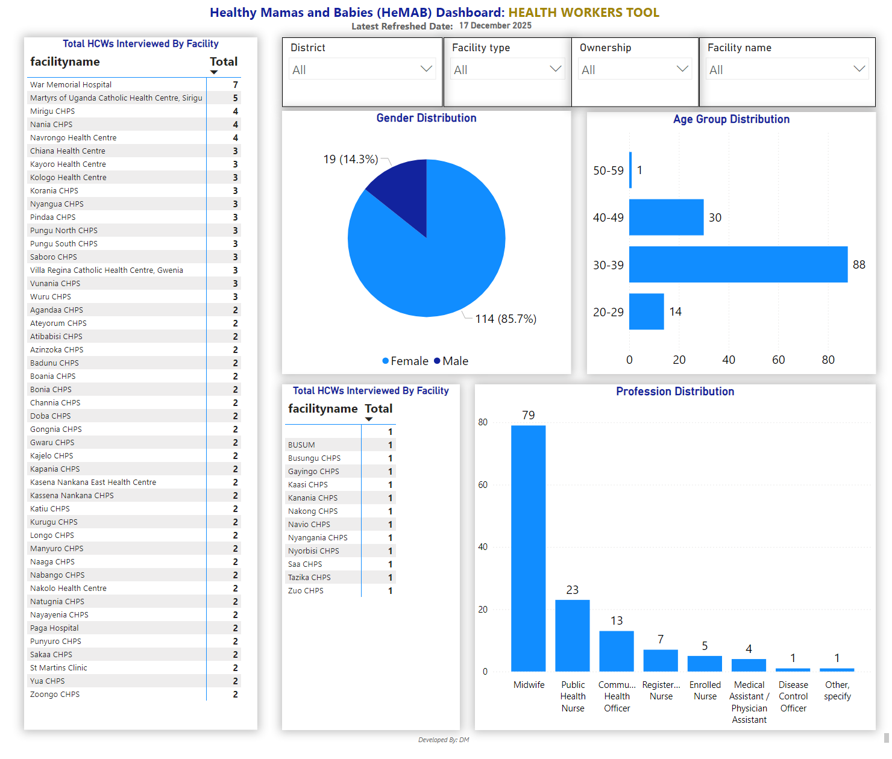
HW-Epid
Notes:
Total HCWs Interviewed By Facility
No alt text provided
slicer
No alt text provided
slicer
No alt text provided
slicer
No alt text provided
Gender Distribution
No alt text provided
Profession Distribution
No alt text provided
Age Group Distribution
No alt text provided
slicer
No alt text provided
card
No alt text provided
textbox
No alt text provided
textbox
No alt text provided
Total HCWs Interviewed By Facility
No alt text provided
textbox
No alt text provided

Slide 11
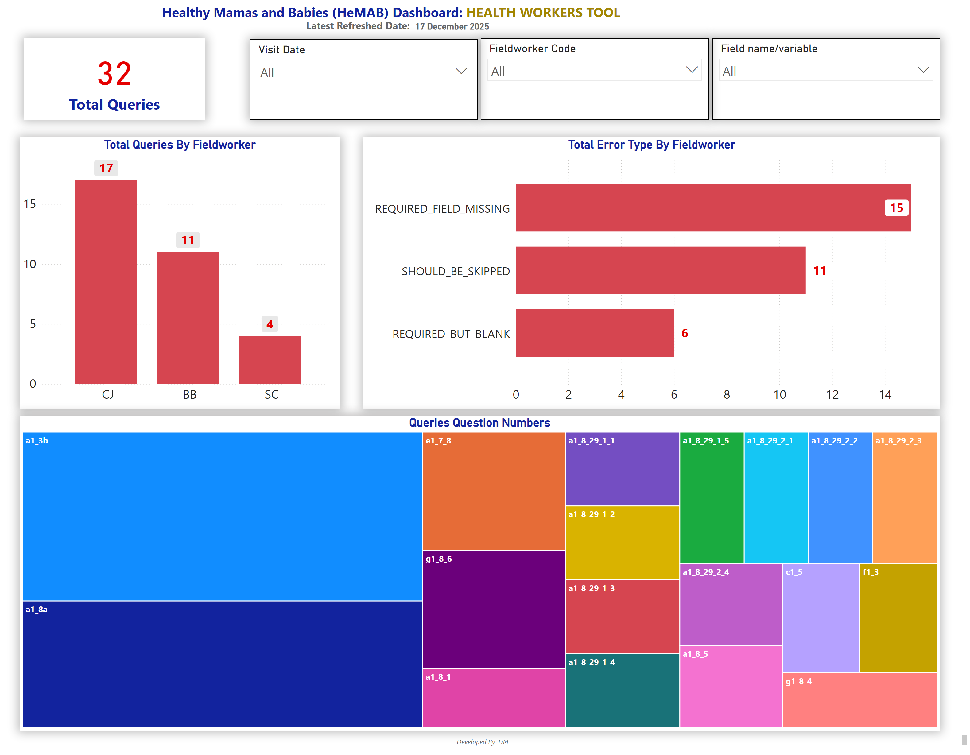
HW-Queries
Notes:
slicer
No alt text provided
card
No alt text provided
Total Queries By Fieldworker
No alt text provided
Total Error Type By Fieldworker
No alt text provided
slicer
No alt text provided
slicer
No alt text provided
Queries Question Numbers
No alt text provided
card
No alt text provided
textbox
No alt text provided
textbox
No alt text provided
textbox
No alt text provided

