Slide 1
FPGA implementation of population-based ant colony optimization

Slide 2
What they were trying to do
In this research paper, the researchers were attempting to implement hardware for a population-based ant colony optimization (P-ACO) on field-programmable gate arrays (FPGAs).
The design they proposed shows moderate space requirements but leads to a significant reduction in runtime over software-based solutions.

Slide 3
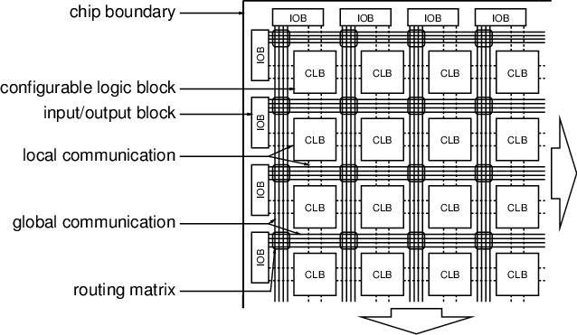
Background information
Ant colonies are capable of finding shortest paths between their nest and food sources.
Parallel versions of ACO algorithms have been studied by several authors before.
FPGAs (Field-Programmable Gate Arrays) are a device used to create digital circuits.
SMTTP (Single Machine Total Tardiness Problem)
Notes:
Line 1 - ants communicate indirectly by disposing traces of pheromone as they walk along a chosen path.
Line 2 - Most used the parallel approach simply to gain speedup by performing the solution construction of the ants in parallel without any significant changes to the solution construction and pheromone update mechanisms
Line 3 - An FPGA is, in essence, a computer chip that can rewire itself for a given task. (https://en.wikipedia.org/wiki/Parallel_computing#Hardware)
We show that ACO can also be implemented on FPGAs, leading to significant speedups in runtime compared to implementations in software on sequential machines.
FPGAs especially find applications in any area or algorithm that can make use of the massive parallelism offered by their architecture. The inherent parallelism of the logic resources on an FPGA allows for considerable computational throughput even at a low MHz clock rates. (http://www.imagsa.com/main/index.php/faq/61-fpga)
One of the best features of using FPGAs for a design is the inherent parallelism, with an FPGA you can enjoy massive parallelism since all the pieces are just hardware. (https://hackaday.com/2018/05/19/parallel-programming-for-fpgas/)
SMTTP is a problem where a job set must be scheduled on a single machine where each job j, a processing time, and a due date are defined.
The problem asks for arranging the job set into a sequence so as to minimize the completion time of job
It is an NP hard problem, which no known algorithm can solve it in a polynomial time.
https://www-sciencedirect-com.ezproxy.uwe.ac.uk/science/article/pii/S0304397518304079

Slide 4

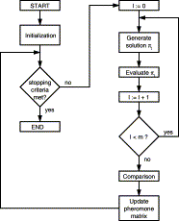
Standard ant colony optimization
The objective of ACO is to find good solutions for a given combinatorial optimization problem
Notes:
The problems considered usually allow solutions to be expressed as a permutation (π) of (n) given items.
Every decision is made randomly according to a probability distribution over the so far unchosen items in selection set S:

Slide 5
Issues with standard ant colony optimization
When developing an ACO design for FPGAs, they encountered several restrictions that make a hardware realization difficult:
Pheromone values and the random numbers used require a floating point representation.
Evaporation, and the integration of heuristic information, requires multiplication operations.
To make a selection according to the probability distribution, they had to calculate prefix sums of the products in the numerator over the as yet unchosen items in the selection set S (probability distribution equation)
Notes:
Such a representation does not lend itself to a fine-grained programmable logic implementation.
(2) However, the computational resources available on an FPGA do not efficiently support the implementation of multiplication circuits. Only a few FPGAs have dedicated multiplication blocks and these are restricted in size.
(3) Therefore, n circuits for prefix sum calculations have to be provided, one circuit per row in the pheromone matrix. The required space and time complexity is prohibitive even for the comparatively large present day programmable gate arrays.

Slide 6
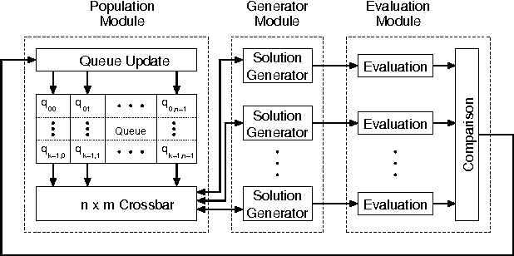
Implementing P-ACO on FPGA
Notes:
At high level, the mapping of the P-ACO algorithm into the corresponding FPGA design is straightforward and consists of three main modules: Population, Generator and Evaluation modules.

Slide 7
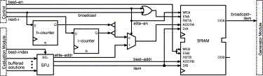
Population Module
The Population module contains the population matrix Q=[qij]n×k
[qij] is the number of a job to be scheduled, in reference to SMTTP
n is permutation of the items
k is the best solutions
Population can be stored in nxk
Population Matrix Q = [qij]n×k
Notes:
Population Module-
The Population module is responsible for broadcasting items (qih) in the ith row of the population matrix to the Generator module.
Q is population matrix
This matrix is called the population matrix. It contains the best solution of each of the preceding k iterations.
Each item qij is the number of a job to be scheduled, in reference to SMTTP
N * K - Solutions represented by a matrix of integer numbers that is better suited to current field-programmable technology.
Since each solution is a permutation of the n items, the population can be stored in an n×k (k = best solutions) matrix Q=[qij], where each column of Q contains one solution.

Slide 8
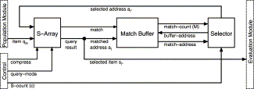
Generator Module
The generator module holds solution generators working concurrently
Notes:
Generator module - One Solution Generator per ant. The solutions are transferred from there to parallel Evaluation Blocks in the Evaluation module

Slide 9

Evaluation Module
This module is used to evaluate the solutions generated by the Solution Generators
The implementation of the P-ACO circuit is done in a way so that it does not retard the beginning of the next decision, this is in regards to SMTTP
Solutions are generated in parallel
Notes:
Evaluation Module -
With respect to SMTTP, the selected job is evaluated by calculating its job-tardiness which is then added to the intermediate tardiness sum over all previously scheduled job.
Such an Evaluation block takes problem-specific evaluation parameters (e.g. job processing times and deadlines for the SMTTP) and calculates the objective function value of a solution arriving from a Solution Generator.
If a solution cannot gradually be evaluated after each decision then the complete solution is evaluated after the last decision has been made. In every iteration m, solutions are generated in parallel. Afterwards, these solutions are compared by their evaluation quality and the population is updated
The Comparison block determines the best solution of the iteration and the new elite solution (if found) to be stored into the population. The design of the Comparison block for SMTTP is shown in. A comparator tree reduces the logic delay of the Comparison block. The index (best-index) of the Solution Generator, which constructed the best solution, is forwarded to the Population module.

Slide 10
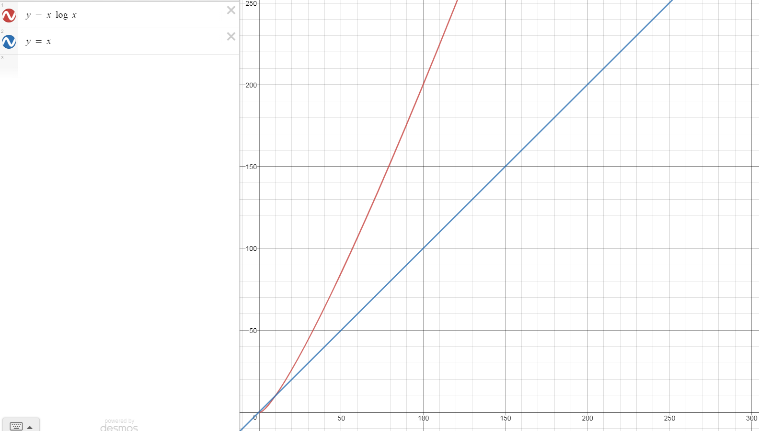
Population-based ant colony optimisation
For every ant decision in ACO, the probability distribution has to be computed.
By using parallelisation, this operation can use O(log n) instead of O(n)
Notes:
On a sequential machine, this requires O(n) multiplication and addition steps.
By parallelising, or by implementing in hardware, this operation the time complexity could be reduced to O(log n) steps.
O(log n) steps is quicker and rises exponentially, but is a little slower with little items to deal with, where O(n) multiplication is constant and only quicker with little items
This process uses ants so there is many items
P-ACO transfers less and only the most important information from one iteration of the algorithm to the next.
Instead of a complete pheromone matrix as in ACO, P-ACO transfers a small population P of the k best solutions that have been found in past iterations.

Slide 11
Results (Hardware vs Software)
Notes:
They compared the P-ACO algorithm implemented in software against the hardware realization.
Since the software and hardware versions produce the same solutions, their performances are compared by means of the required time per iteration.

Slide 12
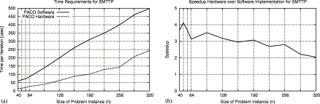
Comparison of hardware and software implementation of P-ACO for fixed m(solutions)=8.
First graph is time requirements per iteration
Seconds graph is Speedup of hardware over software implementation
Notes:
The execution time per iteration for hardware and software implementations grow with a linear trend as the problem size is increased.
But the hardware version runs faster for every problem size

Slide 13
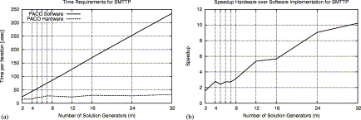
Comparison of hardware and software implementation of P-ACO for fixed n(problem size)=64
First graph is time requirements per iteration
Second graph is Speedup of hardware over software implementation
Notes:
Shows that the time per iteration in software grows with a linear trend as the number of Solution Generators is increased; whereas for the hardware implementation, the time requirements remain on an almost constant level of approximately 28 microseconds
From the P-ACO perspective this means that within certain constraints they can easily increase the degree of parallelism (in terms of concurrently working ants) with only a marginal decline in execution speed.

Slide 14
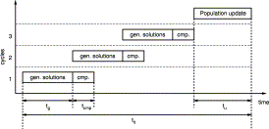
Modifications
In every cycle m′, solutions are generated in parallel.
Notes:
If a problem size n is given, the available resources might constrain the number of Solution Generators that can be implemented on the FPGA device. We propose implementing only m′<m Solution Generators operating in g cycles, where m=gm′ (see Fig). In every cycle m′, solutions are generated in parallel. Afterwards, these solutions are compared by their evaluation quality. After each cycle, the newly created solutions are compared among each other, and the best solution of the current cycle is compared with the best solution of all preceding cycles.

Slide 15
Conclusion
They have presented a mapping of population-based ant colony optimization to an FPGA architecture. In doing so, they have implemented new ways for dealing with the pheromone information, which asymptotically have led to significant improvements in runtime and area requirements in comparison to the standard ACO algorithm if it was implemented in hardware.
Test results of an FPGA implementation for the SMTTP problem have shown a considerable speedup over a software implementation, especially for a large number of ants per iteration.

Slide 16
Comments on the paper
Image resolution of their graphs and diagrams is too small

