Slide 1

An Introduction to Programming With Python
September 22th, 2017, Cal State Fullerton
Center for Computational and Applied Mathematics
(Part-2)
Arjang Fahim, PhD
Department of Biomedical Engineering
University of California, Irvine

Slide 2
Libraries in Python Introducing numpy, pandas, matplotlib

Slide 3

Enhancing Python with Libraries
Out of the box there are many functions available to you in Python
But you are not limited to the ‘out of the box’ version of Python and there are entire libraries of functions that are available to use within Python

Slide 4
Python’s Standard Library
Python’s standard library is very extensive
The standard library provide access to functionality such as I/O that would otherwise be inaccessible to Python programmers
Additionally it provides standardized solutions to many problems that occur in programming
Often in Python it’s worth checking to see if someone has done it before you reinvent the wheel

Slide 5
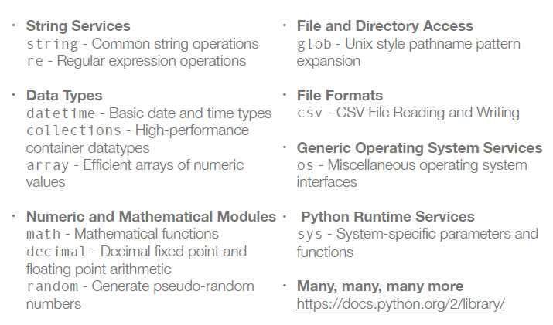
Common Modules, Packages, Solutions

Slide 6
Using external modules and libraries
It’s nice that all of these modules and libraries exist, but it isn’t apparent yet how to interface with them
Python has a syntax for imports, for example
import math
import math.pi
The above makes the module math available for the code. The second line prints the attribute pi from the math module
To see all of the functions available to the math module see
https://docs.python.org/2/library/math.html

Slide 7
Using external modules and libraries
There is an alternative way of importing modules and packages where we shorten their names
This is especially useful because using the ‘dot’ – notation of the python objects can require a lot of typing and programmers want to minimize their typing as much as possible
This motivates the “as” statement
import math as m
print m.pi

Slide 8
Importing specific functions
If we wanted to be really aggressive we could import all of the functions and attributes from a library with the following notation
from math import *
Generally this is unadvisable ! ( Don’t do it)
Consider
pi = 5
from math import pi
print pi
We see that pi has been replaced by the value from the math module. We’re getting into the types of programming that makes us dangerous if we’re not careful

Slide 9
Command-line Example

Slide 10
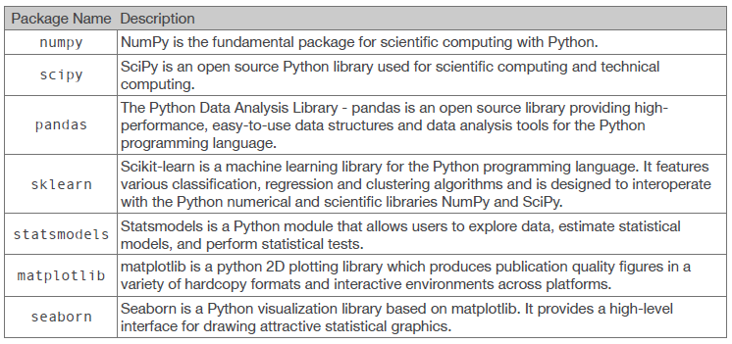
Libraries for Data Science

Slide 11
Getting started with NumPy
NumPy is imported into python as the identifier np
Import numpy as np
This is the first package to get familiar with for working with data
Provides data structures for creating arrays and matrices and for manipulating them

Slide 12
NumPy arrays
NumPy arrays are one of the reasons for the packages success
my_array = np.array([1, 2, 3.])
They can also be used to create multidimensional arrays
matrix_array = np.array([[1, 2], [3, 4]])
They look awfully familiar to lists …

Slide 13
NumPy arrays VS. Lists
A simple check of the methods available to the two objects shows the major advantages of lists vs. numpy arrays
a = [ [ 1, 2] , [3, 4] ]
b = np.array( [ [ 1, 2], [3,4] ])
print dir(a)
print dir(b)

Slide 14
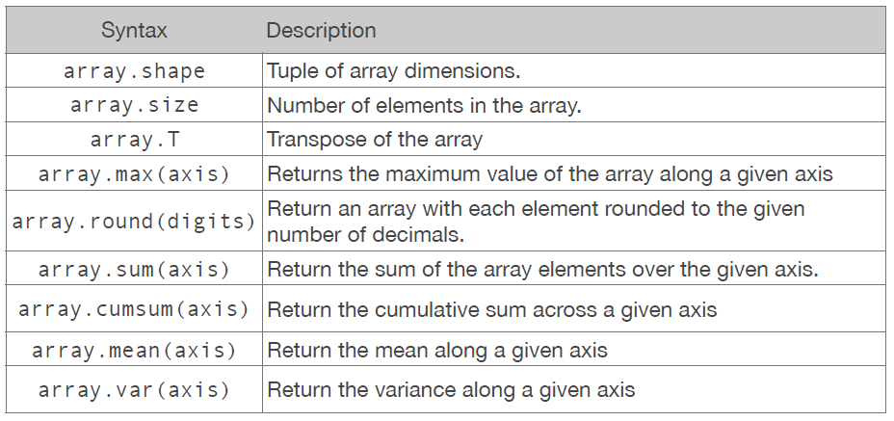
Some Methods and Attributes for Arrays
Here are a sample of some useful methods and attributes of arrays

Slide 15
But numpy has Matrix Object?
NumPy provides, in addition to np.array( ), an additional np.matrix( ) type that you may see used in some existing code. Which one to use?
Short answer? Use np.array ( )
NumPy provides the matrix class for matrix algebra, but you can almost consider it a “subclass” in numpy.
Additionally, array are the standard vector/matrix/tensor type of numpy. Many numpy functions return arrays, not matrices.
Any algebra you would want to use on matrix object is available to an array object

Slide 16
Matrix Operations in numpy
Matrix multiplication can be done using the .dot() method
A = np.array([ [ 1, 2], [3, 4] ] )
b = np.array( [1, 2])
print np.dot (A, b.T) # Matrix Mult
print np.dot (A, b) # numpy fixes dim
print A.dot (b) # Chained method
print A * b # Element-wise

Slide 17
Linear Algebra Operation – numpy.lialg
There are other linear algebra functions within
numpy.linalg
A = np.array([ [ 1, 2], [3, 4] ] )
b = np.array( [1, 2])
A_inv = np.linalg.inv(A) # inverse
A_det = np.linalg.det(A) # determinant
A_svd =np.linalg.svd(A) #sing. Val.decomp

Slide 18
Examples numpy1.py, numpy2.py

Slide 19
Getting started with Pandas
Pandas builds on the functionality of numpy, but introduces data frames
import pandas as pd
DataFrames are two-dimensional tabular data structure ( very similar to data frames in R)
Here the data is actually composed of numpy array! Therefore much of what we just learned is still useful
Named columns for easy access
We now have almost everything we had with numpy array, but with more functionality

Slide 20
A few ways to create a DataFrame
fake_data = np.array ( [ [ ‘AJ’, 36], [‘Brett’, 29], [‘Jake’, 26], [‘Bob’, 57 ] ] )
data_set = pd.DataFrame ( fake_data, columns = [‘Name’, ‘Age’])
print data_set.Name
print data_set.Age
Or
fake_data = {‘Names’ : [‘AJ’, ‘Brett’, ‘Jake’, ‘Bob’], ‘Age’ : [36, 29, 26, 57] }
print data_set.Names
print data_set.Age

Slide 21
Reading Files with Pandas is Easy
Another reason for using pandas is the ease with which it brings data into python
pd.read_csv (some_file)
This function can take in many arguments to customize its behavior, but it generally works well without any modifications

