Slide 1
Autonomous Underwater Vehicle Status Update (9/25/2023)
William Buhrig, Nick Eoff, Tom Herlihy, Matt Laverty, Justin Day

Slide 2
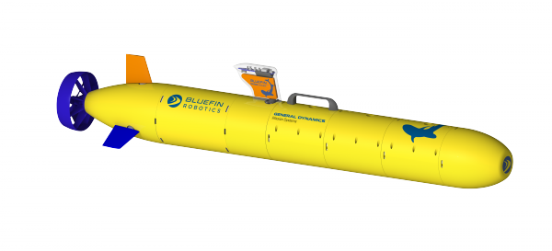
Outlook on Semester Goals
Waterproofing
Raspberry Pi Coding
Buoyancy
Remote transmission

Slide 3
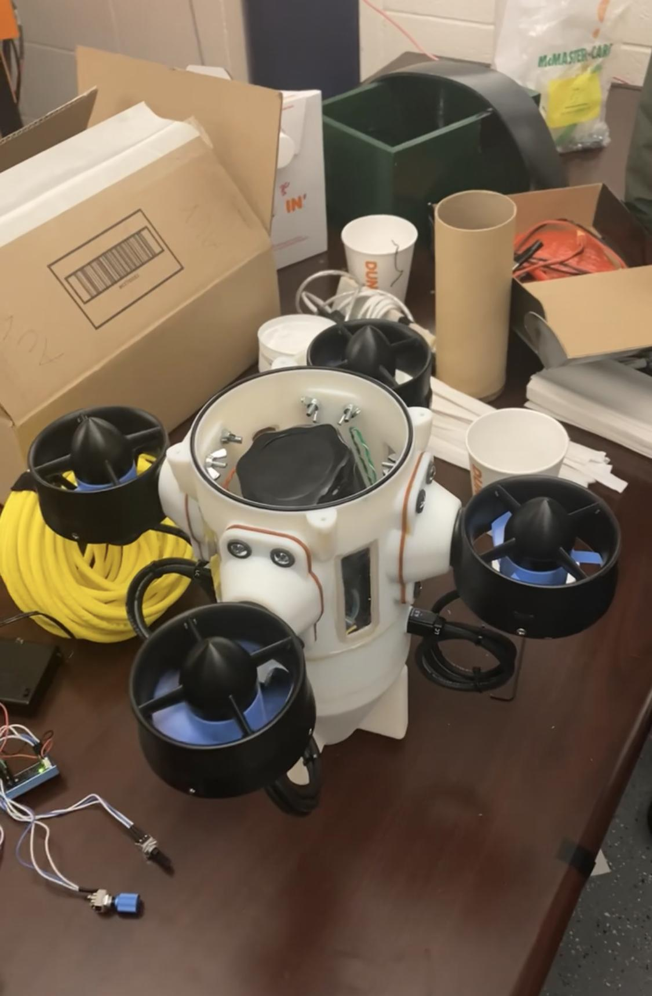
Waterproofing
In our first round of testing it was found that the O-ring on the top part of the AUV was leaking water.
Install thicker O-ring.
Apply lubricant to improve water resistance.

Slide 4
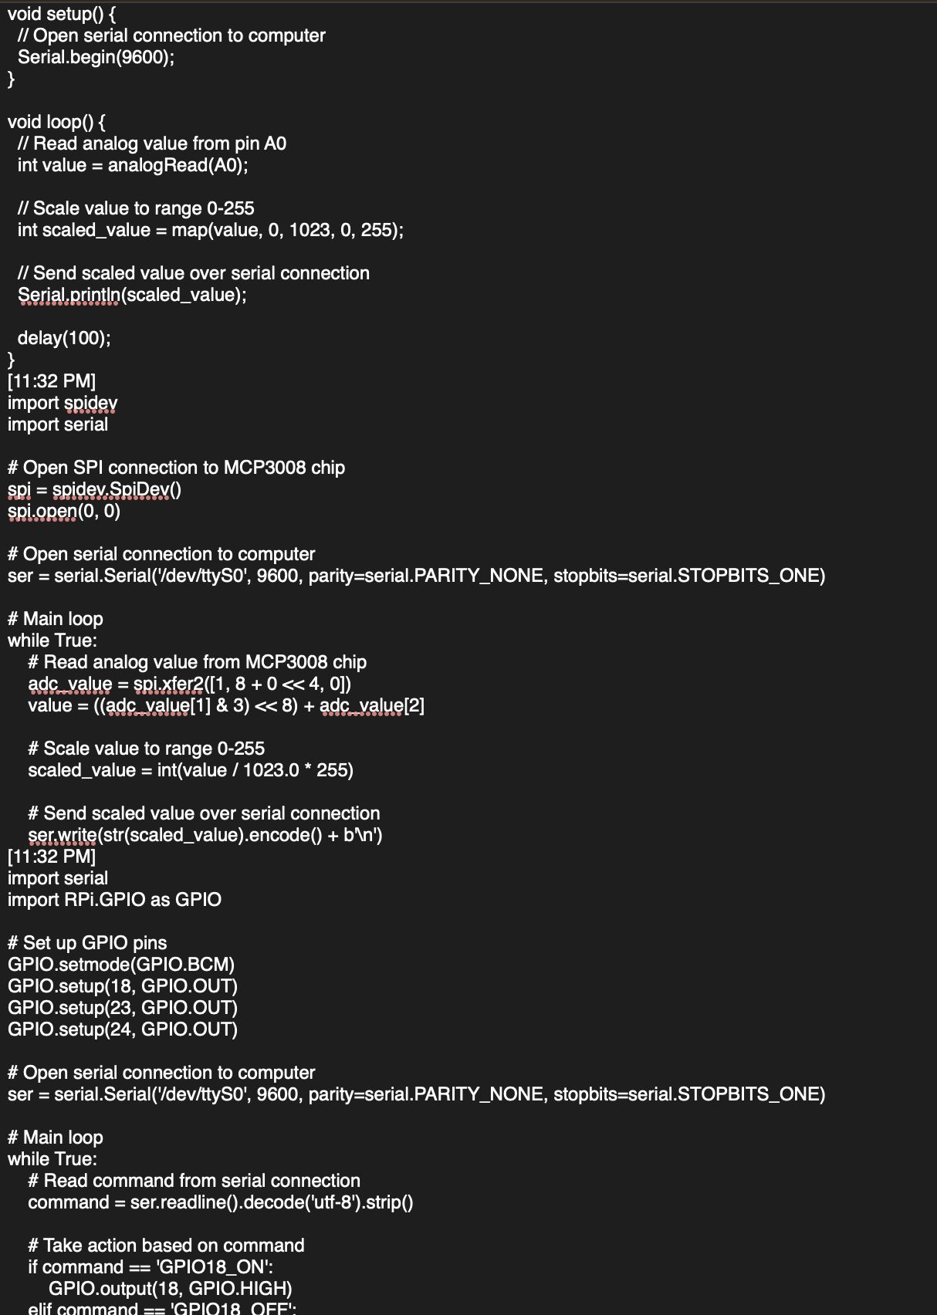
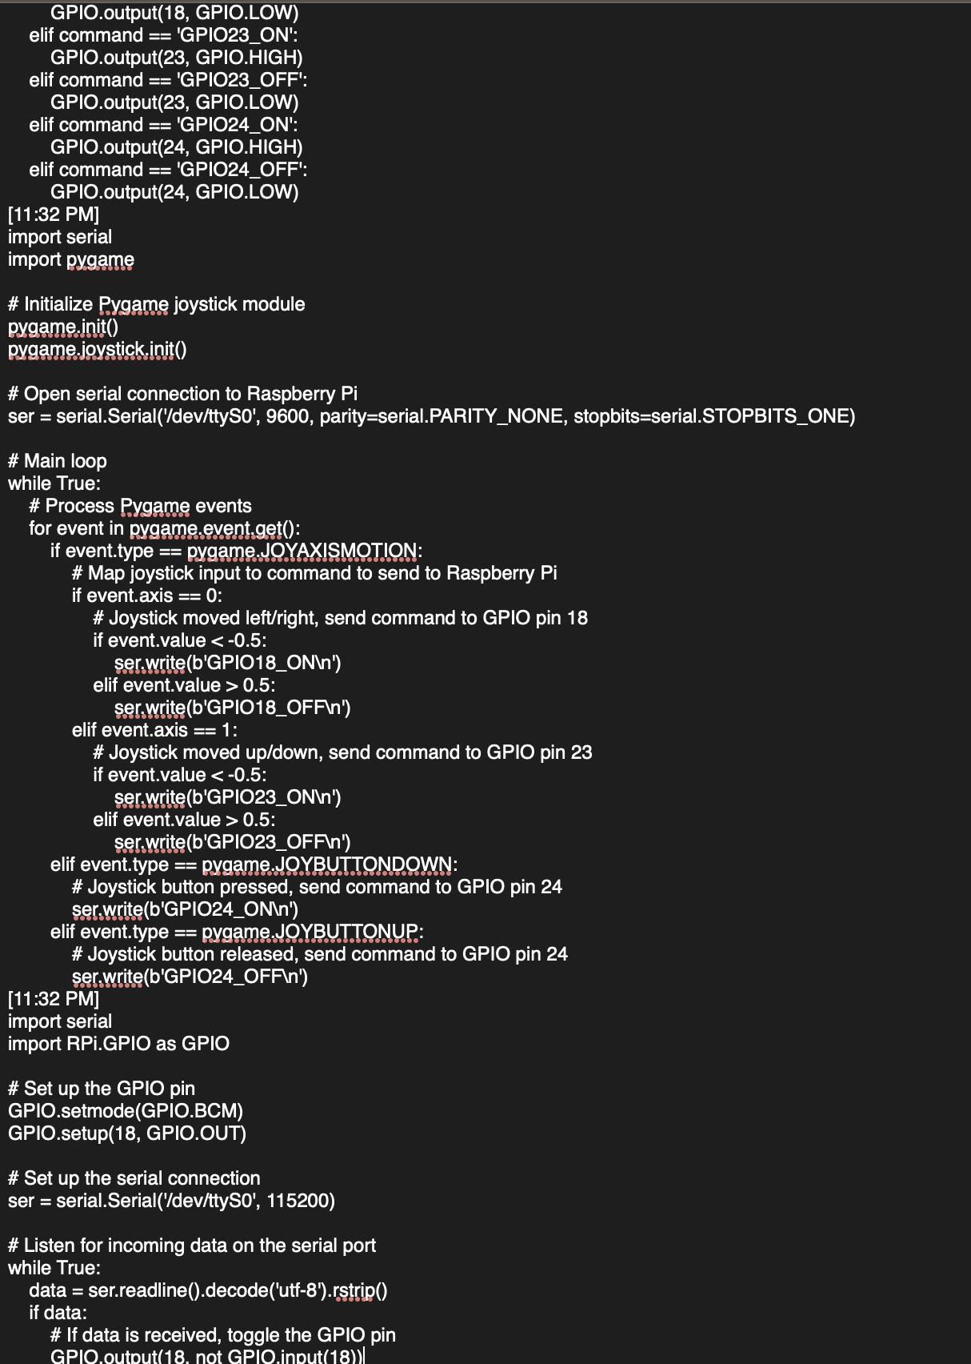
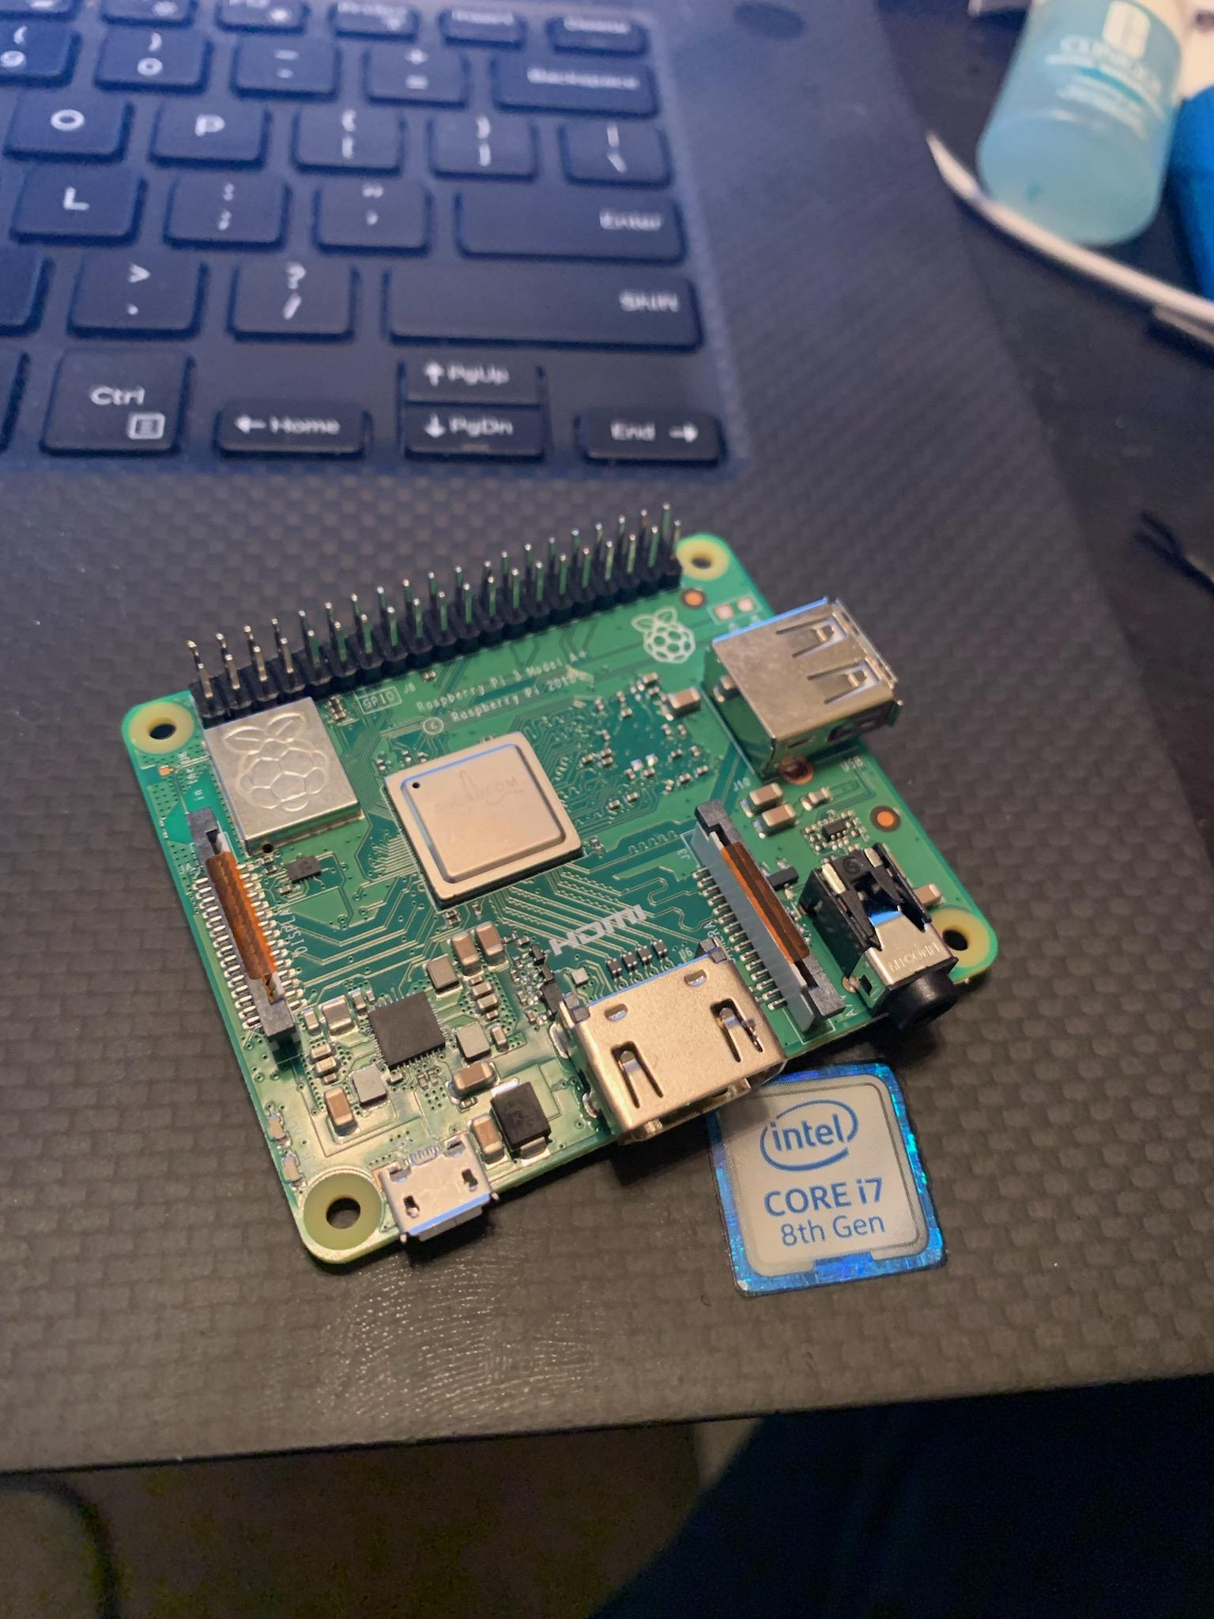
Raspberry Pi Coding

Slide 5
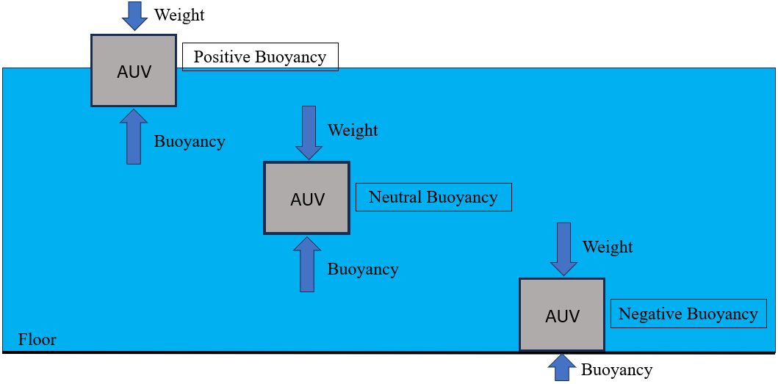
Buoyancy
Add weight to the inside of the UAV to equalize the weight and the buoyancy force.

Slide 6
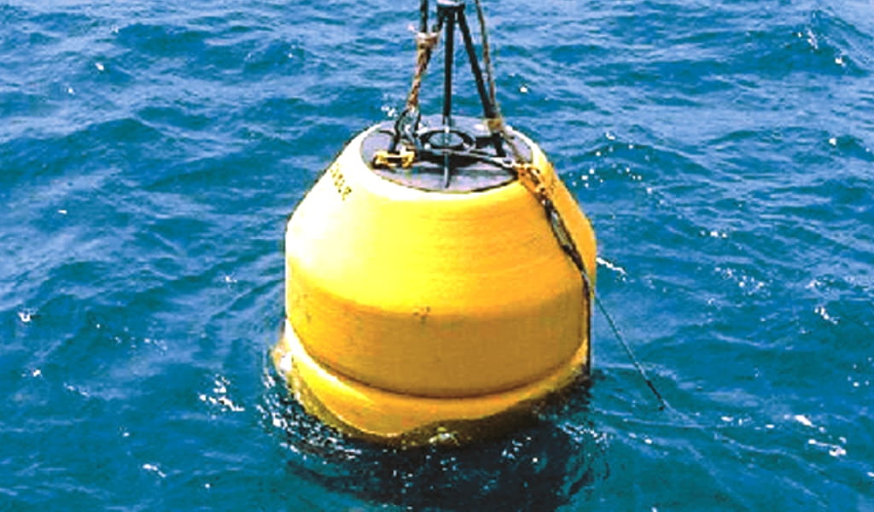
Remote Transmission
The team will construct a buoy housing a transmitter that can be connected to a surface control system.
The buoy will be tethered to the AUV.
Create a buoy device that allows us to transmit control information to the AUV.

Slide 7
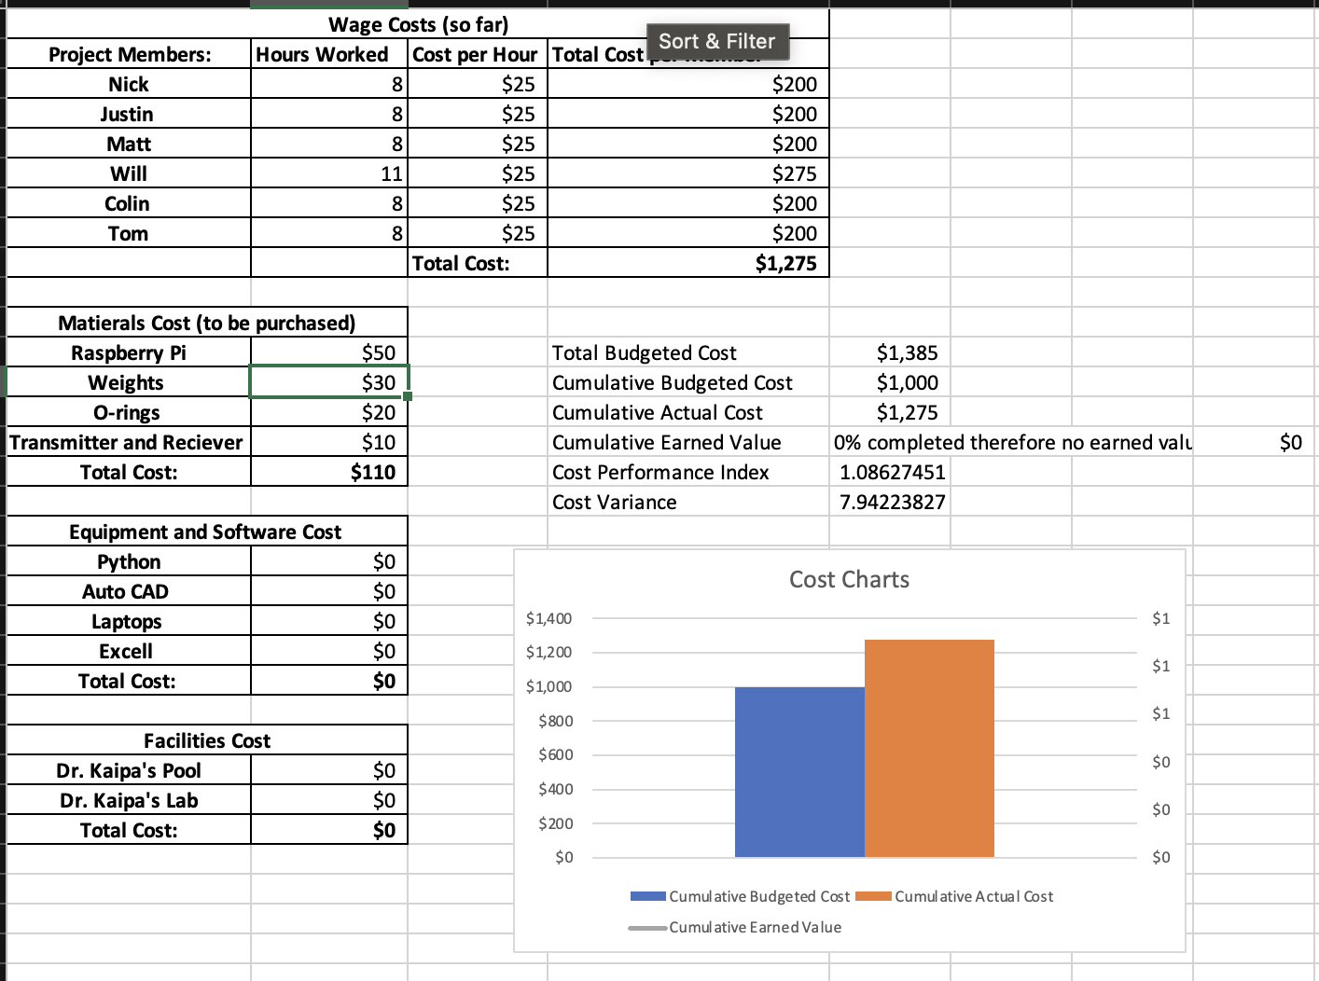
Budget Update
We were able to find a more affordable Raspberry Pi saving around $100.

Slide 8
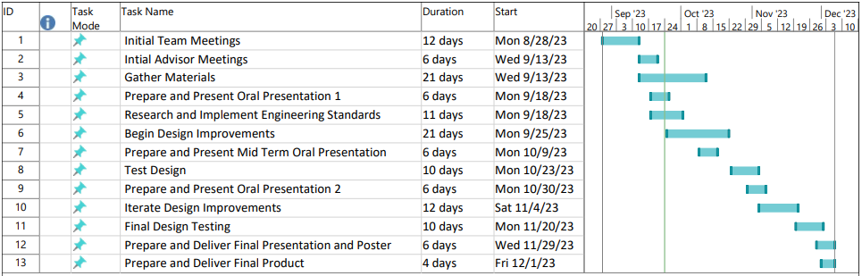
GANTT Chart

