Slide 1



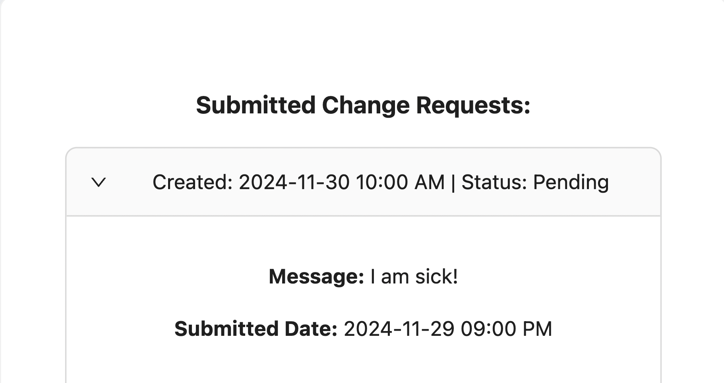
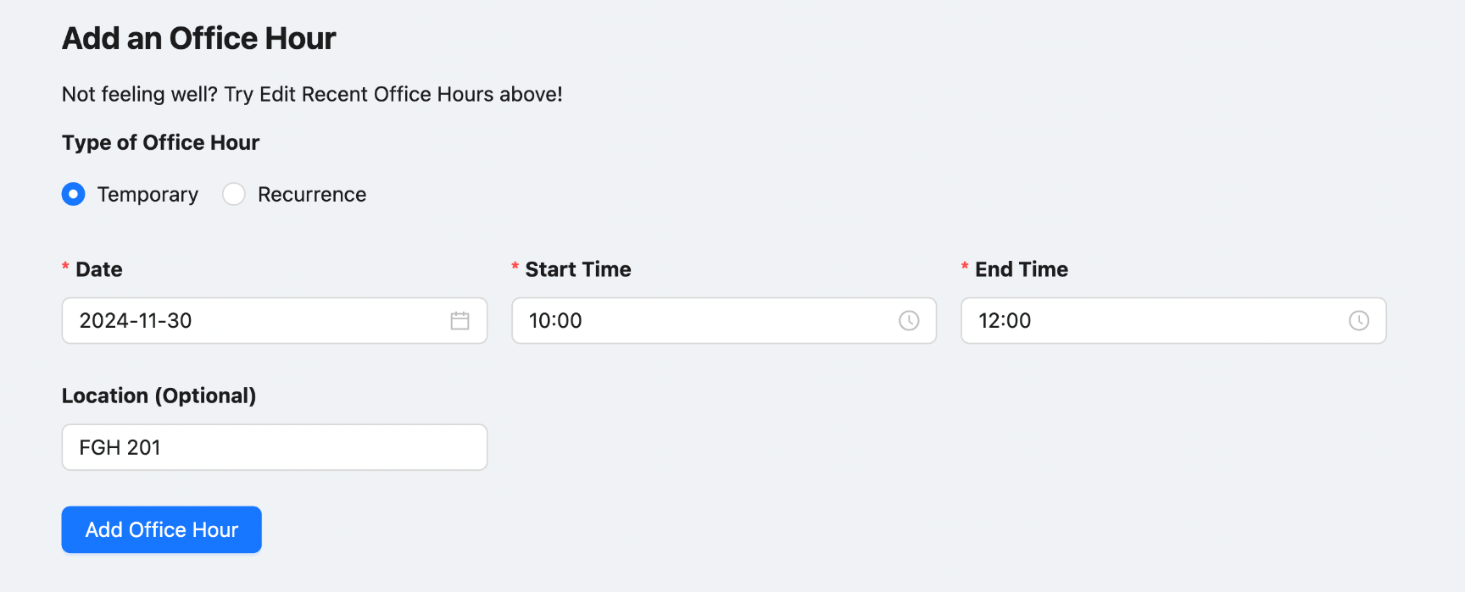
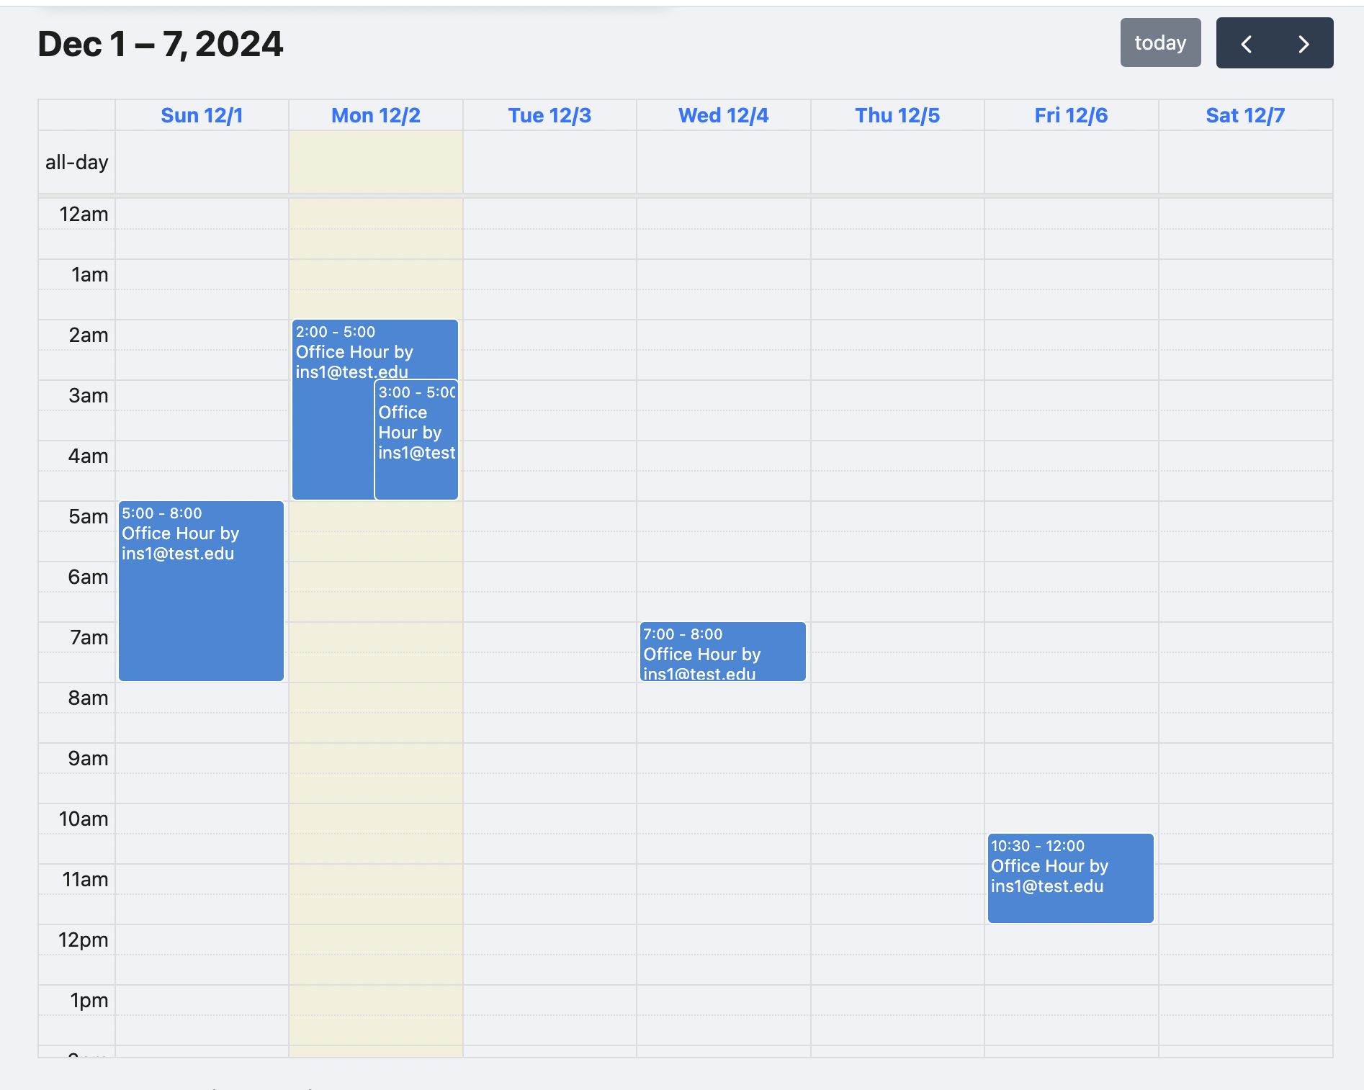
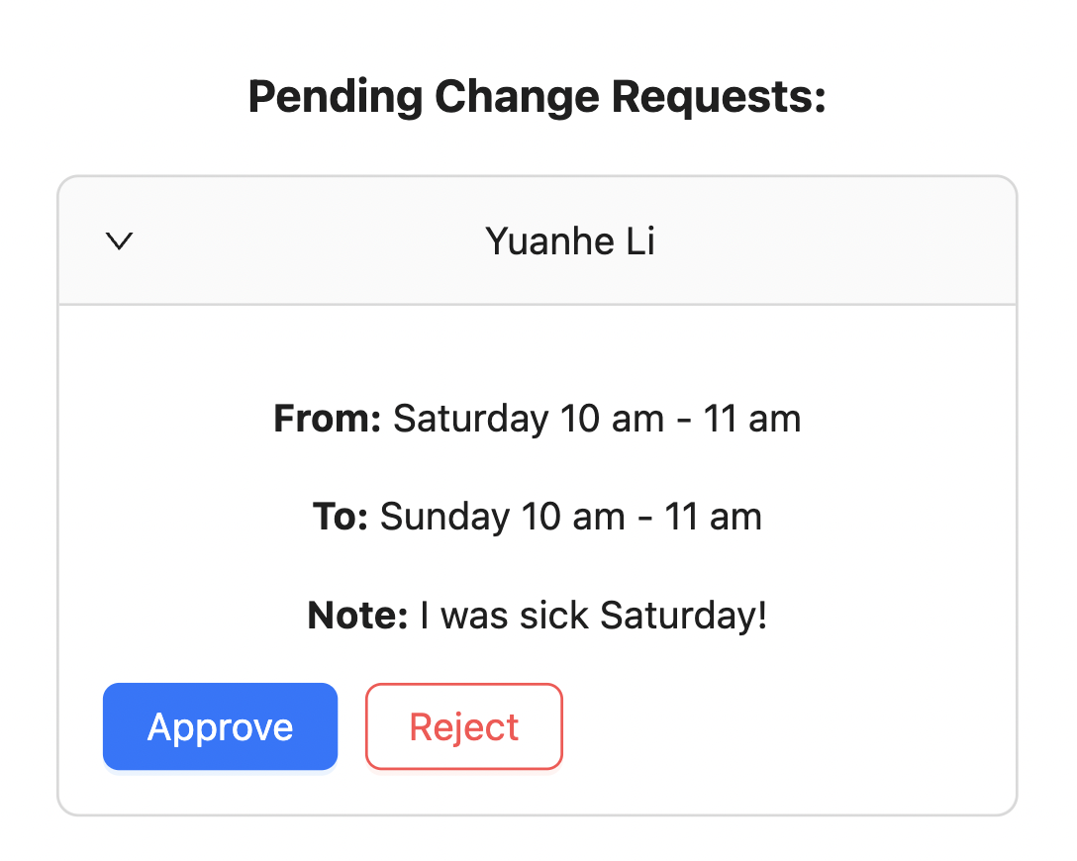
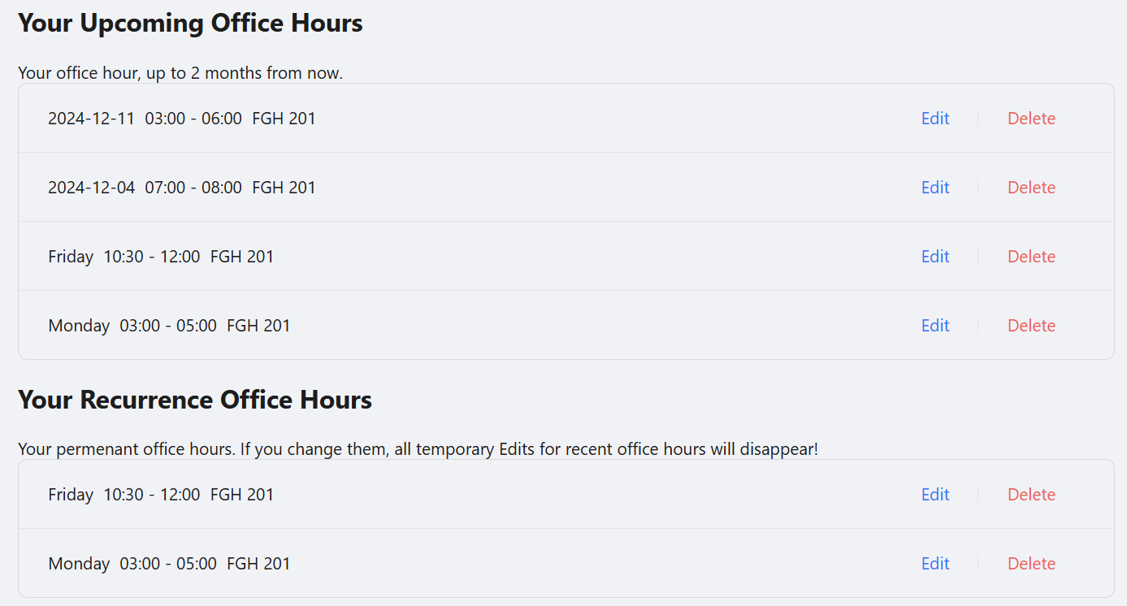
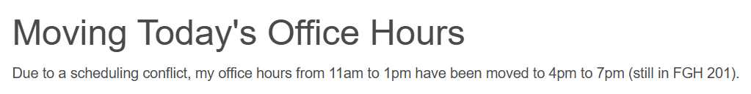
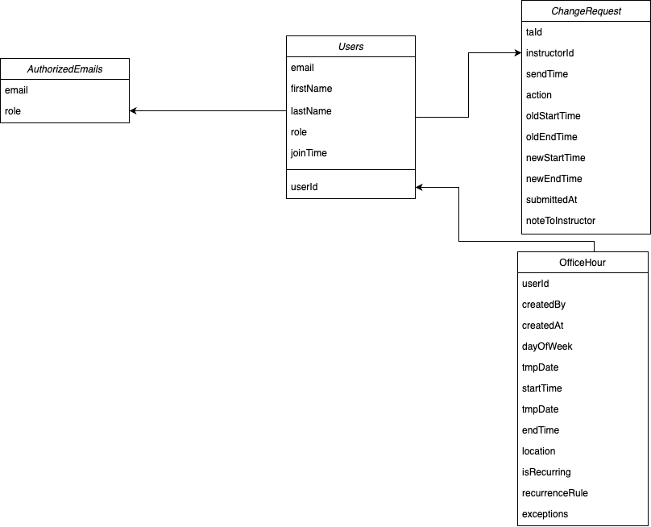
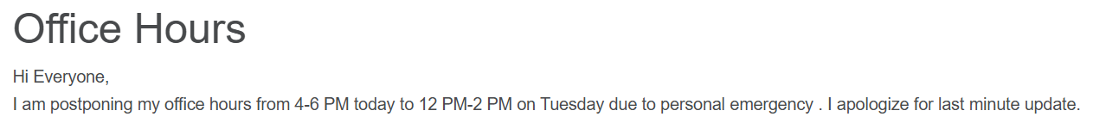
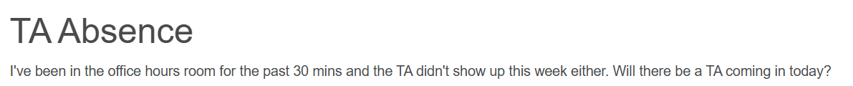
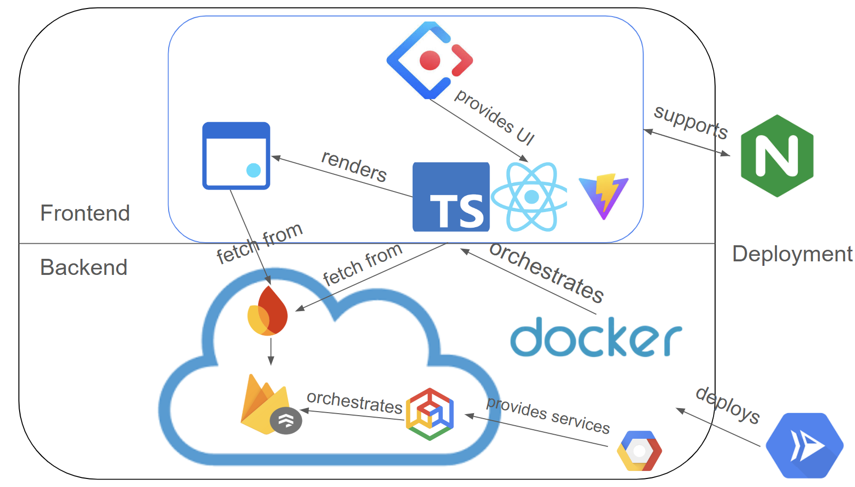
EasyOH: Cloud-based Office Hour Management
Yuanhe Li, Hang Xu, Ziyuan Xu
CS 4287: Principles of Cloud Computing, Fall 2024
Motivation
User Interface
Challenges
Foundational computer science courses at Vanderbilt University such as Data Structures and Intermediate Software Design require a large numbers of teaching assistants (TAs) to hold office hours. TAs’ office hours are often subject to changes, and currently these changes are announced on Piazza. This poses significant inconvenience to students, because they need to navigate through all recent Piazza posts to learn about new office hour changes. Some instructors also require that the TAs ask for their approval before changing office hours, leading to inefficient email communications. Our project aims to solve these problems by providing a centralized office hour management platform, leveraging cloud technologies for data storage and user communications. Users have access to a visualized calendar-style office hour schedule, and TAs and instructors can communicate with each other regarding office hour changes.
1. TA requests to change the office hour
Private Routers. Since TAs and Instructors have separate dashboards, our system prevents accessing the routes by useAuthState() hook.
ISO Date Formatting. We considered timezone conversions. Since the database store every time in UTC +0, we wrote functions to handle timezone difference.
Normalized DB design for Efficiency. We decomposed database for faster information retrieval speed.
Duplicated Sign Ups. Many niche things were handled. Duplicated Sign Up is Login, unauthorized email rejection, office hour overlay displays, etc.
New OH data
3. The Calendar reflects the update
2. Instructor sees the TA’s request and approves
Fetch OH data
Update OH data
Future Works
Solution Architecture
Instructor Manual Account Creation. Right now, we can only manually add Instructor accounts. In the future, we would consider a fourth role, admin, that manages the Instructor accounts.
“Cautious Send”. From some initial user testing, we realized it is too easy for TAs to change office hour. We consider double confirmation, retyping the scheduled time etc. to increase the difficulty of a time change.
Account Deletion. If an instructor disables an account, the TAs will not be able to sign in, but the account still exists in the Firebase Authentication tab. In the future, we will leverage Firebase SDK Admin features to better cleanup user data.
Multi class support. Currently the platform is designed for only one class. In the future, the platform have multi class support, where all users should be able to select which class’ office hour they want to check.
Functions
Our project assumes three types of users:
Students. The students should simply open the website and see a calendar with office hour schedules.
TAs. The TAs should be able to create an account and login to see 1) an office hour schedule calendar, and 2) a form where the TAs can submit office hour change requests to the instructors.
Instructors. The instructors should be able to create an account and login to see 1) an office hour schedule calendar, 2) a form for adding/removing TAs, 3) a section to manage office hour change requests, and 4) a form to change their own office hour.

