Slide 1

GitInsight
U+1F921
Notes:
Raquelle

Slide 2
Agenda
Demo
Testing
Software Requirements
(Non-)Functional requirements
Database
Design Patterns
Architectural patterns
Design principles
Missing features
Notes:
Raquelle

Slide 3
Testing
Test driven development
Unit testing
Integration testing
System testing // End-to-end testing
No Unit test of API (hands-on testing with swagger)
Notes:
Guldborg
- Automated unit tests
- No tests for the RestAPI (Would require a lot of code for setup, and the RestAPI doesn't have any logic, only the infrastructure does)
- Not so much integration testing
- We do test that the Github API Controller integrates with the Github API using environments variables.
- Manual end-to-end testing
- Hard to automate testing graphical results
- Usually costs money to get proper automated end-to-end testing tools
-

Slide 4
Functional requirements
Receives repository identifier from GitHub, and should collect commits with author names and dates.
Should clone the repository from GitHub.
Has a front-end web-application.
Shall expose a REST API.
Front end should visualize `CommitFrequency`, `CommitAuthor` and `Forks` for a repository.
Front end should visualize line additions, deletions and total changes per commit, per repository.
Front end and REST API shall only be accessible to authenticated and authorized users.
In case the repository already exists locally, the local repository should be updated.
Notes:
Mads

Slide 5
Functional requirements
CLI tool should run in two modes - `CommitFrequency` & `CommitAuthor`
`CommitFrequency` produces an output which lists the number of commits per day.
`CommitAuthor` produces an output which lists the number of commits per author per day.
The system should be able to produce a list of forks of a given repository.
The system should store information about which repositories were analyzed at what state.
If an already analyzed repository is to be re-analyzed, but the data is already up to date, the analysis should be skipped and results should be gathered from already stored data.
Notes:
Mads

Slide 6
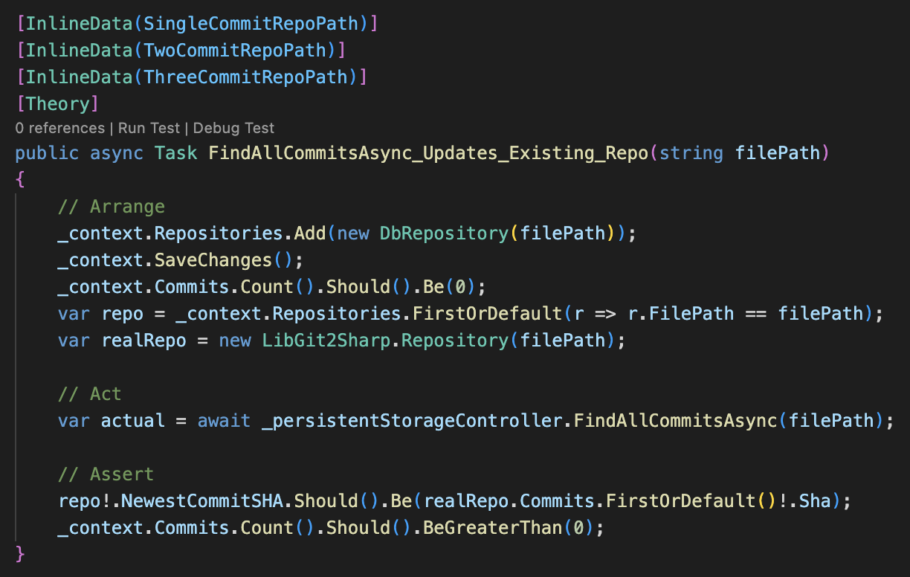
Functional requirements
In case the repository already exists locally, the local repository should be updated.
Notes:
Mads

Slide 7
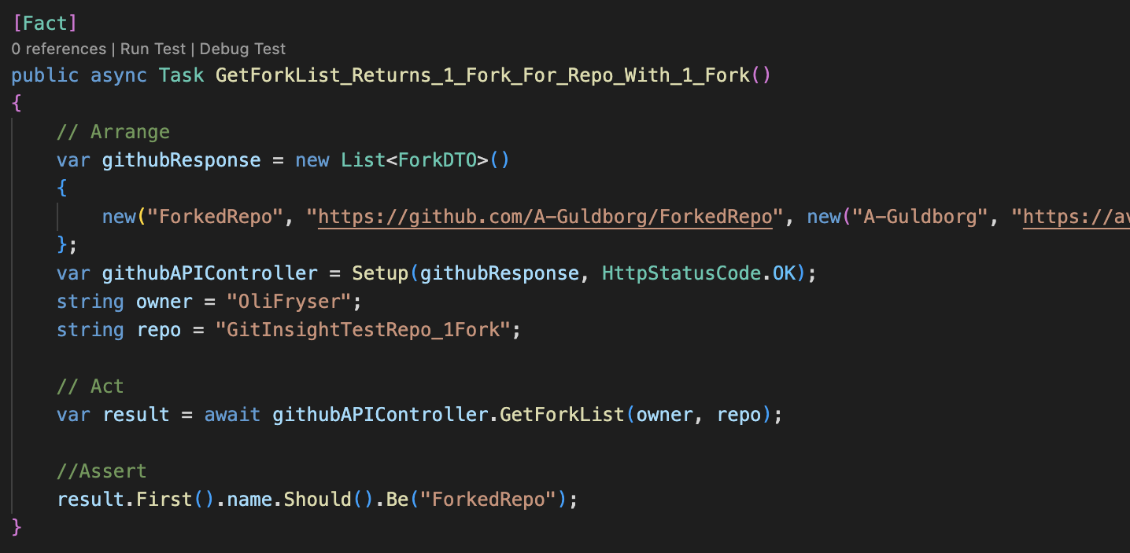
Functional requirements
The system should be able to produce a list of forks of a given repository.
Notes:
Mads

Slide 8
Functional requirements
Front end and REST API shall only be accessible to authenticated and authorized users.
Notes:
Mads

Slide 9
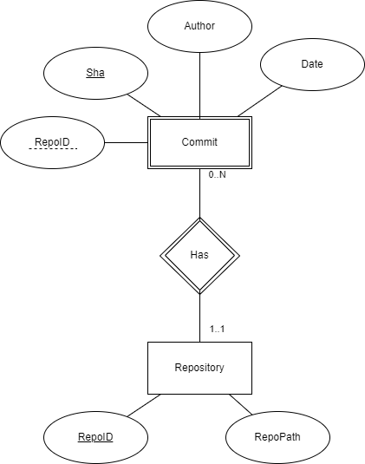
Database Design
Two entities:
Repository
Commit as weak entity
Possible alternative: Author as its own entity
Might enable faster queries, fx "Find all commits in any repository by this author."
Notes:
Oli

Slide 10
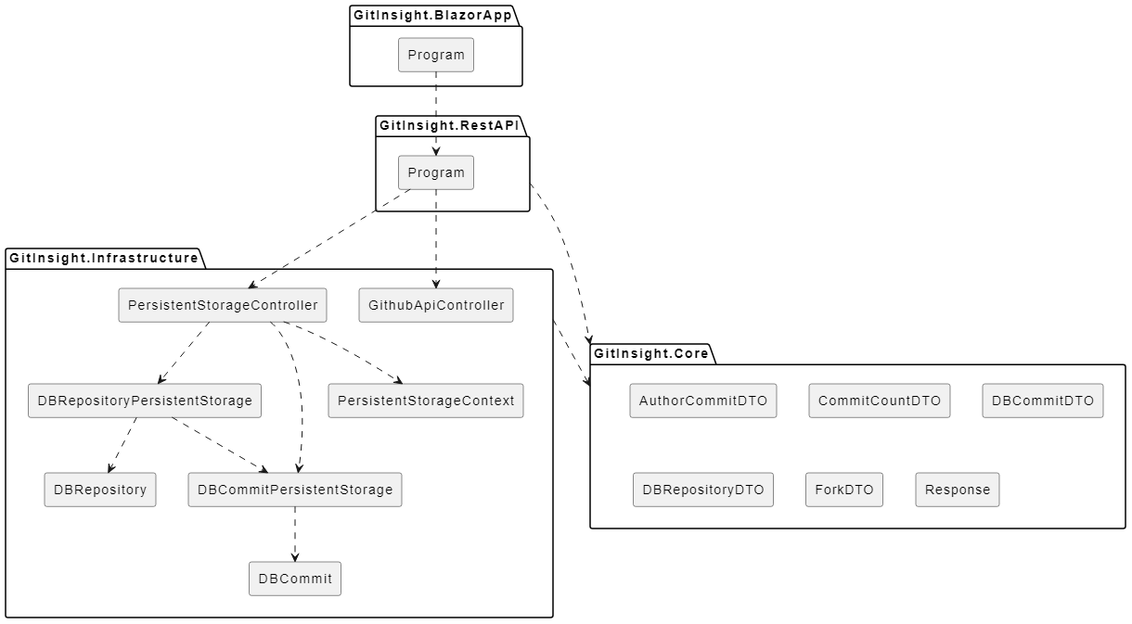
Architectural Patterns
Layered pattern
Notes:
William
Component responsibilities
- Core is used for the data that multiple apps uses, e.g. Data Transfer Objects (DTO)
- Infrastructure with backend logic – allows multiple "frontends" (e.g. API, Blazor, CLI).
Guldborg
CLI -> Rest API + BlazorApp
CLI still exists, but logic was refactored to Infrastructure.
- Enables keeping CLI without touching code.
- Tests to show it still works.
- No new development

Slide 11
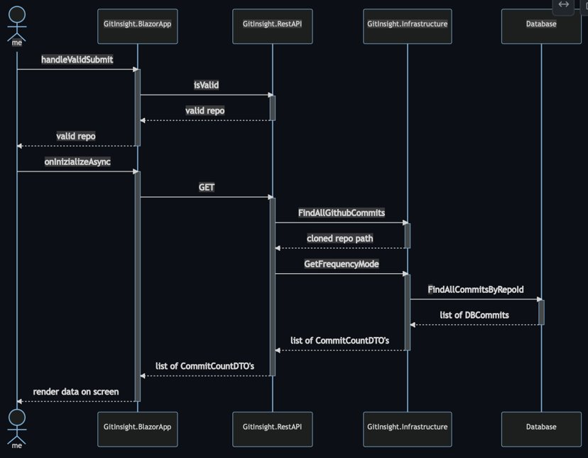
Notes:
William
Component responsibilities
- Core is used for the data that multiple apps uses, e.g. Data Transfer Objects (DTO)
- Infrastructure with backend logic – allows multiple "frontends" (e.g. API, Blazor, CLI).
Guldborg
CLI -> Rest API + BlazorApp
CLI still exists, but logic was refactored to Infrastructure.
- Enables keeping CLI without touching code.
- Tests to show it still works.
- No new development

Slide 12
Design Principles
SOLID
Single responsibility principle
Open for extension / closed for modification
Criticism of own program
Liskov substitution principle
✓
Interface separation principle
ICommitStorage, IRepositoryStorage
Dependency inversion principle
Command pattern; Controller(ICommitStorage, IRepositoryStorage)
Notes:
William

Slide 13
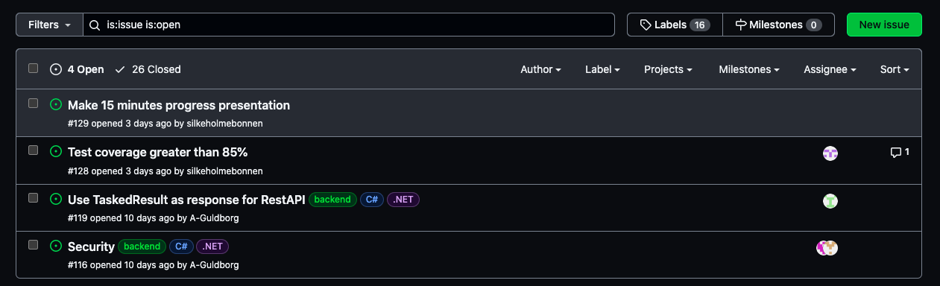
Missing
App is without Authentication and Authorization
Response status code from controllers
Test coverage is not > 85%
Notes:
Raquelle
Authentication & Authorization:
- Unable to find a proper guide for setting it up in an app
- We wanted to use the ASP.NET Core Identify framework
- Unable to install SQL Server Express LocalDB on Mac
- Unable to use Azure without subscription
- Should've created the app from start with
- dotnet new blazorwasm -au IndividualB2C -o GitInsight.AuthenticatedBlazorApp
TaskedResults:
- Would've taken a lot of refactoring of the code
- Not enough time to solve it
Test coverage:
- The interfaces aren't tested
- A lot of classes with lines of code that aren't executed
- Ex. DBCommit class, doesn't have methods, but we use it in the program

