Slide 1
Microsoft Carbon Emissions Project Plan
Melton Team:
Dana Kenney
Jacob Voyles
Sydney Yeargers
Tatumn Laughery
William Holbert

Slide 2
Summary of Work: Question, Problem, and Objective
Business Question: What are the levers and impact of said levers on Microsoft's carbon emissions?
Business Problem: Currently companies have no way to accurately predict their carbon usage
Objective: To provide an app that informs Microsoft about the impact their activities have on their carbon usage, and in turn their forecasted costs

Slide 3
Summary of Work: Data Collection and Compilation
We have limited additional sources:
carbon consumption data from CDP reports dating from 2010 to 2021
State energy breakdown data from EPA
Data center data from datacenters.com
All data was compiled via manual entry into an Excel spreadsheet

Slide 4
Summary of Work: Data Processing
Very little data processing was required:
Aggregation of 'Canada' and 'United States' into 'North America' where appropriate
Standardization of region names for Latin America and Caribbean (LAC)
User error resulted in the occasional need to standardize spellings
Different forms of missing values were initially used, which had to be standardized (#N/A)
Removed or interpolated missing values case-by-case
Notes:
- Very little data processing was required because we entered the data manually

Slide 5
Summary of Work: Data Structure and Management
Data is broken down by year and scope
Unit is metric tons of CO2
Several tables that can be joined on year and filtered by scope

Slide 6
Summary of Work: Exploratory Data Analysis
Our takeaway from the EDA, was that datacenters are the primary source of carbon usage within Microsoft.
While other areas have decreased their carbon usage, datacenters continue to increase exponentially.
Microsoft additionally chooses to offset their emissions with carbon buybacks.

Slide 7
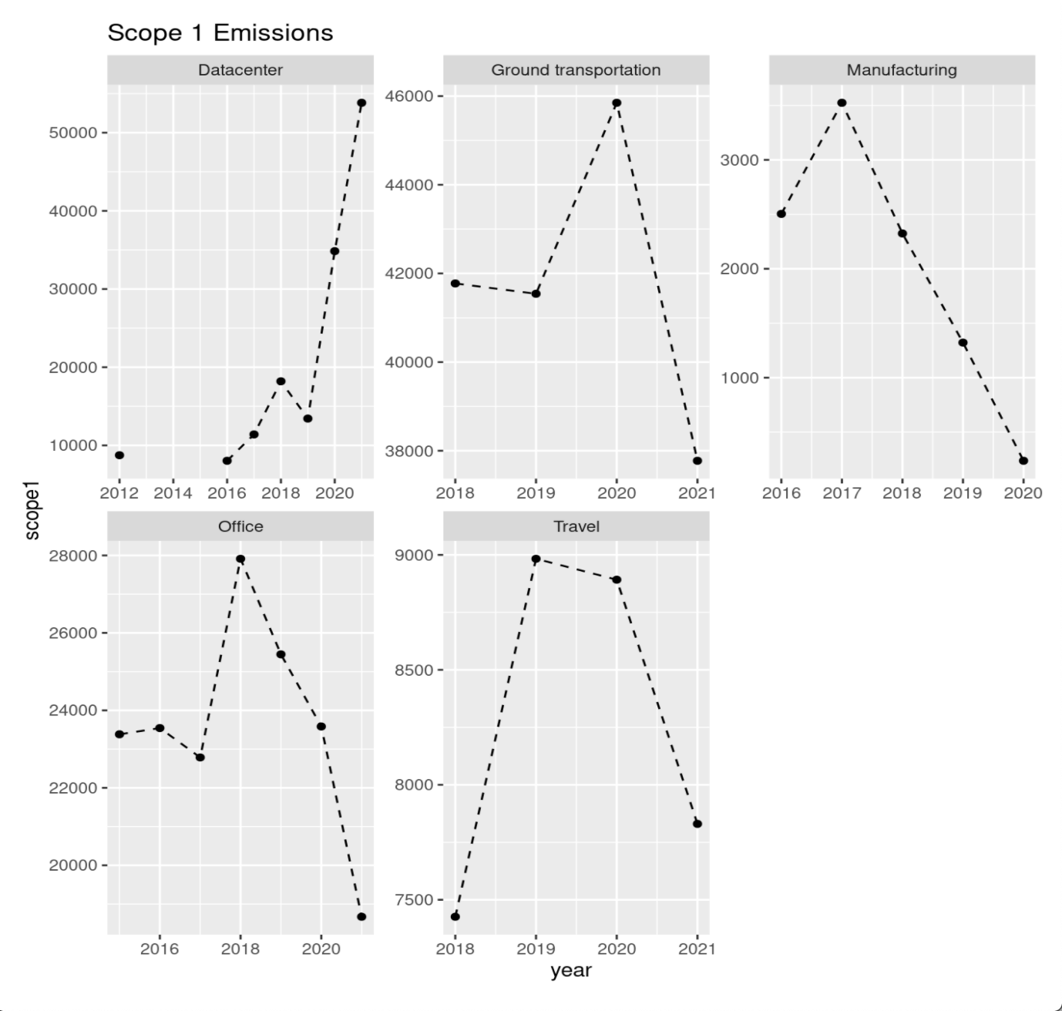
Summary of Work: Exploratory Data Analysis Scope 1

Slide 8
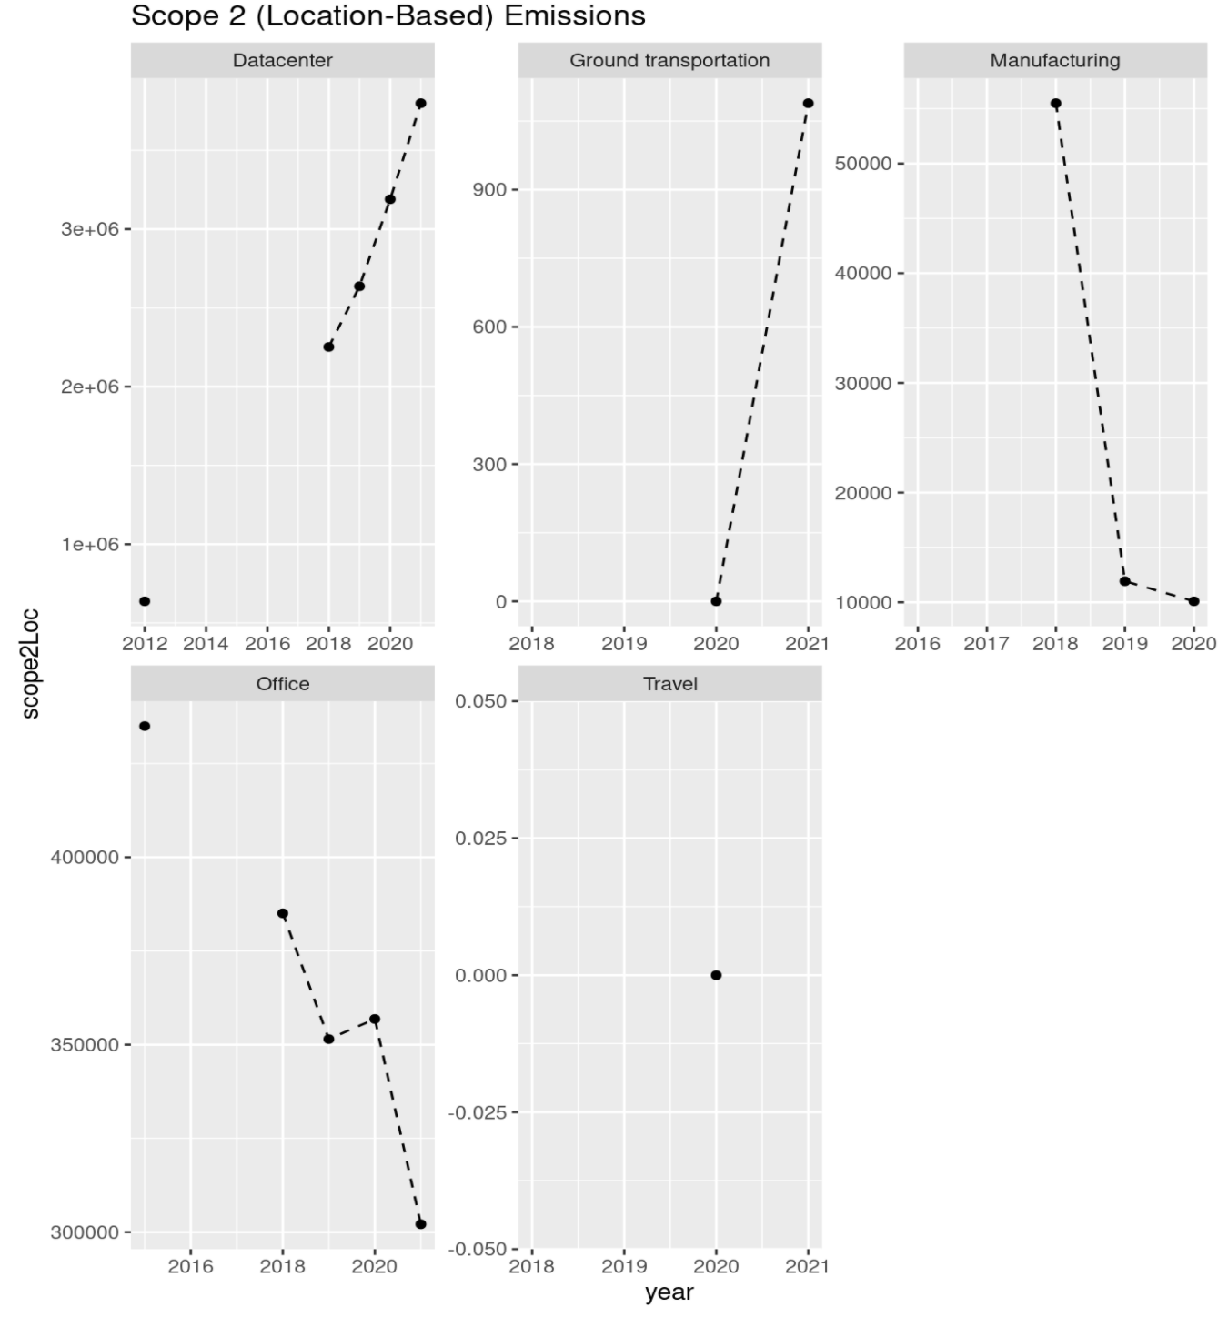
Summary of Work: Exploratory Data Analysis Scope 2- Location

Slide 9
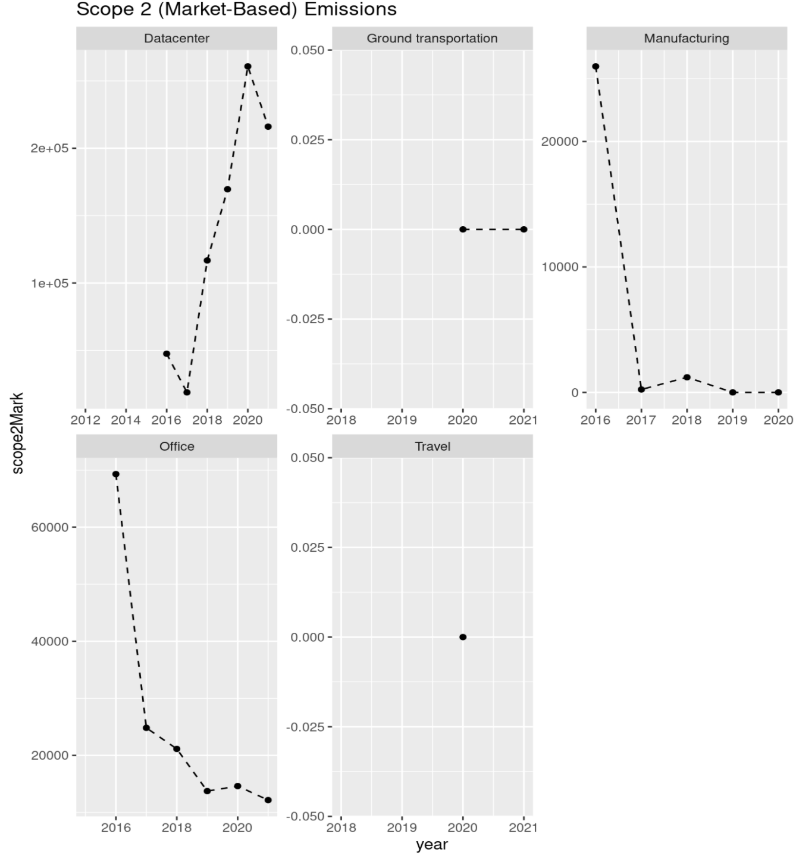
Summary of Work: Exploratory Data Analysis Scope 2- Market

Slide 10
Summary of Work: Product
Developing an interactive UI that can work with a streamlined carbon calculation method
We use information about datacenters size and location to calculate their current carbon footprint
Using this method we can forecast future carbon emissions based on various forecasting metrics

Slide 11
Summary of Goal: Product
Have a product that can forecast future carbon
By datacenter groupings
By individual datacenter specs.
Use carbon to calculate future offset costs by year
Forecast changing renewable resources availability by region
This is the result of those bought offset investments by the industry

Slide 12
Plan for Remaining Time
What | By When | Who
Final Product Planning | Week 10 | Team Melton
Product Development: Carbon Calculation | Week 11 | Team Melton
Product Development: Adding Additional Metrics and Hypothesis Testing | Week 12 | Team Melton
Product Development: Final Aesthetics | Week 13 | Team Melton
Results | Week 14 | Team Melton

Slide 13
Closing Thoughts
Summary:
The problem we set out to solve is that currently, there is no way for a company to accurately predict their carbon usage
We decided to solve this problem by developing an app that would inform Microsoft about the impact their activities have on their carbon usage, and in turn their forecasted costs
Thus far, we have completed most of our exploratory data analysis, and some of our app
Our goal is to add additional metrics and parameters to the app to expand the information given to the user

