Slide 1
Hy-Vee Liquor Store Research
Capstone Project by Will Han & Gary Lin

Slide 2
Table of Contents
01
02
03
04
Introduction
EDA
Data source, time period, etc.
Data cleaning and exploratory data analysis
Analysis
Conclusion
Store, product analyses & forecasting
Recommendations to
Hy-Vee

Slide 3
01
Introduction

Slide 4
Background Information
Liquor sales data from Iowa, limited to Hy-Vee
Time period range from 2012 to present
24 sales record variables including invoice number, store number, and county
Research plan:
Perform initial data cleaning to handle inconsistency
Perform store & product analysis by categories and location over time
Perform store segmentation analysis to find most valuable store
Perform market basket analysis
Perform time series & sales forecasting

Slide 5
Hy-Vee Highlights
“Where there’s a helpful smile in every aisle”
Stores
Employees
Revenue
More than 265 locations in midwestern U.S.
Over 84,000 employees
Over $10 billion in 2018

Slide 6
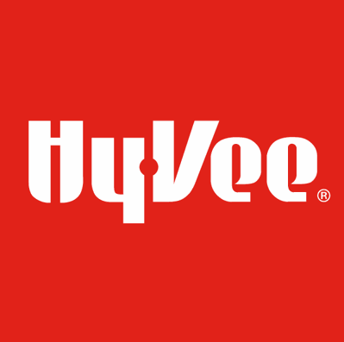
02
EDA
Data cleaning and exploratory data analysis

Slide 7
Data Cleaning
Same liquor getting mapped to different categories or names
Same store associated with non-unique longitude & latitude coordinates and non-standardized store names
Standardization needed to be used on multiple fields including store name, city, and county
Same vendor and store having more than one name
Once data was cleaned, multiple duplicate removed tables were created

Slide 8
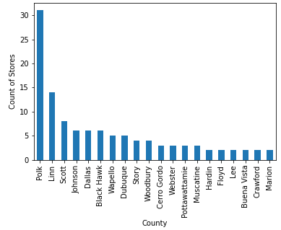
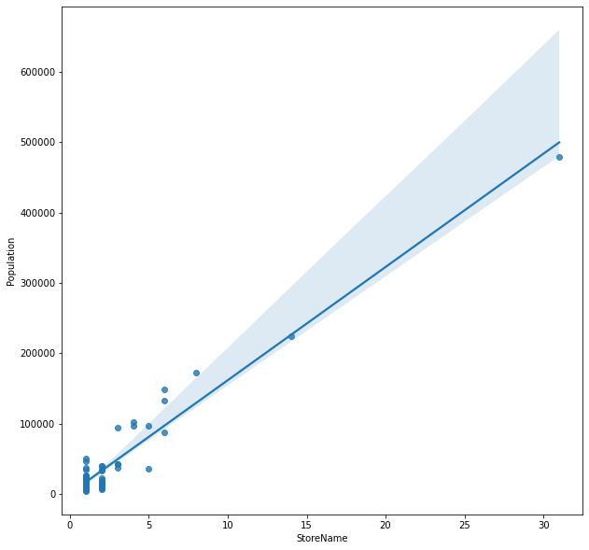
Initial Exploratory Data Analysis (EDA)
Initial EDA showed that Polk had the most stores and generally more stores to support more population.
Count of Stores

Slide 9
03
Analysis
Store, product analyses & forecasting

Slide 10
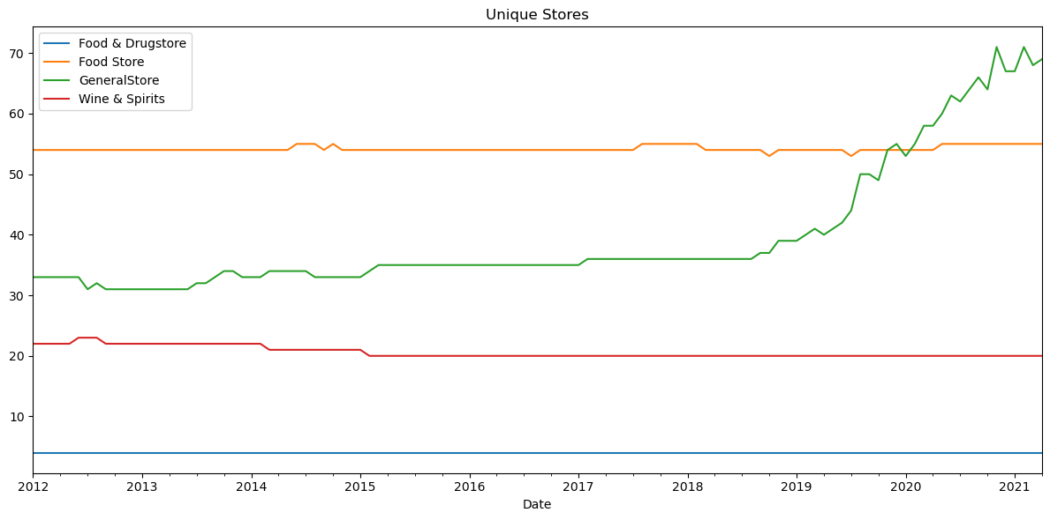
Unique Stores by Category
Categories were determined manually
Huge growth in general store over time compared to the other types
Count of Stores

Slide 11
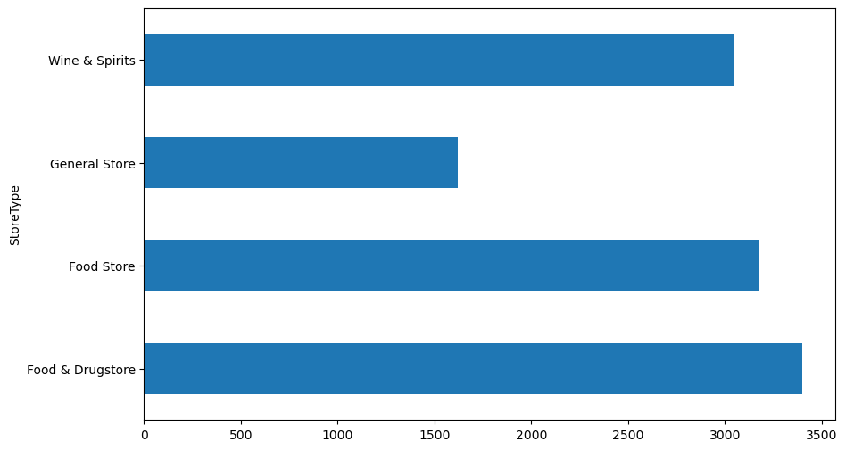
Mean Store Life
Mean store life seems to be low for general store most likely due to new stores opening
Other three types all have mean store lives of 3000+ days
Count of Stores

Slide 12
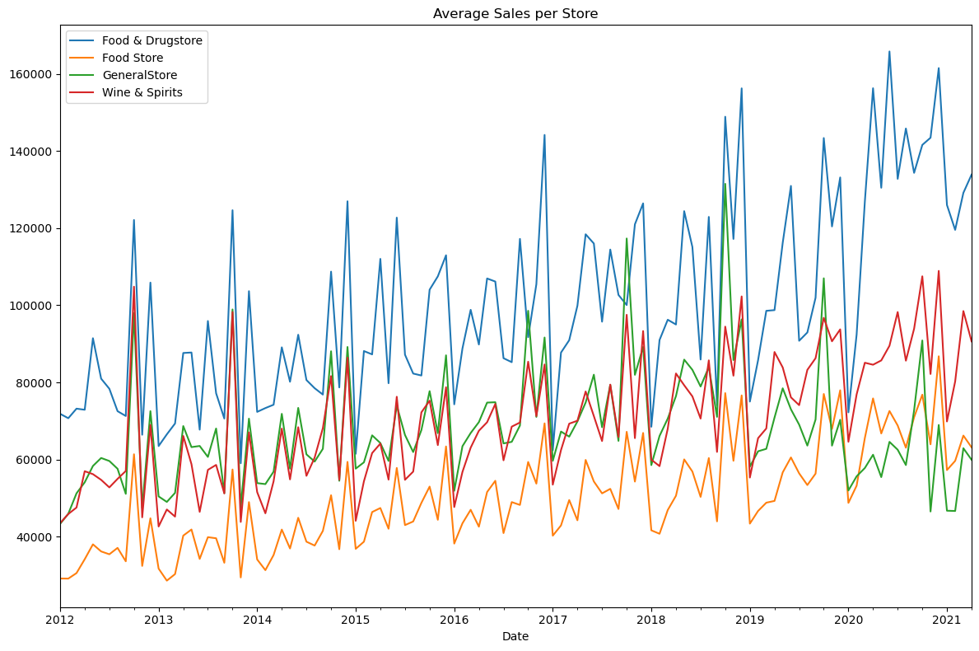
Average Sale per Store
Average sales seem to be increasing overall, with food & drug store leading in sales (most likely due to its store size)
Again, general store seems to be decreasing due to new stores
Average Sales per Store (USD)

Slide 13
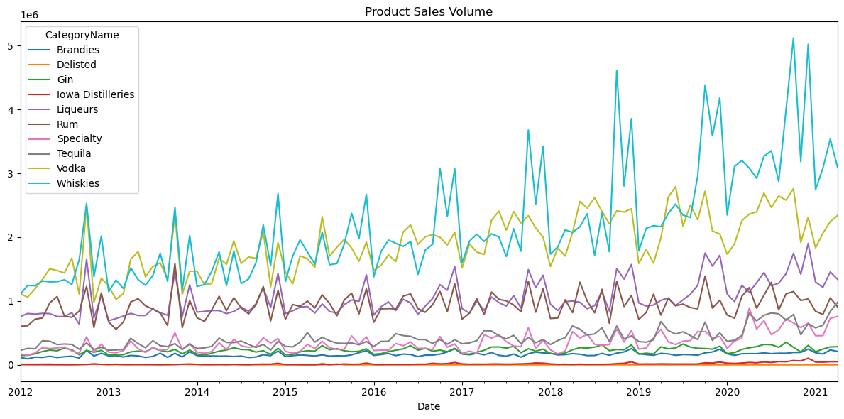
Product Sales Volume by Category
Whiskies and vodka are the leading products driving the sales with a growing trend over the years (almost x3 over 10 years)
Other categories are fairly stable
Sales (USD)

Slide 14
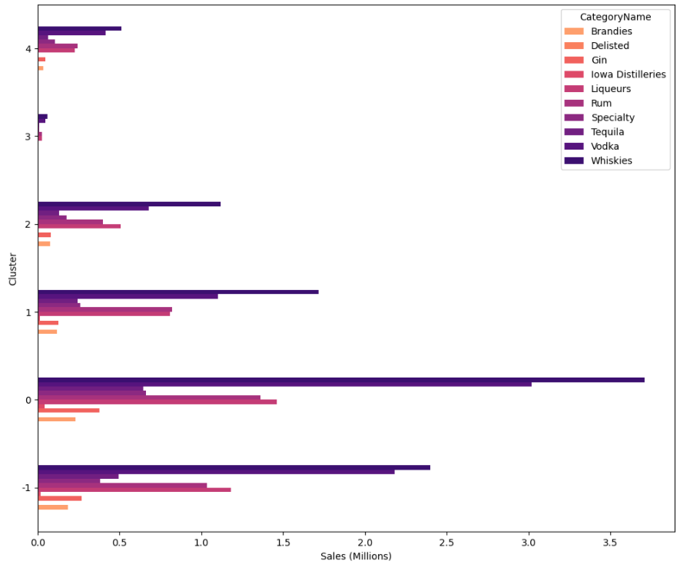
Store Clusters
HDBSCAN was used to cluster Hy-Vee stores using product categories
-1 represent the stores that did not make it to one of the clusters

Slide 15
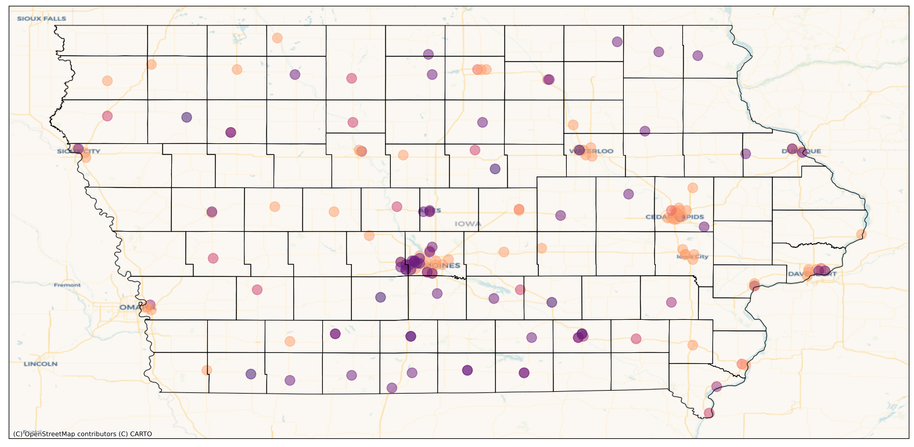
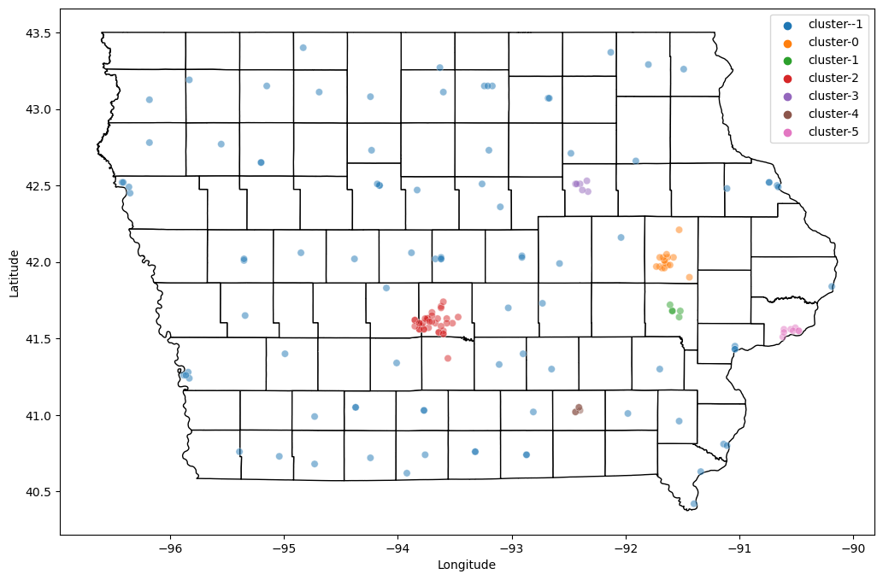
Product vs. Location Clustering
Left: grouping using product
Right: grouping using location (the blue dots have not been assigned to a cluster)

Slide 16
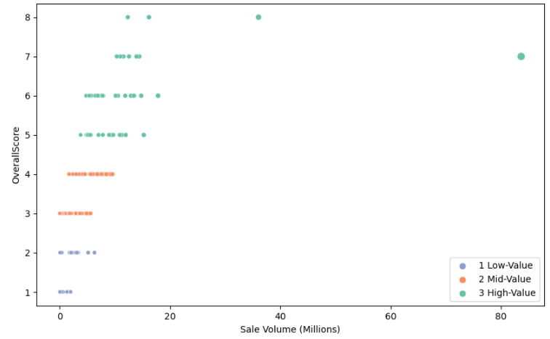
Store Segmentation
Unsupervised learning and the Recency, Frequency, and Monetary Value (RFM) was used to segment stores into three sections (low, mid, high)
There was one store (#2633) that had a dominating value (sales)

Slide 17
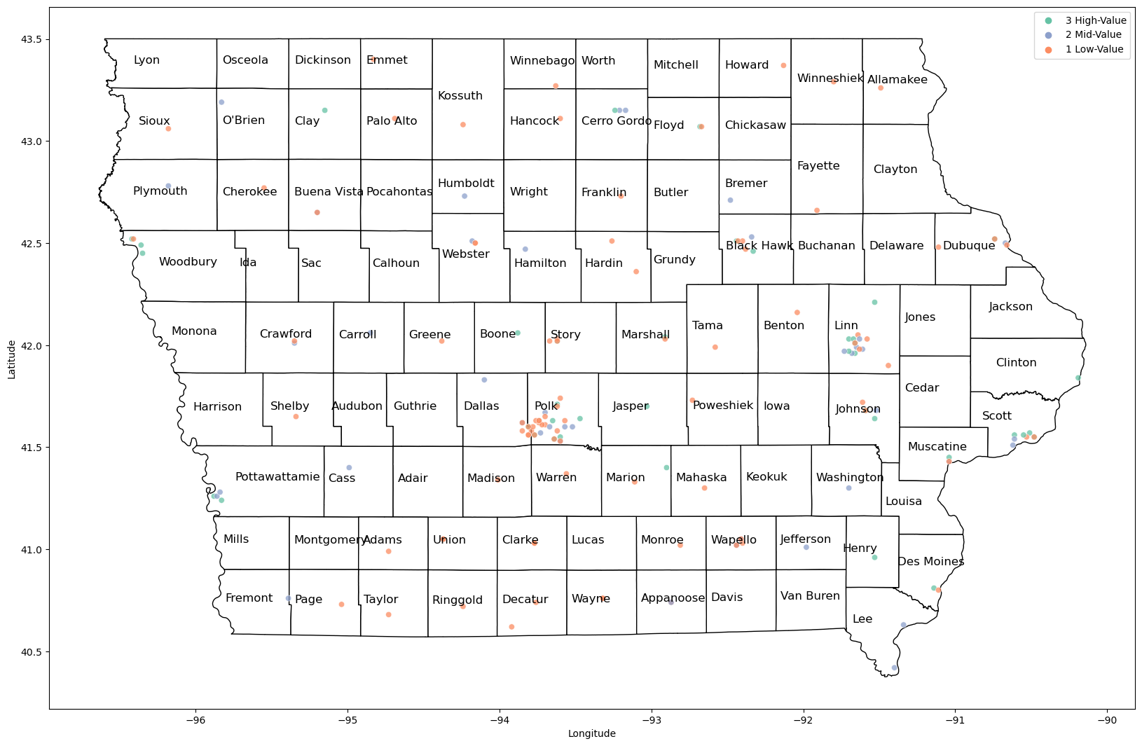

Slide 18
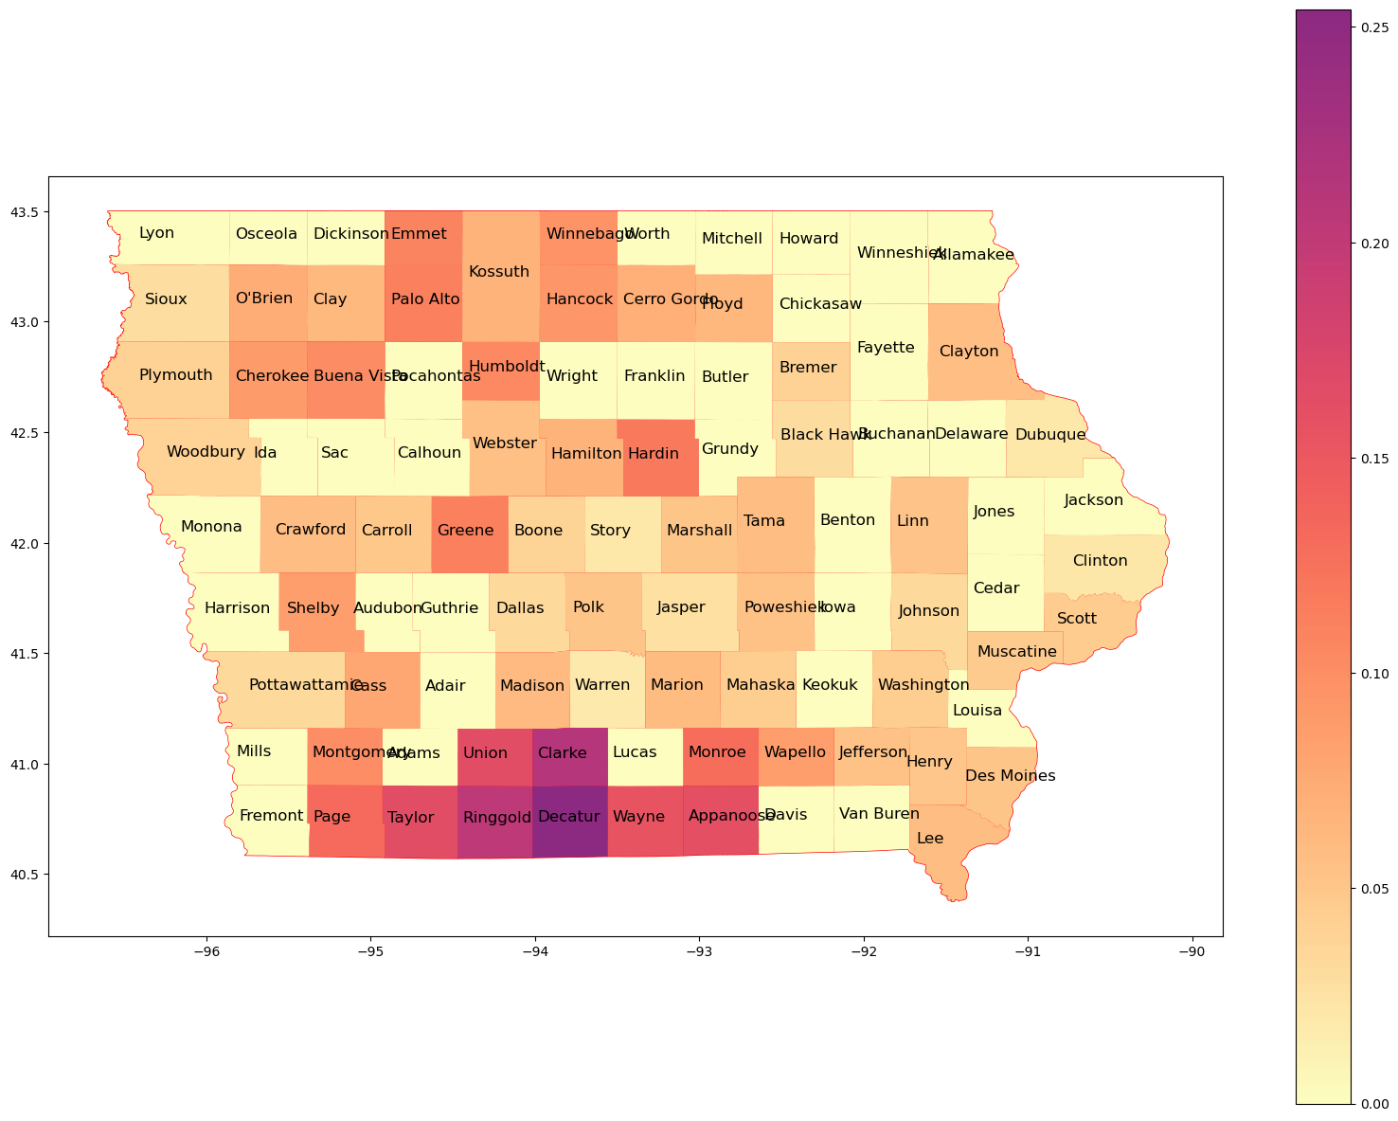
Stores per Population
Stores per 1,000 population
Even if Polk is the county with most population, there are lots of stores which brings this metric down
Southern Iowa has a high metric

Slide 19
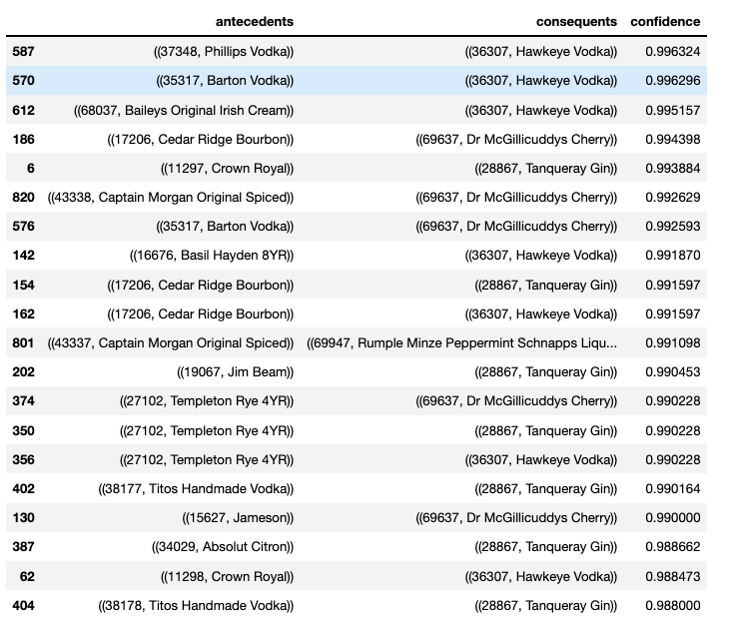
Market Basket Analysis (MBA)
MBA was performed limited to the top store (#2633) and top 100 items.
Hawkeye seems to a fan favorite (less than $15 per 1.75ml).

Slide 20
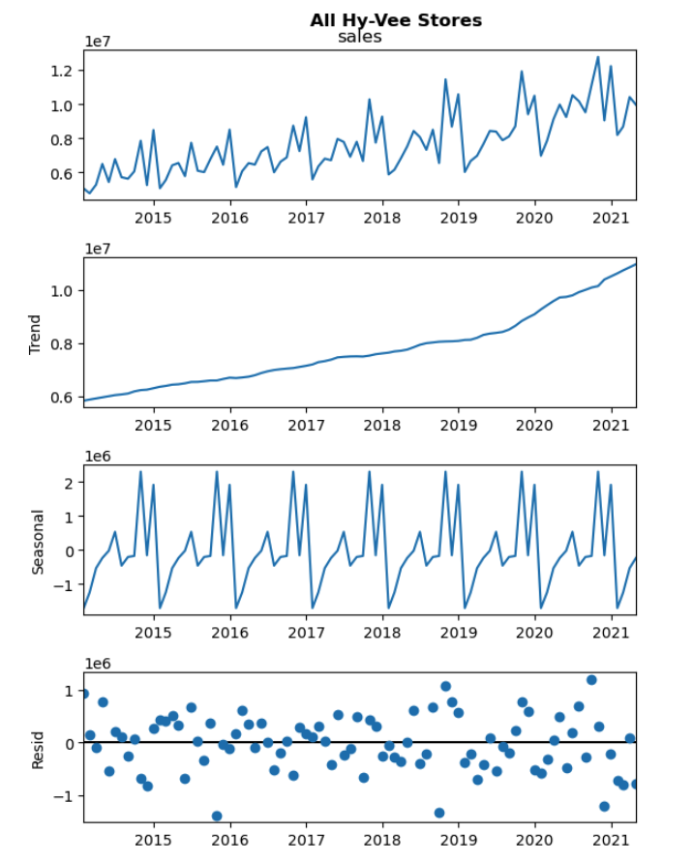
Trend & Seasonality: All Stores
Break in trend around mid-2019.
Clear seasonality: peaks in Q3-Q4, trough in Q1.
Residual appears to increase starting in 2019.

Slide 21
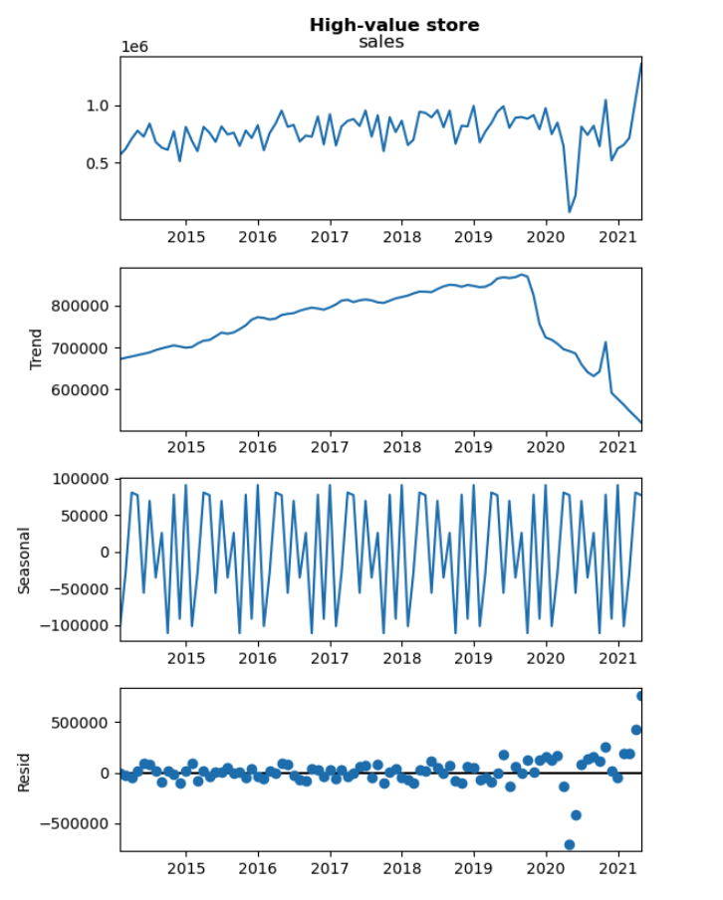
Trend & Seasonality: High-Value Store
Trend/seasonality stand in stark contrast to the patterns in previous slide.
Clean downward trend in mid-2019.
Larger residuals post-2020.

Slide 22
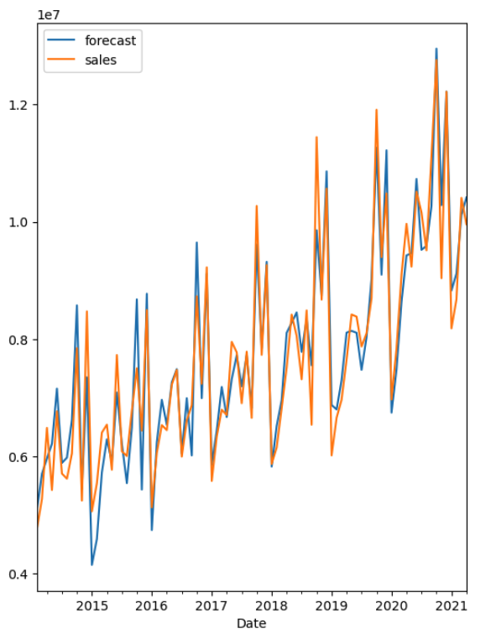
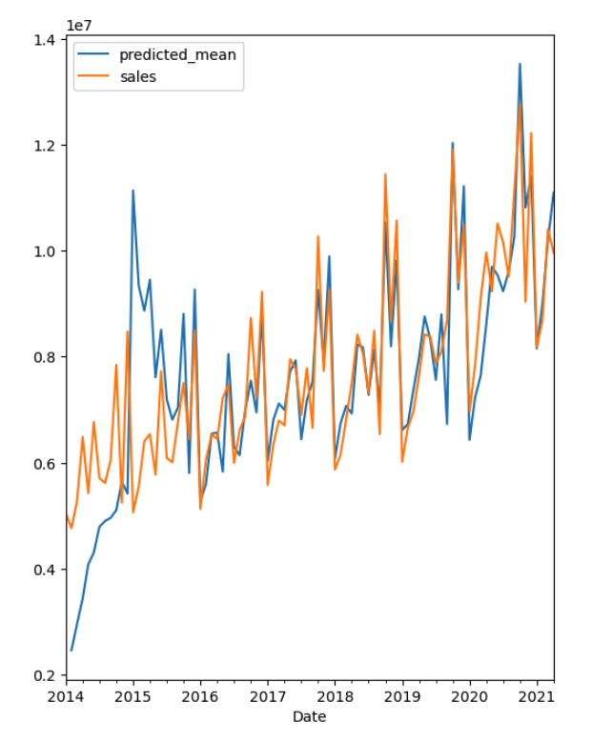
Forecasting
Left: forecasting using ARIMA
Right: forecasting using SARIMAX
ARIMA results in a better in-sample prediction
ARIMA
SARIMAX
Sales (USD)
Sales (USD)

Slide 23
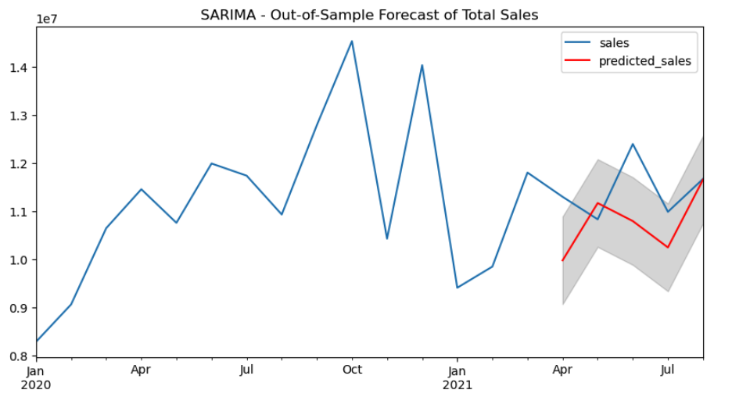
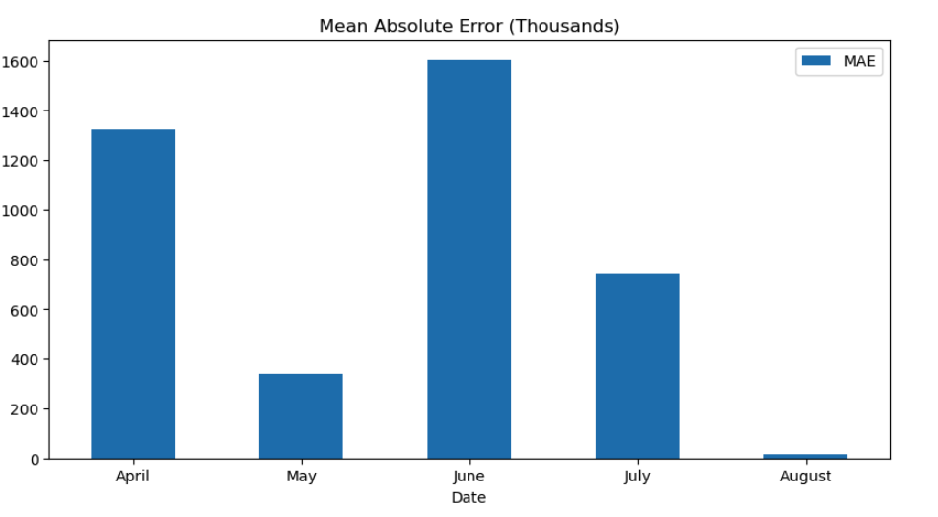
Forecasting Accuracy
Forecasting result was compared to actual data between April through August 2021
Average MAE ~ 800k

Slide 24
04
Conclusion

Slide 25
Closing Thoughts & Recommendations
Are we opening too many stores and they are cannibalizing each other’s sales?
A deeper dive into the high-value store is needed. What is causing the break in trend?
Future Work
Compare machine learning/deep learning approaches with stats models
Use population forecasts to increase precise

Slide 26
Thank You

