Slide 1
Vivino
Web-Scraping Project
William Jeongwoo Han
May 2021

Slide 2
What is Vivino?
Data Dictionary
Table of Contents
Data analysis
conclusion
Notes:
© Copyright Showeet.com

Slide 3
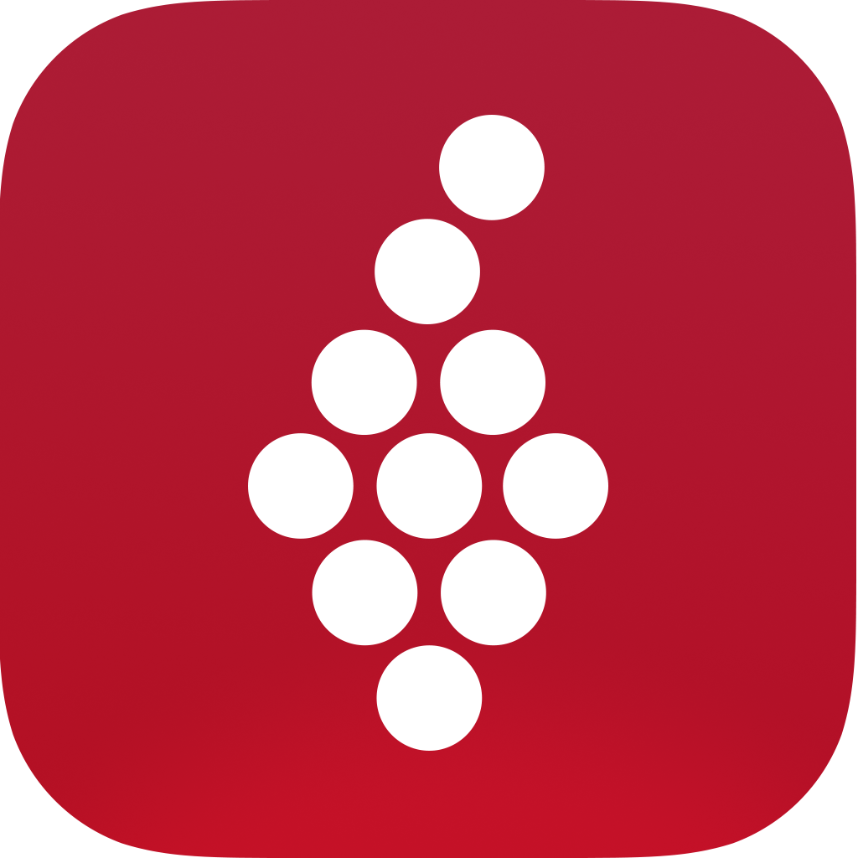
What is Vivino?
Online wine marketplace & wine app
More than 13 million different wines
More than 50 million users

Slide 4
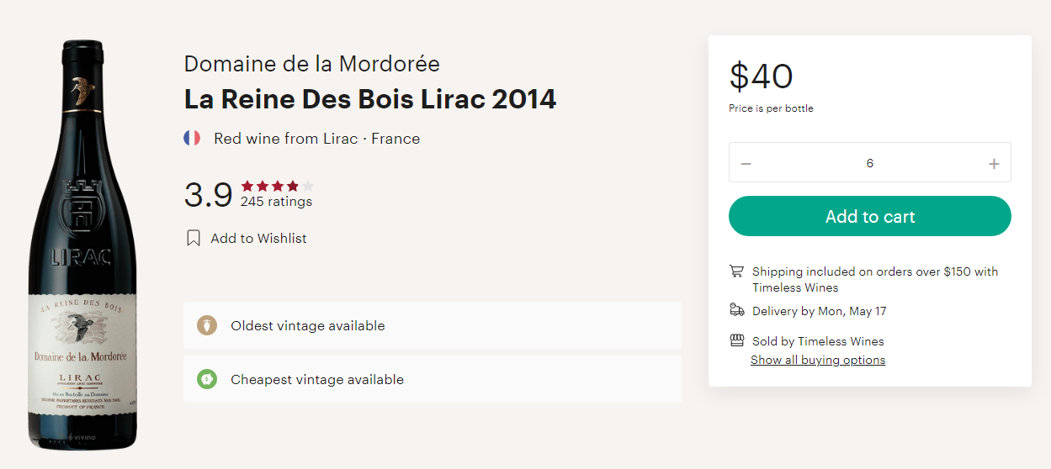
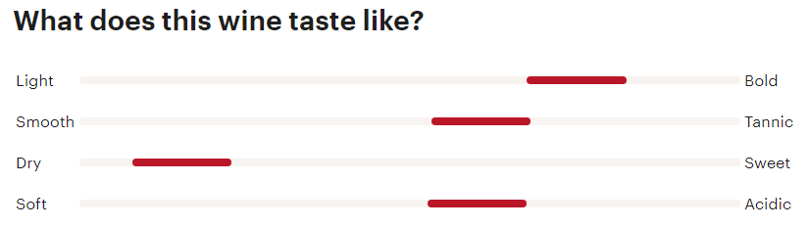
Data Dictionary
Price
Price of the wine (in USD)
Year
Year the wine was made
Country
Country the wine was made in
Overall_Rating
Average across all ratings
Overall_Rating_Count
Count of all ratings
Wine Notes:
Light_Bold
Smooth_Tannic
Dry_Sweet
Soft_Acidic

Slide 5
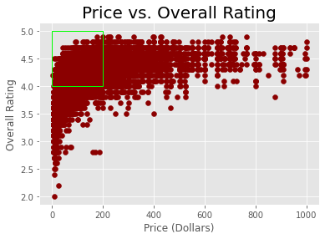
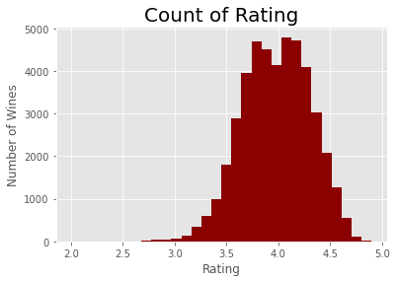
Data Analysis
Price vs. Rating
Higher Ratings = More Expensive
~100 wines that have lower than 3.0 rating.
Main focus: wine with good rating (above 4.0) that are cheaper (under $200)

Slide 6
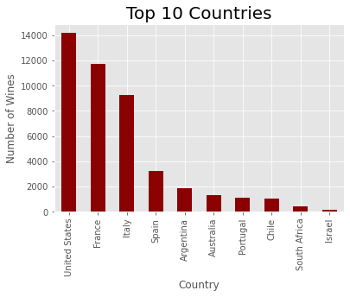
Data Analysis
Top Countries
United States, France, and Italy are dominating with more than 8,000 wines.
Eight countries (up to Chile) have more than 1,000 wines.

Slide 7
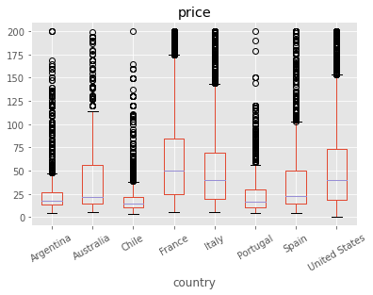
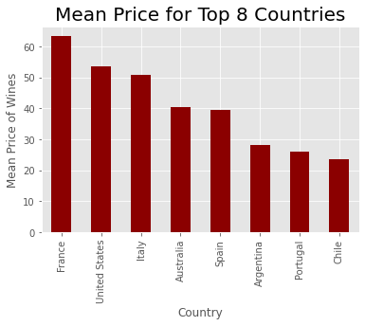
Data Analysis
Top Countries (Price)
Median & 3rd quartile price of wine in United States, France, and Italy are much higher than other countries.
Eight countries (up to Chile) have more than 1,000 wines.

Slide 8
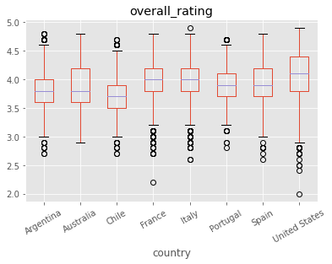
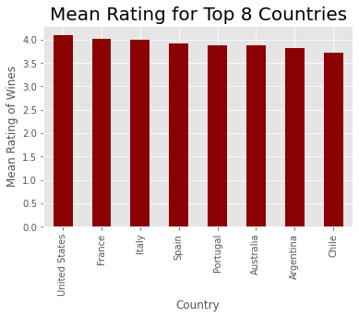
Data Analysis
Top Countries (Rating)
Median & 3rd quartile price of wine in United States, France, and Italy are much higher than other countries.
Eight countries (up to Chile) have more than 1,000 wines.

Slide 9
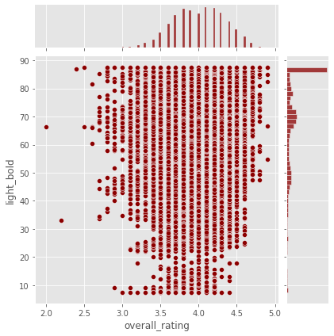
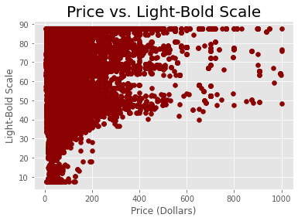
Data Analysis
Light-Bold Note
There are a lot more wine that are bold.

Slide 10
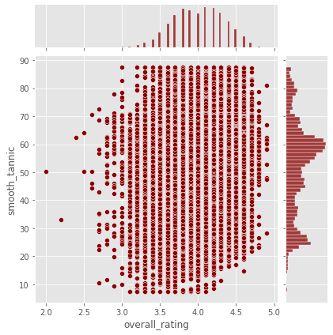
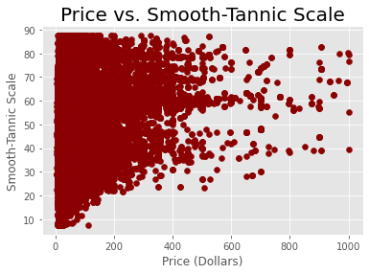
Data Analysis
Smooth-Tannic Note
The smooth-tannic note is more spread out with a little skewness towards tannic.

Slide 11
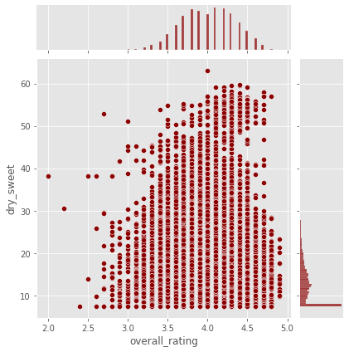
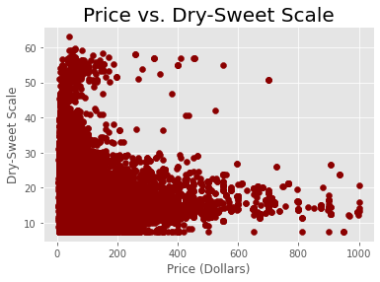
Data Analysis
Dry-Sweet Note
Red wines are generally dry than sweet.

Slide 12
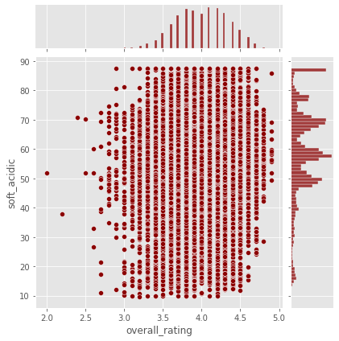
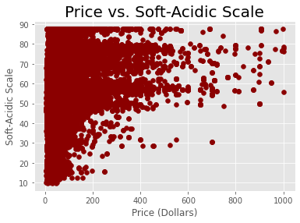
Data Analysis
Soft-Acidic Note
The soft-acidic note is more spread out but still skewed towards acidic.

Slide 13

Conclusion
Conclusion

Slide 14
Thank you!
Any questions or comments?
Author Contact Information
LinkedIn: https://www.linkedin.com/in/williamjeongwoohan/
GitHub: https://github.com/WilliamJHan
Email: william.jeongwoo.han@gmail.com

