Slide 1
Vivino
Web-Scraping Project
William Jeongwoo Han
May 2021

Slide 2
What is Vivino?
Data Dictionary
Table of Contents
Data analysis
conclusion
Notes:
© Copyright Showeet.com

Slide 3
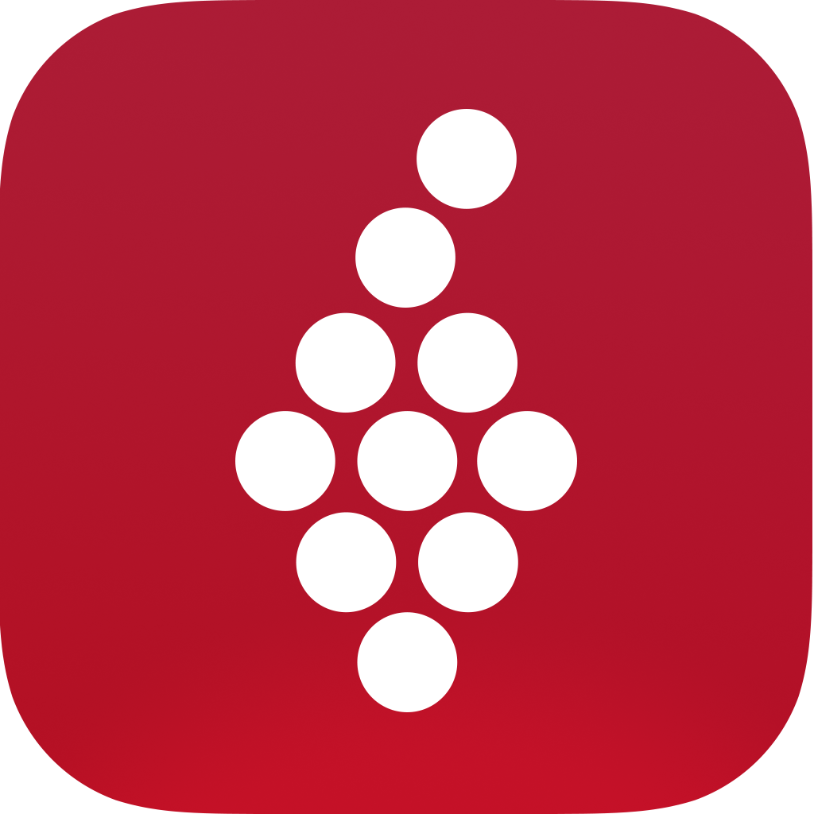
What is Vivino?
Online wine marketplace & wine app
More than 13 million different wines
More than 50 million users

Slide 4
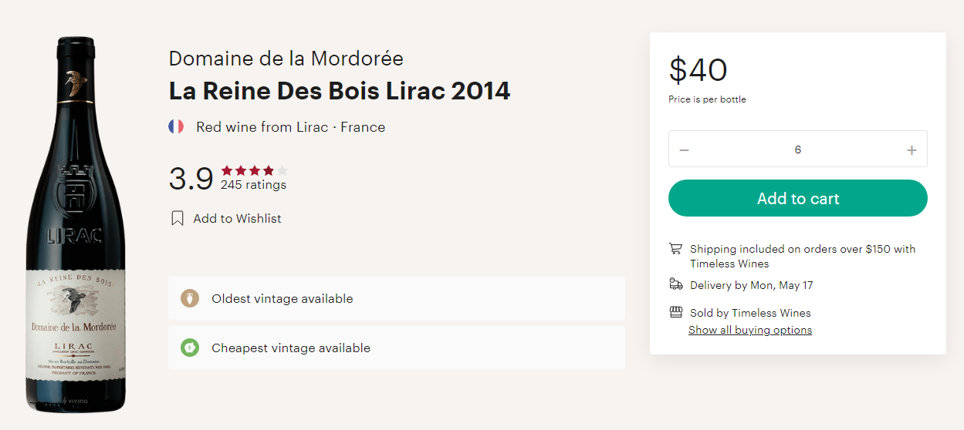
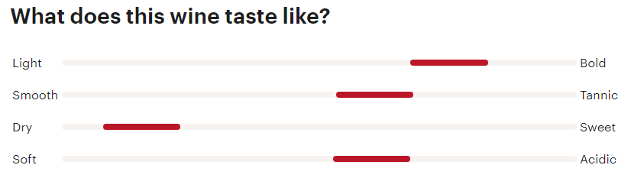
Data Dictionary
Price
Price of the wine (in USD)
Year
Year the wine was made
Country
Country the wine was made in
Overall_Rating
Average rating (out of 5)
Overall_Rating_Count
Count of all ratings
Wine Notes:
Light_Bold
Smooth_Tannic
Dry_Sweet
Soft_Acidic

Slide 5
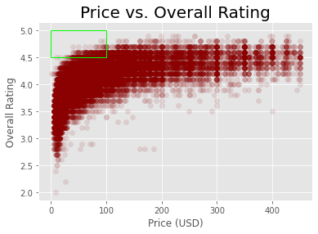
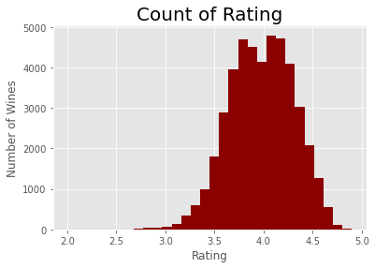
Data Analysis
Price vs. Rating
Higher Ratings = More Expensive
~100 wines that have lower than 3.0 rating.
Main focus: wine with good rating (greater than 4.5) that are cheaper (under $100)

Slide 6
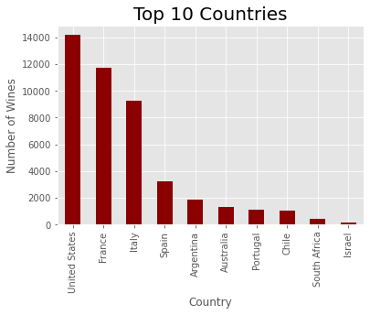
Data Analysis
Top Countries
United States, France, and Italy are dominating with more than 8,000 wines.
Eight countries (up to Chile) have more than 1,000 wines.

Slide 7
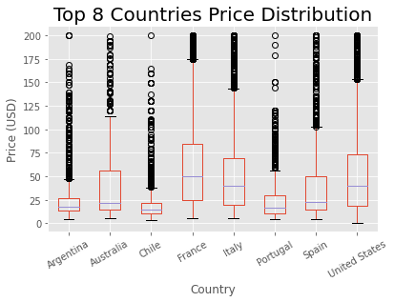
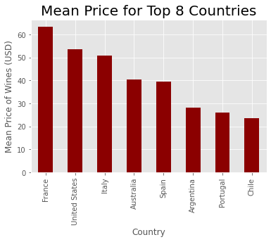
Data Analysis
Top Countries (Price)
Median & 3rd quartile price of wine in United States, France, and Italy are much higher than other countries.

Slide 8
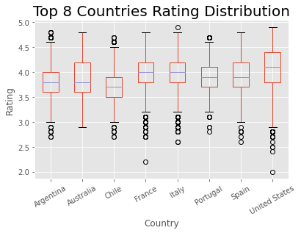
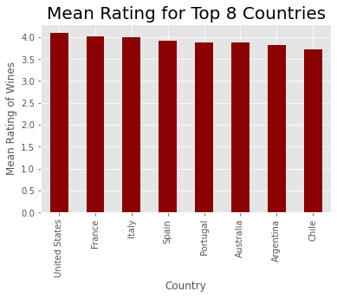
Data Analysis
Top Countries (Rating)
Median & 3rd quartile rating of wine in United States is the highest.

Slide 9
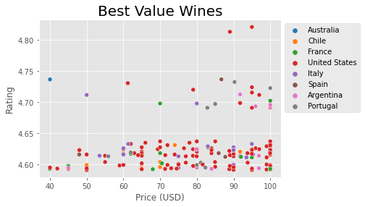
Data Analysis
Best Value Wines
United States seem to be dominating in the best value wine that are under $100 and have over 4.5 rating.

Slide 10
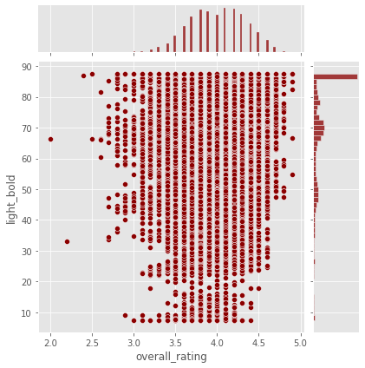
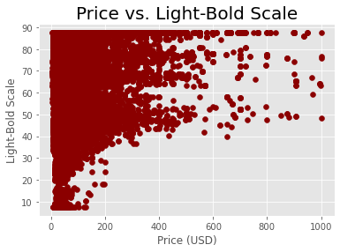
Data Analysis
Light-Bold Note
There are a lot more wine that are bold.
Bolder wines are more expensive.

Slide 11
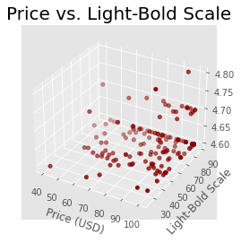
Data Analysis
Light-Bold Note (Best Value Wines)
From the best value wines, people who are looking for best wine should fine:
Light-bold scale > 80

Slide 12
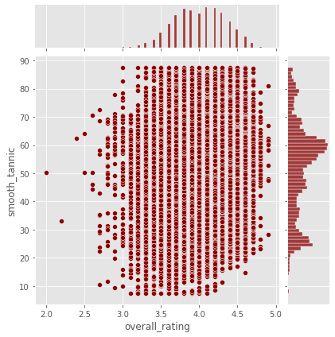
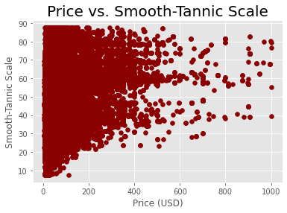
Data Analysis
Smooth-Tannic Note
The smooth-tannic note is more spread out with a little skewness towards tannic.

Slide 13
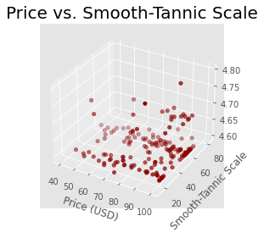
Data Analysis
Smooth-Tannic Note (Best Value Wines)
From the best value wines, people who are looking for best wine should fine:
Smooth-tannic scale between 50 and 70

Slide 14
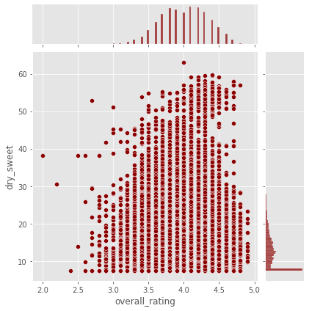
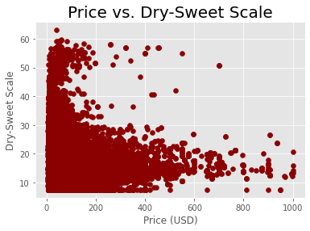
Data Analysis
Dry-Sweet Note
Red wines are generally dry than sweet.

Slide 15
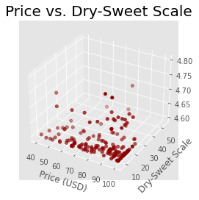
Data Analysis
Dry-Sweet Note (Best Value Wines)
From the best value wines, people who are looking for best wine should fine:
Dry-sweet scale < 15

Slide 16
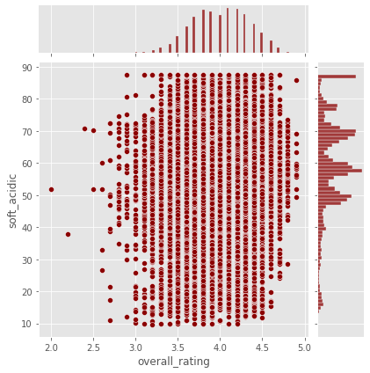
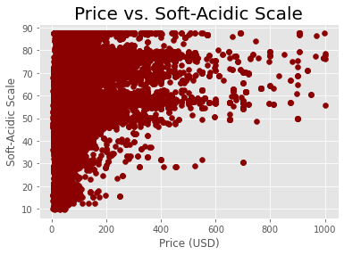
Data Analysis
Soft-Acidic Note
The soft-acidic note is more spread out but still skewed towards acidic.

Slide 17
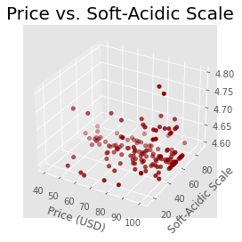
Data Analysis
Soft-Acidic Note (Best Value Wines)
From the best value wines, people who are looking for best wine should fine:
Soft-Acidic scale between 50 and 70

Slide 18
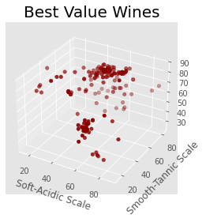
Data Analysis
Best Value Wines
Dry-sweet scale has been excluded from this as most red wines were classified as dry.
Two big clusters
Light-bold: 60-70
Smooth-tannic: 20-40
Soft-acidic: 60
Light-bold: 90
Smooth-tannic: 60
Soft-acidic: 60
Light-Bold Scale

Slide 19
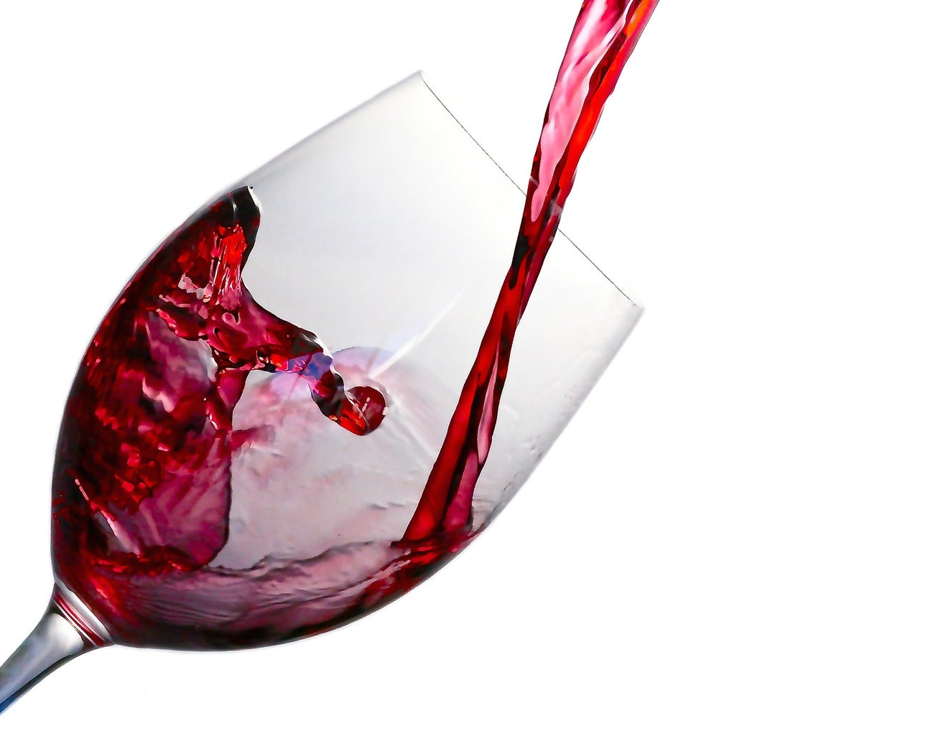
You don’t need to pay hundreds of dollars to enjoy good wine!
If you are just getting into wine and are looking for best value wine (rating greater than 4.5 and price under $100), look for the following traits:
From United States
Light-bold scale > 80
Smooth-tannic scale between 50 and 70
Dry-sweet scale < 15
Soft-acidic scale between 50 and 70

Slide 20
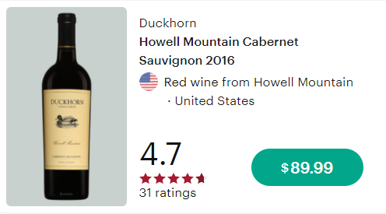
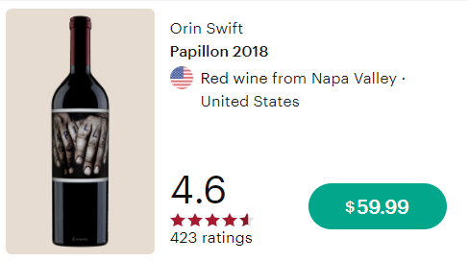
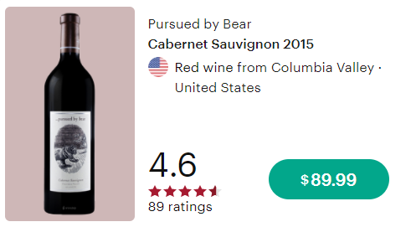
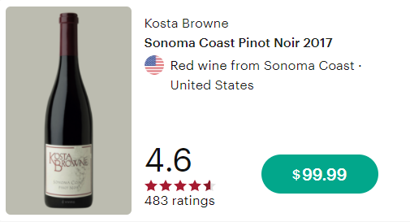
Best Value Wine Recommendations

Slide 21
Thank you!
Any questions or comments?
Author Contact Information
LinkedIn: https://www.linkedin.com/in/williamjeongwoohan/
GitHub: https://github.com/WilliamJHan
Email: william.jeongwoo.han@gmail.com

