Slide 1

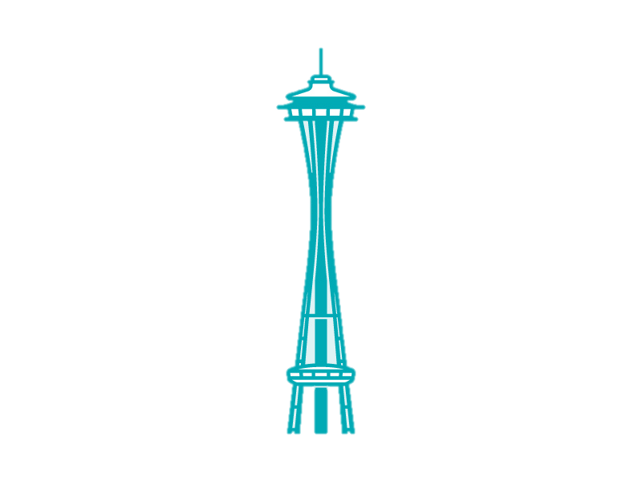
Seattle Airbnb Initial User Analytics
William Justice

Slide 2
Who Cares and Why?
Client
Airbnb
The large market analysis of Seattle Airbnb First Time users shows areas
for expanding operations in the
region as well as market dynamics for similar growth prospects.
Seattle, WA

Slide 3
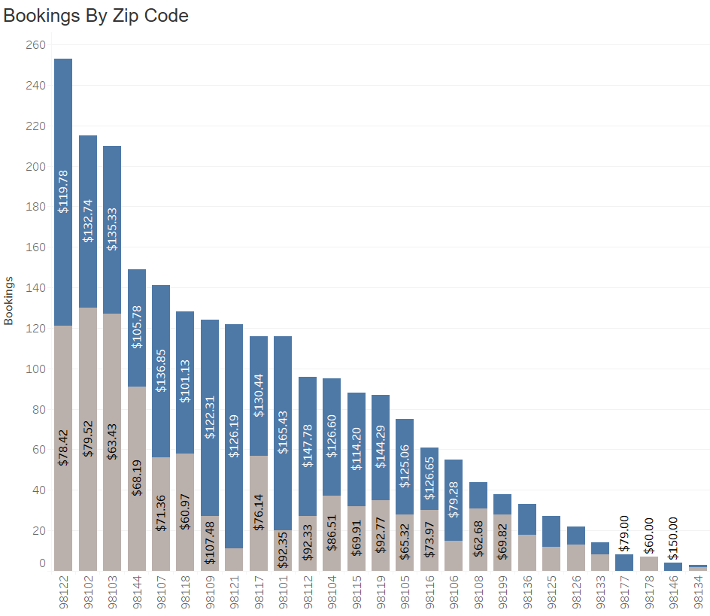
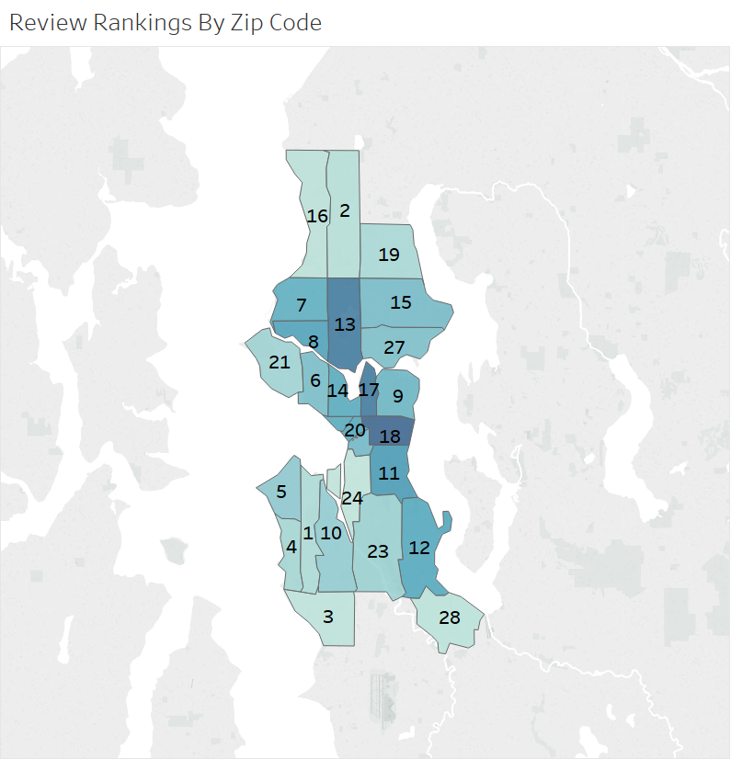
First Time User Key Findings
The most popular Zip
Codes were found to be
less interested in Home
Type when compared to
surrounding zip codes. But were willing to pay 43% more
for Private Homes than
shared homes.
These most popular Zip
Codes Ranked at #18,
#13, and #17 when
comparing review
rankings by Zip Codes.
Entire Home/apt.
Private Room
These popularly booked locations may suggest
areas where
concentrated marketing is likely to have a high
RIO.

Slide 4
The problem focused on 3 primary areas…
01
The more time a host has on Airbnb will result in a higher rated first time user experience.
02
First time Airbnb users are more likely to purchase accommodations at a higher price point compared to non-initial users.
03
First time Airbnb users are more interested in the Home Type (Full home/ Apartment) opposed to a shared or single room.
*Assumption: First time users were established through key phrases found within reviewer comments.
Key Phrases: “First time user”, “First time”, “First experience”, “first time”

Slide 5
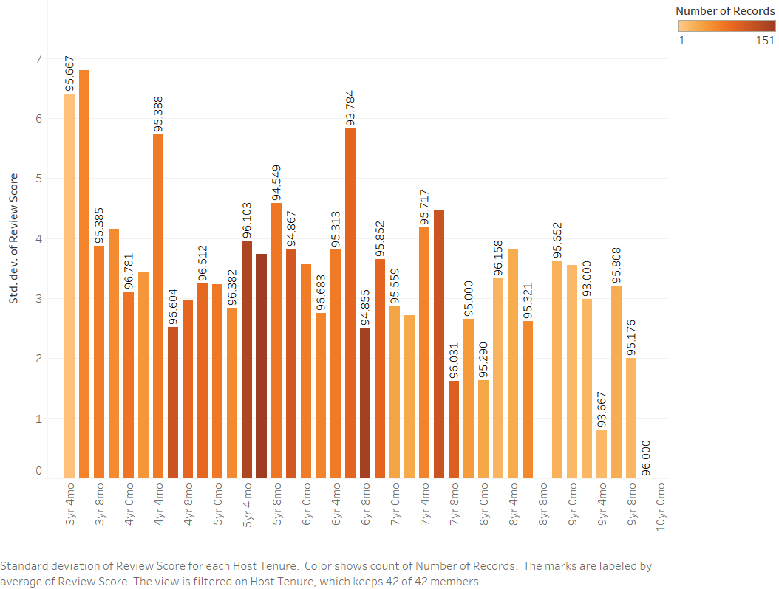
Rating as a function of Airbnb host Tenure failed to result in increased First Time user ratings…

Slide 6
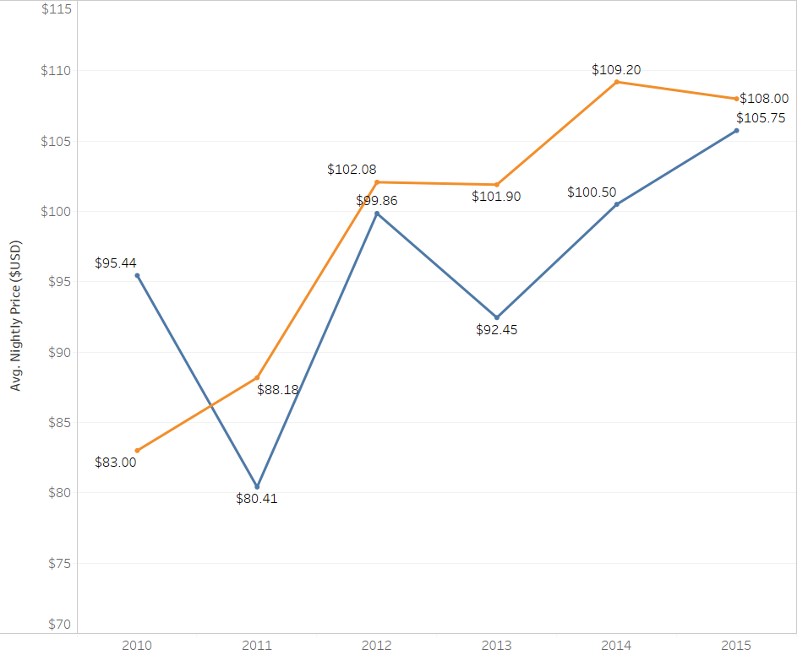
…Nor were first time users observed spending significantly more for accommodations…
First time Users
$95.74 /
Nightly
Non-Initial Users
$98.73 /
Nightly

Slide 7
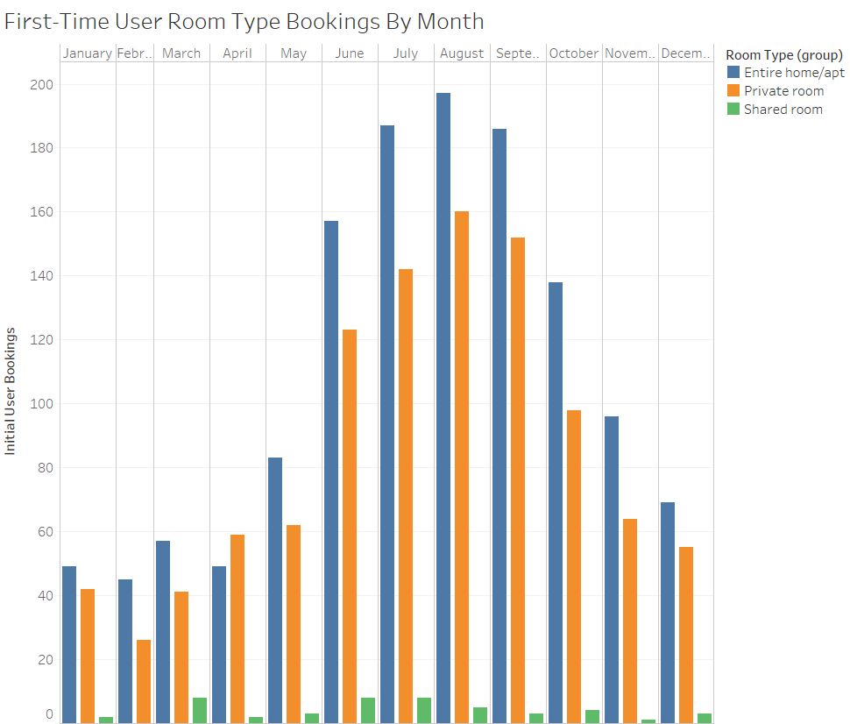
…But Bookings of Entire Home/Apts were far more popular, especially from June through October.
June- October
accounted for 66%
of total
bookings.
Of June- October
bookings,
Entire home/apts
booking represented 55%.

Slide 8

Thank You.

