Slide 1
Exploratory Data Analysis of Mothers Age on Child Birthweight
William Justice
8/8/2020
DSC 530

Slide 2
Five Variables were Explored to help navigate this interesting question
Pregnancy Length (prglngth) = integer duration of pregnancy in weeks.
Birth Order (birthord) = serial number for live births; code for first child is one and so on.
Birth Weight (birthwgt_lbs) = pounds of baby at birth.
Mother Age (agepreg) = Mothers age at end of pregnancy.
Outcome (outcome) = integer code for outcome of birth; 1 means live birth.

Slide 3
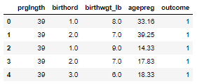
Let’s Take a look at a snippet of the data…

Slide 4
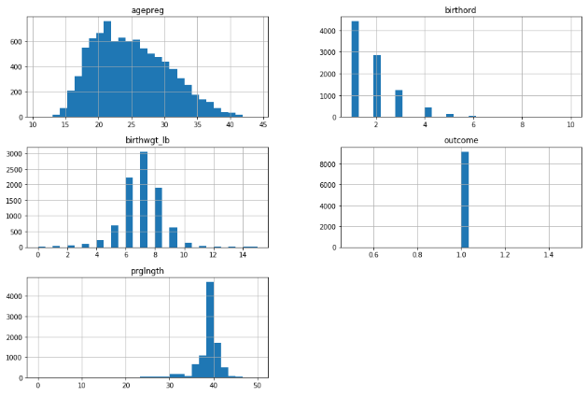
Now a look into some distributions of each variable…

Slide 5
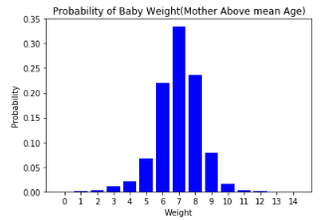
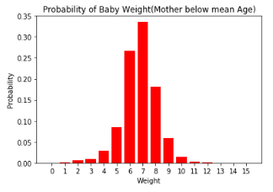
PMF for Birthweight depending on mothers age above or below mean age
*It appears there is only a slight difference between birthweights

Slide 6
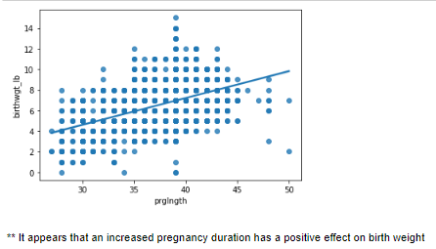
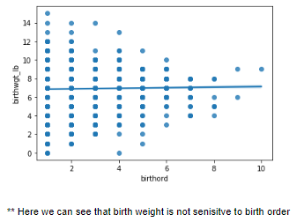
Lets take a look into two other variables effects on birthweight.

Slide 7
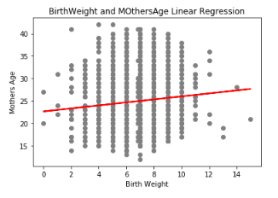

Regression Analysis
*We can see that the prediction line for this regression model is relatively weak.
*When put into context with the coefficient calculation we can assume that for every one year increase in a mothers age, there is an increase in ~1/3 pounds of child birth weight. Interesting, but not statistically significant.

