Slide 1

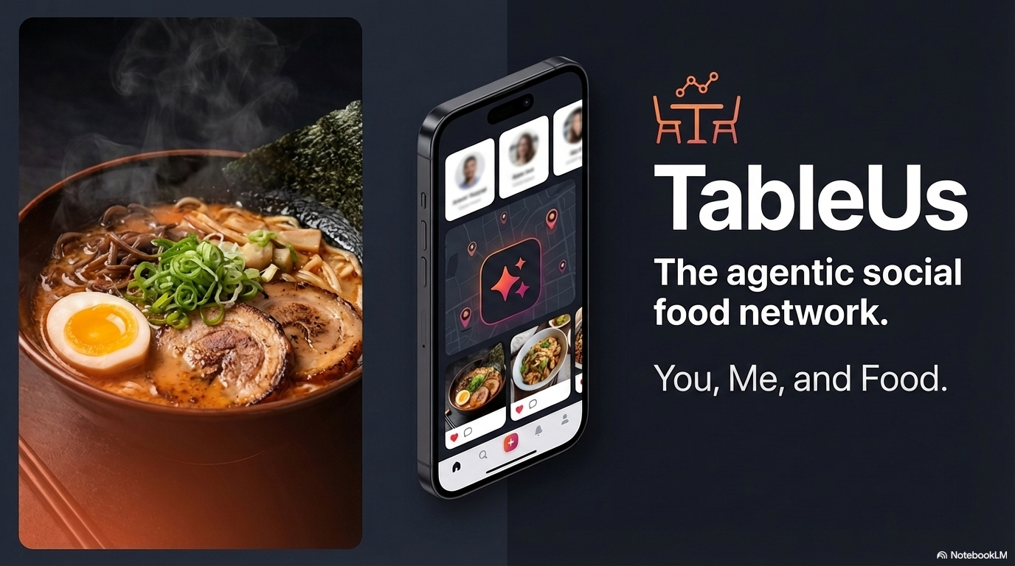



Slide 2
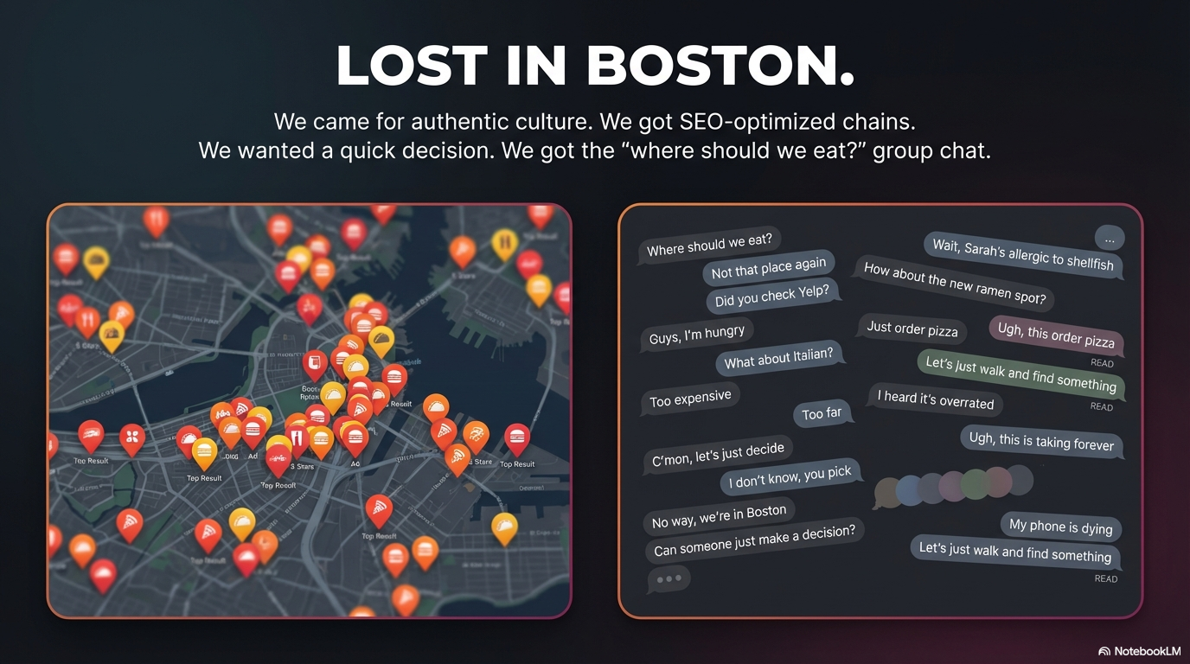
Finding Food Shouldn’t Be This Hard!!

Slide 3

Why now: diners are social, exploratory, and ready for AI
The behavior change is already visible in restaurant demand, cuisine discovery, and planning tools.
Problem:
40%
44%
prefer group over solo
plan more AI use
Traditional searching app ignore complex taste preferences.
Americans who say they would rather eat with a group.
For restaurant discovery and reservations in 2026.
+11%
group dining YoY
58%
86%
OpenTable says group dining rose year over year in 2025.
explore global cuisines
Discover new foods
Consumers say they now eat a wider variety of cuisines.
Consumers who see restaurants as places to learn new tastes.

Slide 4
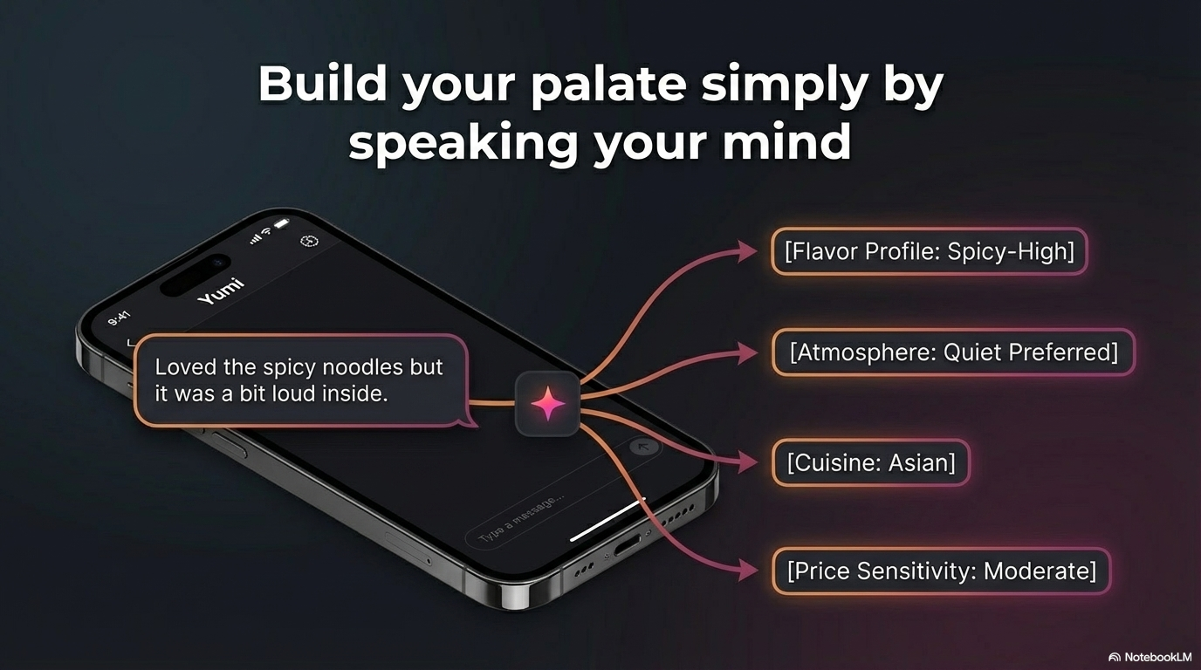

Slide 5
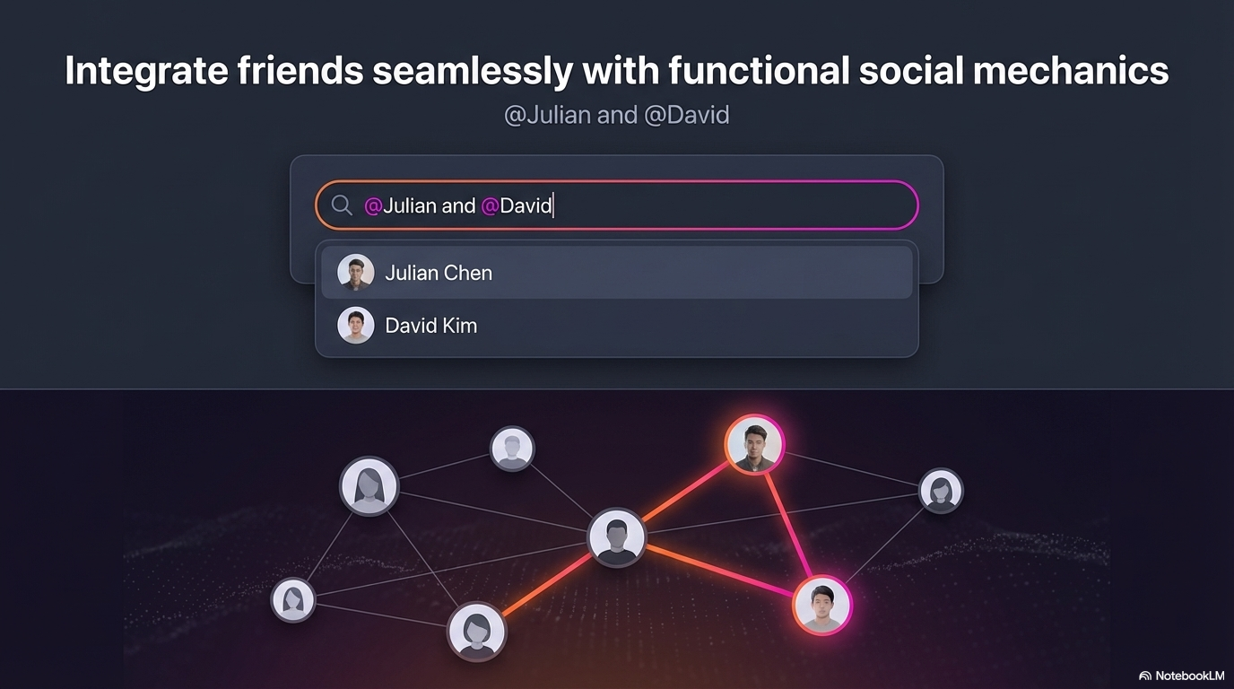

Slide 6
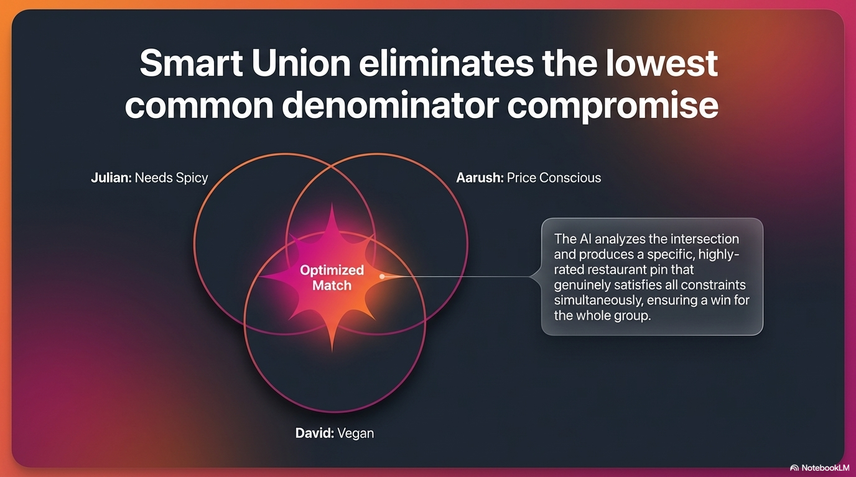

Slide 7
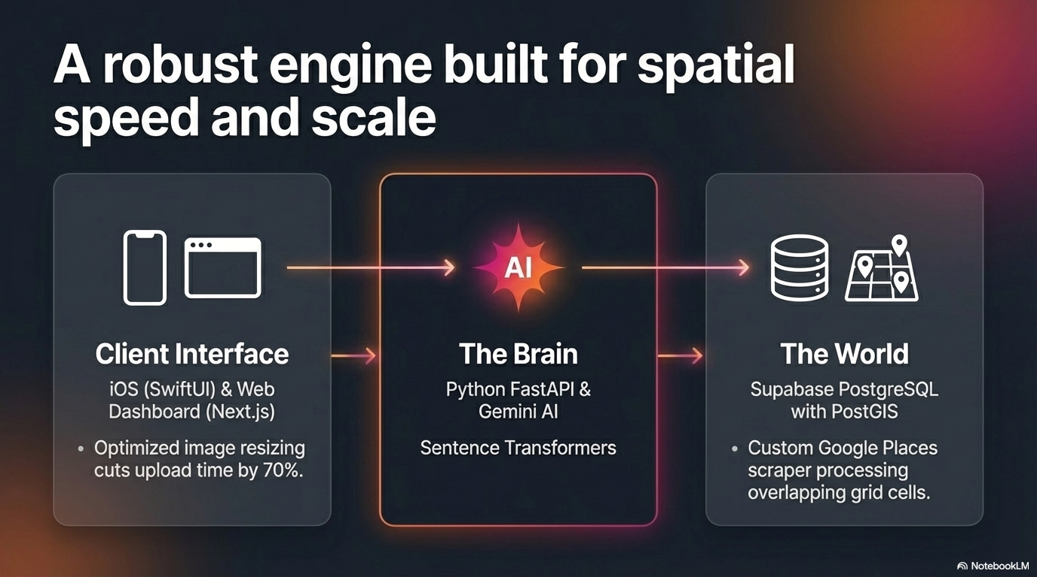

Slide 8
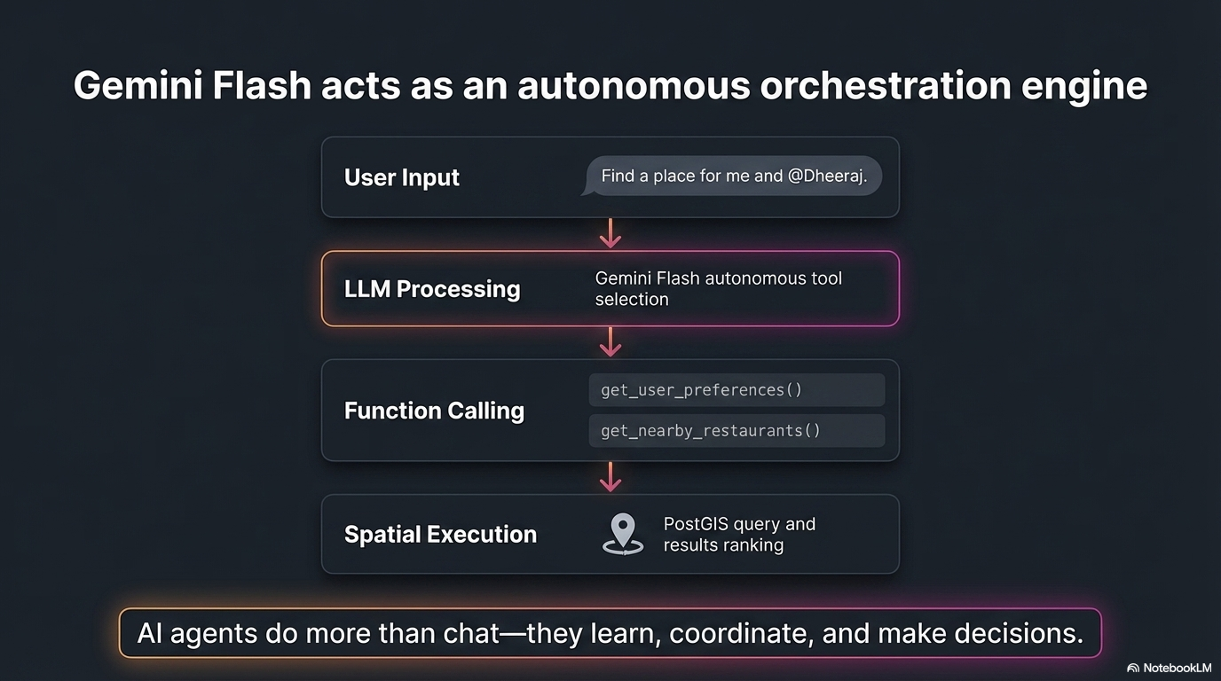

Slide 9
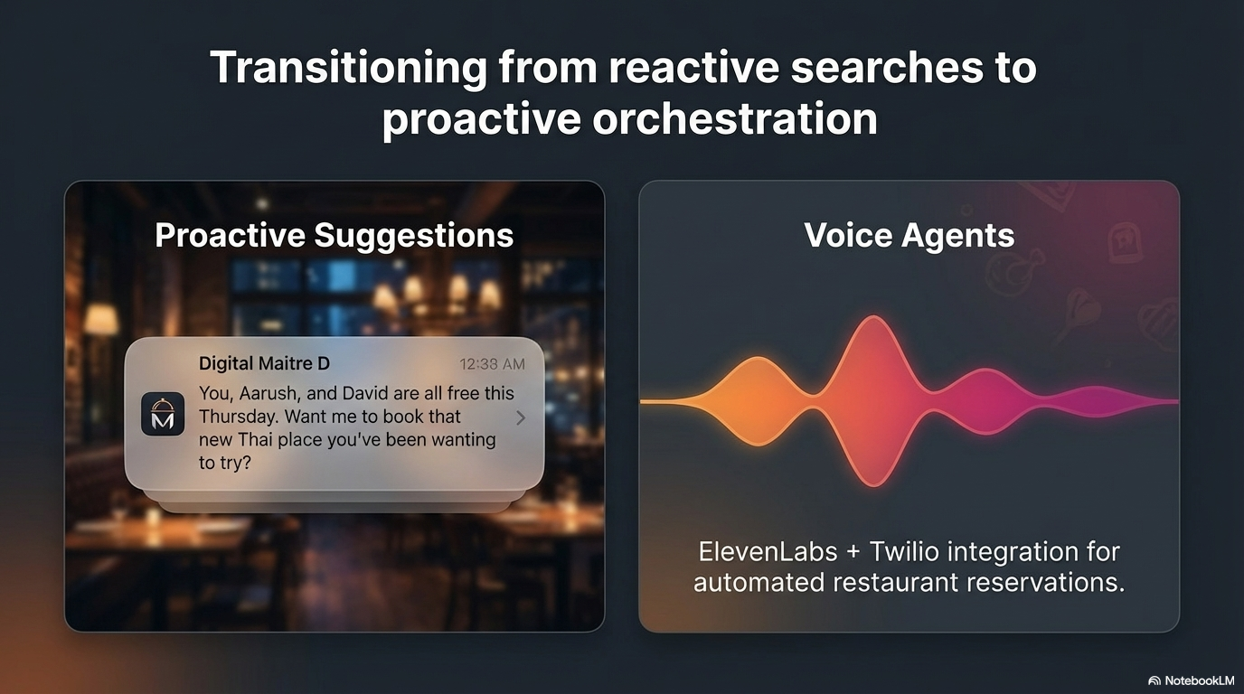

Slide 10
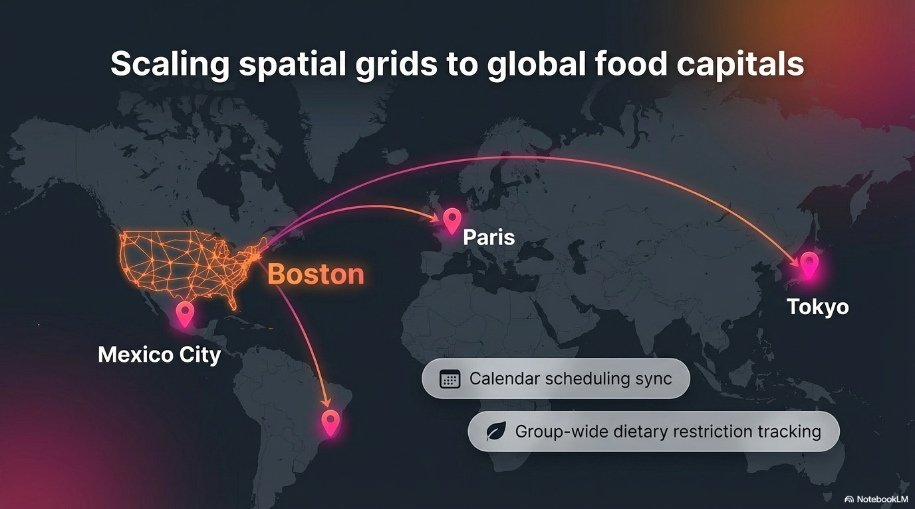

Slide 11
