Slide 1
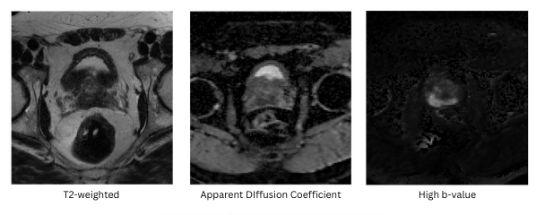
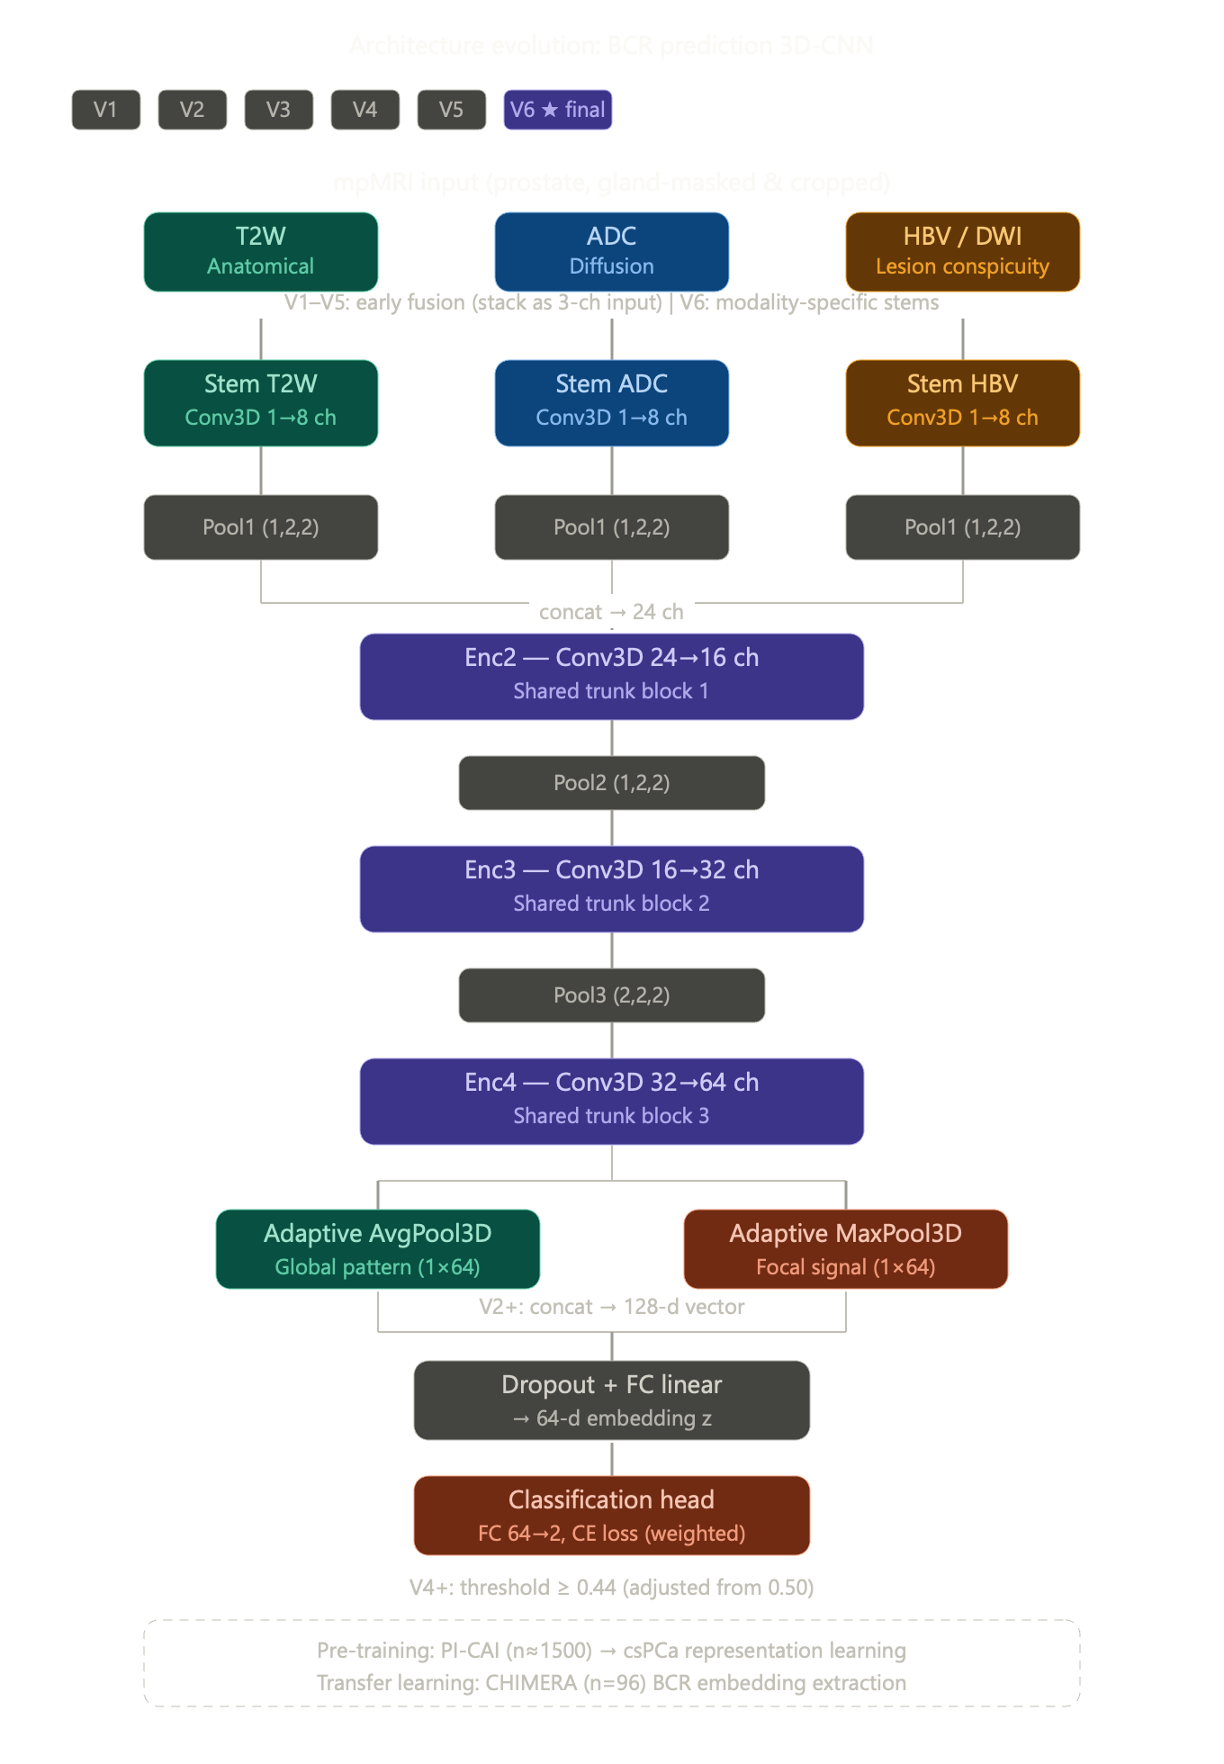
MRI embeddings extraction – Global patient-level
Stem T2W
Conv3D 1→8 ch
Stem ADC
Conv3D 1→8 ch
Stem HBV
Conv3D 1→8 ch
Pool1 (1,2,2)
Pool1 (1,2,2)
Pool1 (1,2,2)
Concat → 24ch
Enc2 — Conv3D 24→16 ch
Shared trunk block 1
Pool2 (1,2,2)
Enc3 — Conv3D 16→32 ch
Shared trunk block 2
Pool3 (2,2,2)
Enc4 — Conv3D 32→64 ch
Shared trunk block 3
Adaptive AvgPool3D
Global pattern (1×64)
Adaptive MaxPool3D
Focal signal (1×64)
Dropout + FC linear
→ 64-d embedding z
Pre-training: PI-CAI (n≈1500) → csPCa representation learning.
Transfer learning: CHIMERA (n=96) → BCR embedding extraction
Classification head
FC 64→2, CE loss (weighted)

Slide 2
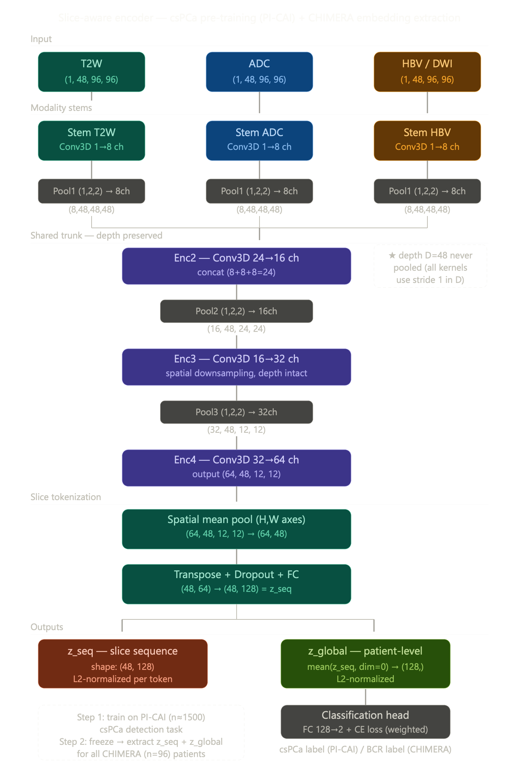
MRI embeddings extraction – Global patient-level
Stem T2W
Conv3D 1→8 ch
Stem ADC
Conv3D 1→8 ch
Stem HBV
Conv3D 1→8 ch
Pool1 (1,2,2)
Pool1 (1,2,2)
Pool1 (1,2,2)
(8,48,48,48)
(8,48,48,48)
(8,48,48,48)
Shared trunk – depth preserved
Enc2 — Conv3D 24→16 ch
Concat (8+8+8=24)
Pool2 (1,2,2)
(16,48,24,24)
Enc3 — Conv3D 16→32 ch
Pool3 (2,2,2)
(32,48,12,12)
Enc4 — Conv3D 32→64 ch
Output (64,48,12,12)
Spatial mean pool (H,W axes)
(64,48,12,12) → (64,48)
Transpose + Dropout + FC
(48,64) → (48,128) = z_seq
z_seq — slice sequence
shape: (48 or 24, 128)
L2-normalized per token
z_global — patient-level
mean(z_seq, dim=0) → (128,)
L2-normalized
Step 1: train on PI-CAI (n=1500) csPCa detection task
Step 2: freeze → extract z_seq + z_global for CHIMERA (n=96)
Classification head
FC 128→2 + CE loss (weighted)
csPCa label (PICAI)

Slide 3
MRI embeddings extraction – Global patient-level
Stem T2W
Conv3D 1→8 ch
Stem ADC
Conv3D 1→8 ch
Stem HBV
Conv3D 1→8 ch
Pool1 (1,2,2)
Pool1 (1,2,2)
Pool1 (1,2,2)
Enc2 — Conv3D 24→16 ch
Shared trunk block 1
Pool2 (1,2,2)
Enc3 — Conv3D 16→32 ch
Shared trunk block 2
Pool3 (2,2,2)
Enc4 — Conv3D 32→64 ch
Shared trunk block 3
Adaptive AvgPool3D
Global pattern (1×64)
Adaptive MaxPool3D
Focal signal (1×64)
Dropout + FC linear
→ 64-d embedding z
Classification head
FC 64→2, CE loss (weighted)

