Slide 1

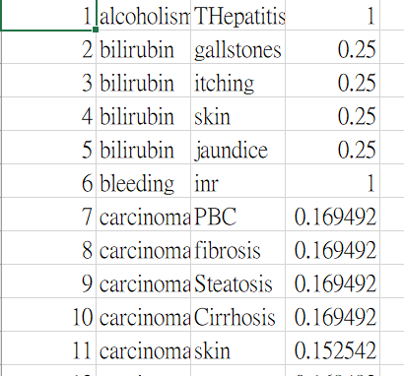
Visualizing Decision Rules and Relations for Medical Data Analysis: Modeling
Authors: LIANG LIHENG, DB626233 & CHEANG WENG HEI, DB625417
Supervisors: Prof. Simon FONG & Prof. Shirley SIU
Department of Computer and Information Science, Faculty of Science and Technology, University of Macau
Introduction
Medical diagnosis is a main part of in medicine. It is the first and important procedure to save the patient’s life and improve health. As many possible reasons are involved, it is not easy for medical diagnosis and identify the cause of the illness. Traditionally, a doctor can only give a diagnosis result based on his/her knowledge and experience. Many researchers combine computer science and medical science in recent years. By taking advantage of computer science, medical research can be efficiently. Although computers cannot completely replace doctors for medical diagnosis, computers provide doctors with useful tools to help doctors make diagnosis efficiently and accurately.
Objectives
The objective of this FYP is focused on a vertical solution for analyzing medical data, which joins advantages of several data mining techniques in one system. Our project includes two parts: modeling and visualization.
For the modeling part, the main workflow is analyzing the data to generate a useful result for the visualization part. A set of medical data is given. The data was collected by other medical researchers and published on the Internet. The data includes patients living habits, diseases, and other factors. Then, data processing methods can be used to filter out the invalid data. By using machine learning method, the relationships between different attributes can be found.
Although there is already have simple visualization. But for better result, we need to provide more functions, especially for interactive function. Thus, we output the result to a csv file. It can be passed to specific visualization program written by my teammate to show a better result.
Conclusions
Design
Our project analysis the medical data by using machine learning method. Different to other project, our main objective is to provide a visual result. According to the division of labor, our part generate the useful data for visualization, and my teammate work on visualization. Program accept raw medical data set input. Then, it can perform data pre-processing, model training, retrieve the relationship between each attribute. The relationship data is processed by program and generate useful data for visualization. It can be passed to my teammate’s program to provide visual result. Through the cooperation of team members, we successfully completed the goal of providing users with visual results of medical data analysis.
For the modeling part, we combine advantages of different software to provide retrieve the relationship between each attribute in the data set, including R, Weka, RapidMiner. Those software involve different model, such as Decision tree and Bayesian network.
References
R, "The R Project for Statistical Computing". [Online]. Available: https://www.r-project.org/
Weka, "Data Mining with Open Source Machine Learning". [Online]. Available: https://www.cs.waikato.ac.nz/ml/weka/
RapidMiner, "Best Data Science & Machine Learning Platform". [Online]. Available: https://rapidminer.com/
Acknowledgements
We forces on generating data for visualization by using machine learning method. After modeling the data, relationship between different nodes can retrieved from the model. We can use Weka and RapidMiner built-in simple visualization tool for quick viewing.
The author would like to express his utmost gratitude to UM for providing the opportunity to carry out a project as a partial fulfillment of the requirement for the degree of Bachelor of Science.
Throughout this project, the author was very fortunate to receive the guidance and encouragement from his supervisor Prof. Simon FONG & Prof. Shirley SIU.
Notes:
https://www.posterpresentations.com/free-poster-templates.html

