Slide 1
Visualizing Decision Rules and Relations for Medical Data Analysis: Machine Learning
Group K

Slide 2
1
Group presentation
LIANG LIHENG, DB626233
CHEANG WENG HEI, DB625417

Slide 3
Introduction
Background
Research problem
Importance
Motivation
Goal
How to achieve

Slide 4
Background
Medical diagnosis is a main part of in medicine.
The invention of wearable sensors that can easily collect data on a person’s day to day vitals makes machine learning systems incredibly useful in the health care industry.
There is also great value to be gained from machine learning at the clinical trial stage of medical procedures.
Notes:
Medical diagnosis is a main part in medicine. It is the first and important procedure to save the patient’s life and improve health. As many possible reasons are involved, it is not easy for medical diagnosis and identify the cause of the illness. Traditionally, a doctor can only give a diagnosis result based on his/her knowledge and experience. Mentioned in [1], many researchers combine computer science and medical science in recent years. By taking advantage of computer science, medical research can be efficiently. Although computers cannot completely replace doctors for medical diagnosis, computers provide doctors with useful tools to help doctors make diagnosis efficiently and accurately.
‘The invention of wearable sensors that can easily collect data on a person’s vitals day to day makes machine learning systems incredibly useful in the health care industry. Decision tree style algorithms tend to be especially helpful. Patients can be broken down by group to track how certain variables affect the efficacy of treatment plans, or the likelihood of developing certain diseases.

Slide 5
Research problem
Using computer technology in medical data analysis accelerate medical progress.
Finding causal relationship is not enough, an intuitive representation of causal relationship is also required.
Notes:
Using computer technology in medical data analysis accelerate medical progress. Nowadays, artificial intelligence and mechanical learning are already mature. By taking advantage machine learning, computer can generally provide a reliable and accuracy result. The traditional machine learning model is a black box learning process, and this technology sometime lacks interpretability. In medicine, interpretability is important for doctors to analyze and interpret data. It enables doctors to determine causal relationship between diseases, living habit, and other features.
Finding causal relationship is not enough, an intuitive representation of causal relationship is also required. A graphical representation is preferred because humans have the strong power to analyze graph. Data and graph are two different representation of information, converting data to graph is a challenge. No universal visualization tool is existed. Depending on the application, special visualization tool needs to be developed.

Slide 6
Importance
Visualizing data is important in data analysis.
Humans have the strong power to analyze structures and relationships by studying graphical data.
Notes:
Visualizing data is important in data analysis. Humans have the strong power to analyse structures and relationships by studying graphical data. It may facilitate data mining that learning from visually presented information may faster. It is useful in the stage of exploration if exploring goal is not well known. It may also help people to confirm preliminarily knowledge quickly by studying the graphical data.

Slide 7
Motivation
This final year project is focused on analyzing medical data.
Our motivation is providing useful information for doctor or medical research by taking the advantage of computer power.
Notes:
This final year project is focused on analysing medical data. Our motivation is providing useful information for doctor or medical research by taking the advantage of computer power. Data information is not intuitive enough, providing a better result by using visualizing technology is also our motivation. By the advantage of the phenomenal abilities of the human visual system, visualizing result can improve understandability, usability and efficiency.

Slide 8
Objective
Objective of this FYP is focused on a vertical solution for analyzing medical data
We would like to apply data processing, machine learning and visualization in this final year project.
Combines the advantages of different technologies to produce useful medical results.
Notes:
objective of this FYP is focused on a vertical solution for analysing medical data, which joins advantages of several data mining techniques in one system.
many of the computer technologies we learned in our bachelor's degree programs are useful for analysing medical data, including data processing, machine learning and visualization. Therefore, we would like to apple those technologies in this final year project.
Data processing can deal with raw data and transform it into research-worthy data. Machine learning enables us to learn data and generate useful prediction. Visualization provides a concise, understandable, and user-friendly representation to demonstrate the final result
We want to design a system that combines the advantages of different computer to produce useful medical results.

Slide 9
How to achieve
We divide it into two part: machine learning & visualizing.
Machine learning: find out and understand relationship between behaviors and the disease
Visualization: provide a concise, understandable, and user-friendly graphical representation
Notes:
we divide it into two part: machine learning & visualizing.
For the machine learning part, To find out and understand relationship between behaviours and the disease, we try to use algorithms like Bayesian network, decision tree etc. the main workflow is analysing the data to generate a useful result for the visualization part. A medical data set is given. The data was collected by other medical researchers and published on the Internet. The data includes patients living habits, diseases, and other factors. Then, data processing methods can be used to filter out the invalid data. By using machine learning method, the relationships between different attributes can be found.
Besides, to make the result more ‘user friendly’ we are going to make some improvement through existed visualizing tool. For the visualization part, the main task is to develop a visualization software to show the result of the machine learning. The result of the machine learning part is given by another sub team. Based on the result, a concise, understandable, and user-friendly graphical representation should be provided.

Slide 10
What is Bayesian network
Bayesian network is an effective technology for medical diagnostic systems.
The structure of the Bayesian networks is very suitable for medical decision making.
Notes:
BN is an effective technology for medical diagnostic systems. They are a graphical model that includes a set of variables and their probabilistic independences, medical diagnosis procedure, they can predict the likelihood of a patient's illness based on living habit and detected symptoms.
Bayesian networks are graphical presentation, the nodes represent variables. The arcs between different variables represent relationships. The structure of the Bayesian networks is very suitable for medical decision making.

Slide 11
What is Decision Tree
Decision tree is a very common machine learning classification method that requires supervised learning.
Information gain measures the relative change in entropy with respect to the independent variables.
Notes:
Decision tree is a method of machine learning. A decision tree is a tree structure in which each internal node represents a judgment on an attribute, each branch represents the output of a judgment result, and finally each leaf node represents a classification result. Decision tree is a very common classification method that requires supervised learning, supervised learning is to give a bunch of samples, each sample has a set of attributes and a classification result. Then, by learning these samples, a decision tree is obtained, which can correctly classify the new data.

Slide 12
Division of Project
Part 1
Part 2
Daniel focused on using R and its library to do Bayesian network learning
William focused on RapidMiner & Weka to do decision tree learning

Slide 13
2
Individual presentation
William, LIANG LIHENG, DB626233

Slide 14
Contents of Individual Presentation
Tools Used In This Project
Design
Demonstration and Result

Slide 15
Software For Machine Learning
Weka
RapidMiner
An open source platform with learning algorithms to do data mining.
A world-leading data mining solution, with advanced technology

Slide 16
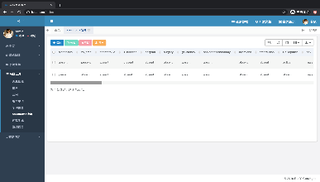
User Interface
This user interface is designed based on an open-source platform called RuoYi.

Slide 17
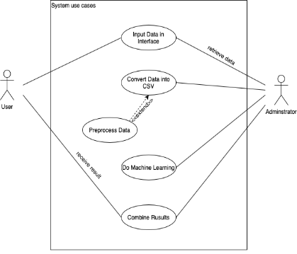
“design
Use case diagram for the system

Slide 18
Machine learning algorithms
‘J-48’ decision tree
FURIA rule

Slide 19
“Demonstration
Please refer to the video

Slide 20
(Demo video. Due to file size limitation, this ppt file does not contain the video. Please watch the mp4 file.)

Slide 21
3
Individual presentation
Cheang Weng Hei, DB625417

Slide 22
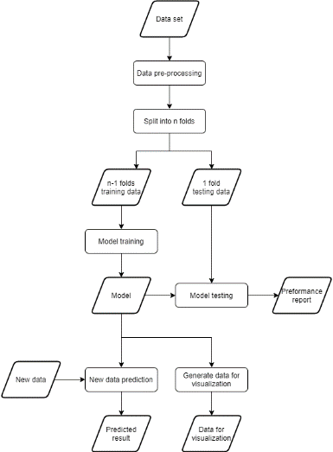
Design

Slide 23
Design
Program includes the following parts:
Data input
Input the data set for model training
Data pre-processing
Do some operations to optimize the data set
Model training
Training the Bayesian network model with the data set
Model testing
Testing mode l with testing data and generating performance report
New data prediction
Allow user input new data and do prediction
Output data for visualization
Retrieve the relationship between attribute from model to a file

Slide 24
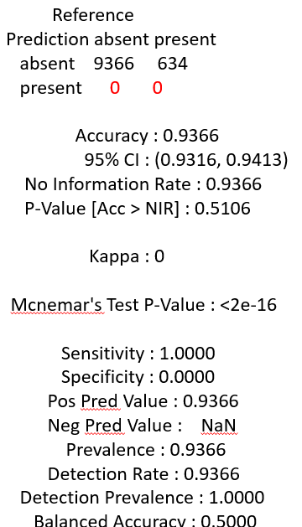
Imbalanced problem
Imbalanced data set problem is a common for medical data
If I ignore it, I will get a non-reliable result
Solution: SMOTE resampling method
Decrease size of majority class
Increase size of minority class

Slide 25
(Demo video. Due to file size limitation, this ppt file does not contain the video. Please watch the mp4 file.)

