Slide 1
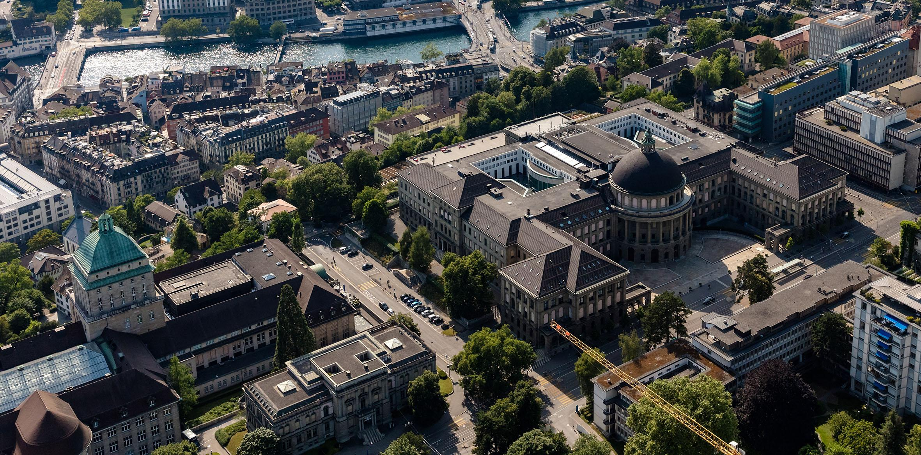
Comparing the transparency of the haptic paddle using different interaction controllers
Organisational unit, can be spread over 2 lines
Your names go here
Role of person giving presentation
dd Month yyyy, Location

Slide 2
Introduction - Background and Motivation
Background and Motivation
Rehabilitation robots today. (Some pictures here). Rehabilitation robots should be able to render a broad dynamic range of impedances. (pictures from the lecture slides here)

Slide 3
Introduction - Problem Statement
Interaction Control Scheme
Open-loop Impedance Control(Block diagram)
Impedance Control with Model Feedforward(Block diagram)

Slide 4
Introduction - Problem Statements
Interaction Control Scheme
Impedance Control with Force Feedback(Block diagram)

Slide 5
Introduction - Problem Statement
Transparency Mode and Transparency Planes
(Transparency mode and planes explained, can be found in the paper, picture of free air can also be added here)

Slide 6
Methods - TEMPLATE
Approach
Implementation
Metrics / Outcomes
E.g., setup, subjects, algorithm, equations, etc.
Use photos/videos, shcemes, drawings…
Argue WHY you did it like this

Slide 7
Methods - Implementation
Tachometer Characterization(Transfer function, performance comparison)

Slide 8
Methods - Implementation
Force Sensor Characterization(Transfer function)

Slide 9
Methods - Implementation
Force Feedback Implementation in Transparency Mode

Slide 10
Methods - Outcome
Data Recording for Transparency Planes

Slide 11
Results - TEMPLATE
DRY facts
Preferably quantitative results (key values, plots, …)

Slide 12
Results
Transparency Planes with Apparent Mass and Apparent Damping reported

Slide 13
Discussion - TEMPLATE
Interpretation of your results
E.g., do the results reflect what you expected?
Reflection on methodology
Potential limitations of your work

Slide 14
Conclusion / Outlook
Key message

Slide 15
Professor John Doe
Role of person giving presentation
beat.muster@abcd.ethz.ch
ETH Zurich
Organisational unit
Building Room
Street House number
0000 Town, Country
www.abcd.ethz.ch

