Slide 1
Superspreading and Stochastic Branching Processes: An Exploration
William Magrogan

Slide 2
Goals and Overview
Take idealized branching process and expand on it
Branching processes are tractable
Good proxy for simple network dynamics
Locally-tree like approximations => branching processes
Highly extensible and tunable
Motivated by Lloyd-Smith (2015) paper
Extends material covered in class in a new direction
Generic, non-specific pathogen, focus on model development

Slide 3

Superspreading
Superspreading Event (SEV): Event causing high secondary infection rate
Superspreader: Individual associated with anomalously high secondary infection rate
Modeled by contact distributions of high variance
Standard contact structure (Poisson), $O\left(σ\right)\sim 1$
Overdispersed contact structure (NB, Geometric), $O\left(σ\right)>1$
Power Laws (Zipf, Cauchy), $O\left(1\right)≫1$

Slide 4
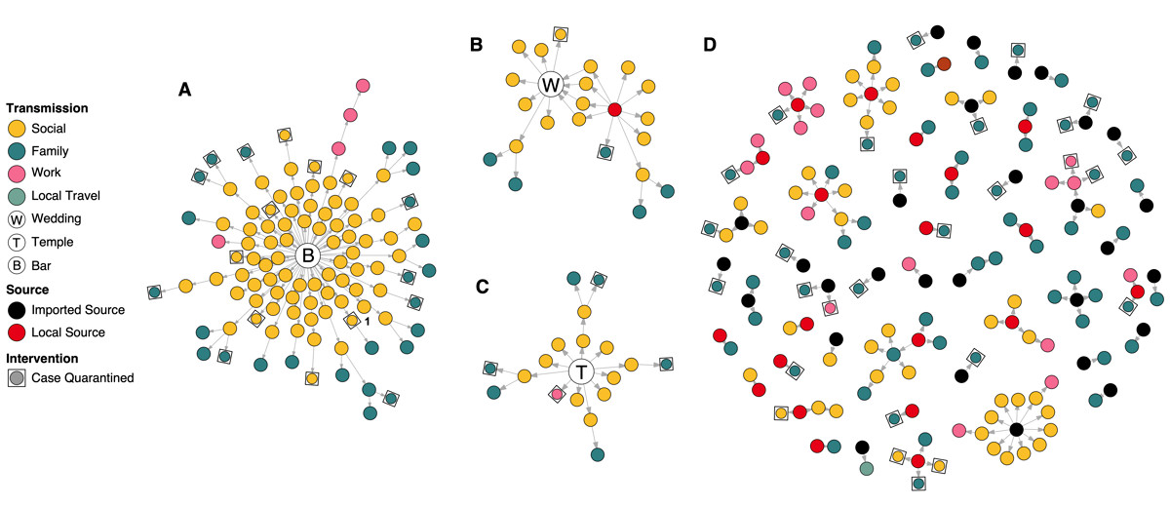
Superspreading

Slide 5
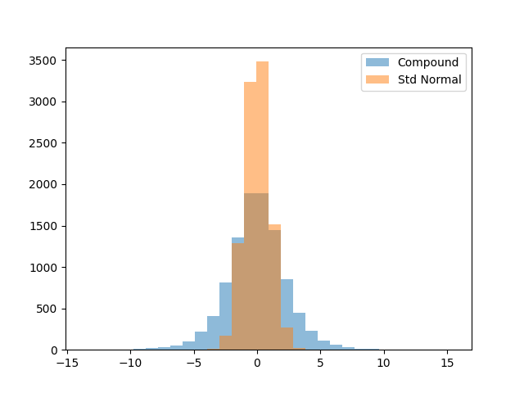

Compound Distributions
Random Variables (RV) who’s
parameters are RVs themselves
Not usually closed form
Useful to describe stochastic
systems
For example
$X\sim N\left(Y, Z^{2}\right)|Y\sim N\left(0, 1\right), Z\sim Γ(α, β)$

Slide 6
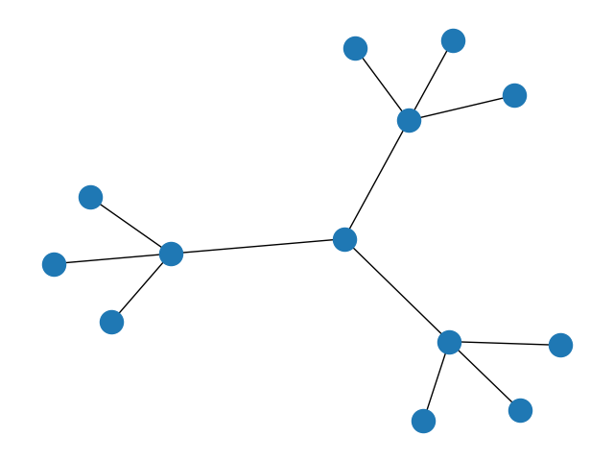
Branching Processes
Abstract model
Each layer is a ‘generation’
Infections happen stochastically
Each node has properties
affecting transmission

Slide 7
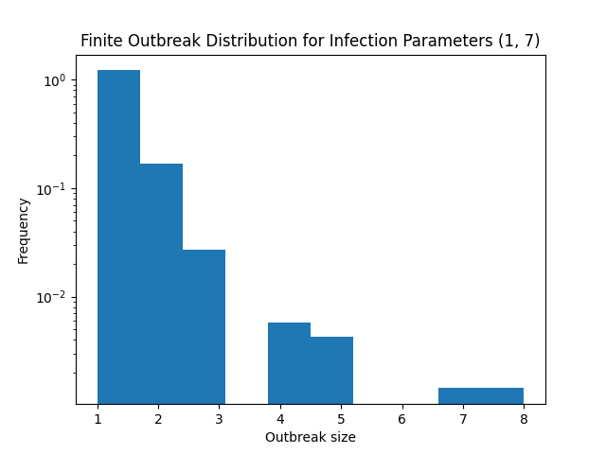
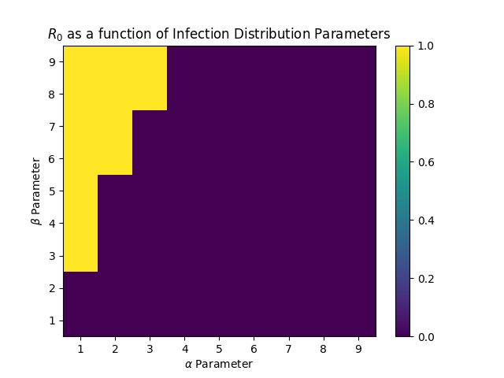

Analysis
Compare to simpler
branching processes
Effective distribution of $R_{0}$
Probability of major outbreak
Relative Size of outbreaks
Effect of vaccinating

Slide 8
Introducing Additional Effects
Secondary contact distribution
Number of true contacts
Poisson, Geometric, NB, Zipf
Infectiousness distribution
Some strains have higher/lower infectiousness
Uinform(0, 1), Beta
Effect of vaccination
Leaky vs All-or-Nothing model

Slide 9
Nice-to-Haves and Future Work
Correlation
“Do vaccinated people know more vaccinated people than unvaccinated people?”
“Do highly connected people know more highly connected people?”
Nonequilibrium processes
“Pathogens may evolve over the course of an outbreak.”

Slide 10
Questions
Thank you all for your time

