Slide 1
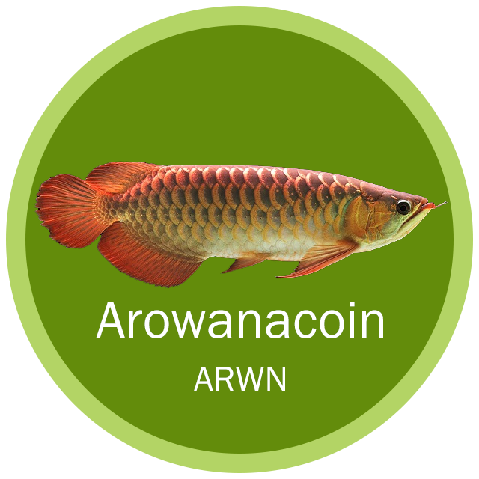

Arowanacoin
A CPU Mineable Cryptocurrency based on
NIST's Post-Quantum Security Standards
Whitepaper
V1.0

Slide 2
Project Background

Slide 3
Classical Computers vs Ones
Classical
The security of crypto relies on intractability of certain problems to modern computers.
Example: RSA and factoring
Quantum
Exploit quantum mechanics to process information
Use quantum bits = “qubits” instead of 0’s and 1’s
Superposition – ability of quantum system to be in multiples states at the same time
Potential to vastly increase computational power beyond classical computing limit

Slide 4
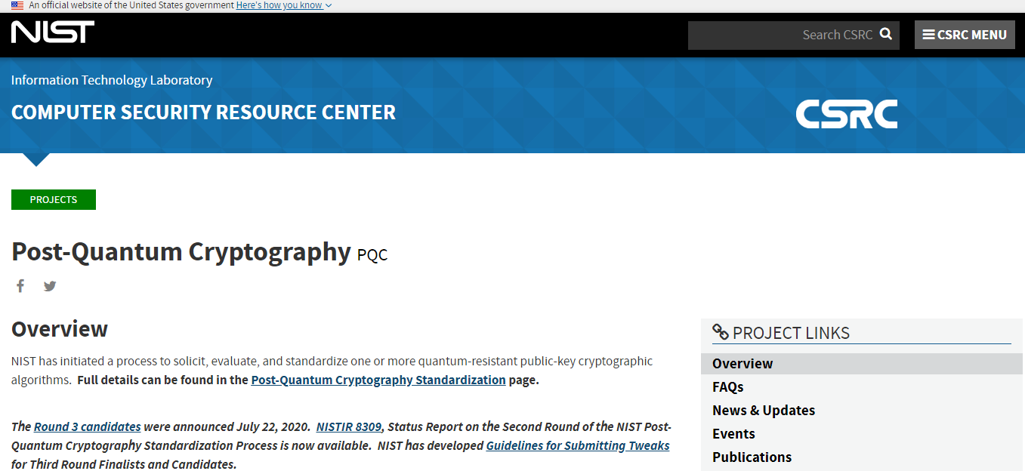
NIST and Post-Quantum Cryptography
Quantum
https://csrc.nist.gov/projects/post-quantum-cryptography

Slide 5
FALCON
Falcon is a cryptographic signature algorithm submitted to NIST Post-Quantum Cryptography Project on November 30th, 2017. It has been designed by: Pierre-Alain Fouque, Jeffrey Hoffstein, Paul Kirchner, Vadim Lyubashevsky, Thomas Pornin, Thomas Prest, Thomas Ricosset, Gregor Seiler, William Whyte, Zhenfei Zhang.
The point of a post-quantum cryptographic algorithm is to keep on ensuring its security characteristics even faced with quantum computers. Quantum computers are deemed feasible, according to our current understanding of the laws of physics, but some significant technological issues remain to be solved in order to build a fully operational unit. Such a quantum computer would very efficiently break the usual asymmetric encryption and digitial signature algorithms based on number theory (RSA, DSA, Diffie-Hellman, ElGamal, and their elliptic curve variants).
https://falcon-sign.info/

Slide 6
Security
01
a true Gaussian sampler is used internally, which guarantees negligible leakage of information on the secret key up to a practically infinite number of signatures (more than 264).
Compactness
02
thanks to the use of NTRU lattices, signatures are substantially shorter than in any lattice-based signature scheme with the same security guarantees, while the public keys are around the same size.
Speed
03
use of fast Fourier sampling allows for very fast implementations, in the thousands of signatures per second on a common computer; verification is five to ten times faster.
Algorithm Highlights
RAM Economy
04
the enhanced key generation algorithm of Falcon uses less than 30 kilobytes of RAM, a hundredfold improvement over previous designs such as NTRUSign. Falcon is compatible with small, memory-constrained embedded devices.
https://falcon-sign.info/

Slide 7
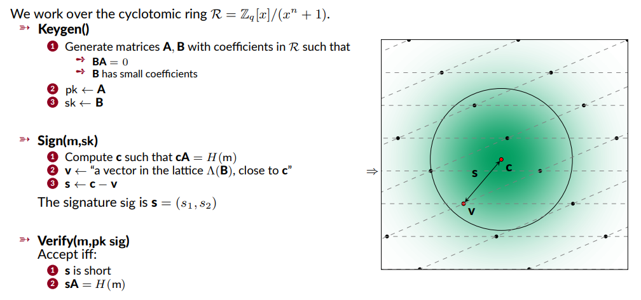
Falcon in a Nutshell

Slide 8
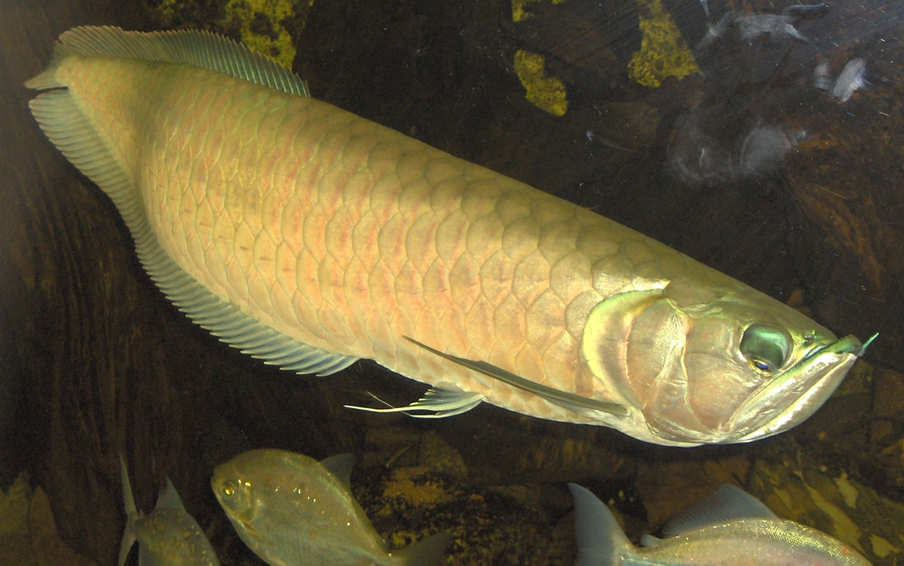
About
Arowana
Arowanas are freshwater bony fish of the family Osteoglossidae, also known as bony tongues (the latter name is now often reserved for Arapaimidae). In this family of fish, the head is bony and the elongated body is covered by large, heavy scales, with a mosaic pattern of canals. The dorsal and anal fins have soft rays and are long based, while the pectoral and ventral fins are small. The name "bonytongues" is derived from a toothed bone on the floor of the mouth, the "tongue", equipped with teeth that bite against teeth on the roof of the mouth. The arowana is a facultative air breather and can obtain oxygen from air by sucking it into its swim bladder, which is lined with capillaries like lung tissue.
https://en.wikipedia.org/wiki/Arowana

Slide 9
Arowanacoin
ARWN

Slide 10
Features of Arowanacoin
Popularization
Mining with PC and Mobile Phone.
Security
Rely on NIST(National Institute of Standards and Technology)'s finalists for Post-Quantum security standards
Fast
Faster transaction speed
Fairness
No icon, no airdrop, Pow only consensus
Anti-mining-machinery
CPU friendly, GPU unfriendly, FPGA/ASIC unfriendly.

Slide 11
Specification
Name
Fullname: Arowanacoin
Tick: ARWN
Algos
POW Algo: Yespower-ARWN
Signature Algo: FALCON
Ports
P2P Port: 12631
RPC Port: 12632
Params
Total supply: 2,831,348,000
Block time: 1.5 minutes
SubsidyHalvingInterval: 210000 blocks
Confirmation: 100 blocks

Slide 12
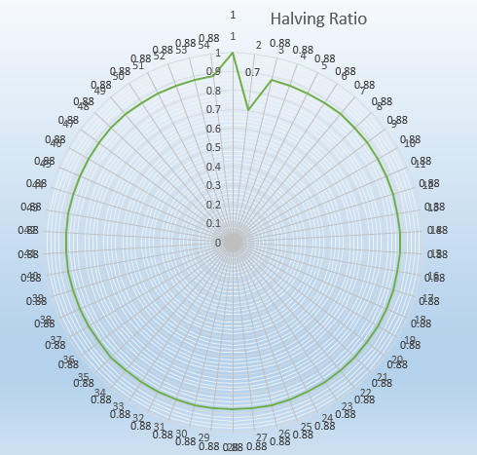
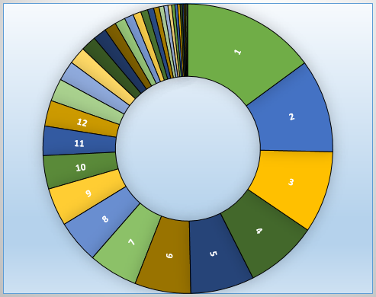
Halving Ratio & Block Reward
Halving Ratio
Block Reward

Slide 13
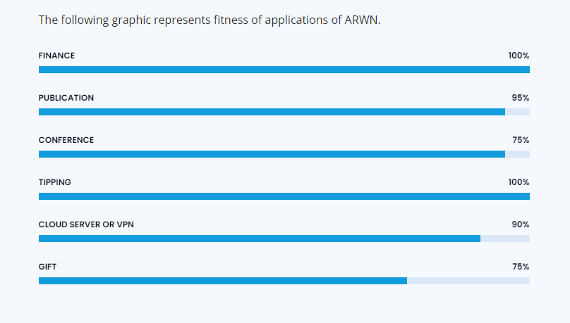
Applications

Slide 14
THANK YOU
Team of ARWN

