Slide 1
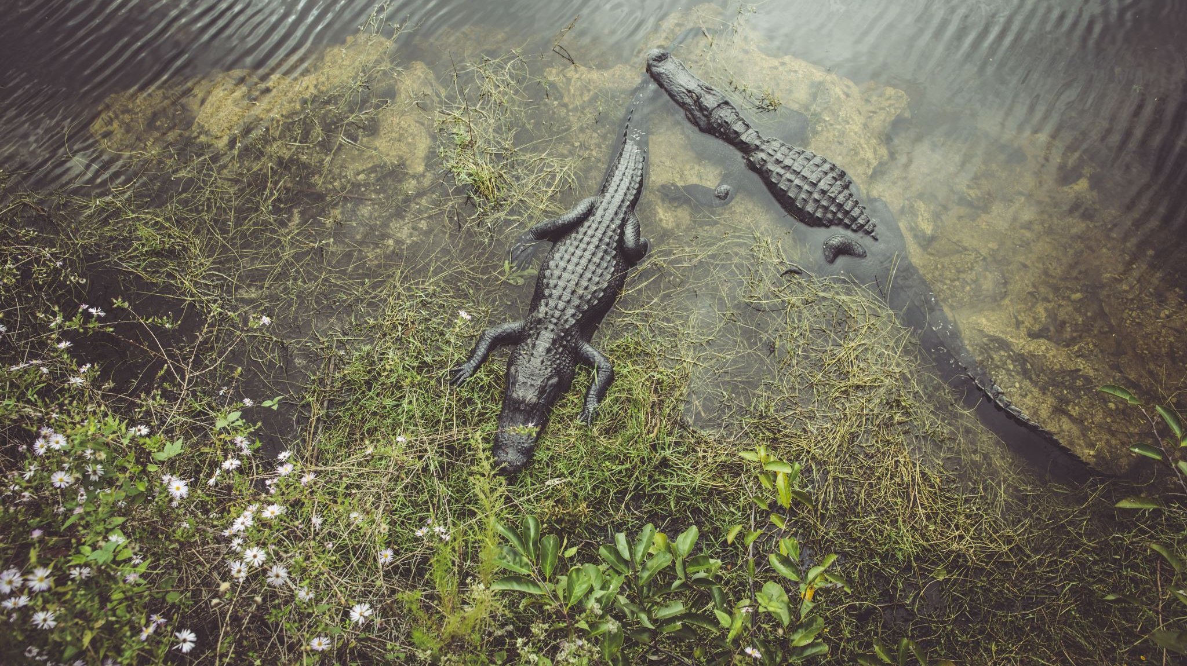
US National Park Biodiversity
Billy McCarthy

Slide 2

Introduction
Biodiversity data imported into Jupyter notebook directory
Git Repository fosters collaborative development
Insights into various species and their conservation status, and recorded sightings
Bryce National Park, Great Smoky Mountains National Park, Yellowstone National Park, Yosemite National Park
Last 7 days

Slide 3
Method
Joined datasets on scientific_name
Tidied dataset by filling in null conservation status values with “not specified”
Filtered the data to only include endangered and threatened species

Slide 4
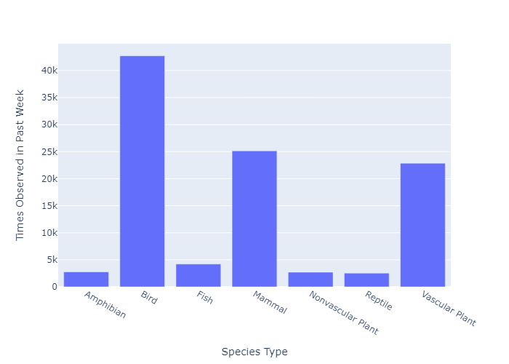
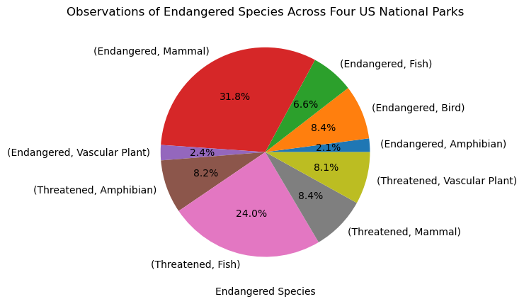
Summary of the endangered and threatened species observed in the past week
Pie chart shows the number of observations for each of these species

Slide 5
Least observed animals
Conservation Status | Category | Scientific name | Common Names | Observations
Endangered | Amphibian | Rana sierrae | Yellow Legged Frog | 4
Endangered | Bird | Grus americana | Whooping Crane | 4
Endangered | Bird | Gymnogyps californianus | California Condor | 4
Endangered | Bird | Picoides borealis | Red-Cockaded Woodpecker | 4
Endangered | Bird | Vermivora bachmanii | Bachman's Warbler | 4
Endangered | fish | Chasmistes liorus | June Sucker | 4
Endangered | Fish | Etheostoma percnurum | Duskytail Darter | 4
Endangered | Fish | Noturus baileyi | Smoky Madtom | 4
Endangered | Mammal | Canis lupus | Gray Wolf | 12
Endangered | Mammal | Canis rufus | Red Wolf | 4
Endangered | Mammal | Glaucomys sabrinus coloratus | Carolina Northern Flying Squirrel | 4
Endangered | Mammal | Myotis septenrionalis | Northern Long-Eared Bat | 143
Endangered | Mammal | Ursus arctos horribilis | Grizzly bear | 115

Slide 6
Hypothesis Testing
Endangered and Threatened Species
Chi-square tests of independence
See whether the difference between observations of different species is due to chance
Includes measure of effect size (Phi, φ)
Mammals vs. Birds
χ² = 1.50
p = 0.21
φ = 0.90
Mammals vs. Fish
χ² = 17.72
p < .001
φ = 0.89
Mammals vs. Amphibians
χ² = 11.07
p < .001
φ = 0.91

Slide 7
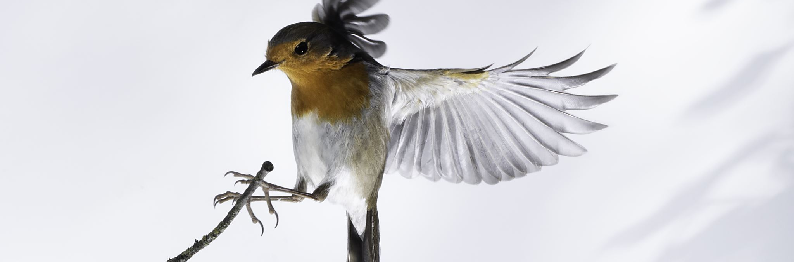
Comparing Mammals and Birds
Endangered and Threatened Mammals vs. Birds (χ² = 1.50, p = 0.21, φ = 0.90)
This suggests that the proportion of observations of endangered or threatened species is significantly different between mammals and birds.

Slide 8

Comparing Mammals and Fish
Endangered and Threatened Mammals vs. Fish (χ² = 17.72, p < .001, φ = 0.89)
This suggests that the proportion of endangered or threatened species is significantly different between mammals and fish.

Slide 9

Comparing Mammals and Amphibians
Endangered and Threatened Mammals vs. Amphibians (χ² = 11.07, p < .001, φ = 0.91)
This suggests that the proportion of endangered or threatened species is significantly different between mammals and amphibians.

Slide 10
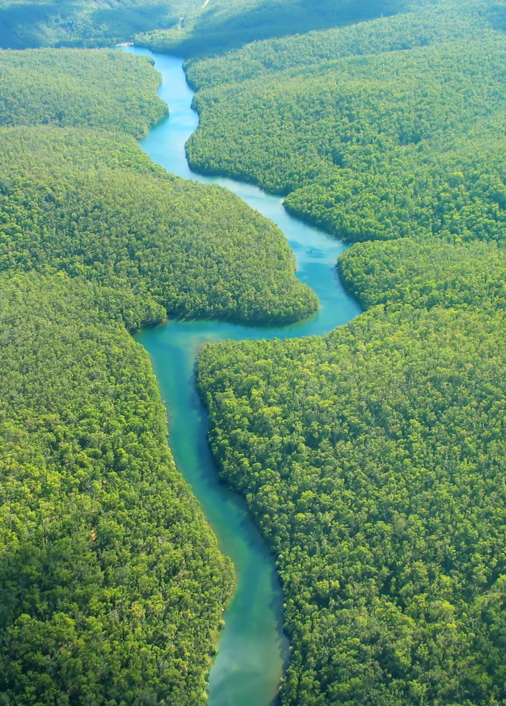
Looking ahead: US National Parks Biodiversity
Identified least noticed species in the past week
Noteworthy increase in mammalian sightings
Impact of volume and size on species visibility
Highlights heightened vulnerability of commonly noticed species

