Slide 1
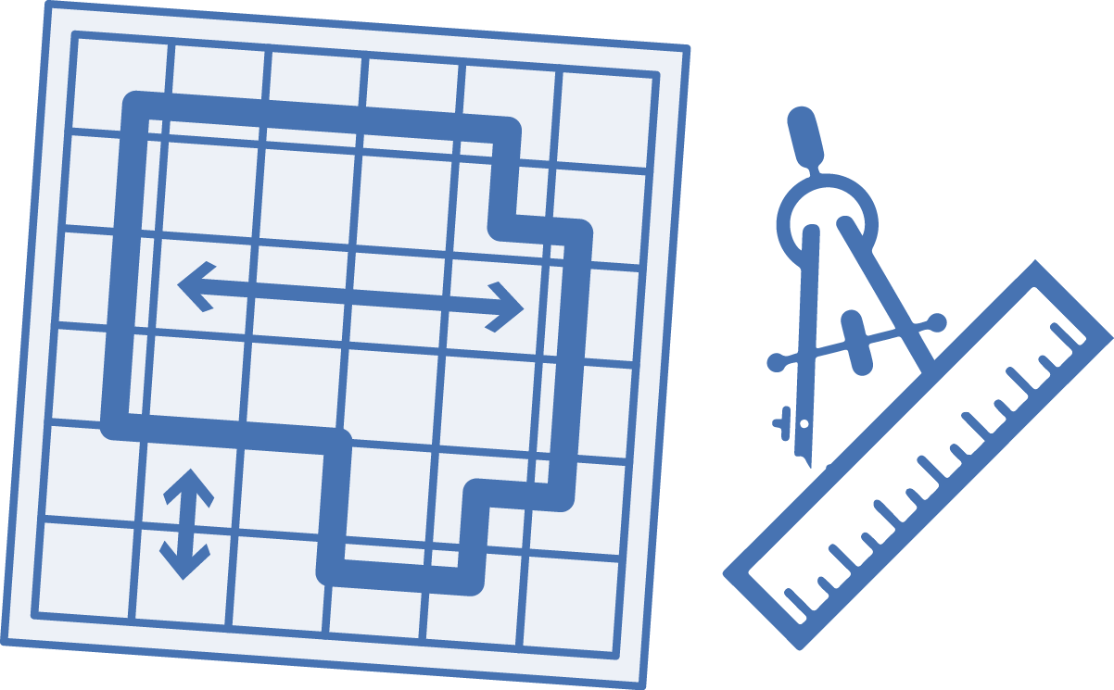




ARM
Terraform
or
ARM
Import
Visual Azure Studio
YAML
Create schematic
.ps1
.sh
or
Execute script
Resources created

