Slide 6

Assets
Corner shape to measure correct rounded corner
Logo
Tag/pill shape
Corner shape template
When using multi-placeholders, or when copying a picture or shape into PowerPoint, rounded corners must be applied manually.
After inserting a picture > Go to Picture Format > Crop > Crop to shape > Select “Rectangle: rounded corners”.
Use the “Corner shape template” to ensure the right ratio on the corners:
Copy corner shape template.
Paste and place the corner shape template upon the corners of shape or picture.
Click on the shape or placeholder and drag the yellow handle in the top left corner to get the correct rounded corner.
Do not change size on corner shape.
Tag/pill shape
Copy/paste this logo if you need an extra one
on a specific slide.
Use this tag/pill shape as a tag, chapter header or image text. Use it in grey with black text or red with white text.
Do not change font size or shape. The shape will expand as you write in the shape.

Slide 7
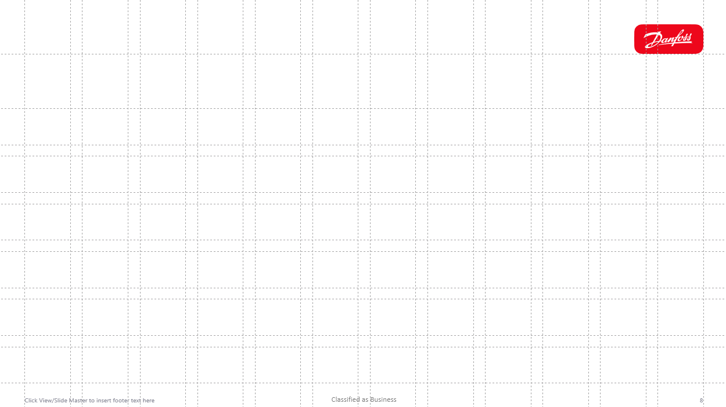
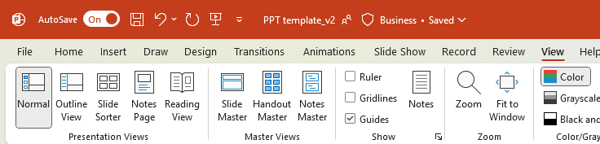
Use the grid to guide you!
Enter your headline here in
max 2 lines
A Danfoss-bespoke grid is available in PowerPoint to guide you when creating slides. Use the grid to ensure
A top margin with correct distance between headline and content
Margins in bottom and sides
Same distance between shapes/boxes
Find the grid by going to View and enabling the “Guide” box.
Your content (text, graphs, images, tables etc.)
should be placed in this grey space
The thin spacing between content cells indicate
distance/reserved space between content boxes

Slide 8
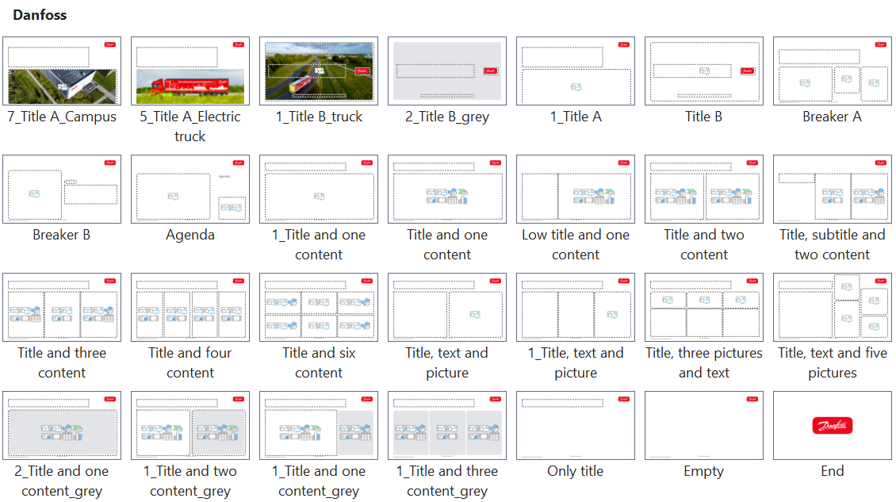
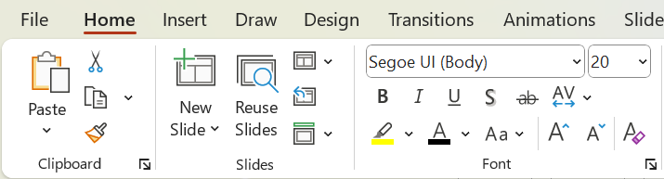
28 ready-to-use slides
This PowerPoint template comes with 28 ready-to-use slides. Select your slide and insert your content: text, images, shapes, graphs, tables etc.
Find the custom slides in Home → New Slide

Slide 9

Introducing rounded corners
Our visual identity leverages a subtle yet powerful detail: rounded corners. Use rounded corners on images and shapes to a uniquely organic yet digital feel.
Use the corner template to get the right scale on your shapes or images in PowerPoint (read more on the Asset supporting slide).
Corner shape template
Corner shape template

Slide 10
Preferred text sizes
Use font size 43 for headlines on front- or breaker slides*
Use font size 28 for headlines on regular slides
Use font size 15 for content and text areas
Use font size 13 for details
Use font size 10 for graphs, legends, image text etc.
*Default PowerPoint templates may vary from this for design purposes

Slide 11
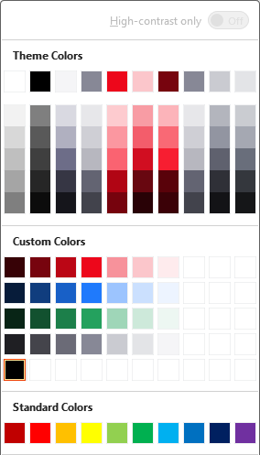
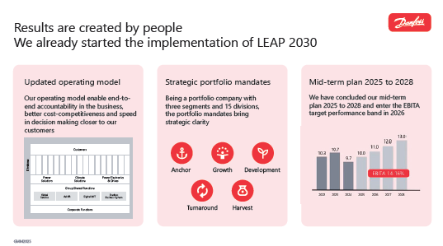

Getting started on colors
The primary colors in PowerPoint is red, white, grey and black. Use the swatches (light to dark) for color variation. Blue and green is reserved for graphic and data use only.
Examples of color use

