Slide 1
World Cities

Slide 2
Summary
Introduction/Business Problem
Methodology
Results
Discussion/Conclusion
References

Slide 3
Introduction
Travel agencies necessity to find similar cities around the world
Clustering techniques has the ability to form groups with similarities, and show differences among itens
Solution:
Collect features to describe each city
Apply clustering to show cities groups

Slide 4
Methodology
25 Most famous cities to visit
https://www.worldatlas.com/articles/the-most-popular-cities-in-the-world-to-visit.html
Foursquare API to select venues data
https://developer.foursquare.com/
Each city is described by the number of venues of each category
Used this information to cluster cities

Slide 5
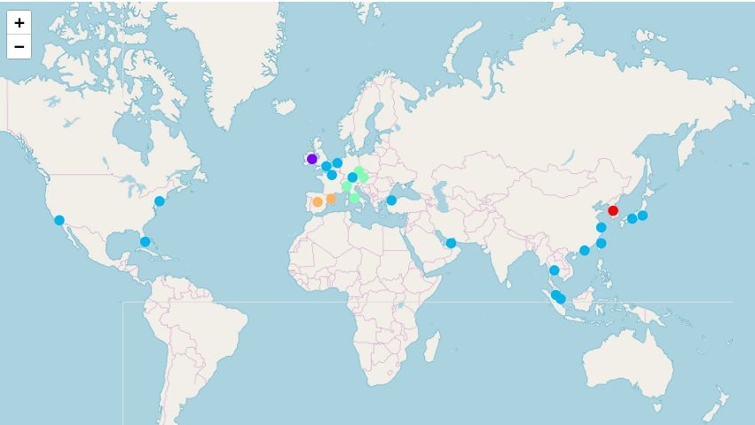
Results

Slide 6
Conclusion
Data was clustered
Information may be used to plan trips to similar cities

Slide 7
References
Jessica Dillinger. 2018. The Most Popular Cities In The World To Visit. [ONLINE] Available at: https://www.worldatlas.com/articles/the-most-popular-cities-in-the-world-to-visit.html. [Accessed 4 December 2018].
Foursquare Developers. [ONLINE] Available at: https://developer.foursquare.com/. [Accessed 4 December 2018]

