Slide 1
Primer Notes

Slide 2
Testing
our definition: “anything that proves that a requirement is satisfied”
a way of ensuring that we get expected results
Code quality check is also sort of a test
Quality Assurance: guaranteeing quality is maintained; processes that go into making sure that a certain standard is met for the client

Slide 3
Testing Pyramid
User Acceptance Test (UAT): Tests conduct by an actual human; usually it tests to see if it meets the requirement in a way that could be deemed as acceptable to the average user
Ex: a product owner using the developed application and giving feedback on whether or not it is satisfactory; Alpha and Beta testing
System Test: ensuring that the whole app works as a whole; E2E
Selenium, Protractor, Postman
Integration Test: testing multiple units together
Ex: testing a repository method by transacting on the db
Unit Test: A method test; testing the smallest possible unit
Increase in cost (less frequent)
Increase in Frequency (faster,cheaper)

Slide 4
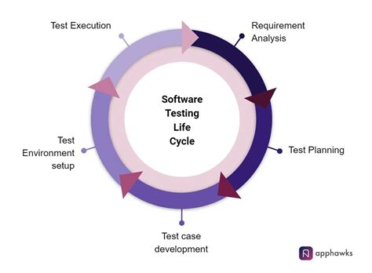
Testing Lifecycle
Iterative process of analyzing requirements and developing/executing testing regime
Logical problem-solving process

Slide 5
Functional Testing
Doing testing where you provide a set of inputs and verify against a set of outputs
Testing to see if the feature work as intended
Are there test that are non-functional?
Performance testing: Load testing, etc.
Security

Slide 6
TDD
Test Driven Development
Development philosophy that prioritizes developing tests prior to implementing functionality
Acceptance vs Developer TDD
Ex: analyze requirements -> Write Method signiature -> write Junit test case -> write implementation for method -> code until it passes

Slide 7
Test Strategy Document
A static document that sets standards for testing standards and activities
Doesn’t get changed often; sets precedence for application
Test Strategy is DIFFERENT from the Test plan document
Test Strategy is more high level and more static
Usually created by product manager; illustrates what the expectations are form the product manager
https://www.guru99.com/how-to-create-test-strategy-document.html

Slide 8
Test Plan Document
Defines scope objective approach emphasis on a software testing approach effort
It tells you per project what you are going to do for testing/what is in your scope
It is project specific and dynamic (can be changed at any time)
Usually made by test lead or manager
https://www.guru99.com/test-plan-for-project.html

