Slide 1
Primer Notes

Slide 2
Testing
our definition: “anything that proves that a requirement is satisfied”
a way of ensuring that we get expected results
Code quality check is also sort of a test
Quality Assurance: guaranteeing quality is maintained; processes that go into making sure that a certain standard is met for the client

Slide 3
Testing Pyramid
User Acceptance Test (UAT): Tests conduct by an actual human; usually it tests to see if it meets the requirement in a way that could be deemed as acceptable to the average user
Ex: a product owner using the developed application and giving feedback on whether or not it is satisfactory; Alpha and Beta testing
System Test: ensuring that the whole app works as a whole; E2E
Selenium, Protractor, Postman (for apis)
Integration Test: testing multiple units together
Ex: testing a repository method by transacting on the db
Unit Test: A method test; testing the smallest possible unit
Increase in cost (less frequent)
Increase in Frequency (faster,cheaper)

Slide 4
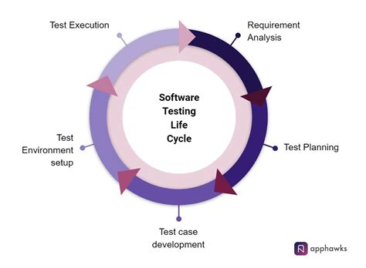
Testing Lifecycle
Iterative process of analyzing requirements and developing/executing testing regime
Logical problem-solving process

Slide 5
Functional Testing
Doing testing where you provide a set of inputs and verify against a set of outputs
Testing to see if the feature work as intended
Are there test that are non-functional?
Performance testing: Load testing, etc.
Security

Slide 6
TDD
Test Driven Development
Development philosophy that prioritizes developing tests prior to implementing functionality
Acceptance vs Developer TDD
Ex: analyze requirements -> Write Method signiature -> write Junit test case -> write implementation for method -> code until it passes

Slide 7
Test Strategy Document
A static document that sets standards for testing standards and activities
Doesn’t get changed often; sets precedence for application
Test Strategy is DIFFERENT from the Test plan document
Test Strategy is more high level and more static
Usually created by product manager; illustrates what the expectations are form the product manager
https://www.guru99.com/how-to-create-test-strategy-document.html

Slide 8
Test Plan Document
Defines scope objective approach emphasis on a software testing approach effort
It tells you per project what you are going to do for testing/what is in your scope
It is project specific and dynamic (can be changed at any time)
Usually made by test lead or manager
https://www.guru99.com/test-plan-for-project.html

Slide 9
Test Case Document
Outlines all of the specific test cases for all user stories
Useful for the RTM
You don’t have to go into code base to have knowledge of what tests are exiting and if they pass or not, etc.
https://www.guru99.com/download-sample-test-case-template-with-explanation-of-important-fields.html

Slide 10
RTM
Requirements Traceability Matrix outlines all test cases and compares them to the desired requirements
It marks if they have passed or failed their test
Single location where you can show that you succeeded at your job as tester
https://www.guru99.com/traceability-matrix.html

Slide 11
Controllers
….
Dispatcher
controller
service
…
@Get(“/”)

Slide 12
Method chaining with promises
fetch() <- returns a promise
.then(…) <- promise
.then(…) <- promise
-----
mockMvc.perform(…) <- Result actions
.andExpect(check for criterion 1) <- result actions
.andExpect(check for criterion 2) <- result actions

Slide 13
Selenium
E2E testing: will test your app from start to finish
Can be used to simulate functional tests; can be integrated with TestNG or Junit
Supports automation across different OS, even mobile
Refers to a family of tools for testing
Automated user input
Open source
You can write testing scripts in multiple languages
Many features; one of which is that you can record tests and play them back later

Slide 14
WebDriver
Test automation tool supporting different program languages
Different from selenium because Selenium WebDriver is used in particular for web apps
For each type of browser that you have, you will need a different driver.
This is the thing that has the API’s that you have to learn (the methods and stuff that you have to memorize)
Faster than RC bc it can directly call browser

Slide 15
Selenium Locators
How the webdriver finds elements in the page
Options:
(CSS locators/selectors) Find by id, name, class, etc.
by link text: can identify by the text of the hyperlink
Xpath: XML path – path to the element
Name
Id
Class
Etc.
driver.findElement(By.[locator]).[event]()
Examples of events: click, submit, sendkeys

Slide 16
Page Object Model
Design Pattern
Model each page as a Java Object so that it is easier to use… in java
Allows for easier object-oriented programming when writing selenium scripts

Slide 17
BDD
Behavior driven development; extension of test-driven development
Tests are based off of customers or end users
Encourages communication between different members/roles within the project
Uses tools like Gherkin and Cucumber to facilitate interactions between technical and non-technical
User stories from the client (BA, project, product owner) ->conversion of business req. to technical requirements for the dev team to develop on -> Develop tests first -> implement methods so that tests will pass

Slide 18
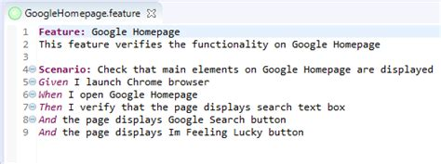
Cucumber
Open-source software tool that supports BDD
Describes the scenario, inputs, outputs, etc.
Who uses cucumber? Project Manager/BA (person doing requirements gathering), people writing the test

Slide 19
Gherkin
The language that Cucumber feature files are written in
They come in a variety of spoken languages (English, Spanish, Portuguese, etc.)
Feature
Scenario
Given
When
Then
And
Etc.

Slide 20
Cucumber
Allows for requirement gathering by potentially non-technical personnel (in the form of feature files)
Cucumber can generate the outlines (step definition files) for tests that can be incorporate with a test-runner (Junit/TestNG)
Write the Junit tests that correspond to the step definition files

Slide 21
Proposed Project Architecture
Goal is to incorporate testing automation into Kevin and Alex’s Team’s P2
Some how adding in Selenium and Cucumber test automation

Slide 22
Ideal automation scenario with Se
Controller
Service
Repo
Model
Src/main/java
Controller
Service
E2E
Cucumber Step Definitions
Src/test/java
Junit
Junit
Junit
Feature file
Src/test/resources

Slide 23

Tangent: server side vs client side rendering
Client
Server
CSR
Server
Usually we would use selenium in a backend that was responsible for returning views.
SSR

Slide 24
Cucumber workflow with Se
Obviously pretty similar to a classical BDD workflow
Defining overall user stories/ requirements
Usually done by not the dev (BA, Project Manager)
Fulfilled in the Feature files (written in Gherkin)
Feature file used to translate business req. into tech req. (source of truth)
Use Cucumber to generate tests in Java
Do TDD

Slide 25
Testing in Angular
What we have done so far: Java + Junit +Selenium + Cucumber
Java -> Language/Environment
Junit -> unit test
Selenium -> Automated E2E testing
Cucumber -> BDD
What this would look like for Angular?
TS/Angular -> Language/Env/Framework instead of Java
Jasmine + Karma instead of Junit
Protractor instead of Se
Cucumber if you want to I guess…

Slide 26
Jasmine and Karma
Jasmine is the unit testing framework
Common key words: describe, it, beforeEach, expect, toBe, etc.
describe: used to define a test suite
it: used to define a test
Expect + toBe: the assertions you make to see if the behavior works as expected
Karma is the test runner; it will run the tests through your browser

Slide 27
Use TDD to develop the following feature
As a user, I can click on a button, then the button will display some text containing: request info, item type, number of items request

Slide 28
What this might look like
Click me
request info: “”
item type: #
number of items request:#

Slide 29
Protractor
E2E testing for front ends
Chrome driver by default
Build on Selenium
Jasmine will run our protractor scripts

